Slide 1
2016 Annual Dropout and Cohort Graduation Rates

Slide 2
Goals for the Presentation
Review cohort graduation rate methodology and present results for the 2015 and 2016 cohorts
Review annual dropout rate methodology and present results for the 2015-16 school year

Slide 3
Calculating Graduation Rates in MA
4 Year Rate – 2016 Cohort
# of students in cohort who graduate within 4 years
[# of 1st time 9th graders 4 yrs earlier] – transfers out + transfers in
July 1, 2012 9th grade first time
Transfer out/deceased
What percent graduate by summer ‘16?
Transfer In

Slide 4
Cohort Graduation Rate
2016 4-year cohort graduation rate increased to 87.5% from 87.3% for the 2015 cohort
2015 5-year cohort graduation rate increased to 89.4% from 88.5% for the 2014 5-year rate.
Ten consecutive years of increased 4-year rates
All racial/ethnic groups increased their 2016 4-year graduation rate.
African American students +1.4 percentage points
Hispanic students +0.5 percentage points
White students +0.3 percentage points
Asian students +0.3 percentage points

Slide 5
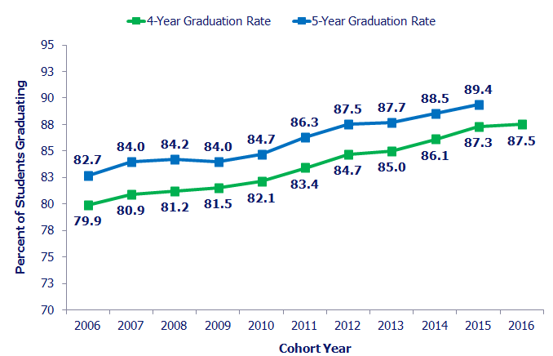
Cohort Graduation Rates 2006-2016

Slide 6
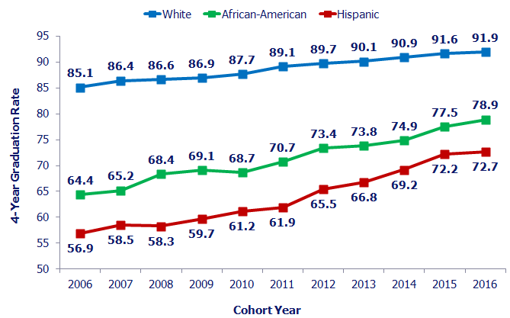
Graduation Rate Gaps Narrowing
Notes:
Represents a 32% reduction in the graduation rate gap between White and African American students and between White and Hispanic students

Slide 7
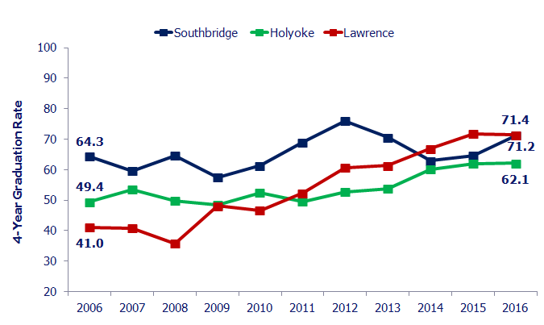
Graduation Rates – Receivership Districts 2006-2016
Notes:
Lawrence – 60.6 in 2012

Slide 8
Improved Graduation Rates for All Subgroups 2006-2016
Group | 2016 4-Year Rate | 2006 4-Year Rate | State Change
All Students | 87.5% | 79.9% | +7.6
Low Income/ED | 78.4% | 62.3% | +16.1
ELL | 64.1% | 54.5% | +9.6
SWD | 71.8% | 61.1% | +10.7
African American | 78.9% | 64.4% | +14.5
Asian | 92.7% | 83.9% | +8.8
Hispanic | 72.7% | 56.9% | +15.8
White | 91.9% | 85.1% | +6.8

Slide 9
Calculating Annual Dropout Rates
The final dropout rate = [(Summer Dropouts + School Year Dropouts) – Returned Dropouts] / High School Enrollment
Summer Dropouts:
Students reported as dropping out of school or transferring to an in-state public school without a record of enrollment prior to the beginning of the school year.
School Year Dropouts:
Students reported as dropping out of school or transferring to an in-state public school without a record of enrollment during the school year.
Preliminary Dropout Count:
Total number of students considered to be preliminary dropouts for the school year.
Preliminary Dropout Count:
Total number of students considered to be preliminary dropouts for the school year.
Returned Dropouts:
Remove any Preliminary Dropouts are reported to have enrolled, graduated or received a high school equivalency by October 1st of the following school year
Final Dropouts:
The remaining students are considered to be final dropouts for the school year.

Slide 10
2015-16 Annual Dropout Rate
5,523 students in grades nine through twelve dropped out of high school in the 2015-16 school year
Represents 1.9% of all students in grades nine through twelve
Remains the lowest dropout rate on record at ESE
Mixed results among racial/ethnic subgroups

Slide 11
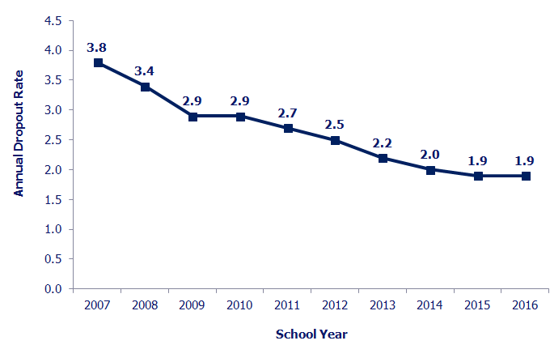
Annual Dropout Rate 2007-2016

Slide 12
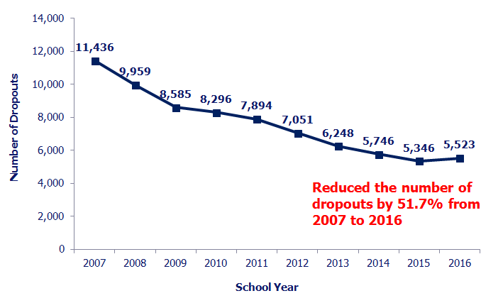
Annual Dropout Numbers 2007-2016

Slide 13
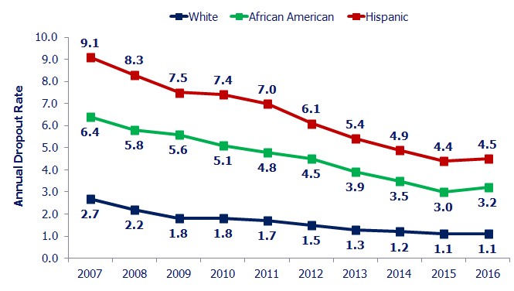
Dropout Rate Gaps Narrowing
Notes:
White Hispanic = 47%
White AA = 43%

Slide 14
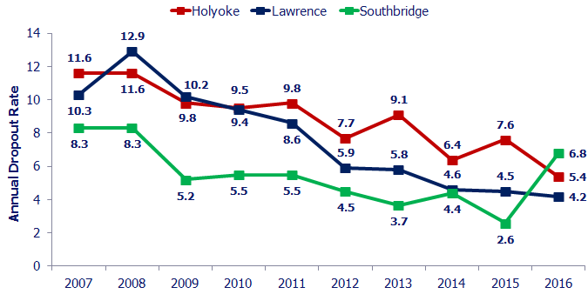
Annual Dropout Rates – Receivership Districts 2007-2016
Notes:
Holyoke – 53% reduction in dropout gap from 2007 to 2016
Lawrence – 59% form 2007 to 2016 and 28% since receivership
Southbridge – 18% from 2007 to 2016

