Slide 1
Educator Evaluation
Discussion and Vote to Amend the Regulations
Heather Peske, Senior Associate Commissioner
Ron Noble, Director of Integration and Strategy
Notes:
HP
Let me start by thanking the Board for its commitment to the continuous improvement of the Massachusetts Educator Evaluation Framework. This topic has been consistently on the Board’s agenda for the past several years, from the launch of the taskforce in 2010 through these first years of implementation. More recently, we have been before you several times since last spring to describe the progress districts are making in realizing the framework and some of the challenges we’ve encountered along the way. We are here today following a period of public comment. We have reviewed and synthesized the public comment and made changes to the original amendments we proposed. Today, we would like to review the final proposed amendments to the regulations for you to vote on these amendments.

Slide 2
Educator Evaluation in MA Five Key Priorities
Promote Growth and Development
Place Student Learning at the Center
Recognize Excellence
Set a High Bar for Tenure
Shorten Timelines for Improvement
Notes:
HP
As a reminder, the Massachusetts Educator Evaluation Framework is designed to meet these five key priorities. As we developed the proposed changes, we have continued to be guided by these priorities.

Slide 3
Proposed Framework Design
One Rating
 | Summative Performance Rating | Student Impact Rating
Purpose: | Provide educators with feedback on professional practice and impact on student learning | Provide educators with feedback on impact on student learning
Rating Scale: | Exemplary Proficient Needs Improvement Unsatisfactory | High Moderate Low
Notes:
HP
As you will recall from the November Board meeting, the current framework includes two separate ratings: the Summative Performance Rating and the Student Impact Rating. These two ratings provide opportunities for evaluators and educators to engage in focused dialogue about both professional practice and impact on student learning. In response to stakeholder feedback, including that which you heard at the June meeting, the proposed changes to the regulations you are considering tonight eliminate the separate Student Impact Rating.
If the Board votes to accept the proposal, there would be only the Summative Performance Rating. As we discussed at your November meeting, in designing the proposed changes, we had to consider how best to modify the Summative Performance Rating to keep what is working well and add a focus on providing educators with feedback about their impact on student learning in order to maintain the key priority of keeping student learning at the center. To ensure that evaluators and educators remain attentive to measures of student learning, the proposed changes include adding a Student Learning Indicator to the Standards of Effective Practice that undergird the framework.
Massachusetts Department of Elementary and Secondary Education

Slide 4
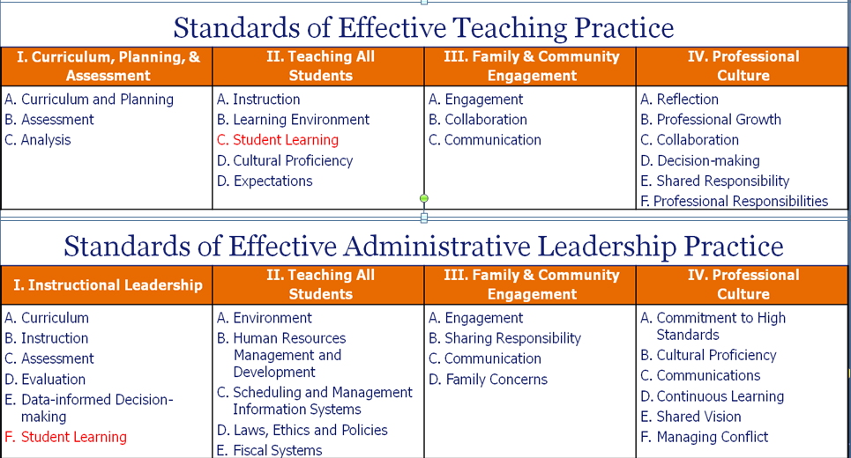
Keeping Student Learning at the Center
“Student learning indicator: Demonstrates expected impact on student learning based on multiple measures of student learning, growth, and achievement. For teachers who are responsible for direct instruction, these measures must include student progress on common assessments and, where available, statewide student growth measures.”
Notes:
RN
To ensure that the framework continues to serve the priority of keeping student learning at the center of the evaluation process, the proposed changes include adding a new Student Learning Indicator. The reason for this change is to ensure that the focused conversation about student outcomes that would have happened as part of the process for determining a Student Impact Rating is not lost with the elimination of that rating. Absent the separate rating, we believe this conversation appropriately fits for teachers in Standard II, which is all about meeting the needs of all students, and for administrators under Standard I, which is about promoting the learning and growth of all students and the success of all staff.
*CLICK Evaluators would consider whether the educator met the expectations of the student learning indicator when determining the educator’s rating on Standard II. Ratings are not typically provided at the Indicator level.
*CLICK The proposed changes add a parallel indicator to the Standards used in administrator evaluation.

Slide 5
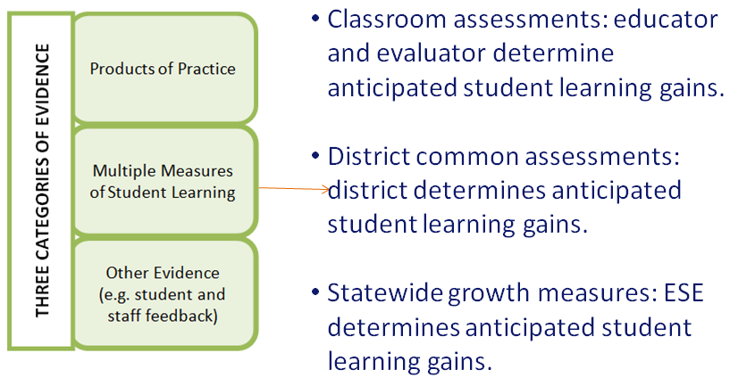
Framework Design
Summative Performance Rating
5
Massachusetts Department of Elementary & Secondary Education
Notes:
RN
The new indicator capitalizes on existing sources of evidence. The proposed changes retain the three categories of evidence originally included in the framework (listed here in these green boxes): products of practice, multiple measures of student learning, and other evidence, such as student feedback. The proposed changes add specificity related to multiple measures of student learning. The goal is for educators and evaluators to be on the same page about how best to use multiple measures to draw conclusions about student learning. How much learning is enough?
To facilitate these conversations and in light of public comments, the proposed changes include a process for educators and evaluators to be clear about which measures will be used as evidence in the evaluation process and the anticipated student learning gains for each measure. *CLICK Three broad types of measures will play a part. First, there are the classroom assessments that educators use regularly. Because these are often chosen or created by individual educators, decisions about how much learning students should demonstrate are best left to educators and evaluators. Second, there are district common assessments. Common assessments allow for consistency across schools and promote collaboration. Here, anticipated student learning gains are best set at the district level, typically by the teams of educators who selected or created the common assessment. Finally, we have student growth percentiles from our state assessment. Here, it’s the Department’s responsibility to set anticipated student learning gains.
This process of being clear about anticipated student learning gains before the measures are administered promotes meaningful conversations about the extent to which student outcomes match the expectations.

Slide 6
Summary of Proposed Changes
Eliminate the separate student impact rating.
Retain the 5-step cycle.
Establish a "student learning indicator" under Standard II: Teaching All Students (for teachers) and under Standard I: Instructional Leadership (for administrators).
Add a new definition of "expected impact" on student learning.
Notes:
To sum up, the proposed changes are responsive to stakeholder concerns about a separate Student Impact Rating, but retain a focus on providing educators with feedback about their impact on student learning. The 5-step evaluation cycle is retained and the addition of a student learning indicator ensures that evaluators and educators are looking at whether the educator is demonstrating expected impact throughout the cycle. The indicator also ensures that an educator’s impact on student learning is factored into the summative performance rating.
From MDC memo to the Board:
The proposed regulatory amendments include the following:
Eliminating the separate student impact rating of high, moderate, or low, which was to be reported to the Department at the educator level.
Retaining the 5-step cycle, which culminates in a summative performance rating based on multiple categories of evidence and the professional judgment of the evaluator.
Establishing a "student learning indicator" under Standard II: Teaching All Students (for teachers) and under Standard I: Instructional Leadership (for administrators). Standards describe the broad categories of knowledge, skills and performance of effective practice, and indicators describe specific knowledge, skills, and performance for each standard. By including a student learning indicator, impact on student learning is a component of the rating for the Standard. The rating for the Standard, in turn, is a component of the Summative Performance Rating. The student learning indicator does not result in a separate stand-alone rating.
Providing additional information about the types of measures that can be used as evidence of educator impact on student learning. The amendments include a definition of common assessments, permit flexibility for the use of common assessments and statewide growth measures in the evaluation process for educators who are not responsible for direct instruction, and clarify that other evidence of student learning beyond common assessments and statewide growth measures may be considered.
Adding a new definition of "expected impact" on student learning.

Slide 7
Summary of Proposed Changes (cont’d)
Additional proposed modifications informed by public comment:
Educators and evaluators discuss anticipated student learning gains during the development of the Educator Plan.
An evaluator’s professional judgment determines the length of a self directed growth plan.
Notes:
HP
In addition, public comment prompted a few additional modifications. Comments indicated the proposed changes could be construed to actually retain a requirement that evaluators make a separate judgment about an educator’s impact on student learning that stands apart from the educator’s performance rating on Standard 2 due to language that teased out an educator’s impact into three categories: more than expected, expected, and less than expected. Commenters pointed out similarities to the high, moderate, and low categories associated with the Student Impact Rating. We’ve modified the proposal to eliminate references to three categories of expected impact and embedded the process mentioned earlier about setting clear anticipated student learning gains for the assessments that will be used as evidence in an educator’s evaluation.
Another modification relates to the evaluator’s professional judgment determining the length of a self-directed growth plan – the plan reserved for those rated Proficient or Exemplary. The earlier proposal hinged a two-year plan on the educator demonstrating at least expected impact. The modified proposal allows evaluators to consider a variety of evidence in making the decision. It also parallels how the length of plans is determined for educators rated less than Proficient.
In total, we believe these changes are responsive to feedback we have heard from the field and should promote a well-rounded evaluation process.

Slide 8
Questions? Discussion.

