Slide 1
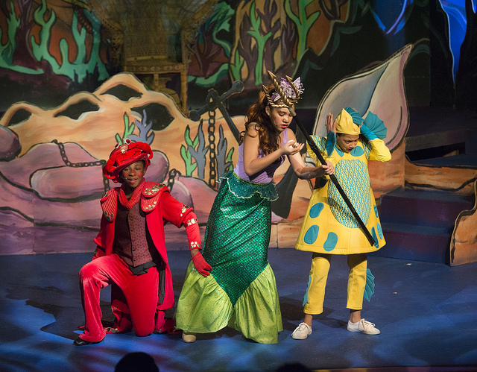
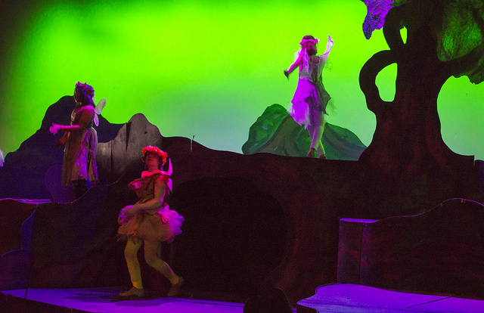
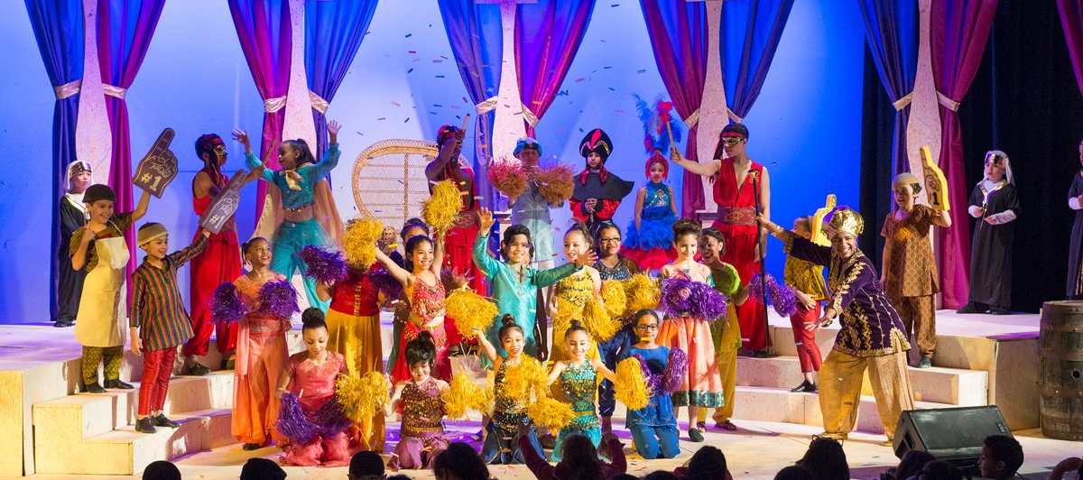
Student Performance
High-quality enrichment
1

Slide 3
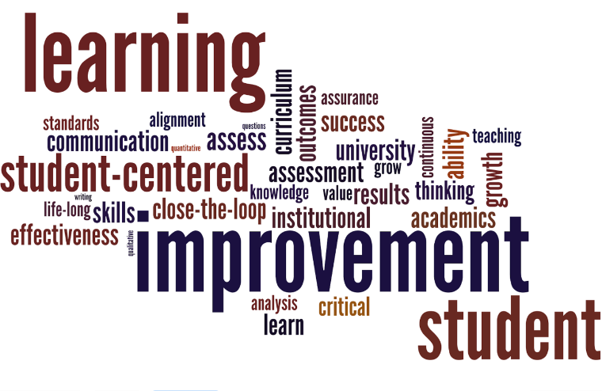
Overall Assessment of School District

Slide 4
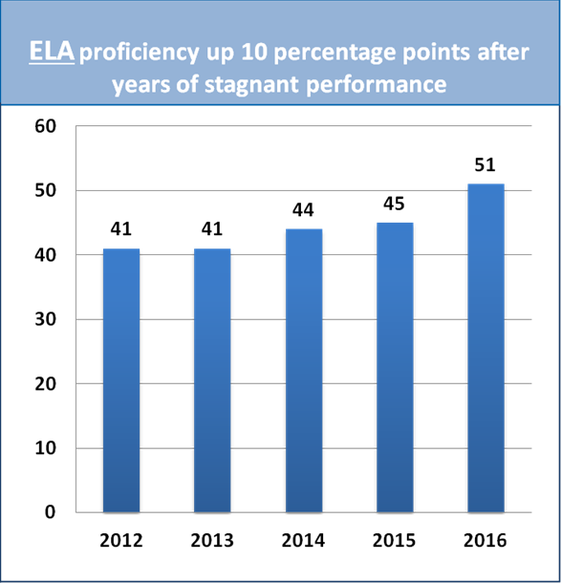
LPS achieved an increase in the % of students scoring at Proficient & Advanced levels
Percentage of students achieving at proficient & advanced levels

Slide 5
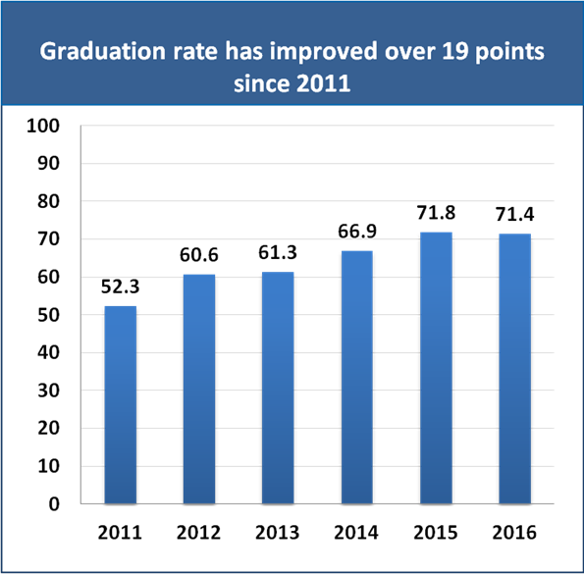
High School Graduation & Dropout Rates

Slide 6
Home Grown Talent
*Note this does not include emergency hires, which would increase the total even more.

Slide 7
Special Education
Priority 1:
Inclusion for All
Priority 2: Communication with Families
Priority 4: Professional Learning
Priority 3: High Quality Continuum of Services
Notes:
Ongoing development of the inclusion implementation plan and quality assurance measures. Tentative completion by the end of the school year.
Early Childhood Centers developed action plans to increase inclusiveness and differentiation in PK-2 classrooms.
Less restrictive IEP placements in PK-2.
Survey tool in development to assess the experience of families of children with disabilities.
18 LPS staff completed certified interpreters training.
The SEPAC developed by- laws, created a schedule of meetings for the year, identified means for dissemination of information to families, and worked on recruitment strategies. Meetings have grown from 5-6 parents to 25-30.
Communication delivered in primary language identified through home language survey.
Conducting needs assessment to identify programming and service needs across district.
Workgroup in place to support the development of the research-based best practices instructional guide. Targeted for dissemination by August 2017.
Monitoring system and tools are in development to assess instructional practices, gather data, assess consistency, and quality across all classrooms.
Baseline data collection almost complete with common themes being identified.
Professional learning sessions have been provided at several schools relative to team teaching in:
All-inclusive classrooms
Student on the Autism Spectrum in the general education classroom
Differentiation of instruction to meet the needs of all students
Social pragmatics and communication

Slide 8
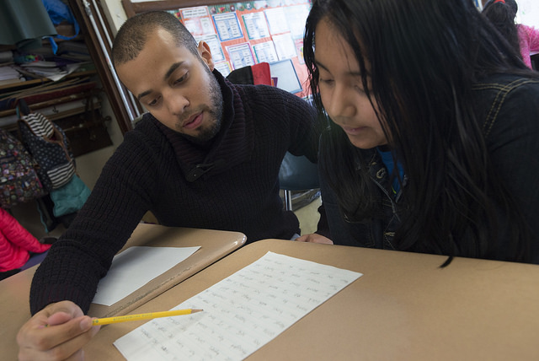
2017 Sontag Prize & Acceleration Academies

Slide 9
Family Resource Center
Centralized, Early Registration for PK and K: May – June 30
Expanded centralized registration to include pre-k, developed new systems to address screenings and enrollment for inclusion classrooms
With early registration comes the opportunity to connect families with their schools and to support them with school readiness
Registration staff host a Parent Open House and co-host information sessions across the city at community partner sites
Newly registered families receive a School Readiness Gift Bag with a bilingual book, writing and art supplies, a community resource guide, and more. Items are all donated by community partners.
Lawrence Learns School Readiness Block Party: August 8
Held on Haverhill Street and including the library, senior center, one of our schools and the North Common Park, last year’s event included a free cook-out, school backpacks, fun activities, a readiness video, music and community resource tables. It was attended by more than 1,000 participants
Lawrence Learns School Readiness Video
This video debuted at the block party and continues to be shown at registration information sessions, via our partners, and on our website: www.lawrencelearns.org
Playgroups – coming this summer
Working with our LEAP partners, the FRC will train parents to run onsite playgroups for children and their parents/caregivers who registered for school in May and June
Playgroups will focus on school readiness activities such as promoting curiosity, smoothing transitions, sharing, taking turns, circle and story times, and how parents can support their children at home.

Slide 10
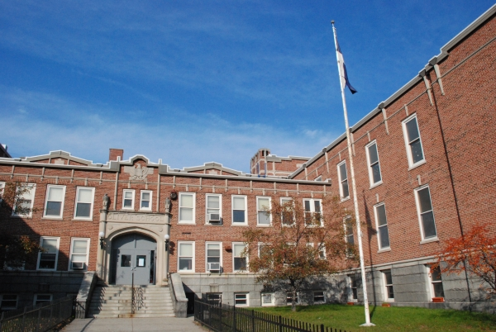
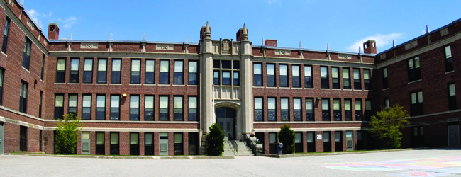
Facilities – Aggressive Pursuit of MSBA Funding
MSBA Accepted- 2/15/17
Accelerated Repair Project:
High School Learning Center
1.5 Million Boiler Replacement
80% Reimbursement
Project Completion 8/2017
Core Project:
Replace the Henry K. Oliver School
Originally built in 1917
MSBA 2017 Applications
Accelerated Repair Project:
School for Exceptional Study
Roof Replacement
Arlington Educational Complex
Roof Replacement
Boiler Replacement
Core Project:
Replace the Leahy School
Originally built in 1921

Slide 11
Babson College Scholarship
CONGRATULATIONS!
2 full scholarship awards valued at $250K apiece:
Dario Guerrero Alenny Acevedo

Slide 12
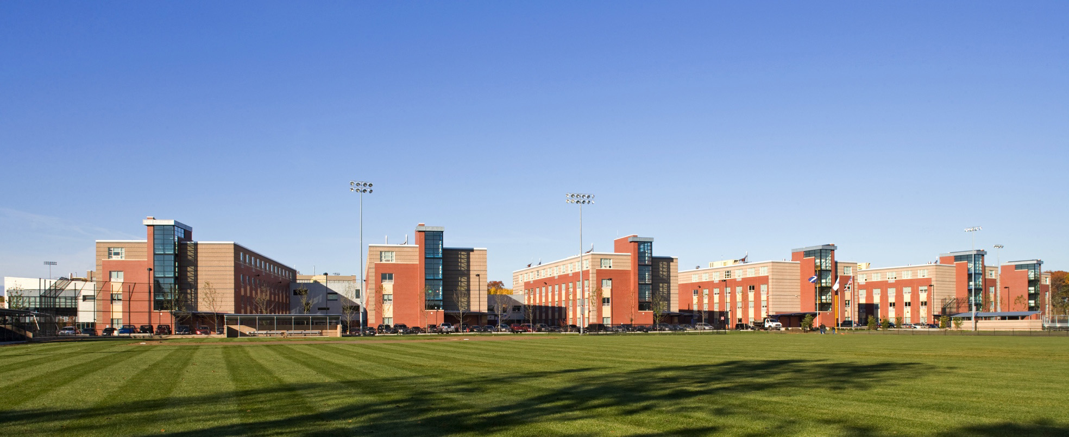
9-12
High School Redesign
Lower Academy: Support Services
Retention
Seamless Academics
Upper Academy: Personalized Career Pathways
Early College
Internships

