Slide 1

Update on Southbridge Public Schools
Russell Johnston, PHD
Senior Associate Commissioner
Massachusetts department of elementary and Secondary Education
August 15, 2017

Slide 2
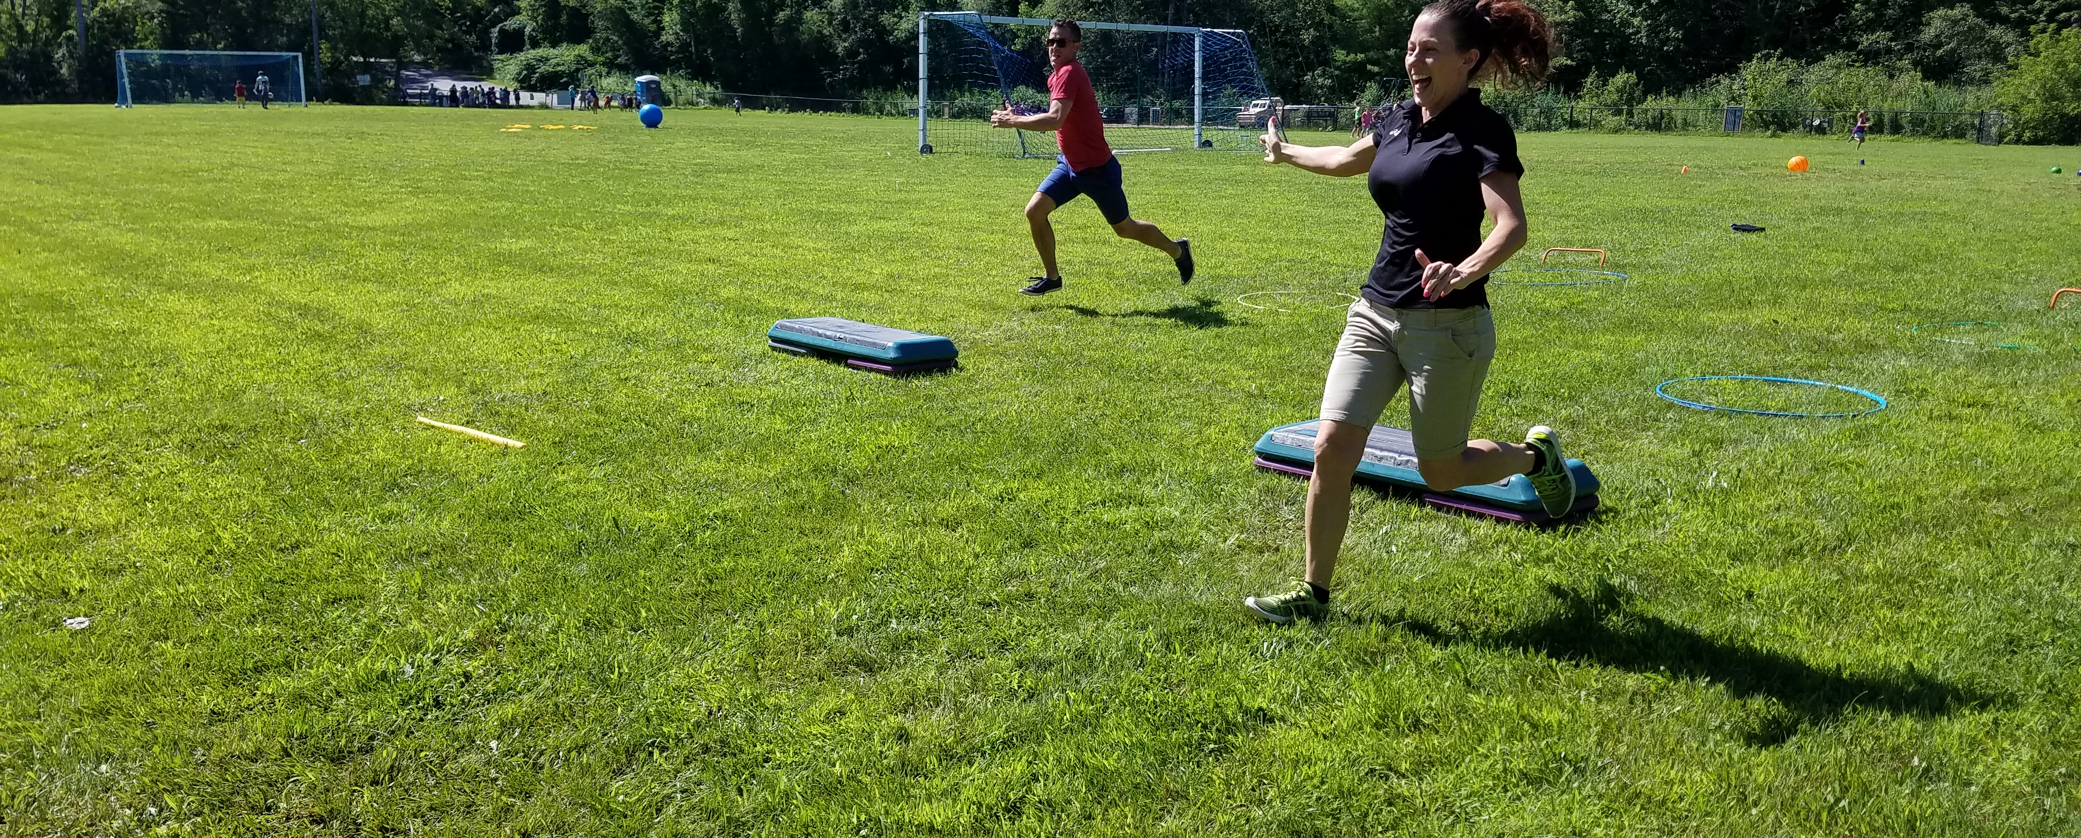
School Year 2016-2017 Update
And Looking Ahead to School Year 2017-2018

Slide 3
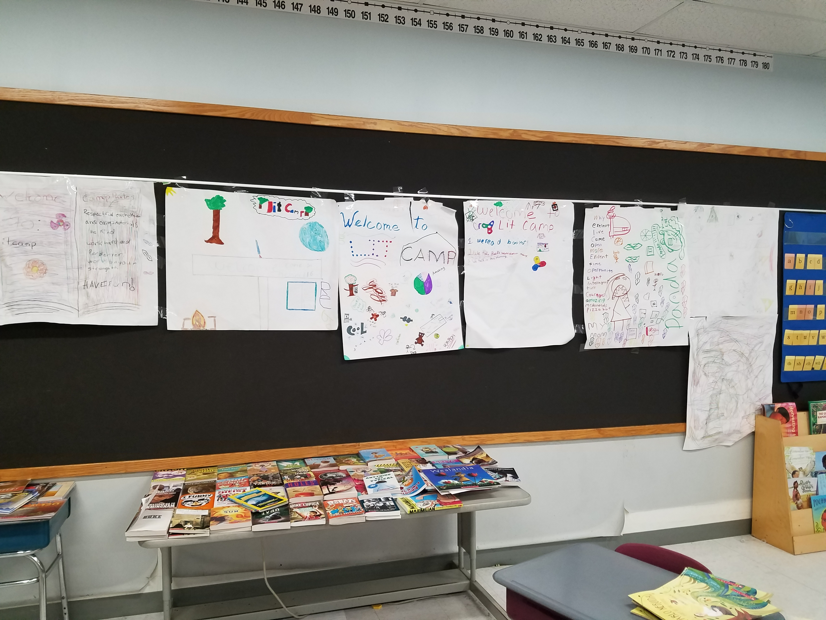
Turnaround Plan Progress: SY17 Selected Achievements
Creation of new curriculum units
Addition of 1400 new student and staff technology devices
Improved Supports for English Learners
Notes:
Improved Supports for English Learners: Combination of better identification of ELs and increasing supports for those students

Slide 4
Turnaround Plan Progress: Summer 2017 Developments
Elementary ELA curriculum units
Budget improvements
School improvement plans

Slide 5

Budget
Highlights
FY17 balanced budget
FY17 observations
FY18 budget funds priorities within district means

Slide 6
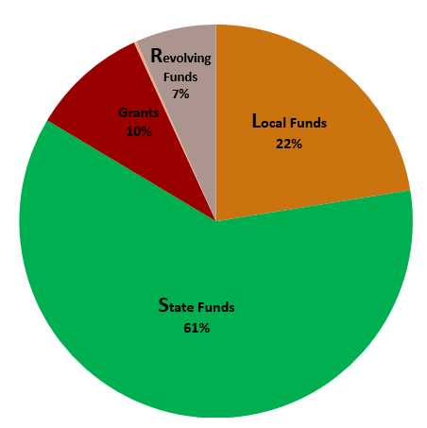
Budget FY17 - Revenues

Slide 7
Budget FY17 - Grants
Entitlement Grants: $2,285,468
Discretionary Grants: $1,132,307
Strategic Support Grant $750,000
School Redesign Grant (planning) $302,007
Nellie Mae Foundation $80,000
Supplement vs Supplant
Notes:
Ventura and Jeff

Slide 8
Budget FY17 - Expenditures
General Fund:
Revenue $26,133,400
Expenses $26,133,400
Grants: $254,401 (supports grant-funded salaries for July and August)
Revolving Funds: $144,397 (not including school lunch)

Slide 9
Budget FY17
Summary
Best practices not followed on a consistent basis
Staff from ESE’s finance unit provided assistance in reconciling FY17 budget
ESE finance staff also provided assistance to implement a fiscally sound FY18 budget
Providing training to administrators on improved business practices
Currently finalizing contract for Lead Partner to manage district’s business operations
Notes:
When I became interim receiver, we noticed that decentralized purchasing was happening. Purchasing was done to meet the educational needs of students. Reasonably calculated to support implementation of TAP. But, coordination wasn’t happening at the district level. That led to a situation where best practices were not followed on a consistent basis.
As a result, we took the following immediate steps:
An employee from ESE’s finance unit worked in Southbridge to provide assistance in reconciling the FY 17 budget.
Staff from ESE’s School finance unit provided assistance to help the district implement a fiscally sound budget for FY 18.
We trained school based administrators on the appropriate process they should use for purchasing; the process is streamlined but also centralized
We are in the process of finalizing a contract for a lead partner to handle the business office and human resources responsibilities in the district. The partner will bring needed expertise, and will professionalize those functions.

Slide 10
FY18 Budget
General Fund: $26,786,735
Entitlement Grants: $2,244,629
Discretionary Grants: $1,411,759
Revolving Funds: $637,545
School Lunch: $1,300,000
TOTAL $32,380,668

Slide 11
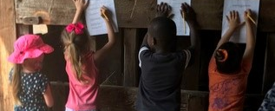
SY18: Turnaround Plan Developments

Slide 12
Receiver Search
Community input on qualities and characteristics
Emphasis on quality over speed
Notes:
Amy Karwan bio
ESE team
CfC support

Slide 13
School-Level Involvement in TAP
School Improvement Plans
Progress monitoring

Slide 14
School Committee Involvement in TAP
Budget and curriculum advisory subcommittees
Two appointees to Receiver Roundtable

Slide 15
SEA Update
Tentative agreement reached with the SEA, pending ratification vote
This school year will include:
Extended time
Teacher career ladder

Slide 16
Looking ahead
New teacher orientation
Convocation week
Start of school on Aug. 28

Slide 17

Questions?

