Slide 1
Every Student Succeeds Act (ESSA) State Plan: Update
Presentation to the Board of Elementary and Secondary Education
September 26, 2017

Slide 2
Purpose of presentation
Provide an update to Board on status of Massachusetts’ state plan under federal Every Student Succeeds Act (ESSA)
Discuss additional revisions requested by U.S. Department of Education
Discuss next steps
Provide an update on 2017 accountability reporting

Slide 3
Timeline
Date(s) | Activity
December 2015 | ESSA signed into law
2016 and 2017 | ESSA plan discussions with BESE (4 meetings in 2016, two meetings in 2017)
2016 and 2017 | Stakeholder engagement
Winter 2017 | Draft state plan developed
Winter 2017 | Public comment period
April 2017 | Submission of state plan to U.S. Department of Education (ED)

Slide 4
Timeline (continued)
Date(s) | Activity
May/June 2017 | Peer and ED staff review
Summer 2017 | ESE/ED staff discussions
Sept 2017 | Final revisions submitted to ED
Sept 2017 | Plan approved by Secretary DeVos

Slide 5
Accountability feedback – average scale score
Original plan:
  Calculate the average scale score in ELA and mathematics separately for each school
  Assign a percentile (1-99) for each, based on performance relative to all other schools statewide
Revised plan:
  Calculate an achievement value that illustrates the degree of proficiency demonstrated on each assessment. The achievement value will represent the percentage of the scale score range “covered” by the average scale score for the school
  Assign a percentile (1-99) for each school’s achievement value

Slide 6
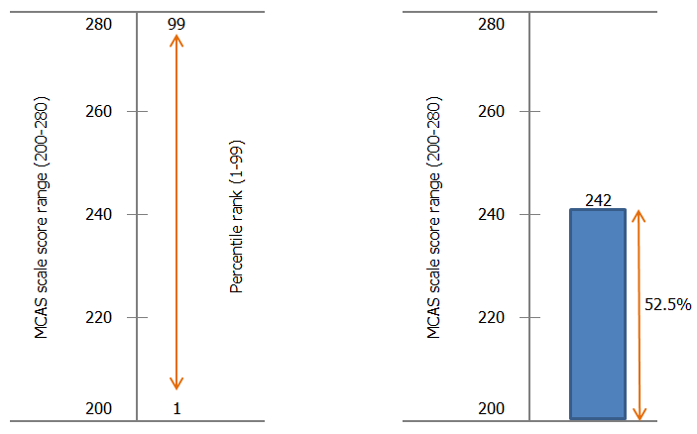
Accountability feedback – average scale score
Original plan
Revised plan

Slide 7
Accountability feedback – small schools
Original plan:
  Schools with fewer than 20 students enrolled will receive an accountability determination of “insufficient data”
Revised plan:
  Combine student-level data starting in 2017 and in subsequent school years for each indicator until the minimum group size is met

Slide 8
Accountability indicators
Indicator | Measure(s)
Academic Achievement | ELA and Math average scale score
Academic Progress | Mean student growth percentile (SGP) Measure of growth to standard (planned)
Graduation Rate | Four-year cohort graduation rate (high schools)
Achieving English Language Proficiency | Student attainment of English language proficiency Progress made by students towards attaining English language proficiency
School Quality or Student Success | Science average scale score Chronic absenteeism Success in grade 9 courses (high schools) Successful completion of broad and challenging coursework (high schools) Extended engagement rate (high schools) Annual dropout rate (high schools)

Slide 9
Next steps
Date(s) | Activity
September – November 2017 | Receive approval of plan (anticipated) Model accountability metrics using first round of Next-Generation MCAS results
December 2017 – January 2018 | Discuss future accountability system design, including weighting of indicators, with BESE

Slide 10
2017 Accountability Reporting - Reminders

Slide 11
Amendment to 603 CMR 2.00: Accountability and Assistance for School Districts and Schools
Approved at the April 2017 BESE meeting
Allows ESE to refrain from placing certain schools into Levels 1-3 at the beginning of the 2017-18 school year
  Applies to one year only
  Impacts schools serving grades 3-8 that administered Next-Generation MCAS tests in spring 2017
  Does not impact high schools serving grades 9-12 that did not administer Next-Generation MCAS

Slide 12
Reporting details
Schools and districts administering Next-Generation MCAS in grades 3-8 that have participation rates below 90% will be placed into Level 3
Schools serving a combination of grades 3-8 and 9-12 that have persistently low graduation rates for any group will be placed into Level 3

Slide 13
Reporting details
Current Level 4 or 5 schools or districts that are not exiting will maintain their level designation
All other Next-Generation MCAS schools meeting participation and graduation rate requirements will not receive a school percentile, Progress and Performance Index (PPI), or accountability and assistance level (1-3)
No new Level 4 or Level 5 schools will be identified among schools serving grades 3-8 in 2017
  Low-performing high schools remain eligible for Level 4 and 5 designations
2017 assessment results will serve as the new baseline for target-setting in 2018 and beyond

Slide 14
Data reported in 2017
Schools administering legacy MCAS tests only (high schools) |  | Schools administering Next-Generation MCAS tests in grades 3-8
Performance on all accountability indicators |  | Next-Generation MCAS achievement percentiles
Progress and Performance Index (PPI) data |  | Transitional student growth percentiles
School accountability percentiles |  | Accountability and assistance levels No level Level 3 Very low assessment participation Persistently low graduation rates Current Level 4 and Level 5 schools
Accountability and assistance levels (1-5)
Schools identified for low or very low assessment participation
Schools identified for persistently low graduation rates

Slide 15
2017 Reporting schedule
Tentative date(s) | Activity
Week of October 16 | Schools and districts preview official embargoed assessment and accountability data Public release of school, district, and state assessment and accountability results
October 23 | Special BESE meeting and discussion of 2017 results

