Slide 1
Updates on the Next-Generation MCAS
Meeting of the Board of Elementary and Secondary Education
September 26, 2017

Slide 2
Next-Generation MCAS
Started with November 2015 Board vote
  Upgrade existing MCAS to reflect the revised learning standards
  Focus on critical thinking, application of knowledge, connections between reading and writing
  First administration in grades 3-8 ELA and math in spring 2017

Slide 3
MCAS 2017 Participation Rates
 | ELA | Math | Science/TE
Grade 3 | 99.3% | 99.5%
Grade 4 | 99.3% | 99.5%
Grade 5 | 99.3% | 99.4% | 99.4%
Grade 6 | 99.2% | 99.3%
Grade 7 | 99.1% | 99.2%
Grade 8 | 98.9% | 98.9% | 98.7%
Grade 10 | 97.9% | 98.3% | 99.0%
All Grades | 99.0% (+.3) | 99.2% (+.6) | 99.0% (+.1)

Slide 4

Computer-based testing
Spring 2017:
  60% of all grades 3-8 students took the test on computers; >93% in grades 4 and 8
Phasing in computer-based testing by grade level
  Spring 2017: Grades 4 and 8 ELA and math
  Spring 2018: Grades 4-5 and 7-8 in ELA and math and grades 5 and 8 in science and tech/eng
  Spring 2019: All tests in grades 3-8, grade 10 ELA and math

Slide 5



Equating of Computer- and Paper-Based Test Forms
Ensure fairness regardless of test form (computer or paper)
Applied in grades where schools could choose to administer computer-based or paper-based tests (grades 3, 5, 6, and 7)
Used the results from parts of the test that are similar to help adjust the scoring on parts of the test that vary by format.

Slide 6
Tentative 2017 MCAS Reporting Calendar
Date | Event
Weeks of October 9 and 16 | Official embargoed data files rolled out to districts
Week of October 16 | Official state, district and school-level results released to the public
October 23 | Presentation to Board on state-level results
October 24 | Parent/Guardian reports received by superintendents, who then forward them to parents.

Slide 7
Standard Setting
Needed anytime you introduce a new test
Establish standards for each achievement level; without standard setting, can’t say whether someone met expectations, only whether they answered an individual question right or wrong
Context for standard setting:
  Legacy MCAS high school tests were designed to measure readiness to graduate, not readiness for college and career
  1/3 of MA public high school graduates who enrolled in public colleges or universities placed into remedial courses
  Legacy MCAS needed to be updated to reflect expectations in revised learning standards

Slide 8
Process for Standard Setting
Standard Setting Policy Committee (fall 2016)
  14 members (classroom teachers, educational administrators, policymakers, and other stakeholders) convened to recommend new achievement level names and descriptors
  Guiding principles included need for
    Clear communication to parents and students about readiness for academics at the next grade level
    Communication of shared responsibility for student success
Public survey on proposed achievement levels
  450 responses (winter 2016-17)
Discussions and approval by BESE
  3 meetings, November 2016-March 2017
Development of content-level descriptors

Slide 9
MCAS Achievement Levels
Legacy
Next-generation
Advanced
Students at this level demonstrate a comprehensive and in-depth understanding of rigorous subject matter, and provide sophisticated solutions to complex problems.
Proficient
Students at this level demonstrate a solid understanding of challenging subject matter and solve a wide variety of problems.
Needs Improvement
Students at this level demonstrate a partial understanding of subject matter and solve some simple problems.
Warning
Students at this level demonstrate a minimal understanding of subject matter and do not solve simple problems.
Exceeding Expectations
A student who performed at this level exceeded grade-level expectations by demonstrating mastery of the subject matter.
Meeting Expectations
A student who performed at this level met grade-level expectations and is academically on track to succeed in the current grade in this subject.
Partially Meeting Expectations
A student who performed at this level partially met grade-level expectations in this subject. The school, in consultation with the student's parent/guardian, should consider whether the student needs additional academic assistance to succeed in this subject.
Not Meeting Expectations
A student who performed at this level did not meet grade-level expectations in this subject. The school, in consultation with the student's parent/guardian, should determine the coordinated academic assistance and/or additional instruction the student needs to succeed in this subject.

Slide 10
Standard Setting for Grades 3-8 ELA and Math
Held August 14-18, 2017
126 educators (with an average of 15 years experience) participated on six panels
  ELA grades 3-4, 5-6, and 7-8
  Math grades 3-4, 5-6, and 7-8

Slide 11
Standard Setting Process
Panelists judged each test item to determine how many points students would need to score to demonstrate they belonged in each achievement level
Panelists did three rounds of item judgments
Process facilitated by measurement and content experts
Final meeting of table leaders from each panel to ensure that expectations were consistent across grades

Slide 12
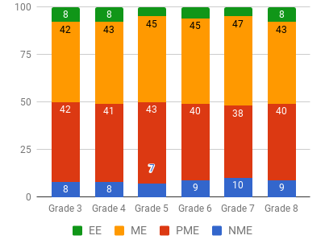
Projected Statewide 2017 Results for Grades 3-8 ELA and Math: Percent of students in each achievement level

Slide 13
Interpreting the Projected Results
The results do NOT mean that students learned less; the next-generation MCAS measures in a different way
The results of the standard setting reflect:
  The value panelists put on a clear progression of learning expectations from grade to grade
  Panelists’ consistent application of the standards as they made expert judgments about student achievement on the new tests
Remember: 2017 is the baseline year — the first year of a new assessment — and we expect scores to change over time, as occurred when the legacy MCAS debuted in 1998.

Slide 14
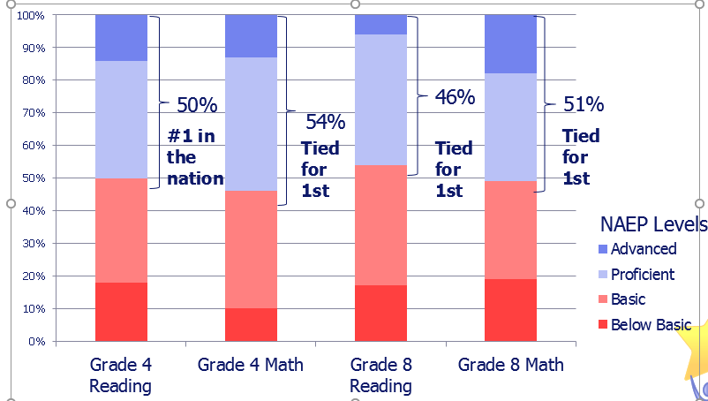
Projected Next-Gen MCAS Results Look More Like Massachusetts’ 2015 NAEP Results…
Notes:
Going into the standard setting, we did have a couple of things in mind. One of the other goals set forth by our new standards and this Board was to look to national and international benchmarks during the development of our next-generation tests. MA continues to be first, or tied for first, in the latest administration of NAEP in 2015. But notice that about half of MA students are still not reaching the Proficient level. nationally, only about a third of students reach the Prof level.
While we did not intend to replicate the NAEP results, we did use it as a lens – this nationally respected test.

Slide 15
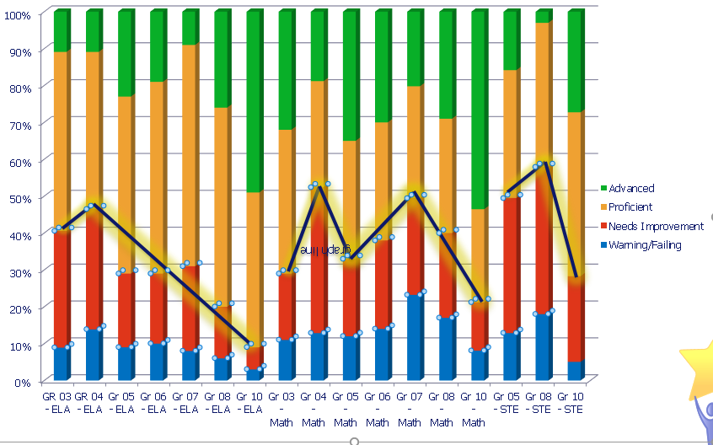
…and Less Like Legacy MCAS Results (2015)

Slide 16
Preview of Parent/Guardian Report Preview
Explain achievement levels
New scale (440-560)
Indicates average scaled scores for comparison to school, district, and state
Color-coded
Item-level results
New format for results by major reporting category
Legacy test results will still be in old format (2017 science and tech/eng and grade 10 tests)

