Slide 1
Center for Instructional Support
MA Board of Elementary and Secondary Education

Slide 2
CONTENTS
01
Arts Curriculum Framework Revision
02
Increasing Access to High-Quality Curriculum
CONTENTS
03
STEM Ambassadors

Slide 3
01 Arts Curriculum Framework Revision
Arts Curriculum Framework Revision
01

Slide 4
Revision of the 1999 Arts Curriculum Framework
Ron Noble and Craig Waterman, DESE
Jennifer Fidler and Dawn Benski, teacher fellows

Slide 5
Revision Process
Preparation
October 2017-May 2018
Stakeholder outreach
Writing and Revising
June 2018 – Jan. 2019
Panel meetings
Refinement and Board Approval
Feb. 2019 – May 2019
Public comment
Board discussion and vote
Facilitator training
Panelist recruitment
Content Advisor input
Drafting framework
Review Draft
Notes:
RN
The review process began in October of 2017 and will culminate with a revised Arts Framework in the spring of 2019. Department of Elementary and Secondary Education (DESE) staff are conducting the review process in three phases:
Preparation (October 2017- May 2018),
Writing and revising (June 2018- January 2019), and
Refinement and Board Approval (February 2019- May 2019).

Slide 6
Vision: What does it mean to be ready for college, career, and civic participation?
What are the components of being Artistically Literate?
Creativity
Communication
Collaboration and Leadership
Cultural Awareness
Notes:
Creativity: 81 percent of American corporate leaders say that “creativity is an essential skill for the 21st century work force, but is the most lacking.
Communication: Many disciplines focus on communication, but art is unique is several ways. Most importantly - 1. focusing on hard to discuss ideas – 2. much art is designed to capture your attention
Collaboration and Leadership: This is an authentic opportunity to include SEL. Especially in ensemble work, there is a great opportunity for student leadership. This is one of the aspects of the frameworks that encourages a shift in current practice- by providing more opportunity for students to lead musical ensembles, direct play and organize art installations.
Cultural awareness: This is two fold – one being aware of the history and connotation of current images, ideas, and sounds in our society – but also provides an authentic opportunity to embrace the cultures of students who may not see schools as representing their communities.

Slide 7
Guiding Principles: What should guide the development and evaluation of curriculum and programs?
Artistic Intent
Coherent Progression
Relevant to Students
Variety of Genre and Styles
Variety of Mediums and Roles
Diverse Grouping
Connected to Other Disciplines
Engages with the Community
Connected to Social Emotional Learning
Supports All Students

Slide 8
Guiding Principles
Artistic Intent
Coherent Progression
Relevant to Students
Variety of Genre and Styles
Variety of Mediums and Roles
Diverse Grouping
Connected to Other Disciplines
Engages with the Community
Connected to Social Emotional Learning
Supports All Students
Notes:
Highlighting three
Art isn’t just about creation – it is about creation with purpose. Mastering techniques or performing works are simply means to the end – an artist is trying to either evoke, express, or communicate. Art programs need to keep this front and center – throughout all of the curriculum.
Relevance to students is critical – and this is probably the most difficult guiding principle, and I would argue most important. Students already have rich experiences with art – and art programming needs to embrace this, the goal of art education is to make students able to evoke, express, and communicate – we need to find more opportunities for students to do this authentically – this may mean students write country songs, analyze memes, or perform spoken word works.
Connected to other disciplines – so a theatre teacher can help students make a presentation capture the audience’s attention. But this also means, using math to understand meter, or understanding the historical context of art.

Slide 9
Practices
What are the multi-dimensional skills students continually refine across their preK-12 education?
Notes:
Creativity: 81 percent of American corporate leaders say that “creativity is an essential skill for the 21st century work force, but is the most lacking.
Communication: Many disciplines focus on communication, but art is unique is several ways. Most importantly - 1. focusing on hard to discuss ideas – 2. much art is designed to capture your attention
Collaboration and Leadership: This is an authentic opportunity to include SEL. Especially in ensemble work, there is a great opportunity for student leadership. This is one of the aspects of the frameworks that encourages a shift in current practice- by providing more opportunity for students to lead musical ensembles, direct play and organize art installations.
Cultural awareness: This is two fold – one being aware of the history and connotation of current images, ideas, and sounds in our society – but also provides an authentic opportunity to embrace the cultures of students who may not see schools as representing their communities.

Slide 10
Four Types of Practices
Creating
Presenting
Responding
Connecting
Notes:
Dawn: The Arts Frameworks are organized around four types of practices, aligned to the national standards. They are Creating, Presenting (or performing), Responding and Connecting.

Slide 11
Eleven Practices
Creating
Presenting
Generating Ideas
Organizing Ideas
Revising Ideas
Selecting or Interpreting
Refining for Presentation
Conveying Meaning
Responding
Connecting
Analyzing
Interpreting
Evaluating
Relating to Self & Knowledge
Connecting Arts & Culture
Notes:
Dawn: For example, when creating an artistic work, student generate, organize, and refine their artistic ideas. Over their preK-12 education, students continue to grow and improve these skills of generating, organizing and revising artistic ideas. Similarly, students develop skills in presenting and performing works, responding to artistic works from peers and masters, and making connections between art, culture, and self.

Slide 12
Content Standards
What are the specific understanding and skills students demonstrate in each grade dyad and discipline?
Notes:
Creativity: 81 percent of American corporate leaders say that “creativity is an essential skill for the 21st century work force, but is the most lacking.
Communication: Many disciplines focus on communication, but art is unique is several ways. Most importantly - 1. focusing on hard to discuss ideas – 2. much art is designed to capture your attention
Collaboration and Leadership: This is an authentic opportunity to include SEL. Especially in ensemble work, there is a great opportunity for student leadership. This is one of the aspects of the frameworks that encourages a shift in current practice- by providing more opportunity for students to lead musical ensembles, direct play and organize art installations.
Cultural awareness: This is two fold – one being aware of the history and connotation of current images, ideas, and sounds in our society – but also provides an authentic opportunity to embrace the cultures of students who may not see schools as representing their communities.

Slide 13
Structure
Five Disciplines
Dance, Media Arts, Music, Theatre, Visual Arts
Grade pairs (e.g., Pre-K/K, 1/2, 3/4, etc.) & High School courses
Notes:
Jen: The standards are organized in five disciplines and in grade pairs for preK-8th and in courses for High School (foundation, proficient, advanced).

Slide 14
Example: What different artistic ideas disciplines are generating
Dance 3-4th: Creating-Generating
Media Arts: 3-4th: Creating-Generating
Improvise ideas that explore space (e.g., levels, shapes, directions, pathways) and time (e.g., fast and slow) as elements of dance.
Generate media arts ideas that utilizes interactivity.
Notes:
Jen: Each content standard works to support one of the practices. Here is an example of the content standards that supports the generating ideas practice in each discipline standard in 3-4th grade.

Slide 15
Example: What different artistic ideas disciplines are generating
Music: 3-4th: Creating-Generating
Theatre: 3-4th: Creating-Generating
Sing or play original musical ideas that explore more complex rhythmic and melodic methods (including syncopation, three-four time signature, and minor keys).
Create and articulate sensory details of imagined worlds, and improvised stories.
Notes:
Jen: You can see that in this standard students are exploring the artistic elements in each discipline, such as meter, color, level, or interactivity.

Slide 16
Example: What different artistic ideas disciplines are generating
Visual Arts: 3-4th: Creating-Generating
Create different visual effects that explore the elements of art (e.g., use found objects to create texture in clay).

Slide 17
02 Increasing Access to High-Quality Curriculum
Increasing Access to High-Quality Curriculum
02

Slide 18
Increasing Access to High-Quality Curriculum in Massachusetts
Heather Peske, Ron Noble, and Rachel Bradshaw, DESE
Kevin Cormier and Nicole Palmieri, teacher fellows

Slide 19
Why curriculum, why DESE, and why now?
Research and Policy Consensus
Demand from MA Educators
Curricular materials matter.
Curricular coherence matters.
Upgrading curricular materials is cost-effective.
The most effective professional learning centers on curriculum.
Teachers and administrators spend a lot of time developing and searching for materials.
Teachers need more time to collaborate on fine-tuning instruction to serve their students’ needs.

Slide 20
What are we doing in response?
The CURATE project
Partners: Teach Plus MA, Rennie Center for Education Research and Policy
Ratings: draw on several sources of data on materials’ quality, alignment to MA expectations for teaching and learning
Fellows: current classroom teachers from across MA
Supports for self-assessments
aligned policies, messages
Curriculum ratings by teachers
Supports for decision-making

Slide 21
Introducing two of our CURATE Fellows:
Kevin Cormier
Nicole Palmieri
Teaches grades 7 and 8 math at Nissitissit Middle School, North Middlesex Regional School District
Serves on grades 6-8 math materials review panel
Teaches kindergarten at John Breen School, Lawrence Public Schools
Serves on grades K-2 English language arts materials review panel

Slide 22
03 STEM Ambassadors
STEM Ambassadors
03

Slide 23
Science, Technology Engineering and Mathematics Ambassadors
Erin Hashimoto-Martell, Nicole Scola and Leah Tuckman, DESE
Karen Cross and Nicole Finneran, teacher fellows

Slide 24
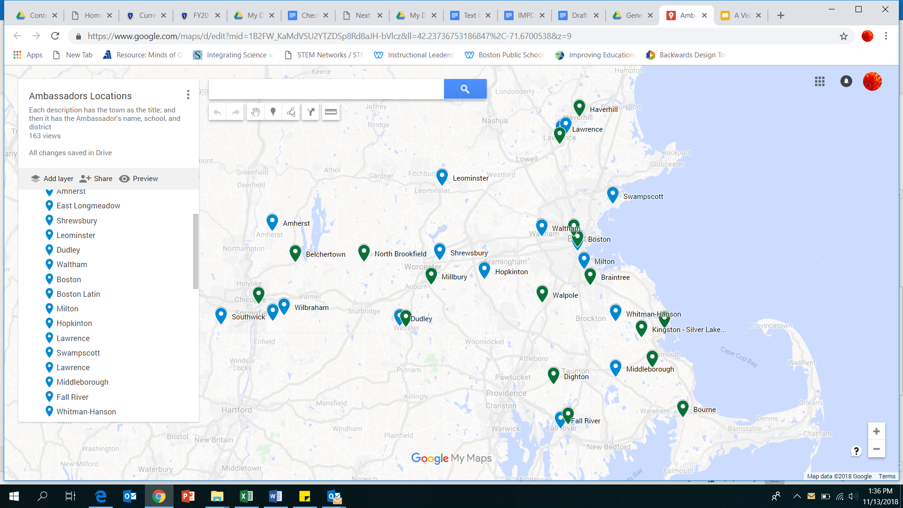
STEM Ambassador Program Goals
Provide leadership and collaboration opportunities within districts and across the state
Increase understanding of the 2017 MA Math Curriculum Frameworks and the 2016 MA STE Framework across the state
Provide educators, schools and districts with high quality, standards aligned tasks

Slide 25
STEM Ambassador Deliverables
Ambassadors will:
Create a task development team of teachers from the following grade spans:
Grades 4-8 for Math
Grades 6-12 for STE
Lead professional development sessions to guide educators in the development and piloting of the tasks
Collaborate with two additional districts

Slide 26
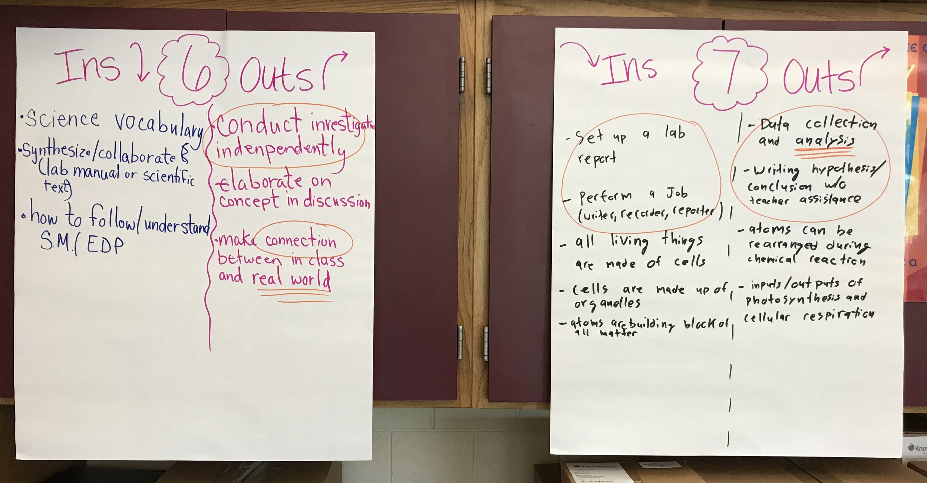
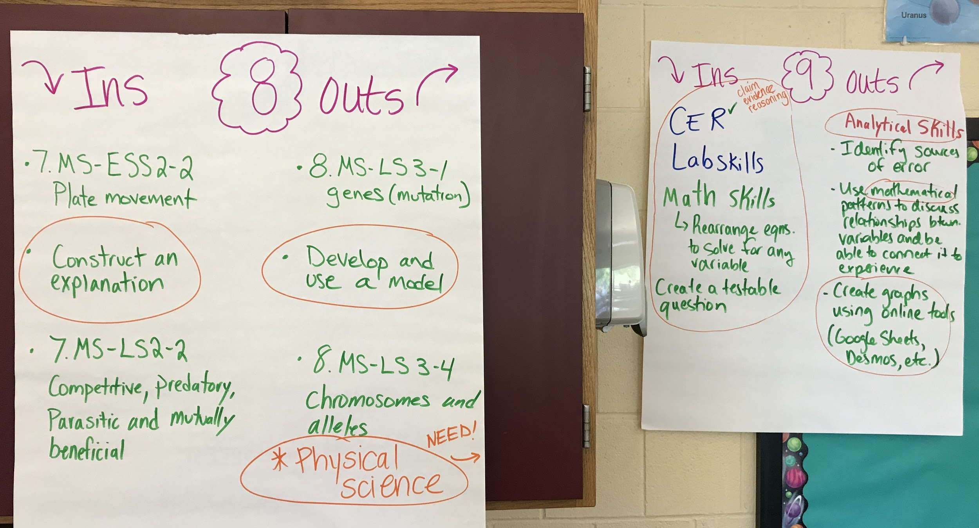
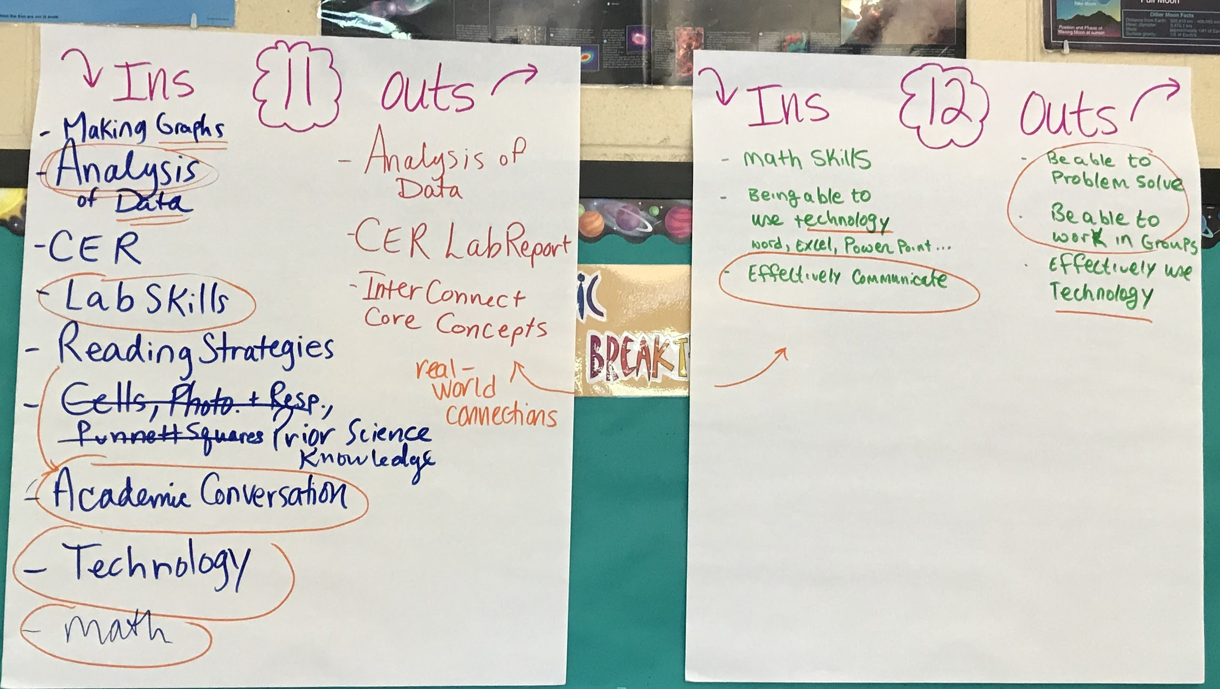
Nicole Finneran – Science & Technology/Engineering Ambassador
Frost Middle School, Lawrence Public Schools

Slide 27
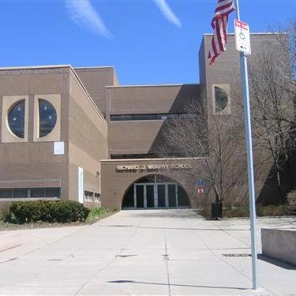
Karen Cross – Math Ambassador
Richard J. Murphy K-8 School, Boston Public Schools
Instructional Focus: Teachers with the support of Murphy School leaders will regularly facilitate challenging, standards-aligned academic experiences that generate student engagement by encouraging perseverance through posing questions, strategic prompting and writing tasks that allow all students to develop a deep understanding of content. Teachers and school leaders will demonstrate growth mindset and engage in the very practices they seek to develop in their students.

Slide 28
THANK YOU
THANK YOU
Center for Instructional Support
781.338.6220
instructionalsupport@doe.mass.edu
www.doe.mass.edu
75 Pleasant Street, Malden, MA 02148

