Slide 1
Adult Education Overview December 18, 2018
Wyvonne Stevens-Carter, Acting Adult Education State Director
Cliff Chuang, Senior Associate Commissioner, Educational Options

Slide 2
Massachusetts Adult Education
Overview of FY19-22 Adult Education System
Building a High-Quality, Performance-Driven System
Promising Preliminary Research Results
Panel of Adult Educators and Students

Slide 3
Overview of FY19-22 Adult Education System (Who, What, Where)
Overview of FY19-22
Adult Education System
(Who, What, Where)

Slide 4
Key Terms & Acronyms
ESOL: English for Speakers of Other Languages
ABE: Adult Basic Education (basic literacy services to support the attainment of a high school equivalency credential)
GED and HiSET: the two high school equivalency assessments offered in MA

Slide 5
Need for Services: High School Equivalency and ESOL Needs
Workforce Region | Population 18 Yr. + ¹ | High School Equivalency Need ² |  | ESOL Need ³ |  | Combined Need ⁴ # | Regional Share of Need
 |  | # | % | # | %
Berkshire | 105,651 | 8,645 | 8% | 2,938 | 3% | 11,583 | 1.1%
Cape Cod & Islands | 202,131 | 9,331 | 5% | 5,570 | 3% | 14,901 | 1.5%
Central Mass | 649,061 | 56,430 | 9% | 51,451 | 8% | 107,881 | 10.6%
Greater Boston Metro | 1,905,040 | 149,111 | 8% | 241,248 | 13% | 390,359 | 38.4%
Northeast | 860,885 | 83,968 | 10% | 106,458 | 12% | 190,426 | 18.7%
Pioneer Valley | 567,466 | 58,496 | 10% | 43,215 | 8% | 101,711 | 10.0%
Southeast | 1,062,656 | 110,739 | 10% | 88,827 | 8% | 199,566 | 19.6%
TOTAL | 5,352,890 | 476,720 | 9% | 539,707 | 10% | 1,016,427 | 100%
¹ Based on 2015 American Community Survey 5 Year Estimates
² 25 years and older without a high school credential
³ 18 years and older with limited English proficiency
⁴ Occurrence of Need may be in ABE and/ or ESOL and results in some duplicate headcounts

Slide 6
Our Adult Education System Serves …
CATEGORY | # of Students
ESOL / ABE (GED/HiSet) | 11,972 / 6,485
Men / Women | 6,817 / 11,640
Employed / Unemployed | 9,656 / 8,801
Out of School Youth | 3,042
In correctional institutions | 1,363
Receiving public assistance | 7,473
Parents with dependents <18 | 6,221
Current Waitlist: ESOL17,419 ABE 2,567

Slide 7
Our Adult Education System Serves …
CATEGORY | # of Students
American Indian or Alaskan Native | 49
Asian | 1,736
Black or African American | 4,067
Hispanic or Latino | 6,892
Native Hawaiian or Other Pacific Islander | 39
White | 3,941
Two or More Races | 1,733

Slide 8
FY19 Adult Education System – Educational Options
70 Community Adult Learning Centers (CALCs)
12,599 active seats (4,216 ABE & 8,383 ESOL)
(includes Family Literacy and Adult Diploma Programs)
10 Transitions to College
6 Integrated Education and Training (IET)
11 Integrated English Language and Civics Education (IELCE)
IET/IELCE RFP was posted for additional models ($460,000) and 7 programs applied
Notes:
EDIT THIS and NEXT SLIDE FOR CONSISTENCY
Received 81 proposals – funding 70 programs across the state.
Workforce Areas eligible to apply for additional IET/IELCE programming: Berkshire, Boston, Bristol, Cape Cod, Hampden (IET only), Metro South/West, North Shore, South Shore
IET/IELCE details
17 total programs
6 IET
11 IELCE
Training partnerships
8 Public Career/Vocational Technical Education schools
6 Community Colleges
3 training programs
Occupational clusters: Business (2), Culinary Arts (4), Healthcare (8), and Manufacturing (3)
Total annual participants: approximately 350

Slide 9
FY19 Adult Education System – Educational Options, continued
8 ABE programs in Correctional Institutions – 629 active seats
DOC (5 sites): Norfolk, Shirley, Concord, Gardner, Boston Pre-Release
7 CHOCs: Worcester, Suffolk, Franklin, Hampden, Berkshire, Hampshire, Bristol
1 Distance Learning Hub (ESOL & ABE): Notre Dame Education Center, Boston
1 Primary Instruction by Volunteer Program: Literacy Volunteers of MA
13 communities served: Athol, Boston, Fitchburg, Framingham, Lowell, Methuen, Norwood, Pittsfield, Quincy, Southbridge, Springfield, Stoughton, Worcester
10 Transition to College Programs
Bristol CC, Bunker Hill CC, Cape Cod CC, Holyoke CC, Massasoit CC, Middlesex CC, Mount Wachusett CC, Northern Essex CC, Quinsigamond CC, Springfield Technical CC
8 Workplace Education Programs
3 new applications in FY19; 5 continuing (last year of funding in FY19)
Notes:
DOC sites: Norfolk, Shirley, Concord, Gardener, Boston Pre-Release

Slide 10
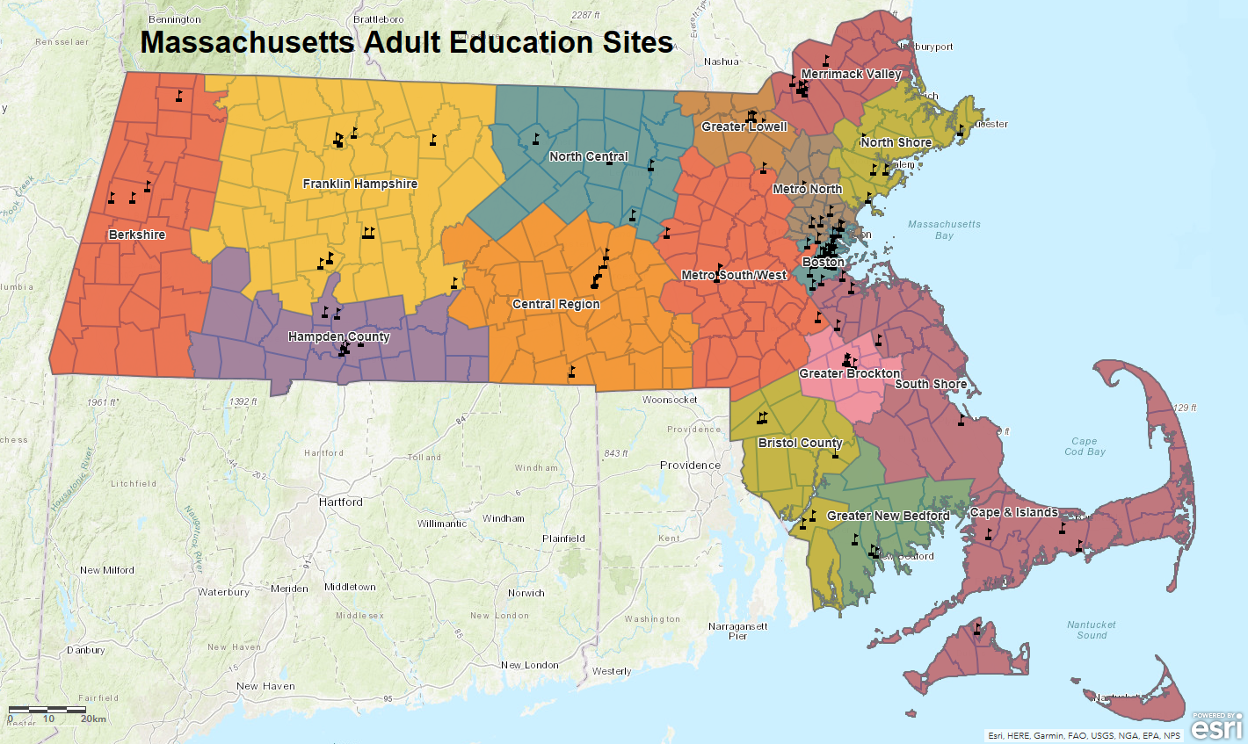
Program Locations Across Massachusetts
Notes:
REPLACE WITH NEW MAP

Slide 11
Building a High-Quality, Performance-Driven System
Building a High-Quality,
Performance-Driven System

Slide 12
A Shift To A PERFORMANCE-Driven System
BEFORE
AFTER
Inputs
Compliance
“Widgetized”Funding based on historical regional funding levels = Inequity
Outcomes (Measurable Skills Gain, Employment)
Flexibility / Quality
“Block” Per-Student Funding rate allocated based on student-need/demand formula = Equity

Slide 13
Focus on Outcomes
Measurable Skills Gain (MSG)
Completion of one Educational Functioning Level (EFL)
Attainment of a High School Equivalency (HSE) credential
Enrollment in postsecondary education or training (PSE/T) after program exit
Employment Measures
Employment in the second quarter after exit
Employment in the fourth quarter after exit
Median income in the second quarter after exit
Notes:
What we measure is what we believe will have a positive impact on students lives. These outcomes are indicators of students progress and success and your success.
________________
ACLS holds programs accountable for the percentage of AE students who achieve measurable skill gain :
Completion of one educational functioning level (EFL)
Attainment of a high school equivalency (HSE) credential
Enrollment in postsecondary education or training (PSE/T) after exit
Programs are assigned an MSG target using a formula that incorporates:
The number of students who pretest into each of the National Reporting System (NRS) levels that a program serves, and the degree of difficulty in achieving an MSG outcome (based on historical data)
Sessions: MA adult Education Performance Standards

Slide 14
Indicators of Program Quality (IPQs)
Student Success | Capacity
Indicator 1: Program Design | Indicator 7: Organizational Support
Indicator 2: Access & Equity | Indicator 8: Educational Leadership
Indicator 3: Career Pathways Collaborations | Indicator 9: Professional Culture
Indicator 4: Curriculum & Instruction | Indicator 10: Fiscal & Data Accountability
Indicator 5: Student Progress
Indicator 6: Advising & Student Support Services

Slide 15
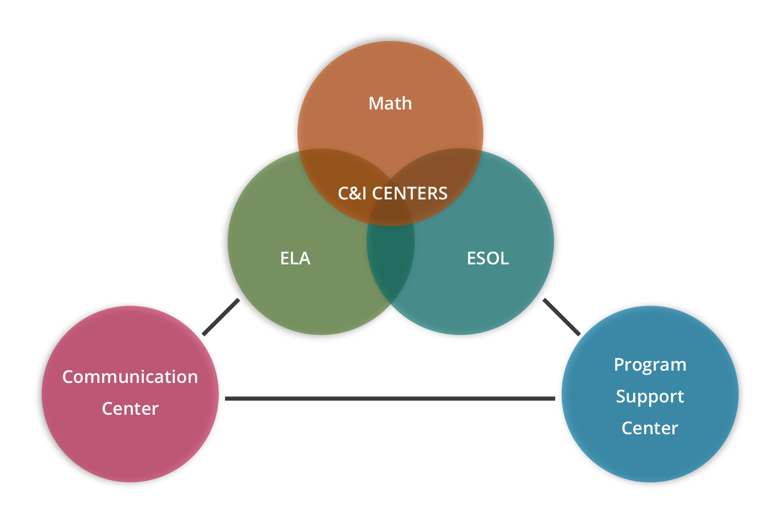
Monitoring & Support
On-site Program Quality Review (PQR)
A PQR will be conducted at all CALCs and correctional institutions will receive (FY19-21)
SABES is the adult education professional development system
ADA Resources and Training, Advising
Career Pathways, Cultural Competence
Curriculum & Instruction, Digital Literacy
Program Management
Educational Leadership, and Licensure
Notes:
PQR – focus on 5 indicators:
#3 Career pathways and collaboration,
#4 Curriculum and instruction,
#5 Student progress (review prior to the visit),
#7 organizational support, #8 Educational Leadership
#8 Educational Leadership
Site visits (all indicators)
Sessions:
Program Quality Reviews and Site Visits

Slide 16
Promising Preliminary Research Results
Promising Preliminary
Research Results

Slide 17
Adult Basic Education + GED: Preliminary Results
Research conducted by Blake Heller & Kirsten Slungaard Mumma, Harvard University, 2018
Research Question: What is the effect of obtaining a GED on student outcomes in MA for students enrolled in state-funded ABE* programs vs. those who are not?
ABE Students Results:
Are more likely to re-take the GED than other test-takers
Obtaining the GED increases the probability that ABE students will enroll in college by 30.6 percentage points, driven by enrollment in two-year colleges
Obtaining a GED increases the number of quarters enrolled by 2.8 for females, with some evidence that obtaining a GED increases female degree attainment.
Non-ABE students Results:
Obtaining the GED has no effect on the probability non-ABE non-graduates will enroll, persist, or obtain a college degree.
*ABE students are students who enrolled in ABE classes before taking the GED (~17,000 total). Non-ABE non-graduates are non-graduating former MA public school students in the non-graduate NSC file who did not enroll in ABE (~28,000 total). About ⅓ of ABE students were matched to SIMS records.
Preliminary results subject to updating. Please contact the authors before circulating or citing.

Slide 18
Framingham Adult ESL Program: Preliminary Results
Research conducted by Blake Heller & Kirsten Slungaard Mumma, Harvard University, 2018
Research Question: What is the effect of participation in the FAESL+ program on the economic, educational, and civic outcome of non-native English speakers? (Lottery research design)
Results: The effect of FAESL+ participation on voting:
FAESL+ participants are 4.6 percentage points more likely to register to vote
Preliminary results subject to updating. Please contact the authors before circulating or citing.

Slide 19
Adult Education Research Next Steps
Wage data is critical to fully understanding the impact of the adult education system, and we have discussed the process for linking our data to wage data through the SLDS project to produce a de-identified dataset.
We are also exploring data-sharing agreements to link to criminal justic records and professional licensure.
We will be working with the field to expand program participation in this research beyond just the Framingham program.
We are also exploring a 3rd research question: What is the effect of parental participation in FAESL+ on the educational outcomes of their children?
Note: Preliminary results subject to updating with further analyses. Please contact the authors before circulating or citing: behller@g.harvard.edu, kslung@g.harvard.edu

Slide 20
Panel of Adult Educators and Students
Panel of Adult Educators
and Students

Slide 21
Chelsea Public School & Charlestown Adult Learning Center
Chelsea Public Schools
Priscilla Vele, Educator
Ana Tizol Cantor, Student
Charlestown Adult Learning Center
Lori D'Alleva, Director
Audrey Kelly, Student

