Slide 1
School and District Report Cards
Presented to the Board of Elementary and Secondary Education
January 14, 2019

Slide 2
Background information
Report cards are important tools for sharing district & school information with families & the public
The federal Every Student Succeeds Act (ESSA) requires districts to annually distribute district & school report cards to the parents/guardians of all children enrolled in district schools
Report cards must include information related to assessment, accountability, educator qualifications, & other measures of school quality
Since 2007, the Department has prepared district & school report cards that contain all federally required elements, & has made them available via the School & District Profiles website

Slide 3
Creating Parent-Friendly School Report Cards
January 14, 2019

Slide 4
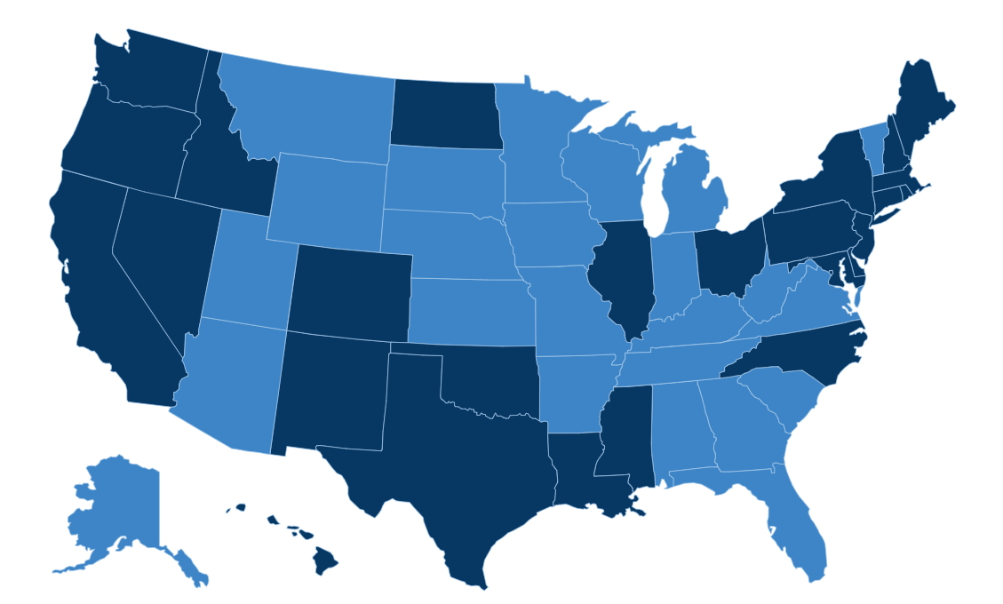
Unprecedented Research
Conducted research in 25 states:
100+ focus groups
Dozens of In Depth Interviews (IDIs)
10 national quantitative surveys
Dozens of ethnography sessions
Dozens of tests of our tools
Focus on low-income parents/guardians and parents/guardians of color
*Dark blue states represent locations where qualitative research was conducted.
2

Slide 5
National partners

Slide 6
Massachusetts Partners
6
Notes:
In addition to affiliates of our national partners and other leaders here today, we’ve reached out to:
1647
Boston Chinatown Neighborhood Center
Boston’s Higher Ground
Boston School Finder
Center For Promise (Boston University)
Collaborative Parent Leadership Action Network (C-PLAN)
First Teacher
Freedom House
Massachusetts Parents United
New Profit
Phenomenal Moms
Sociedad Latina
Teach Plus Massachusetts
The Teacher Collaborative

Slide 7
Findings from Relevant Research

Slide 8
Research methodology
Research Methodology
School-Based Report Card
Qualitative + Quantitative
MS
OH
DC
NM
Parents 2017
National Online Survey of K-8 parents, oversample of African American and Latino families
Massachusetts Parent Mindsets, 2018
State-wide Online Survey of parents with oversample of African American and Latino parents, as well as Suffolk County parents
Parents 2018
80 qualitative sessions with parents, their children, teachers, principals, guidance counselors
National Online Survey of
Grades 3-8 teachers
Grade 3-8 parents with oversample of African American and Latino parents

Slide 9
National Research Reveals a Shocking and Persistent Disconnect
National Research Reveals a Shocking and Persistent Disconnect
Notes:
Parents: Q25: When it comes to each of the areas listed below, is your child achieving…?

Slide 10
Massachusetts Parents
Are more likely to see their child at grade level…
88%
VS.
91%
In Math
In reality, 52% of MA students are below grade level
in Math.*
88%
VS.
89%
In Reading
In reality, 49% of MA students are below grade level in Reading.*
*2018 MCAS for MA 3-8 grades
10

Slide 11
MA Parents More Likely to Question their Child’s Achievement when Presented with Data
How likely is it that your child is below grade level given that…?
Recent state test scores show that, by 8th grade, 52% of students in
Massachusetts were achieving BELOW grade level in math and 49% were achieving BELOW grade level in reading.
51%
VS.
26%
35%
of those who said their child was at/above grade level in both subjects now say it is very/somewhat likely that they are below in at least one.
11

Slide 12
The Disconnect is Solvable
88%
Think their child is at or above grade level in math
% THINK THEIR CHILD IS AT OR ABOVE GRADE LEVEL IN MATH WHEN TOLD…
Child receives a B in math
Doesn’t meet expectations on state test
Child’s school received an overall performance rating of C
52%

Slide 13
Parents Value Academic & Non-Academic Measures
Parents Value Academic & Non-Academic Measures
NEED TO KNOW
NICE TO KNOW
DON’T NEED TO KNOW
A measure of the quality of a school’s learning environment…
Information on teacher credentials and qualifications
Disciplinary data…
School Progress – Growth school has shown in past 3 yrs.
Comparison of how well students in the state did on the NAEP compared to the national average
State test scores for all students on the year-end math & ELA tests
The percentage of students enrolled in AP/IB or college credit-earning
The amount of money that is spent per student…
State test scores broken down by different groups of students…
The attendance rates for the school…
The number of students learning the English language that no longer need add’l instruction...
13

Slide 14
Parents Need Context
Numbers aren’t enough
“I would want to know how to interpret this score. What does this really mean, and how do I understand this? If I should be alarmed I would be, but if I don’t need to, I won’t be.”
(MISSISSIPPI PARENT)
“[I’m] wondering what student satisfaction means… I’d want to look at the definition, I like to go in and see exactly what they’re testing and not assume.”
(WASHINGTON, DC PARENT)
“When I first looked at this I didn’t understand what the percent was and if that was good or bad so that statement kind of helped you understand what the whole goal of this page is.”
(OHIO PARENT)
“When it just says ‘Experienced 78%,’ I don’t understand what that’s saying.”
(OHIO PARENT)
14

Slide 15
When we say… Parents hear…
When We Say…Parents Hear…
School Growth
…increased budget?
Teaching with an Emergency Certificate
…teachers who know CPR?
Proficient
…just enough to get by?
School Climate & Culture
…is the air conditioning working?
…Hispanic, Chinese?
13

Slide 16
Progress Over Time Gives Parents Confidence
Progress Over Time Gives Parents Confidence
LEARNING ENVIRONMENT - SCHOOL M
LEARNING ENVIRONMENT - SCHOOL G
100%
75%
School
60%
50%
District Average
25%
62%
0%
2014
2015
2016
“Given the information here, it looks like there is a plan in place for school M… It tells me there is a plan in place to have the school move. School G, I can’t tell.”
(WASHINGTON, DC PARENT)
“I want to see where [the school] came from and where it’s going and how much better it is going to get in the future. It has to get better.”
(WASHINGTON, DC PARENT)
16

Slide 17
School Performance Drives Action
Bad School Report Card | REACTIONS
64% | Talk to my child
65% | Talk to my child’s teacher
61% | Learn how I can get more involved in the school to help make a difference
53% | Talk to the principal
49% | Talk to the parents
47% | Get together with other parents to try to help make a difference
55% | Talk to someone in the district office, like the superintendent
44% | Try to switch to another public school
21% | Try to switch to a private school
5% | Do nothing
15

Slide 18
Creating a Parent-Friendly School Report in Massachusetts

Slide 19
Phases of support
Phase I:
Phase II:
Qualitative Feedback &
Report Card Recommendations
8 IDIs with parents from across the state (August 8-20, 2018)
Provide counsel on language, design and format of prototype
Support partner and DESE-led parent feedback sessions on prototype
Communications Support
Core set of messages
Development of supplemental collateral (flyer, FAQ, feedback on cover letter)
Support in distribution strategy
17
Notes:
8 IDIs were conducted between August 9, 2018 and August 20, 2018.
Each IDI was approximately 60 minutes in length.
Participants included:
Parents of student(s) in 3rd-11th grade who attend MA public or charter schools.
A mix of gender, race/ethnicity, locality, child grade level, and household income.

Slide 20
Phase I insights
Phase I Insights:
Parents are very familiar with MCAS and have an appetite for school performance information.
Parents overlooked the explanations and went directly to graphs, but sometimes misinterpreted the data.*
Parents felt the report was easy to use and navigate.
Most parents were unable to conclude how their school was doing.
*Parents felt that the terminology and explanations caused confusion.
18

Slide 21
Communications support
Communications Support
Parent Flyer
FAQ
Social Media Toolkit
Engaging Partners
19

Slide 22
contact
Bibb Hubbard
Founder & President, Learning Heroes
bhubbard@learningheroes.org
Erica Gray
Strategic Advisor
Erica_Gray@hcmstrategists.com

Slide 23
Redesign process
Fall 2017
Convene internal working group
Winter 2018
Survey #1: stakeholder input
Spring/ Summer 2018
Design draft prototype
Review federal requirements
Review survey results
Fall 2018
Survey #2: stakeholder feedback
1:1 parent interviews
Parent focus groups
Late Fall 2018
Build reports
Review feedback
January 2019
Publish reports

Slide 24
Stakeholder input
Survey #1 (input), prior to designing report cards – 730 responses
Connection to Massachusetts public schools
Level of comfort with education data
Prioritization of topics (demographics, MCAS results, accountability, climate/environment, finances, teacher data, course offerings, etc.)
Level of detail (overall results, subgroup results, data over time)
Viewing preference (paper, computer, phone/tablet)
Reactions to previous report card overview
Open-ended feedback

Slide 25
Stakeholder input
Top indicators
Student outcomes (graduation & college-going rates)
Course offerings
Climate/environment
Student demographics
Preferences
Detailed data
Data over time
Viewed on a screen (computer, phone, tablet)

Slide 26
Feedback on report card prototype
Survey #2 (feedback) – 1,159 responses
Reactions to prototype
Questions specific to language, data displays, etc.
Interviews
8 in-depth, 1:1 virtual interviews with Massachusetts parents
Parent focus groups
Massachusetts PTA, Massachusetts Parents United, Phenomenal Moms
BESE advisory council feedback
Parent & Community Engagement & Involvement Advisory Council (PCIEAC)
Accountability & Assistance Advisory Council (AAAC)

Slide 27
Report card demo & discussion

