Slide 1
Automated Test Scoring for MCAS Special Meeting of the Board of Elementary and Secondary Education January 14, 2019
Deputy Commissioner Jeff Wulfson Associate Commissioner Michol Stapel

Slide 2
CONTENTS
01
Overview of Current MCAS ELA Scoring
02
Overview of Automated Scoring
03
Summary of Analyses from 2017 and 2018
04
Next Steps

Slide 3
Overview of Current ELA MCAS Scoring
Approximately 1.5 million ELA essays will be scored by hundreds of trained scorers in spring 2019 at scoring centers in 8 states
Scorers must meet minimum requirements
Associate’s degree or 48 college credits, including two courses in the subject scored; requirements are higher for scoring grade 10 and for scoring leaders and supervisors
Preference given to applicants with teaching experience and/or a bachelor’s degree or higher
Scorers receive standardized training on the MCAS program and scoring procedures, as well as specific training on each item that will be scored

Slide 4
Overview of Current ELA MCAS Scoring
Next-generation ELA essays are written in response to text and are scored using rubrics for two “traits”:
1. Idea Development (4 or 5 possible points, depending on grade)
Quality and development of central idea
Selection and explanation of evidence and/or details
Organization
Expression of ideas
Awareness of task and model
2. Conventions (3 possible points)
Sentence structure
Grammar, usage, and mechanics

Slide 5
Overview of Current ELA MCAS Scoring
Scoring begins with the selection of anchor papers (exemplars)
Anchor sets of student responses clearly define the full extent of each score point, including the upper and lower limits
Identifies which kinds of student responses earn a 0, 1, 2, 3, 4, etc.
Training materials are prepared for each test item, including a scoring guide, samples of student papers representing each score point, practice sets, and qualifying tests for scorers.
Training materials include examples of unusual and alternative types of responses

Slide 6
Overview of Current MCAS ELA Scoring
Scorers must receive training on and qualify to score each individual item.
Their ability to score an item accurately is monitored daily through a number of metrics, including a certain percentage of read-behinds (by expert scorers), double-blind scoring (by other scorers), embedded validity essays, and other quality checks.
To continue scoring an item, scorers must achieve certain percentages of exact and adjacent agreement when compared to their colleagues as well as expert scorers.

Slide 7
Defining Scorer Reliability
Exact
A scorer gives an essay the same scorer as another scorer does
Adjacent
A scorer gives an essay an adjacent score (+/- one point)
Discrepant
A scorer gives an essay a non-exact, non-adjacent score
Exact
 | Score (0-5 rubric)
Scorer A | 3
Scorer B | 3
Adjacent
 | Score (0-5 rubric)
Scorer A | 3
Scorer B | 2 or 4
Discrepant
 | Score (0-5 rubric)
Scorer A | 3
Scorer B | 0, 1, or 5

Slide 8
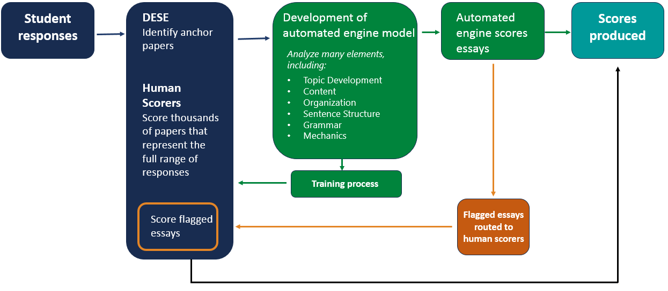
Automated Scoring Process

Slide 9
Automated Scoring Analyses on Next-Gen MCAS: 2017 and 2018
2017 – Pilot study conducted on one grade 5 essay to evaluate feasibility
2018 – Expanded study to grades 3-8
All research in both years was conducted after operational scoring

Slide 10
Pilot Research on One MCAS Grade 5 ELA Essay from 2017
Idea Development |  | N | Mean agreement rates
 |  |  | Exact | Adjacent
Scorer 1 | Scorer 2 | 2,468 | 70.6% | 99.6%
Scorer 1 | Automated engine | 23,457 | 71.7% | 99.3%
Expert score | Automated engine | 1,982 | 81.5% | 99.8%
Idea Development |  | Exact agreement by score point
 |  | 0 | 1 | 2 | 3 | 4
Scorer 1 | Scorer 2 | 55.9% | 75.7% | 71.6% | 65.5% | 31.8%
Scorer 1 | Automated engine | 55.5% | 74.1% | 77.2% | 58.7% | 50.7%
Expert score | Automated engine | 71.8% | 84.4% | 87.8% | 65.8% | 50.0%

Slide 11
Pilot Research on One MCAS Grade 5 ELA Essay from 2017
Conventions |  | N | Mean agreement rates
 |  |  | Exact | Adjacent
Scorer 1 | Scorer 2 | 2,478 | 68.6% | 99.4%
Scorer 1 | Automated engine | 23,470 | 72.1% | 99.4%
Expert score | Automated engine | 1,993 | 82.1% | 99.8%
Conventions |  | Exact agreement by score point
 |  | 0 | 1 | 2 | 3
Scorer 1 | Scorer 2 | 60.4% | 63.4% | 72.1% | 70.7%
Scorer 1 | Automated engine | 68.8% | 63.2% | 76.4% | 73.8%
Expert score | Automated engine | 82.6% | 76.1% | 85.9% | 81.8%

Slide 12
2018 Study of Automated Essay Scoring
Scope
Selected one operational essay prompt from each grade (3-8), as well as one short answer from grade 4
Rescored ≈400,000 student responses to those prompts using the automated engine
Training
Calibrated engine using ≈6,000 responses from each prompt scored by human scorers
Training papers were randomly selected, with oversampling at low frequency score points
Where available, the engine was trained using the best available human score (e.g., read-behind or resolution scores)

Slide 13
2018 Study of Automated Essay Scoring
Overall Results
The scores assigned by the automated engine compared favorably to the human scorers, across dozens of metrics
In particular, the scores assigned by the automated engine tended to show high rates of agreement with scores assigned by expert scorers

Slide 14
MCAS Grade 8 ELA Essay from 2018
Idea Development |  | N | Mean agreement rates
 |  |  | Exact | Adjacent
Scorer 1 | Scorer 2 | 6,553 | 64.4% | 99.5%
Scorer 1 | Automated engine | 72,958 | 60.3% | 96.9%
Expert Score | Automated engine | 4,552 | 65.6% | 97.8%
Idea Development |  | Exact agreement by score point
 |  | 0 | 1 | 2 | 3 | 4 | 5
Scorer 1 | Scorer 2 | 78.4% | 64.0% | 64.7% | 63.4% | 52.1% | 20.5%
Scorer 1 | Automated engine | 62.5% | 57.3% | 66.4% | 61.4% | 41.5% | 56.0%
Expert Score | Automated engine | 70.5% | 61.0% | 71.3% | 66.6% | 46.9% | 68.4%

Slide 15
MCAS Grade 8 ELA Essay from 2018
Conventions |  | N | Mean agreement rates
 |  |  | Exact | Adjacent
Scorer 1 | Scorer 2 | 6,725 | 71.3% | 99.7%
Scorer 1 | Automated engine | 74,939 | 69.6% | 98.7%
Expert score | Automated engine | 4,671 | 75.4% | 99.1%
Conventions |  | Exact agreement by score point
 |  | 0 | 1 | 2 | 3
Scorer 1 | Scorer 2 | 73.9% | 65.8% | 60.1% | 83.4%
Scorer 1 | Automated engine | 71.4% | 61.7% | 59.6% | 82.9%
Expert score | Automated engine | 79.2% | 69.1% | 66.5% | 88.2%

Slide 16
2018 Automated Essay Scoring: Overall Findings
Comparisons were made using 130 different measures of consistency and accuracy.
The automated engine:
met “acceptance criteria” for 128 of those 130 measures
exceeded human scoring on 99 of those 130
 | Grade
Idea Dev. | 3 |  |  |  |  | 4 |  |  |  |  | 5 |  |  |  |  | 6 |  |  |  |  | 7 |  |  |  |  | 8
Auto-Human1
Auto-Backread
Conventions | 3 |  |  |  |  | 4 |  |  |  |  | 5 |  |  |  |  | 6 |  |  |  |  | 7 |  |  |  |  | 8
Auto-Human1
Auto-Backread
Short resp. | 4
Auto-Human1
Auto-Backread
= exceeded criteria
= met criteria
= below criteria

Slide 17
Agreement Rates Across All 2018 Essays
Idea Development |  | Mean agreement rates
 |  | Exact | Adjacent
Scorer 1 | Scorer 2 | 70% | 99%
Scorer 1 | Automated engine | 68% | 98%
Expert score | Automated engine | 71% | ≈100%
Conventions |  | Mean agreement rates
 |  | Exact | Adjacent
Scorer 1 | Scorer 2 | 70% | 99%
Scorer 1 | Automated engine | 72% | 99%
Expert score | Automated engine | 75% | 99%

Slide 18
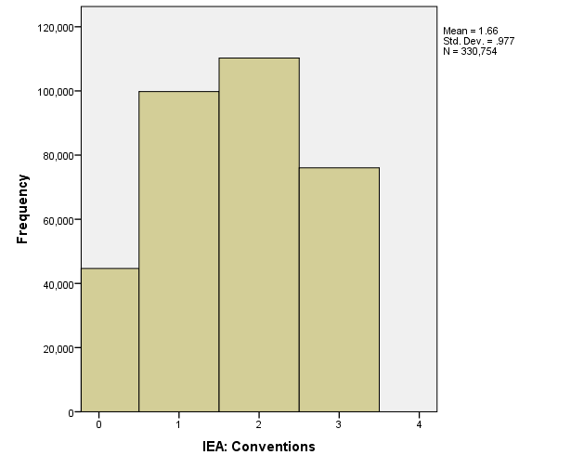
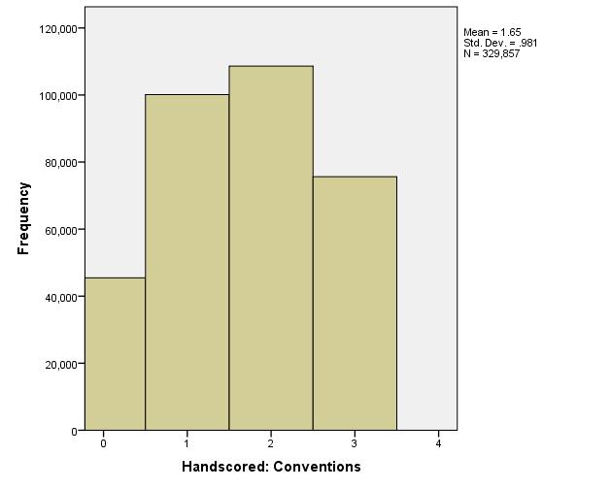
Automated scoring produced virtually identical distributions of scores for Conventions . . .
Automated Engine
Human Scoring

Slide 19
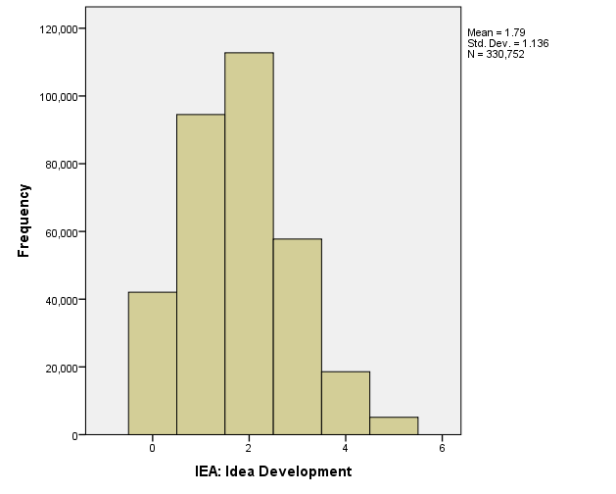
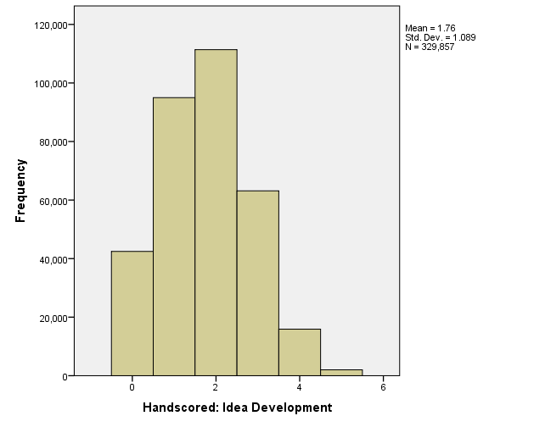
. . . and Idea Development
Automated Engine
Human Scoring

Slide 20
Average Scores Assigned by Subgroup and Achievement Level
By Subgroup
By Achievement Level
Subgroup | Average score
 | Automated Engine | Human-scored
White | 3.6 | 3.6
Hispanic/Latino | 2.8 | 2.8
Black/African American | 2.8 | 2.8
Asian | 4.5 | 4.3
Female | 3.9 | 3.8
Male | 3.0 | 3.0
Econ. Disadvantaged | 2.7 | 2.7
English Learner | 2.0 | 1.9
Students on IEPs | 1.9 | 2.0
Achievement Level | Average score
 | Automated Engine | Human-scored
Not Meeting Expectations | 0.8 | 0.8
Partially Meeting Expectations | 2.4 | 2.4
Meeting Expectations | 4.3 | 4.3
Exceeding Expectations | 6.2 | 6.1
All Students | 3.5 | 3.4

Slide 21
Avoiding “Gaming” of Automated Essay Scoring
Technique | Defense
Text, but not an essay (e.g., “gibberish”) | Analyze whether patterns of words are likely to occur in English
Repetition | Conduct explicit frequency checks and checks for semantic redundancy Evaluate sentence-to-sentence coherence
Length (used to game human scorers as well) | Use non-length related features Parse out elements that contribute to length but are content-irrelevant
Plagiarism/copying of source text (used to game human scorers as well) | Compare semantic representation of response to source text (can be more effective than human scorers at detection)

Slide 22
Next Steps for 2019 and Beyond
Spring 2019
Grades 3-8: Use automated scoring as a second (double blind) score only, for at least one essay per grade
Grade 10: All essays will continue to be scored by hand (no automated scoring) at a 100% double blind rate
An essay receives the higher of the two scores if adjacent scores are assigned
Summer 2019
Analyze results and continue quantitative and qualitative analyses
Fall 2019
Provide an update to the Board

