Slide 1
Student Assessment Updates
Meeting of Board of Elementary and Secondary Education, March 2019

Slide 2
CONTENTS
01
Update on Transition to Next-Generation Grade 10 ELA and Mathematics Tests
02
Standard Setting for Grade 10 ELA and Mathematics Tests
03
Next Steps

Slide 3
Transition to Next-Generation Grade 10 Tests in ELA and Mathematics
Spring 2019 – First administration of the next-generation tests
ELA – March 26 and 27 (primary administration dates)
Mathematics – May 21 and 22 (primary administration dates)
Summer 2019 (Week of August 5) – Standard setting
Massachusetts educators convene to set the achievement levels on the next-generation grade 10 tests
Interim standard is established for the classes of 2021 and 2022 (the first two classes to take the new tests)
Note: Standard setting for next-generation grades 5 and 8 science and technology/engineering tests will also take place in August 2019

Slide 4
Overview of Key Grade 10 Standard Setting Activities
Massachusetts educators work in grade- and subject-specific groups, lead by facilitators, to make judgments that produce cut score recommendations by identifying the knowledge, skills, and abilities that students need to demonstrate to reach each achievement level
Educators review results from grades 7 and 8 tests and make adjustments to their recommendations for grade 10, as needed, to address coherence in the system (“vertical articulation”)
Educators examine student results on the legacy and next-generation tests to verify the interim standard

Slide 5
Next-Generation MCAS Achievement Levels
Exceeding Expectations A student who performed at this level exceeded grade-level expectations by demonstrating mastery of the subject matter.
Meeting Expectations A student who performed at this level met grade-level expectations and is academically on track to succeed in the current grade in this subject.
Partially Meeting Expectations A student who performed at this level partially met grade-level expectations in this subject. The school, in consultation with the student's parent/guardian, should consider whether the student needs additional academic assistance to succeed in this subject.
Not Meeting Expectations A student who performed at this level did not meet grade-level expectations in this subject. The school, in consultation with the student's parent/guardian, should determine the coordinated academic assistance and/or additional instruction the student needs to succeed in this subject.

Slide 6
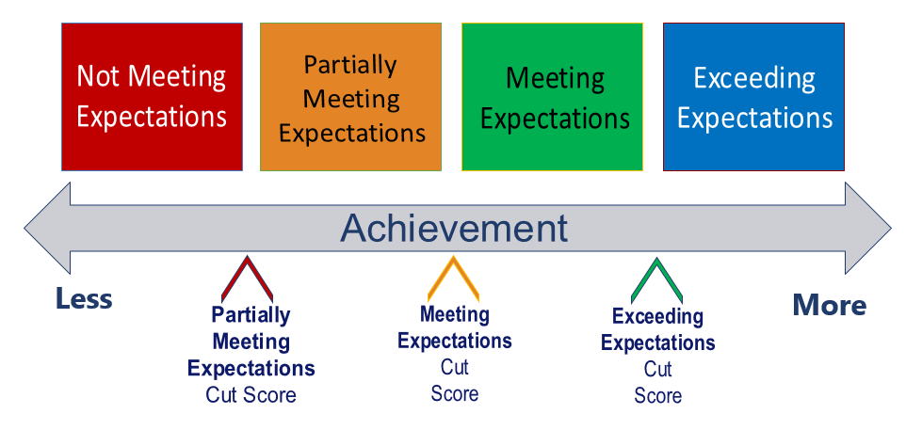
Achievement Levels and Cut Scores

Slide 7
Vertical Articulation
ELA
Math
7
8
39
41
40
38
14
12

Slide 8
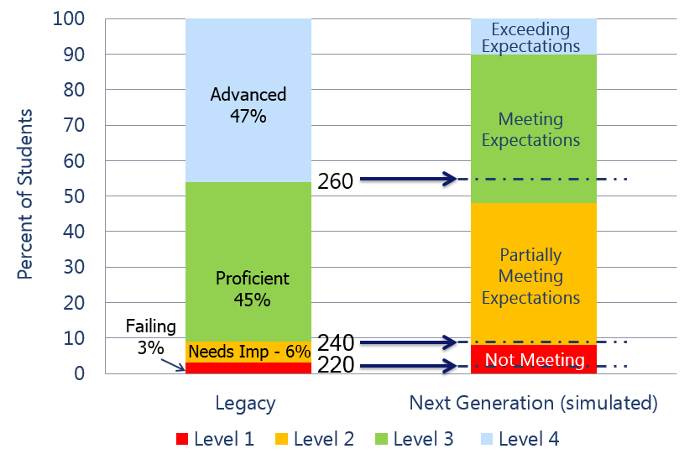
Equipercentile Linking Model for Setting Interim Standard for the Competency Determination (ELA Simulation)
Notes:
Distribution of student performance is expected to change significantly.

Slide 9
Educator Validation of Equipercentile Linking
For each cut score, educators will compare:
Educators will identify the items and student work that represent the best comparison of the knowledge, skills, and ability needed on the legacy and next-generation tests. The results of the statistical cuts will be adjusted if necessary.
Student results on a set of items from the 2018 legacy test that is associated with that legacy cut score (located just below, at, or just above the cut score)
Student results on a set of items from the 2019 next-generation test that is associated with the statistically defined interim cut score (located just below, at, or just above the cut score)
to

Slide 10
Standard Setting for Grade 10 ELA and Mathematics in Summer 2019
What will take place during standard setting?
What will not take place during standard setting?
Identifying the level of student performance needed to attain each achievement level on the next-generation tests
Verifying the interim graduation standard for the classes of 2021 and 2022 (linked to the legacy standard)
Setting a new graduation standard for any class

Slide 11
After Standard Setting
Recommendations are summarized and presented to ESE staff and the Commissioner for approval
Each student receives a scaled score, an achievement level, and a CD status (linked to legacy standard)
Reports printed and sent to districts for distribution to parents/guardians (target date: end of September)
Reports also available electronically for schools

Slide 12
Next Steps
Adopt next-generation achievement levels for grade 10 ELA and mathematics, and for the science and technology/engineering tests (today’s vote)
Convene advisory group(s) and begin consultation with stakeholders (summer and fall)
Plan for communications and engagement, including public hearings and comment periods (summer and fall)
Hold a series of discussions with the Board (fall)
Present to the Board a recommendation on the Competency Determination for class of 2023 and beyond (goal: January 2020)

