Slide 1
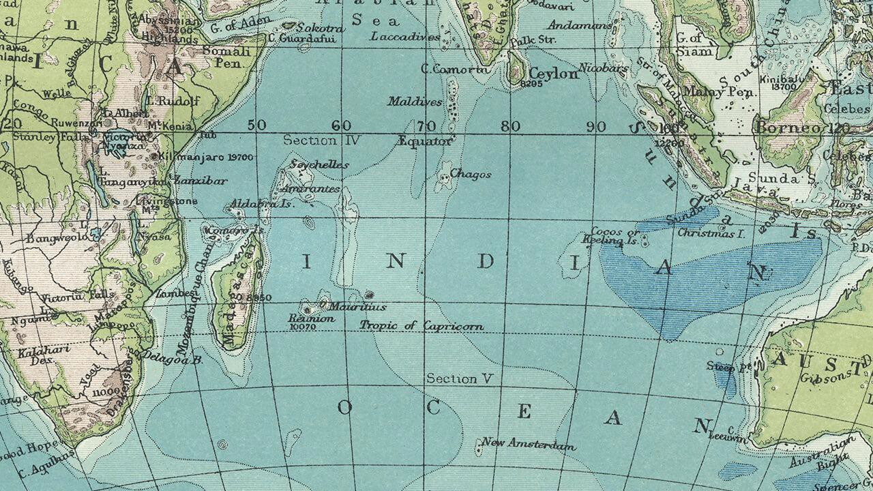



Global Outreach
SSAC Workgroup

Slide 2



Who are we?
SSAC Workgroup created this FY19
A group of students looking for stronger world language and culture education and reform in Massachusetts

Slide 3

Why do we do this?
Cognitive benefits of learning another language
  Ultimate purpose: produce a global citizen
Reinvigorate teaching of languages and excite students about process and world cultures
Minimal learning, yet maximum progression
  Standards are too loose

Slide 4

What have we done?
Global Outreach Network
  Primary focus
Foreign Languages Curriculum Framework for Massachusetts

Slide 5

The Global Outreach Network
“The Global Outreach Network is a student-led social media platform working to promote cultural awareness, appreciation of diversity, and global citizenship, especially by means of increased foreign language education”

Slide 6

In order to institute FLE earlier in the public school system (4th grade) and focus specifically on the critical languages, we first need to establish a baseline:
FLE
High-school graduation requirement, minimum of two years’ worth of credits

Slide 7

Steps
Contact District Superintendents, State Legislators, and most importantly, students
  Growing the Network:
    greater support
    student-driven initiative
    legal change

Slide 8

Future Steps
Reaching out to contacts
  by email, phone call, interpersonal connection
Continuing to grow the platform
Presenting at MFLA (FY20)

Slide 9

Challenges
Disconnect between Department and students
  Critical feedback from students for Language Framework
  Slow rate of approval/permission
Students want to be involved in every step!

Slide 10

Goal
By the end of the summer, we hope to:
Have grown enough support and met with enough legislators to begin drafting a proposal bill
10

Slide 11


THANKS!
Any questions?
@globaloutreachnetwork
globaloutreachmass@gmail.com
11

