Slide 1
Educator Diversification Initiatives
MA Board of Elementary and Secondary Education
May 21, 2019
Notes:
Ventura
Add names
Outline
5 min introductions
20 min presentation
15 min. Q&A

Slide 2
Presenter’s Table
Ventura Rodriguez, Senior Associate Commissioner for Strategic Initiatives
Shay Edmond, Director of Student Equity Initiatives
Cheryl Camacho, Special Assistant to the Commissioner
Sandra Hinderliter, Lead for Educator Preparation

Slide 3
Graduation Rates
Notes:
Ventura

Slide 4
MA’s goal: Prepare all students for success after high school
Strengthening standards, curriculum, instruction, and assessment
Promoting educator development
Supporting social-emotional learning, health, and safety
Turning around the lowest performing districts and schools
Enhancing resource allocation and data use
Notes:
Ventura

Slide 5
Massachusetts K-12 Student Enrollment by Race/Ethnicity
Notes:
Ventura

Slide 6
Massachusetts Educator and Teacher Figures by Race/Ethnicity
Notes:
Ventura

Slide 7
Massachusetts Educator Preparation Program Demographics
Notes:
Ventura

Slide 8
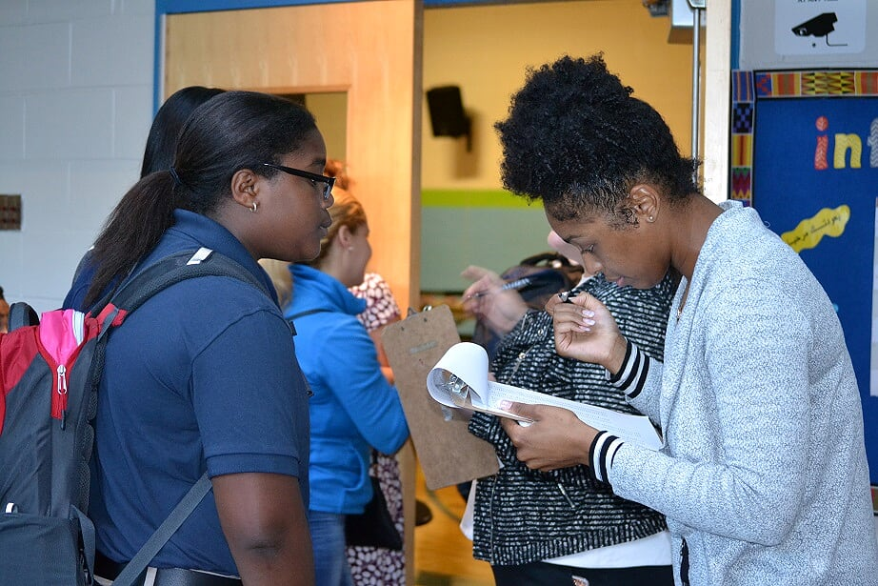
DESE Initiatives to Increase Educator Diversity
Teacher Diversification Pilot Program
Commissioner’s College Visits
InSPIRED Fellowship
Influence 100
MATCH Public Charter School
Notes:
Shay

Slide 9
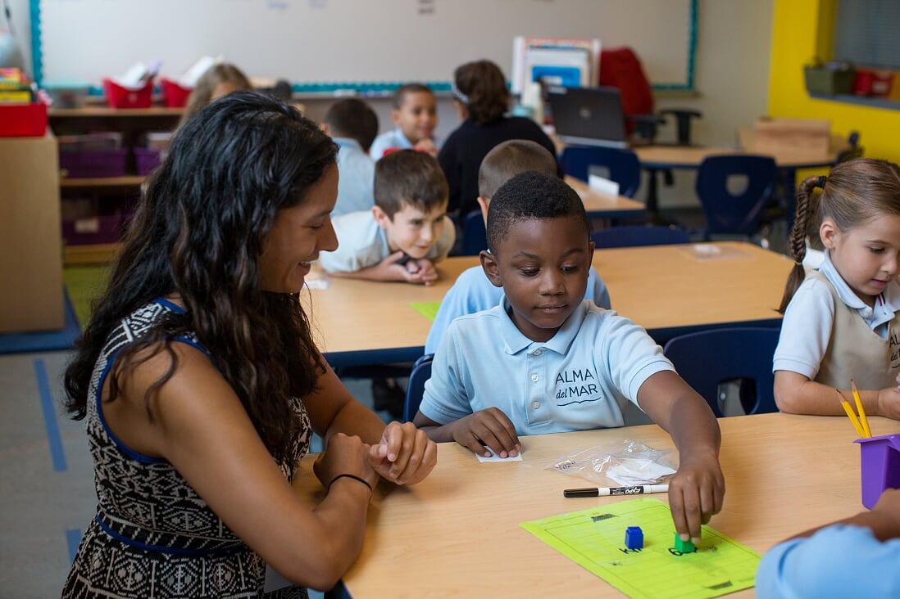
Teacher Diversification Pilot Program
Support district efforts to strengthen and diversify existing teacher recruitment and retention programs
Paraprofessionals with bachelor’s degrees
District graduates and other college graduates
Provisionally licensed teachers
Grow-Your-Own Initiatives
Pilot districts will engage in cultural
proficiency and anti-bias trainings.
Notes:
Shay

Slide 10
Commissioner’s College Visits
Visit Goals
Speak directly with students about the teaching profession & need for a racially and ethnically diverse teacher workforce.
Commissioner Riley met with approximately 300 hundred students and faculty members from:
Bridgewater State University
UMASS Amherst
UMASS Boston
UMASS Dartmouth
Holyoke Community College
Notes:
Shay

Slide 11
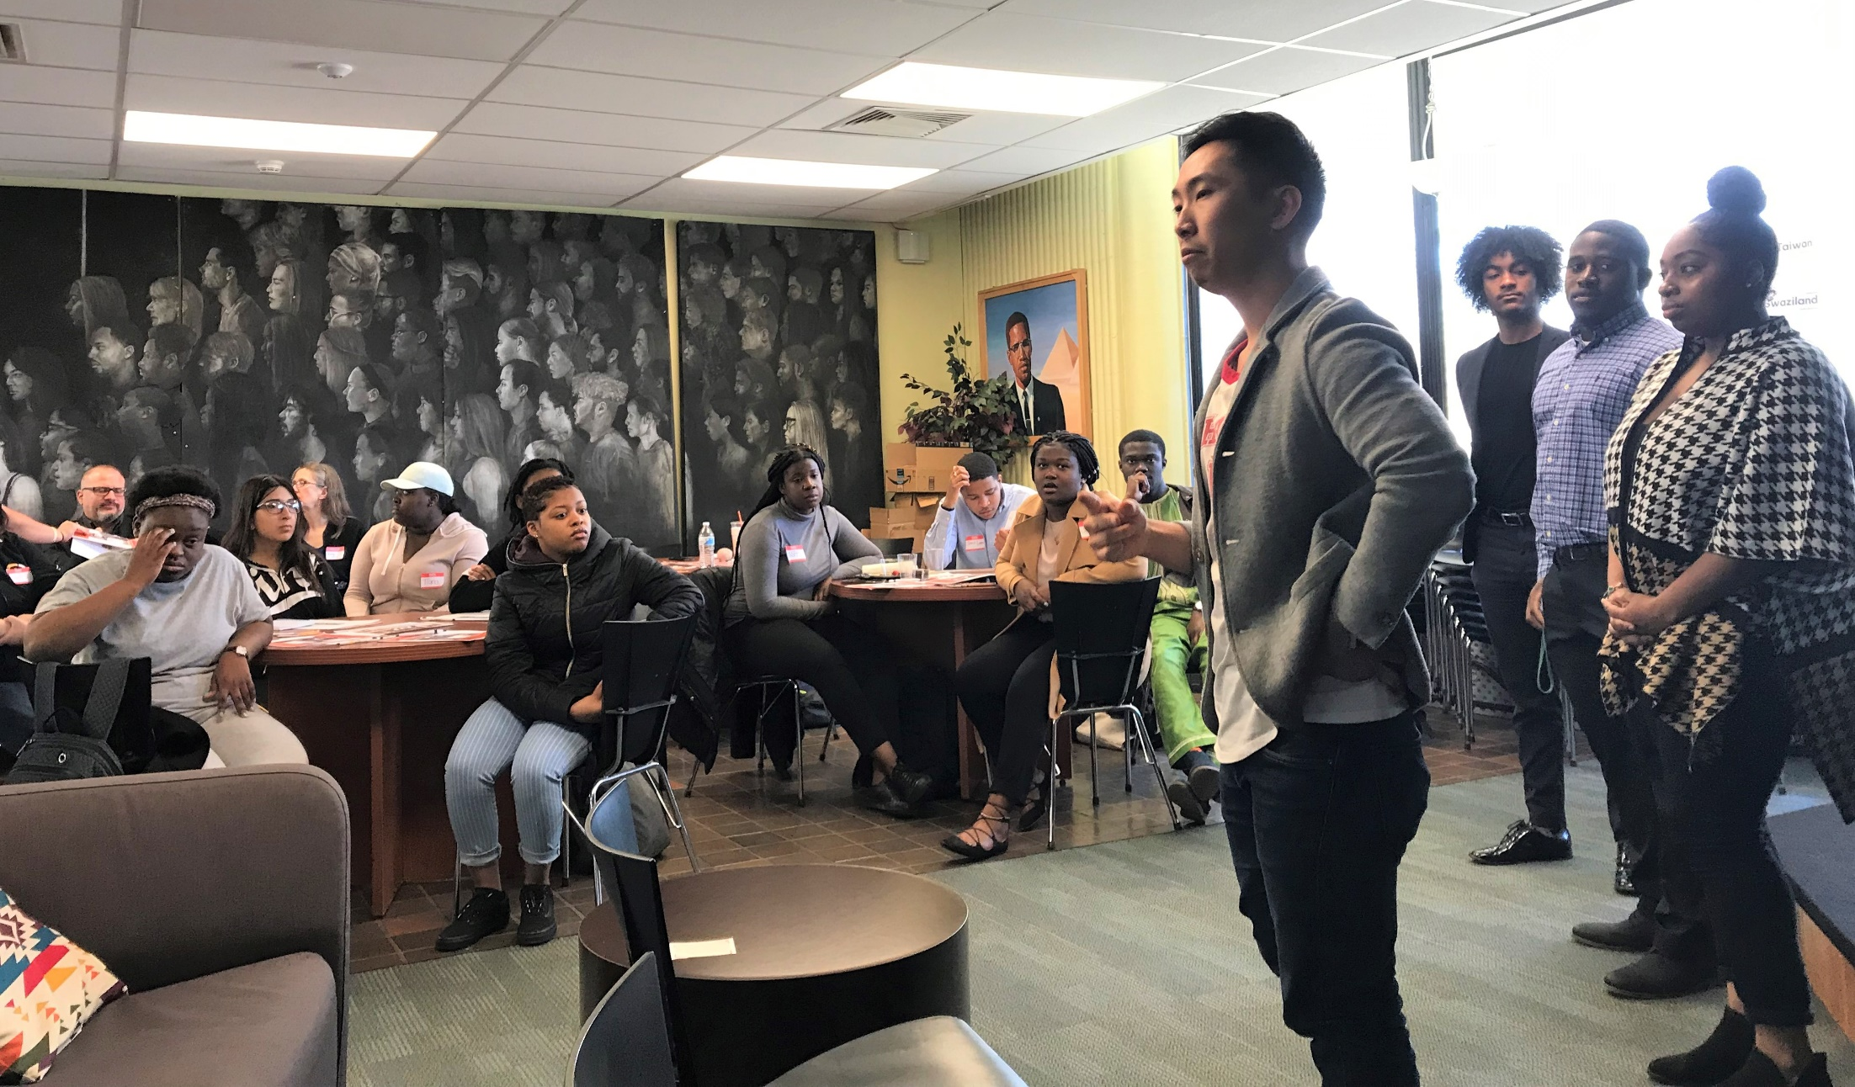
InSPIRED Fellowship
In-Service Professionals committed to Increasing the Racial and Ethnic Diversity of the Commonwealth’s teacher workforce.
Fellowship Goals
Increase the number of students of color entering the teaching profession.
Increase the retention rate of teachers of color.
Notes:
Sandra

Slide 12
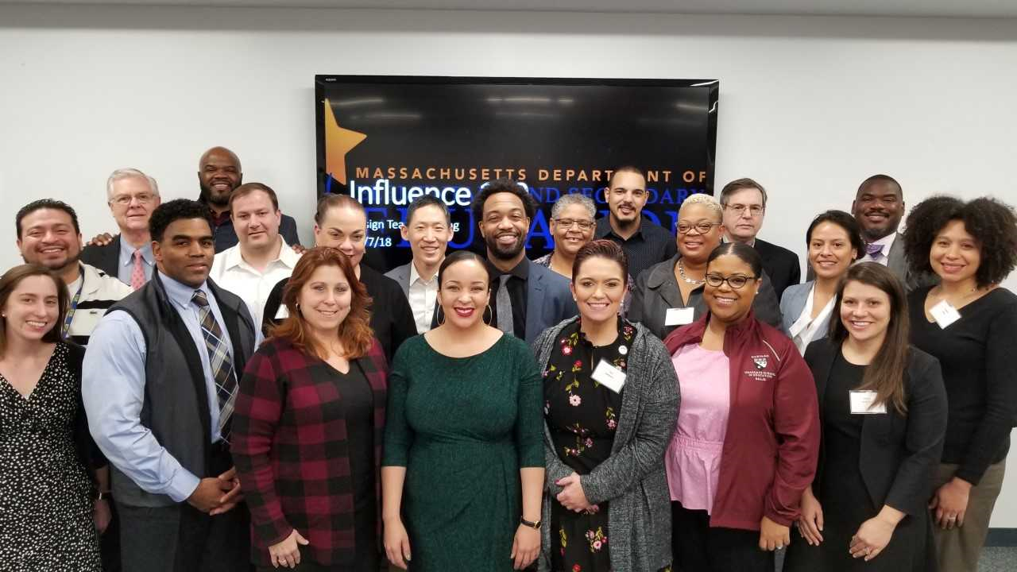
Influence 100
Program Goals
Increase racial and ethnic diversity of superintendents in Massachusetts.
Create more culturally responsive districts and leaders across the state.
To promote better outcomes for students.
Notes:
Cheryl

Slide 13
Questions & Answers
Notes:
Shay

