Slide 1
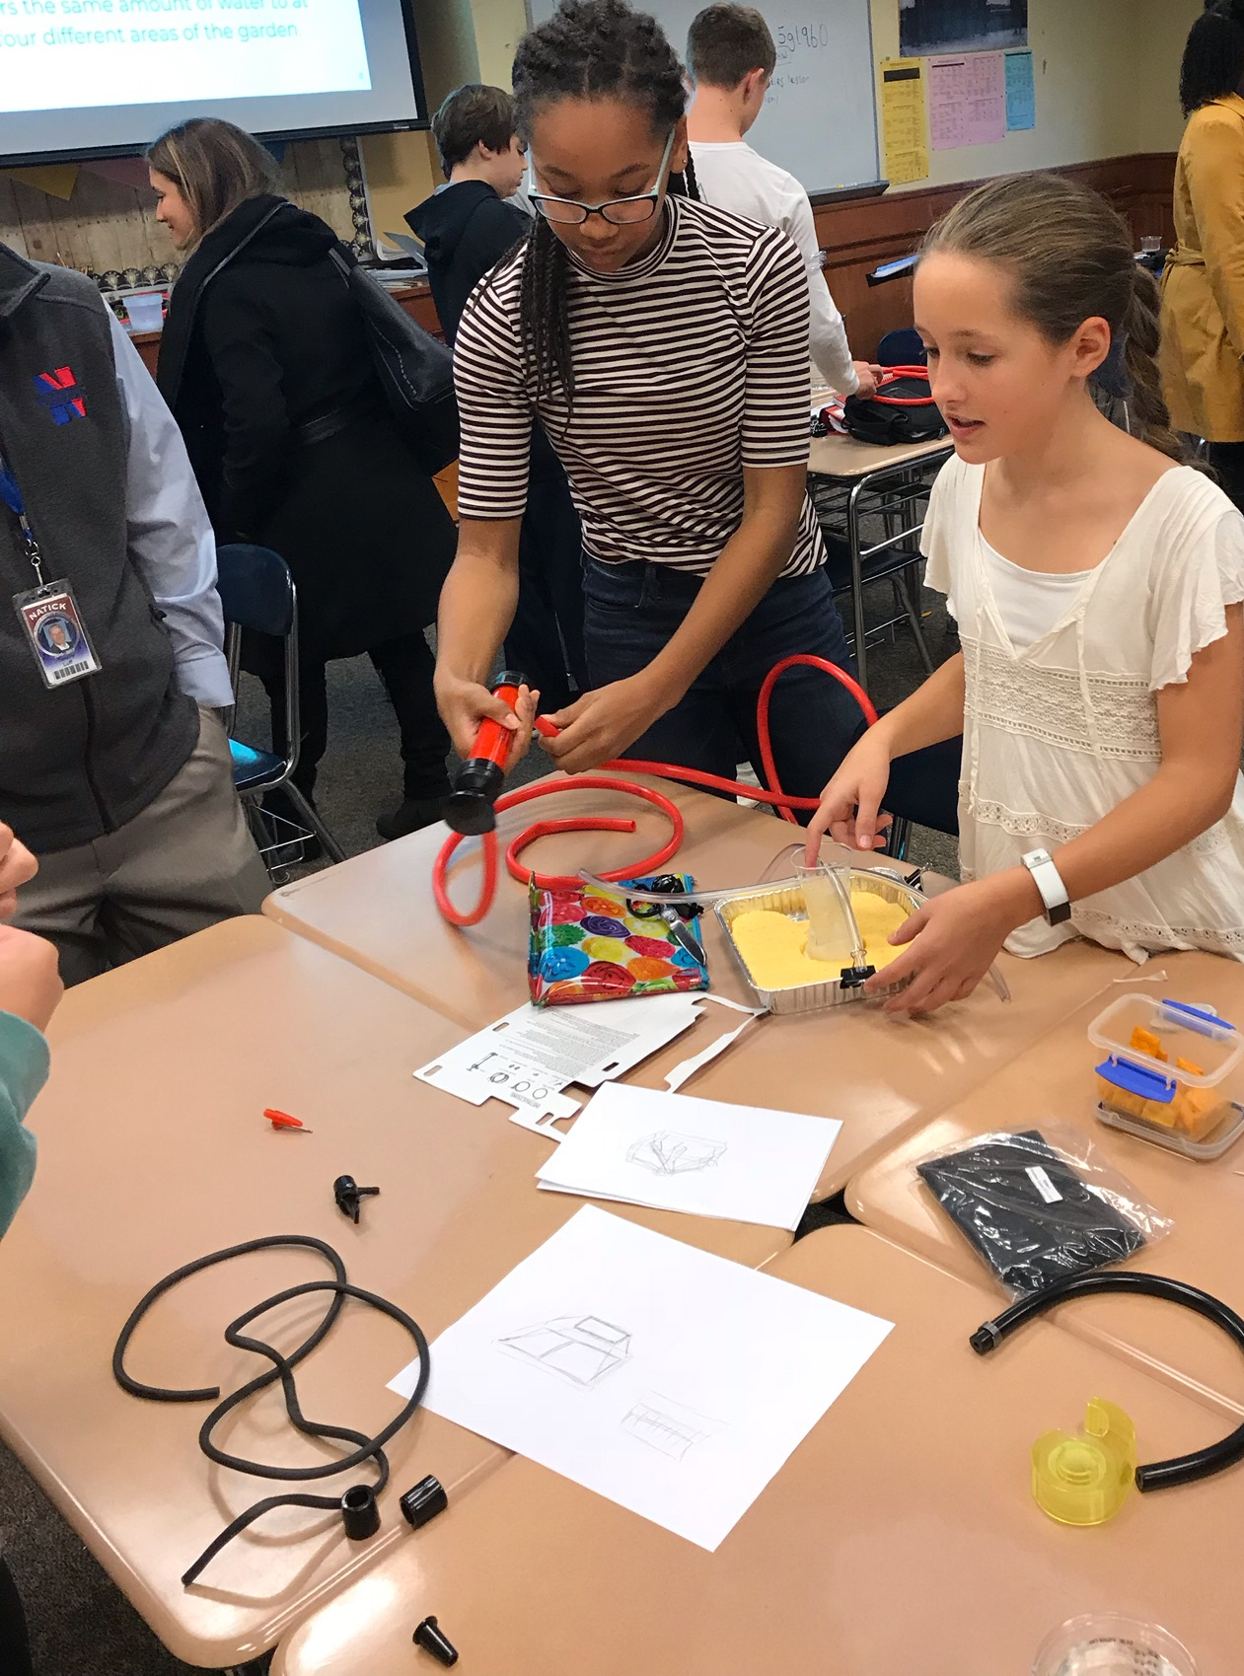
The Commissioner’s Report to the Board:
Our Way Forward

Slide 2
1993 Education Reform Act
Funding
Learning Standards
Assessment
Creation of Charter Schools
Accountability

Slide 3
Massachusetts is #1 for Some
2018 The Massachusetts Education Equity Partnership

Slide 4
Other states are catching up…

Slide 5
Grade 3 ELA MCAS Results 2009-2018
Next-Gen MCAS
% Meet/Exceed
Expectations

Slide 6
Blockbuster Netflix
Need for Constant Gardening

Slide 7
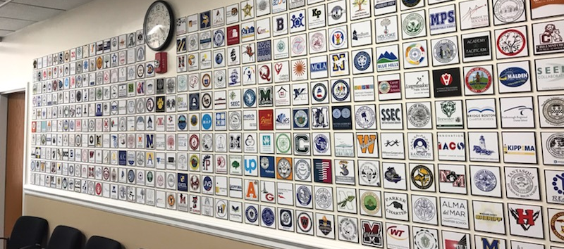
Stakeholder Outreach
Teachers
Students
Administrators
Parents
The Business Community
Foundations
Teacher’s Unions
Community Members
Associations:
Principals
Superintendents
School Committee

Slide 8
Our Way Forward: Emerging Themes
Deeper Learning for All
Holistic Support & Enrichment
Innovation & Evidence-Based Practice
The State as a Partner

Slide 9
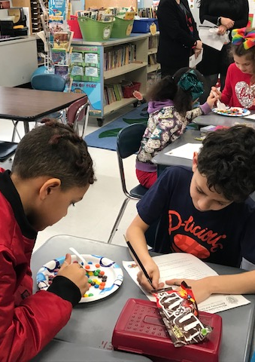
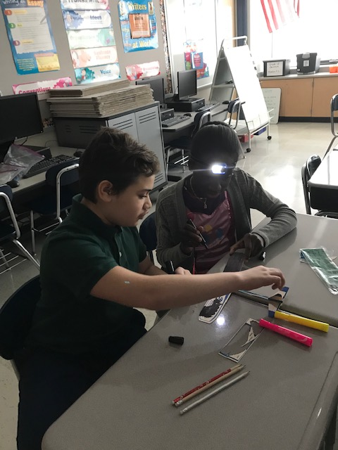
Deeper Learning for All EngagingTasks

Slide 10
Deeper Learning for All: Student Engagement

Slide 11
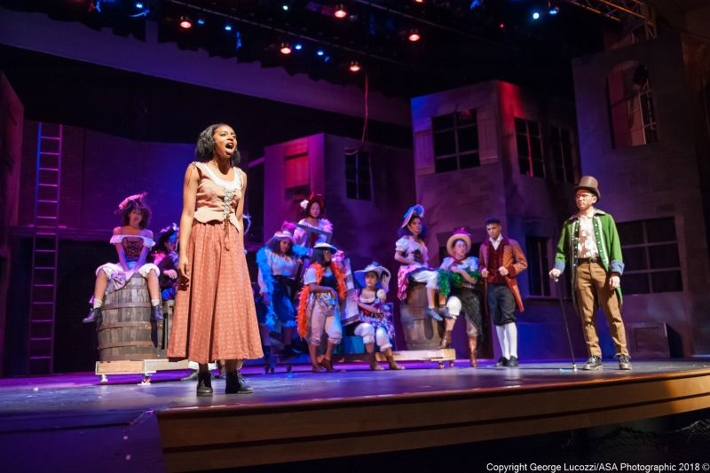
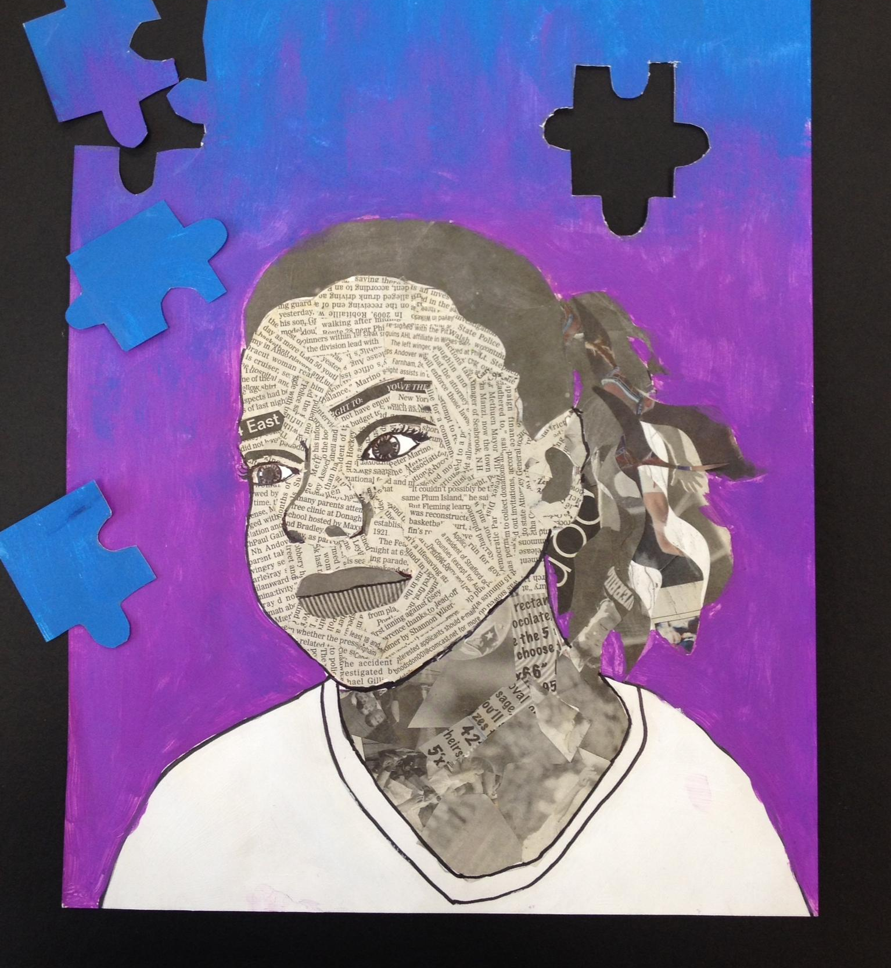
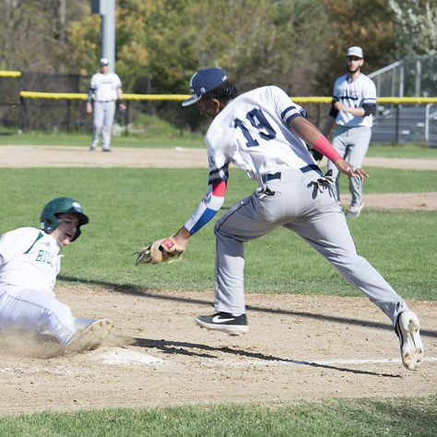
Holistic Support & Enrichment
The Importance of Arts, Enrichment and Sports

Slide 12
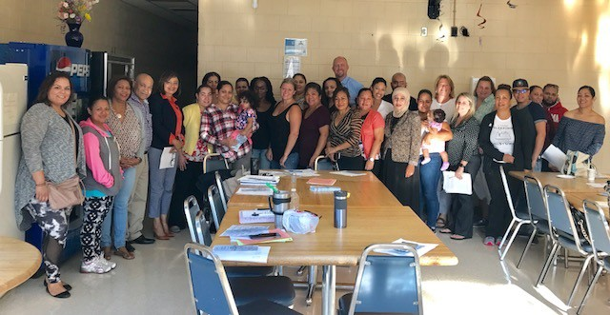
Families as Partners
Holistic Support & Enrichment

Slide 13
Innovation and Evidenced-Based Practices
Educator Workforce Diversity
CURATE: CUrriculum RAtings by TEachers
Expanded Access to Early College Partnerships
Acceleration Academies
Home Visiting Programs
Early Literacy*

Slide 14
State as Partner

Slide 15
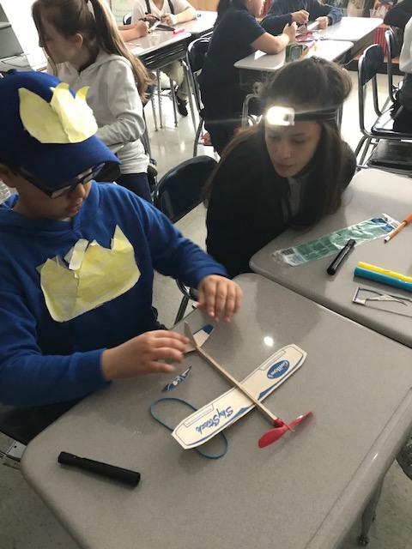
Our First Step
The Kaleidoscope Collective for Learning

Slide 16
Kaleidoscope Schools and Districts: Commitments & Opportunities
Engaging performance tasks
Innovative assessment design
Increased district and school flexibilities
Resources and support

Slide 17
Timeline
Letter of intent: July 2019 – August 2019
Formal application: September 2019 – November 2019
Application review: December 2019
Cohort selection/announcement: December 2019
Implementation: January 2020

Slide 18
In closing

