Slide 1
2019 Massachusetts Arts Curriculum Framework
Ron Noble, Associate Commissioner
Craig Waterman, Assistant Director of Instructional Policy & Lead Writer
Dawn Benski, Arts Content Lead
Board of Elementary and Secondary Education, June 25, 2019

Slide 2
Revision Process
Preparation
Oct 2017 – May 2018
Stakeholder outreach
Writing and Revising
Jun 2018 – Jan 2019
Panel meetings
Refinement and Board Approval
Feb 2019 – May 2019
Facilitator training
Panelist recruitment
Content Advisor input
Drafting framework
Review draft
Public comment
Board discussion and vote
Amend draft
Notes:
RN:
We came to the board in September to share with the board an update on the revision process
In December, we brought together teachers to share with your some high-level overview of the frameworks themselves
We have received feedback from 19 content advisors since we presented in September, as well as continued feedback from our 70 reviewers, 11 facilitators and members of the boards Arts Advisory panel. Today, we are coming with a completed frameworks draft that we believe is ready for public comment.

Slide 3
Artistic practices

Slide 4
Arts Disciplines

Slide 5
New Organization

Slide 6
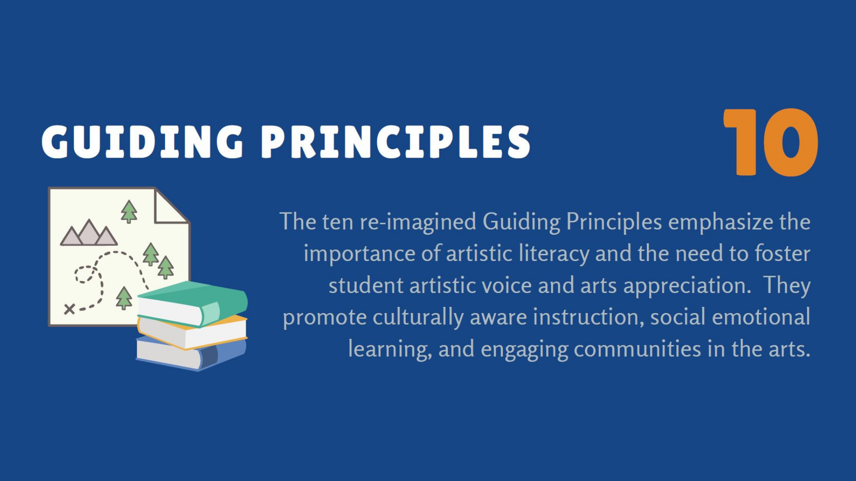
Guiding Principles

Slide 7
Questions/Discussion
Questions/Discussion

Slide 8
THANK YOU
Craig Waterman, Assistant Director, Instructional Policy
781.338.3244
cwaterman@doe.mass.edu
www.doe.mass.edu
75 Pleasant Street, Malden, MA 02148

Slide 9
Public Comment
Public Comment Survey-Background
Number of responses: 301
Respondents: 80.7% are classroom teachers
89.5% were not part of the development of proposed revisions
Major Components | Agree
Vision is clear and compelling description of arts as central to a well-rounded education. | 85.7%
Guiding Principles identify most important characteristics of a high-quality arts education. | 91.2%
Four broad Clusters present an appropriate balance of instructional time. | 91.3%
Standards for Artistic Practice describe most important arts skills PreK-12 students develop. | 90.2%
Overall, the content standards describe the most important relevant knowledge, learning, or skills that students should demonstrate in _____ during their pre-K to grade 12 education. | Dance | 100%
 | Media Arts | 88.9%
 | Music | 84.8%
 | Theatre | 80%
 | Visual Arts | 82.7%

Slide 10
Public Comment- Key Themes and Responses
Importance of specific concepts and skills
Response:
Revised content standards to provide explicit examples of when students will learn specific skills and concepts.
Revised the section titled “What the Framework Does and Does Not Do” to clarify the importance of local flexibility in determining which technical skills, concepts, and academic vocabulary to emphasize, and at which grade levels or courses to introduce and refine them.
Added an appendix for the Development of Singing as an example of skill development aligned to the Framework. Future implementation guides will provide examples for all five arts disciplines.
Balancing instructional time
Response:
The Department revised the overview section for the Standards for Artistic Practice emphasizing the flexibility districts have in implementing the Framework and specifically the flexibility to balance time spent on each practice.

Slide 11
Public Comment- Key Themes and Responses
Respondents recommended additional language be added to the Framework to describe a well-rounded arts education, such as the importance of art appreciation.
Response:
Revised the Vision statement to emphasize artistic literacy and art appreciation.
Revised Guiding Principles, including adding a Guiding Principle related to artistic literacy.
Added specific connection standards to relate content across arts disciplines and with standards from the 2018 History and Social Science Curriculum Framework.

