Slide 1
Career/Vocational Technical Education – Update to the Board of Elementary and Secondary Education
December 15, 2020

Slide 2
CONTENTS
01
Career/Vocational Technical Education Admissions Regulations
Background
Timeline
Stakeholder Engagement
02
CVTE Data and Research
03
Additional Equity-Focused CVTE Initiatives
04
Q&A

Slide 3
Section 01
CVTE Admissions Regulations
Background
Timeline
Stakeholder Engagement
01

Slide 4
1. CVTE Admissions Regulations – Background
Phase 1 changes adopted by BESE in February 2020, to
Support the creation of new VTE programs and expand access to the full range of programs for students;
Strengthen program quality; and
Streamline the vocational educator licensure process and create additional pathways to licensure.
Phase 2 will adopt necessary changes to the CVTE admissions regulations to promote equitable access to CVTE programs, effective for students starting high school in Fall 2022

Slide 5
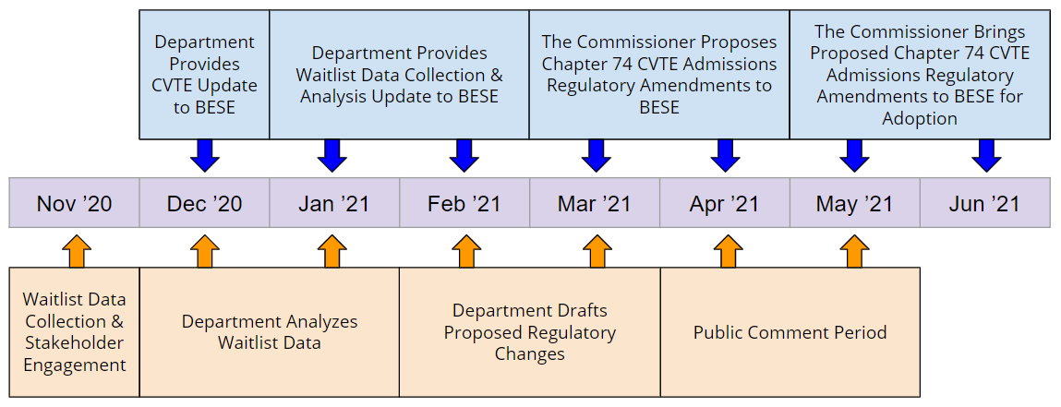
1. CVTE Admissions Regulations – Timeline

Slide 6
1. CVTE Admissions Regulations – Stakeholder Engagement
DESE will continue to conduct stakeholder engagement with student, parent, community, and advocacy groups; educators; statewide associations; the Vocational Technical Education Advisory Council; and other interested parties throughout the winter and spring to inform the proposed regulatory changes.

Slide 7
CVTE Data and Research
CVTE Data and Research
02

Slide 8
2. CVTE Data and Research
Interactive CVTE Enrollment and Performance Data Tools: developed to compare student enrollment for subgroups and performance data over multiple years
New Research on CVTE in Massachusetts: a study of the state’s CVTE system, including associations between participation in CVTE programs and student outcomes, associations between CVTE teacher qualifications and student outcomes and student entry into regional vocational schools.
CVTE Program Waitlist Data Collection: information about who is applying to CVTE programs and who is admitted, including students’ component and overall scores on admissions criteria, applicant eligibility, and admissions and waitlist outcomes for each applicant, if available.

Slide 9
3. Additional Equity-Focused CVTE Initiatives
Additional Equity-Focused CVTE Initiatives
03

Slide 10
3. Additional Equity Focused CVTE Initiatives
CVTE Partnership “After Dark” Programs: unique collaborations between vocational schools and traditional high schools increasing access to CVTE programming
Streamlined and Consolidated Monitoring: the process for CVTE (program quality/equity) and MOA (civil rights) monitoring was streamlined to support districts in promoting equitable access to CVTE programs
CVTE Covid-Related Reopening Guidelines: in partnership with MAVA, developed CVTE-specific reopening guidelines for operating programs safely during the pandemic
CVTE Emergency Admissions Guidance: to address pandemic impacted recruitment and application process, a collaborative approach was developed with stakeholders to create innovative emergency admissions guidance

Slide 11
Q&A
04

Slide 12
THANK YOU

