Slide 1
Update on COVID-19 Action Steps to Support Schools, Students, and Families
September 21, 2021

Slide 2
Reminder: Where the country has been
Source: The New York Times: Coronavirus in the U.S.: Latest map and case count. Available at: https://www.nytimes.com/interactive/2021/us/covid-cases.html

Slide 3
More favorable trends in the Commonwealth in general through June; now managing the rise of the delta variant
6,232.1
March 5: Board votes on returning to in-person learning
July: Rise of the delta variant
2,299.4
2,039.9
1,889.3
Source: MA Department of Public Health COVID-19 Dashboard: Overview Trends. Available at: https://www.mass.gov/info-details/covid-19-response-reporting.
Data points (7-day average of cases) on chart: April 20, 2020; January 8, 2021; March 31, 2021; September 13, 2021.

Slide 4
However, hospitalizations are down compared to previous spikes in case rates, due to vaccines and better treatments
3,874.1
2,346.8
2,346.8
720.0
681.6
681.6
Source: MA Department of Public Health COVID-19 Dashboard: Overview Trends. Available at: https://www.mass.gov/info-details/covid-19-response-reporting. Data points (7-day average of cases) on chart: April 27, 2020; January 7, 2021; April 8, 2021; September 19, 2021.

Slide 5
Monitoring wastewater data: Potential signs that cases may begin to fall, but recent data is noisy
Source: The Boston Herald. Available at: https://www.bostonherald.com/2021/09/15/boston-area-coronavirus-wastewater-tracker-descent-could-be-earliest-sign-of-region-heading-in-right-direction. Wastewater COVID-19 Tracking
Massachusetts Water Resources Authority. Available at: https://www.mwra.com/biobot/biobotdata.htm (samples submitted through 09/17/2021)

Slide 6
Vaccine uptake remains variable across the state and must remain a priority
Some lower rates in western Mass towns
Chelsea: 81%
Source: Massachusetts DPH via WBZ CBS Boston: Available at: https://boston.cbslocal.com/town-by-town-covid-vaccination/

Slide 7
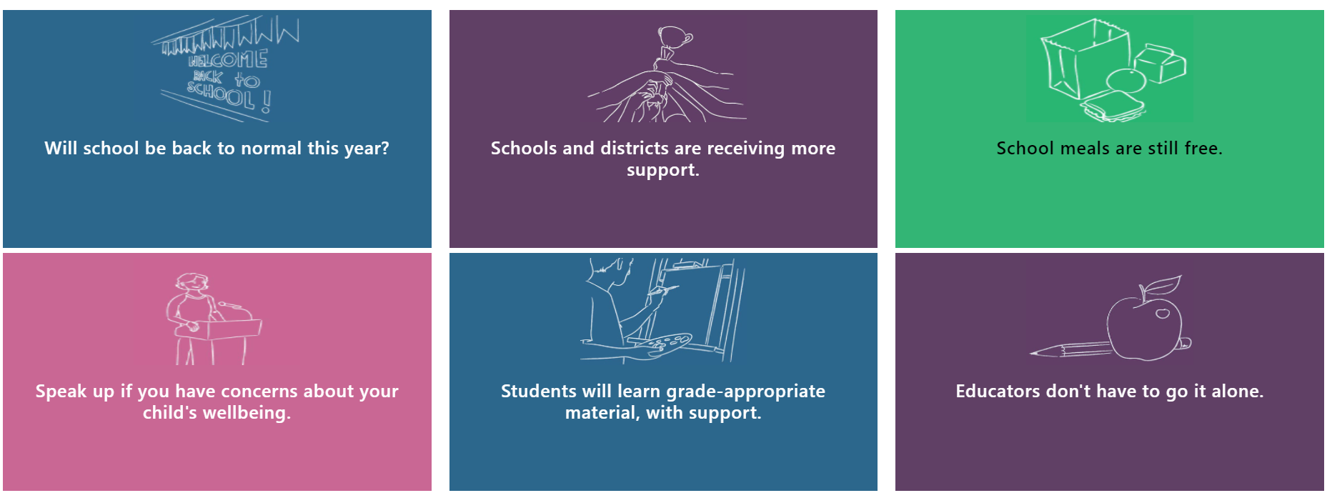
This September, 920,000 Massachusetts public school students are back in school

Slide 8
Districts are providing services for students with medical needs who cannot attend in-person school, including remote learning
Districts expected to provide services for students who cannot attend school in-person due to a documented medical need, through home and hospital program
Districts can purchase individual remote courses or a bundle of grade-level courses from Commonwealth of Massachusetts Virtual Schools to supplement local services

Slide 9
National guard activated to support districts with transportation
173 drivers trained and ready for service
Currently serving eight communities – Chelsea, Lowell, Framingham, Lynn Lawrence, Woburn, Holyoke, and Quincy
Also working to launch support in several other communities soon

Slide 10
Continuing robust testing in schools, including new Test and Stay protocol for unvaccinated close contacts
The comprehensive COVID-19 testing program available to all K-12 schools in the state – including weekly pooled testing, symptomatic testing, and the test-and-stay protocol for close contacts – is on the national vanguard of using testing to keep students safely in school
The Test and Stay protocol saved roughly 1,000 in-person school days last week, including 450 on Friday alone

Slide 11
Last year in review: DESE guidance from June 2020 stated goal of returning students to in-person learning, at physical distance of 3 feet
“DESE is providing initial guidance for school reopening this fall that prioritizes getting our students back to school in person—safely, following a comprehensive set of health and safety requirements. At the same time, DESE is requiring each district and school to also plan for remote learning and a hybrid school model, a combination of in-person and remote learning, should local conditions change this fall or winter.”
- Opening Letter from Commissioner Jeffrey C. Riley
We are now facing the consequences of hybrid and remote learning, both social emotional and academic
Source: Department of Elementary & Secondary Education: Initial Fall School Reopening Guidance, June 25, 2020

Slide 12
Social emotional needs: Pandemic increased anxiety, depression, and suicidal ideation among students
Board voted to implement minimum standards for “live” learning time (remote synchronous or in-person) last winter to increase direct interaction between teachers and students, and among students and their peers
ESSER and SOA funds will support districts in securing additional staffing and interventions to support students’ mental health. DESE’s SOA and ESSER guidance highlights this as an evidence based program that districts are encouraged to adopt

Slide 13
Academic performance: The pandemic significantly impacted all students, across racial subgroups
DESE has supported districts and schools through the Acceleration Roadmap along with summer learning opportunities such as Acceleration Academies

