Slide 1
Title page: March 22, 2022 Presentation for the MA Board of Elementary and Secondary Education
March 22, 2022
Presentation for the Massachusetts
Board of Elementary and Secondary Education
Colleen Curran and Matt Brunell
Co-Executive Directors, SEZP

Slide 2
SEZP A partnership in pursuit of equity
SEZP:
A Partnership in Pursuit of Equity
The Springfield Empowerment Zone Partnership (SEZP) – an independently governed non-profit established in 2015 as a partnership among Springfield Public Schools, the Massachusetts Department of Elementary and Secondary Education, and the Springfield Education Association – seeks to improve the longitudinal life outcomes of its 5,100 students, in the 14 middle and high schools that it exclusively manages and operates.
In all of its work, SEZP is in pursuit of equity and anti-racism – acknowledging the systemic oppression our students and families encounter daily and working to disrupt these provision gaps urgently and courageously.

Slide 3
SEZP 7 years into our Partnership. Our partnership is….
SEZP:
Seven Years Into Our Partnership
Our Partnership is…
Proving to be an impactful and productive approach for Springfield,
Promoting school-level autonomy, informed by teacher voice,
Pushing high levels of innovation,
Elevating new approaches to transparent benchmarking,
Evidencing important gains at some schools pre-pandemic, and showing promising bounce-back this year,
Lifting critical initiatives, like diversification of educators and leaders, early college and stronger outcomes for exceptional learners

Slide 4
Partnership Making a Productive Impact
The Springfield Empowerment Zone Partnership:
A Partnership Making a Productive Impact
To Describe the Productive Impact of the Partnership on the “City of Firsts”:
Mayor Domenic J. Sarno – City of Springfield
Superintendent Daniel J. Warwick – Superintendent of Springfield Public Schools

Slide 5
Partnership Promoting School-bases Autonomy
SEZP:
A Partnership Promoting School-Based Autonomy
School-Based Autonomy
Curriculum
Staffing
Budget
Schedule/Calendar
Culture
With Teacher Leadership Teams deciding…
Educator Working Conditions
At the School Level

Slide 6
A Partnership Promoting Innovation
SEZP:
A Partnership Promoting Innovation
Launching Nine New Schools
Smaller Learning Communities
6-12 Strategy
Diversity of Models (Dual Language,
Career Pathways, Newcomers)
Leveraging Leadership to Serve Multiple Campuses
Proven Executive Principals Managing Multiple Schools

Slide 7
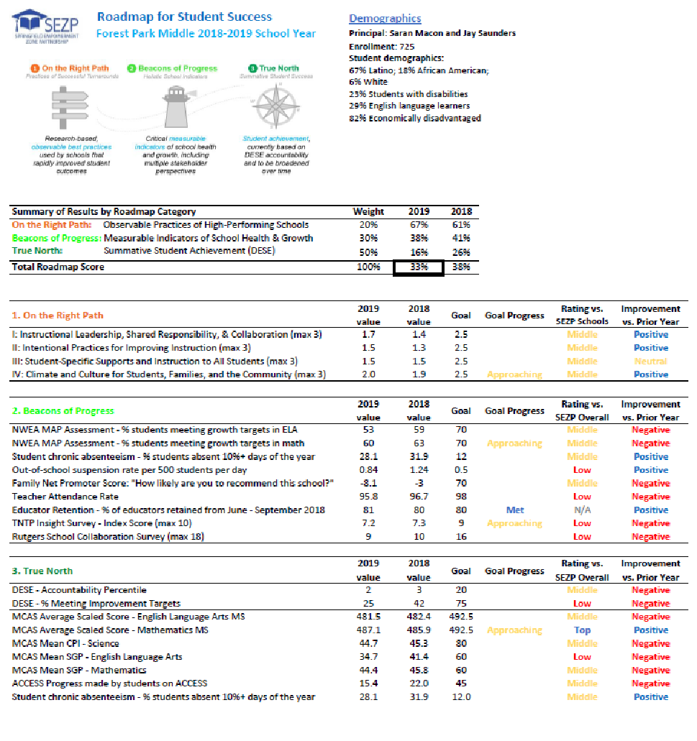
A Partnership Elevating Transparent Benchmarking
SEZP:
A Partnership Elevating Transparent Benchmarking
“Roadmap 1.0”
(2018 – Present)
“Roadmap 2.0”
(In Development)
Emerging Needs:
Student learning in the wake of Covid
Prioritize equity and anti-racism.
Emphasize longitudinal life outcomes
“The Four Core Questions” (To Be Answered by Roadmap 2.0)
I. Are We Readying Our Students, in Need of Academic Support, for High School/College & Career?
II. Are We Readying Our Emerging Bilingual and Exceptional Learners for High School/College & Career?
III. Are We Readying Our Students, in Need of Engagement, for High School/College & Career?
IV. Are We Readying All Students for High School/College & Career?
Metrics Under Consideration
% of FAFSA completion by May 15th
% of senior with specific post-graduation plans
Gap in student/staff diversification
% of Emerging Bilinguals and/or Exceptional Learners, who passed dual-enrollment

Slide 8
A Partnership that Showed & Now Shows (AGAIN) Promise
SEZP:
A Partnership That Showed & Now Shows (Again) Promise
2015 - 2019
Academic Results:
Two schools exited turnaround status
Strong gains at two other schools
Structural Changes:
Launched a small college prep high school
Reconfigured two middle schools into smaller learning communities
2020 – 2021
Academic Results:
Significant learning disruption
40% increase in graduation rate at Commerce
Structural Changes:
Launched a dual language school and a school for newcomers/SLIFE
Reconfigured one large middle school into two smaller schools communities
2021 – Present
Academic Results:
Promising mid-year data (above 2019 Levels)
Structural Changes:
Launched a second dual language school
Launched a wall-to-wall early college high school

Slide 9
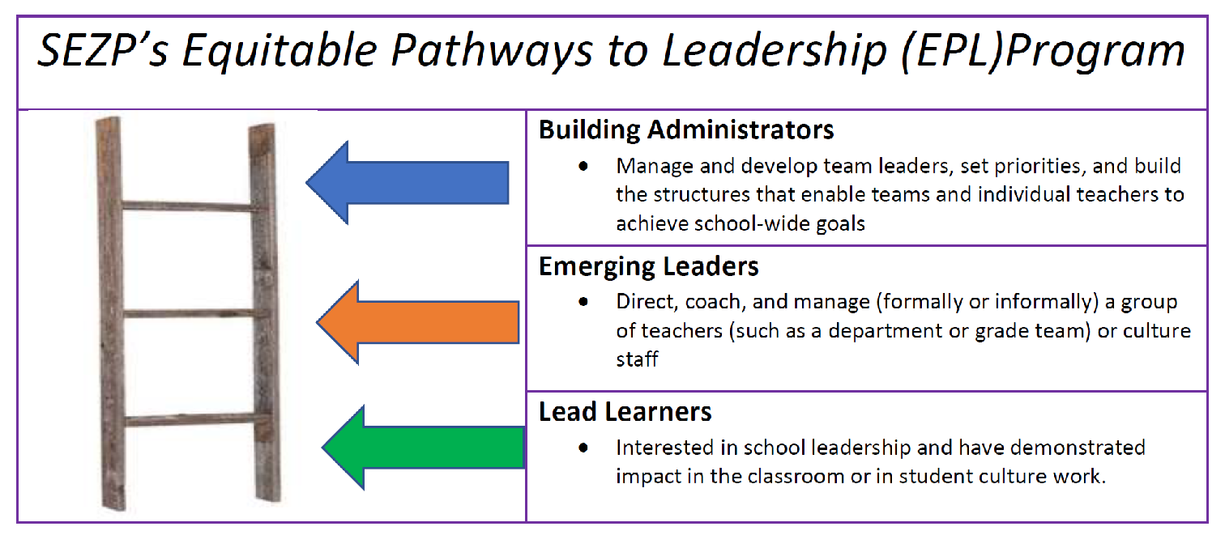
A Partnership Lifting Diversification Efforts
SEZP:
A Partnership Lifting Diversification Efforts
54% In Educators of Color
(in last 5 Years)
And yet…
A Need in SEZP for More “Mirrors and Windows”
Gap with LatinX Educators/Leaders
Variability Between Schools
160% In Leaders of Color
(in last 5 Years)

Slide 10
A Partnership Lifting Exceptional Learners
SEZP:
A Partnership Lifting Exceptional Learners
Covid Chronic Attendance Analysis
State
Monitoring
Results
Graduation Rates
College Matriculation & Persistence
Rates
Lifetime
Earnings
Launch of Multi-Year Exceptional Learner Initiative in 2021-22
Build Teacher Capacity
Strengthen School-to-School Transitions
Guarantee Access to High-Quality, Standards-Aligned Curriculum
Engage in Holistic Development of IEPs
Goal: Exceptional Learners will find measurable, longitudinal success.

Slide 11
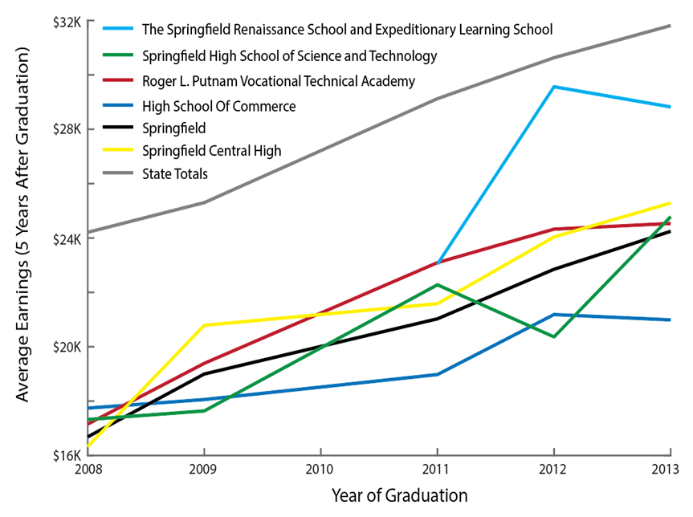
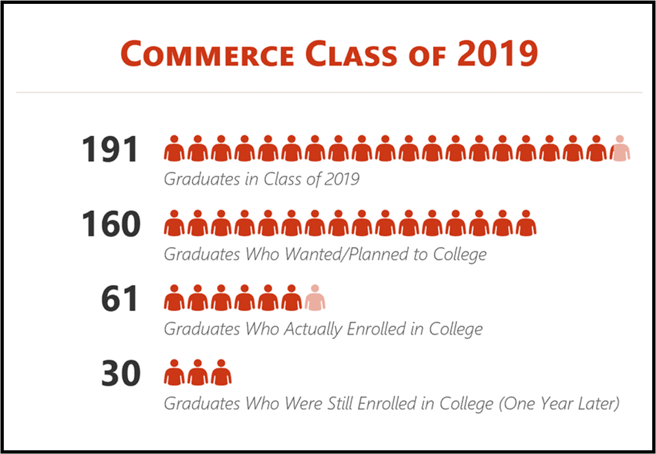
A Partnership Lifting Early College
SEZP:
A Partnership Lifting Early College
Lifetime Earnings
Early College at Greater Scale
From a handful (pre-SEZP) to now a hundred students
From a programmatic afterthought to strategic courses for seniors to credit-bearing classes for 10-12 to 5th year program to launch of a wall-to-wall/associate’s degree in 4-years model (DHS)
Potential for more Early College experience with ASOST-R grant
College Persistence

Slide 12
Seven Years Into Our Partnership
SEZP:
Seven Years Into Our Partnership
Our Partnership is…
Proving to be an impactful and productive approach for Springfield,
Promoting school-level autonomy, informed by teacher voice,
Pushing high levels of innovation,
Elevating new approaches to transparent benchmarking,
Evidencing important gains at some schools pre-pandemic, and showing promising bounce-back this year,
Lifting critical initiatives, like diversification of educators and leaders, early college and stronger outcomes for exceptional learners

Slide 13
Questions/Comments/Follow-Up: Colleen Curran & Matt Brunell Co-Executive Directors, SEZP ccurran@ springfieldempowerment.org mbrunell@springfieldempowerment.org

