Slide 1
Competency Determination and Long-Run Outcomes in Massachusetts
Educational Opportunity in Massachusetts
Brown university
April 2022
Notes:
Today’s goals are to briefly Review evidence from December 2021 presentation to CD Advisory Committee and earlier Board presentation

Slide 2
Study motivation and background
How can evidence from nearly 2 decades of MCAS high-school assessments inform next steps for Massachusetts education policy?
Our partnership addresses three broad questions relevant to discussions of the CD policy:
  How do MCAS scores relate to long-run outcomes?
  Are students scoring at different MCAS levels college-/career-ready?
  How do students affected by the policy fare?
We use longitudinal data that tracks students through MA public schools to college and the workforce
  We focus on first-time 10th grade test-takers.
  Long-run outcomes are for earlier test-taking cohorts (although we see quite similar patterns with more recent cohorts)
  We use 2019 earnings to avoid pandemic-related issues

Slide 3
Key takeaways
(1) High school MCAS scores predict long-term success and appear to reflect students’ academic skills (not simply SES or school characteristics)
(2) Students scoring near the passing cutoff do not fare well and do not appear to be college- or career-ready, on average
(3) Most students who fail do retest and pass; barely passing does improve longer-term educational attainments
(4) Students who earn their CD on retest or appeal have similar outcomes to students who barely passed their first try

Slide 4
High school MCAS scores predict long-term success
High school MCAS scores predict long-term success and appear to reflect students’ academic skills (not simply SES or school characteristics)

Slide 5
MCAS scores reflect academic skills that pay off in the labor market
We look at median annual earnings ~ age 30 for students at each MCAS score
Students with higher MCAS scores go on to earn substantially more in the labor market.
There is substantial variation in earnings at each MCAS score point (MCAS scores explain about 13% of the variation in earnings).
75th Percentile
25th Percentile
NOTE: We only observe in-state earnings reported to the UI system. This excludes self-employed individuals or those who work for the federal government or military. Living Wage from MIT estimates for two working parents with two children.

Slide 6
MCAS scores predict earnings among similar students with the same education level and demographics
Estimated average 2019 earnings by MCAS math percentile and educational attainment
for demographically similar students who attended the same high school
We compare students with similar demographics from the same high school.
Among students with the same education level, students with higher MCAS scores have higher earnings.
We also see large returns to educational attainments (particularly four-year college degrees) for students at the same MCAS score level.
4-year college graduates
Terminal high school graduates
High school dropouts
Notes:
We see the same pattern for 2-year college graduates. We tend to focus on 4-year colleges in the report because of the large returns to a bachelor’s degree, although we are actively engaged in some research looking at the experiences of students in Massachusetts two-year colleges because they are the most common form of post-secondary education for low-income students.

Slide 7


Comparing students with similar 8th grade scores, those with higher 10th grade have better longer-term outcomes
We compare students with similar 8th grade MCAS scores and similar demographic characteristics who attend the same high school.
Among these students, those who have higher 10th grade MCAS scores go on to earn more ~15 years later.
$64,000
(+21%)
75th percentile
Students scoring at the state average in 8th grade
State average
$53,000
8th Grade
MCAS
10th Grade
MCAS
Age 30
Earnings

Slide 8
Students scoring near the passing cutoff
Students scoring near the passing cutoff do not fare well and do not appear to be college- or career-ready, on average

Slide 9
We look at long-term outcomes for students scoring at four different parts of the test-score distribution
Mathematics
8th %ile = Pass-Fail cutoff on legacy test in recent years
22nd %ile = Needs Improvement/Proficient cutoff on legacy test
39th %ile = Partially meets/Meets cutoff on NextGen test
8th %ile
22nd %ile
39th %ile
NOTE: We only observe in-state earnings reported to the UI system. This excludes self-employed individuals or those who work for the federal government or military. Living Wage from MIT estimates for two working parents with two children.

Slide 10
Students near the Math passing cutoff are very unlikely to graduate from a four-year college
Educational attainments for 2011 Math test-takers at select percentiles
 | 8th P/F | 22nd P/NI | 39th M/PM | State Avg
HS Graduation | 79% | 89% | 93% | 91%
Any College Enroll | 45% | 61% | 74% | 74%
4-yr College Enroll | 11% | 28% | 48% | 55%
Any College Grad | 12% | 23% | 40% | 47%
4-yr College Grad | 5% | 17% | 32% | 42%
NOTE: We measure HS graduation within 3 years of taking the 10th grade test, college attendance within 4 years, and college graduation within 7 years.

Slide 11
Most students who fail do retest and pass
Most students who fail do retest and pass; barely passing does improve longer-term educational attainments

Slide 12
Raising graduation requirements can influence students in several ways
Overall impact of increasing standards on schools, teachers, and students
  e.g., improved instruction, narrowing curriculum, increased motivation
  This is hard to study empirically without a good comparison group
Impact on students directly affected by the policy because they fell on one side of the cutoff or the other.
  e.g., students scoring below 220 must re-test; those scoring 220-240 after 2010 must satisfy EPP
  Compare students with similar scores, on either side of these cutoffs, over time
We are interested in two types of equity issues:
  Equity across groups: Did the policy have a disproportionate effect on students with special challenges stemming from poverty?
  Equity within groups: By specifying minimum score cutoffs, the policy inevitably treats differently students with essentially equal proficiency whose scores fall just on either side of the cutoff. Does this difference in requirements translate to differences in outcomes for students with similar skills?

Slide 13
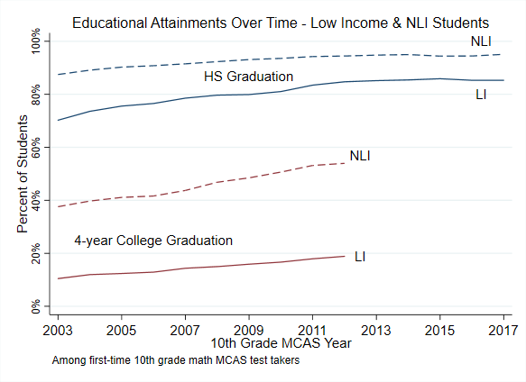
Despite introduction of CD requirement, educational attainments have increased over time, particularly for low-income students
We do not have similar data pre-2003 test-takers, but other sources do not show large drops when the CD policy was introduced.
NOTE: the transition to ecodis complicates comparisons over time after 2014
NOTE: We measure HS graduation within 3 years of taking the 10th grade test, college attendance within 4 years, and college graduation within 7 years.

Slide 14
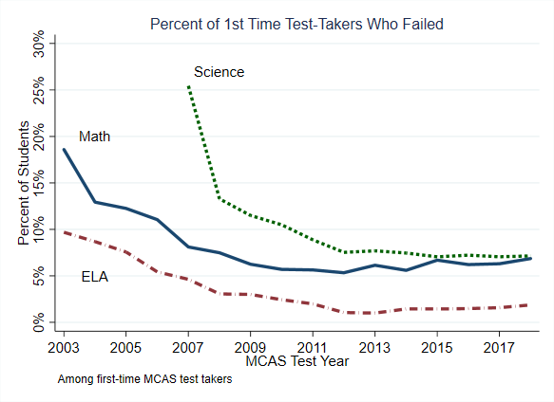
Many fewer students are failing the examinations on their first attempt
NOTE: We measure failing the first test with scaled scores less than 220.

Slide 15
Most students who fail go on to retest (and pass)
More than 90% of students who fail go on to retest at least once, most at the first retest opportunity.
Those who fail their first retest tend to persist and continue to retest.
Three-quarters of students who retest eventually pass.
Few students appeal, but for those who do the success rate on appeals is about 75%.

Slide 16
Barely passing/failing the exam does affect student outcomes
We compare students who barely pass the exam to those who barely fail. These students have similar academic skills, so any differences in outcomes are the impact of passing vs. failing.
We focus on first-time 10th grade test-takers from 2003 to 2007.
Barely failing the math exit exam affects student outcomes:
  Reduces the probability of graduating from high school for low-income students (by 3% points) but not higher-income students
  Reduces the probability of graduating from a 4-year college for higher-income students (by 2% points), but not low-income students.
This could be a positive impact of passing (e.g., encouragement) or a negative impact of failing (e.g., discouragement). We find suggestive evidence of the former.

Slide 17
We use a regression-discontinuity design
We zoom in near the cutoff and estimate what outcomes would have been for students who failed had they scored at the cutoff (but still failed).
Compare that to outcomes for students who scored at the cutoff and passed.
Estimated impact of passing (vs. failing) the exam

Slide 18
Barely passing the math exam increases the probability of HS graduation for low-income students at the cutoff
For low-income students near the cutoff, just passing the MCAS math exam increases the probability of graduating from high school by three percentage points. No impact for higher-income students.

Slide 19
Barely passing the math exam increases the probability of graduating from a 4-year college for higher-income students
For higher-income students near the cutoff, just passing the MCAS math exam increases the probability of graduating from a 4-year college by two percentage points (about 20%). No impact for lower-income students.

Slide 20
What to make of this evidence?
First, we do not know whether these impacts reflect the encouragement of passing or the discouragement of failing.
  Suggestive evidence of encouragement based on students’ 8th grade scores, but not conclusive.
Second, barely passing (vs. failing) the MCAS math exam appears to operate on different margins for these two groups. It is not a barrier to high-school graduation for higher-income students, but it does affect their college outcomes.
  Passing the MCAS math exam appears to affect the types of post-secondary institutions in which students enroll.

Slide 21
Students who earn their CD on retest or appeal
Students who earn their CD on retest or appeal have similar outcomes to students who barely passed their first try

Slide 22
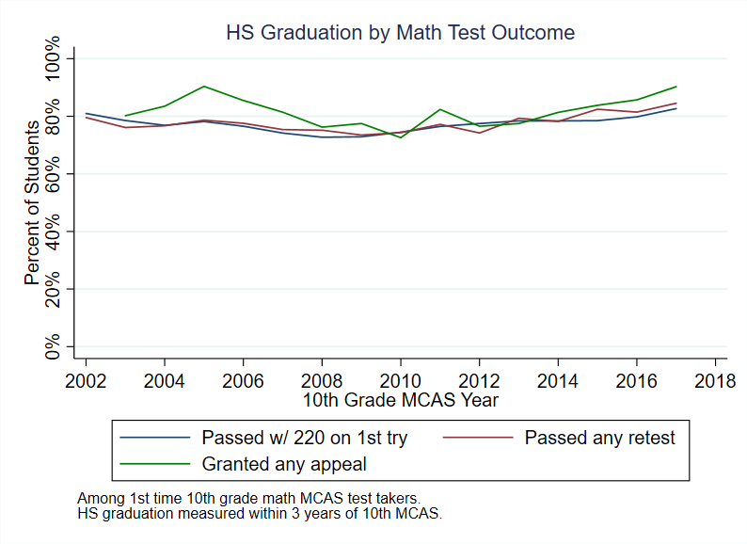
Students who pass on retest or appeal graduate from high school at similar rates to students who pass with 220
We compare outcomes for students who (a) pass with a 220 on their first attempt; (b) pass on retest; or (c) satisfy the CD on appeal.
Students who appeal are somewhat more likely to graduate from high school (as expected).
Granted appeal
Passed retest
Scored 220 1st try

Slide 23
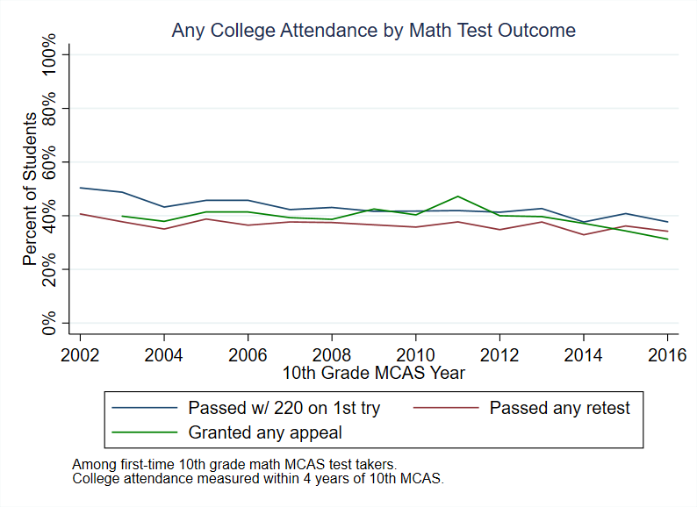
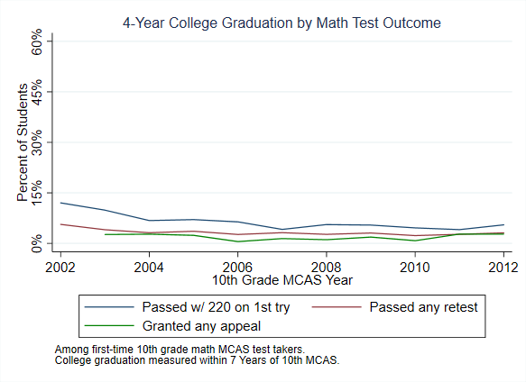
We see generally similar patterns for college attendance and college graduation.
Students who pass on the first try have somewhat better four-year college graduation outcomes, but rates are quite low in general for this group of students scoring near the pass/fail cutoff.

Slide 24
Questions?
Questions?
john_papay@brown.edu

Slide 25
Appendix

Slide 26
Students who fail are disproportionately students of color, low-income students, and students with disabilities
 | All 2018 Test-Takers | Fail Math | Fail ELA | Fail Science
White | 63% | 32% | 22% | 26%
Black | 9% | 17% | 14% | 17%
Hispanic | 18% | 46% | 59% | 51%
Low-Income | 30% | 65% | 70% | 69%
Student w/ disability | 17% | 51% | 38% | 43%
English learner | 7% | 37% | 64% | 44%

Slide 27
Demographics of failing vs all test-takers, 2011
 | All 2011 Test-Takers | Fail Math | Fail ELA | Fail Science
White | 71% | 38% | 33% | 33%
Black | 9% | 20% | 19% | 19%
Hispanic | 13% | 36% | 41% | 41%
Low-Income | 31% | 67% | 73% | 71%
Student w/ disability | 16% | 56% | 58% | 45%
English learner | 4% | 22% | 38% | 24%

Slide 28
Demographics of failing vs all test-takers, 2003
 | All 2003 Test-Takers | Fail Math | Fail ELA | Fail Science
White | 78% | 57% | 46% | N/A
Black | 8% | 17% | 20% | N/A
Hispanic | 9% | 21% | 27% | N/A
Low-Income | 21% | 42% | 53% | N/A
Student w/ disability | 14% | 37% | 42% | N/A
English learner | 5% | 10% | 22% | N/A

Slide 29
Among students who retest or appeal, success rates are high

Slide 30
Most students who fail continue to retest

Slide 31
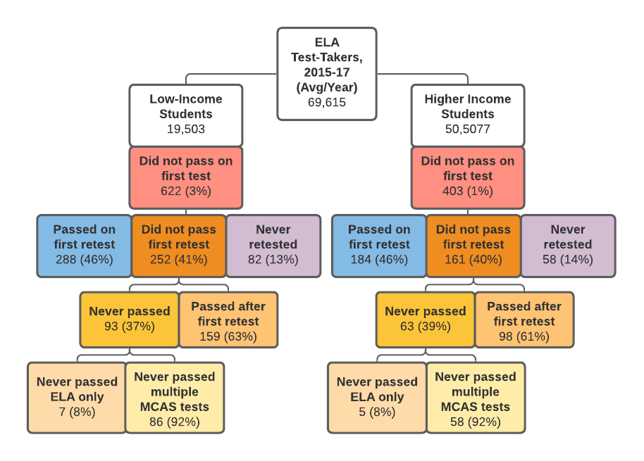
Students who fail ELA: MCAS performance
NOTE: We measure failing the first test with performance level.

Slide 32
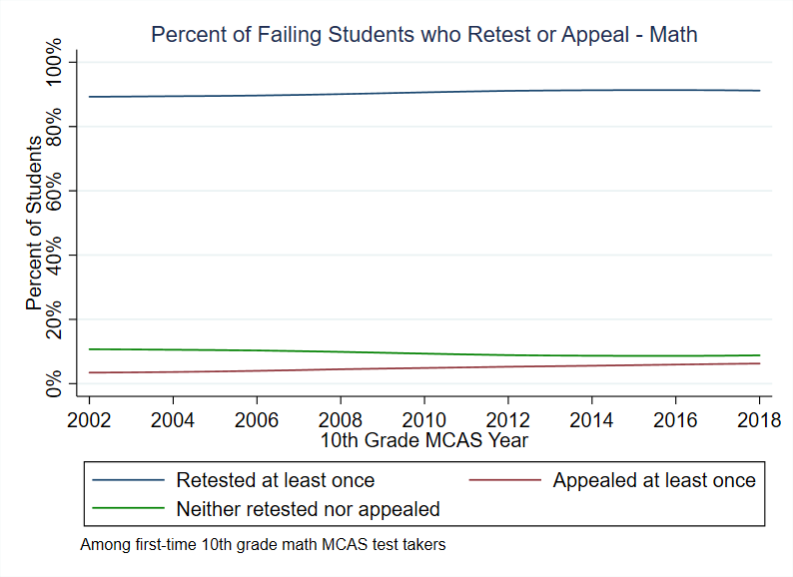
More than 90% of students who fail go on to retest at least once. Very few students appeal.
Retests are quite common, while appeals are relatively rare.
76% of students who retest eventually pass.
Most students who retest do so at the first testing opportunity.
Students who fail their first retest persist.
Success rate on appeals is about 78%.
Retest at least once
No retest or appeal
Appeal at least once

Slide 33
(3) MCAS scores predict college performance above and beyond HS GPA, demographics, and school attended
Probability of Earning Credit toward Graduation Relative to Students Scoring 220
We compare students with similar GPAs, demographics, high school, & college attended.
Students scoring 260 are 31% points more likely to earn college credit towards graduation than similar students scoring 220.
+31% points
+14% points

Slide 34
Demographics of students failing have shifted
English Language Learners account for an increasing proportion of the first-time test-takers who fail Math & ELA over time. In 2017-19, nearly 60% of students scoring below 220 on ELA were ELs.
Most students who fail are now from low-income families and attend urban schools.
NOTE: First-time test-takers who qualified for FRPL (pre-2014) or as economically disadvantaged (post-2014) in the test year are counted as low-income.

Slide 35
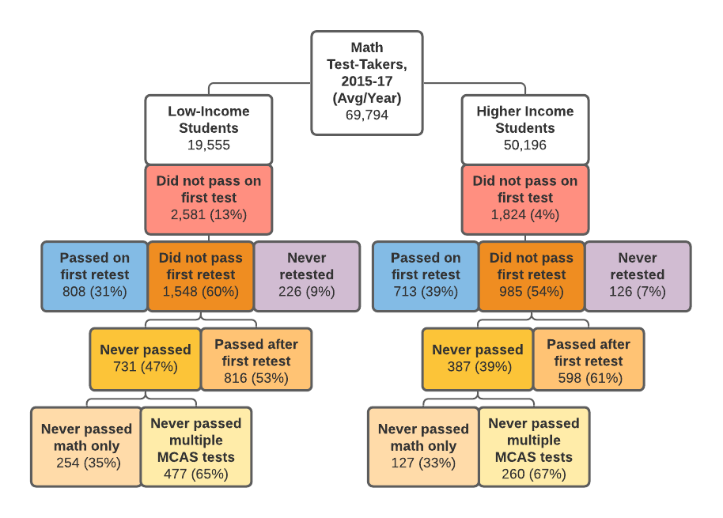
Most students who fail go on to retake (and pass on retest)
NOTE: We measure failing the first test with performance level.

Slide 36
ELs who fail MCAS are equally likely to retest, but less likely to pass on retest
Percent of students who fail MCAS who retest, pass on retest, and pass on appeal, 2016
 | Math |  | ELA
 | ELs | Non-ELs | ELs | Non-ELs
% Retest | 91% | 93% | 85% | 88%
% Pass 1st Retest | 28% | 39% | 37% | 56%
% Ever Pass | 55% | 72% | 66% | 75%
% Pass on Appeal | 11% | 5% | 3% | 1%
Retesting behavior is similar for ELs and non-ELs – most students who fail retest.
Non-ELs pass on retest at substantially higher rates than ELs.
ELs are more likely to satisfy their CD on appeal than non-ELs.

Slide 37
Retest behavior and success is quite similar for students with and without disabilities
Percent of SWDs & non-SWDs who retest, pass on retest, and pass on appeal, 2016 test-takers
 | Math |  | ELA
 | SWDs | Non-SWDs | SWDs | Non-SWDs
% Retest | 93% | 90% | 89% | 85%
% Pass 1st Retest | 34% | 38% | 51% | 41%
% Ever Pass | 68% | 65% | 74% | 67%
% Pass on Appeal | 8% | 6% | 3% | 2%
Retesting behavior is similar for SWDs and non-SWDs – most students who fail retest.
Passing rates on retest are quite similar (if anything, higher for SWDs in ELA).
SWDs are more likely to satisfy their CD on appeal than non-SWDs in math.

