Slide 1
DESE Supports for Students’ Behavioral & Mental Health and Wellbeing
Board of Elementary and Secondary Education Meeting – September 20, 2022
Cliff Chuang, Senior Associate Commissioner, Educational Options
Kristen McKinnon, Assistant Director, Student & Family Support (SFS)
Christine Pond, SFS Behavioral & Mental Health Specialist

Slide 2

Major themes
1. Times are challenging yet there’s hope.
2. DESE is continuing to support schools/collaboratives
with funding, guidance, and professional development.
3. Statewide advisory groups are informing the efforts.
4. We’re continuing to see promising practices across the state.

Slide 3
Supporting Student’s Social Emotional Learning, Behavioral & Mental Health, & Wellness (SEL & Mental Health Grant)
DESE Funding Example:
Supporting Students’ SEL, Behavioral & Mental Health (MH), and Wellness through MTSS (SEL & MH Grant)
    developing comprehensive, integrated multi-tiered systems for student, family, and educator social-emotional and/or mental health supports; and
    building sustainable infrastructure to facilitate integrated coordination between school and community-based services and/or providers.
    State + federal funding
  FY22 competitive grantees, ~$11M, 70 communities
  FY23 continuation + new competitive grantees, totaling ~$14M, anticipated 110 communities
  District examples of promising practices and ongoing challenges: Chelsea & Holliston

Slide 4
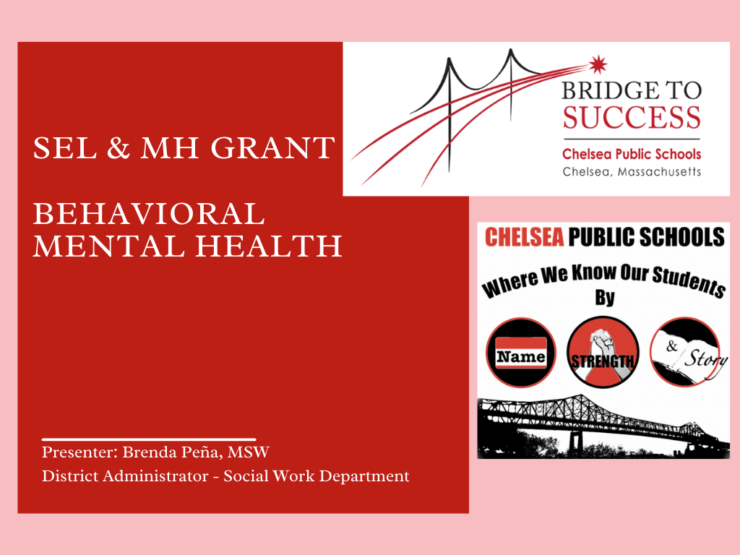
SEL & MH Grant Behavioral Mental Health
4

Slide 5
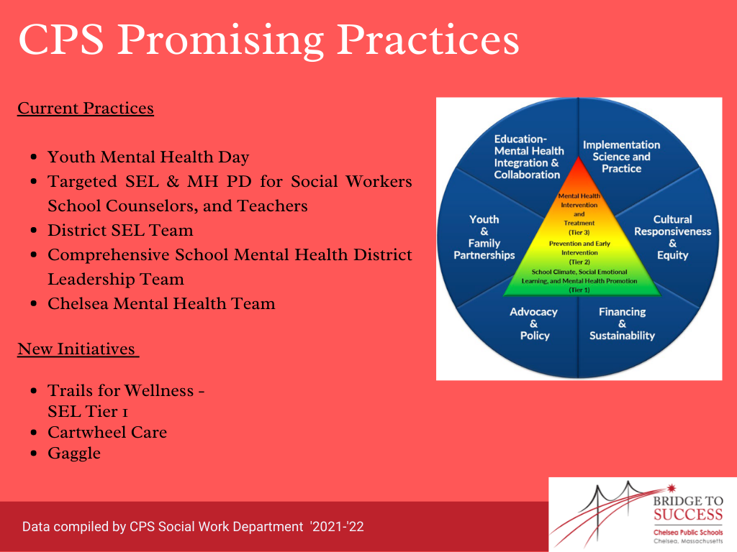
Chelsea Public Schools Promising Practices
5

Slide 6
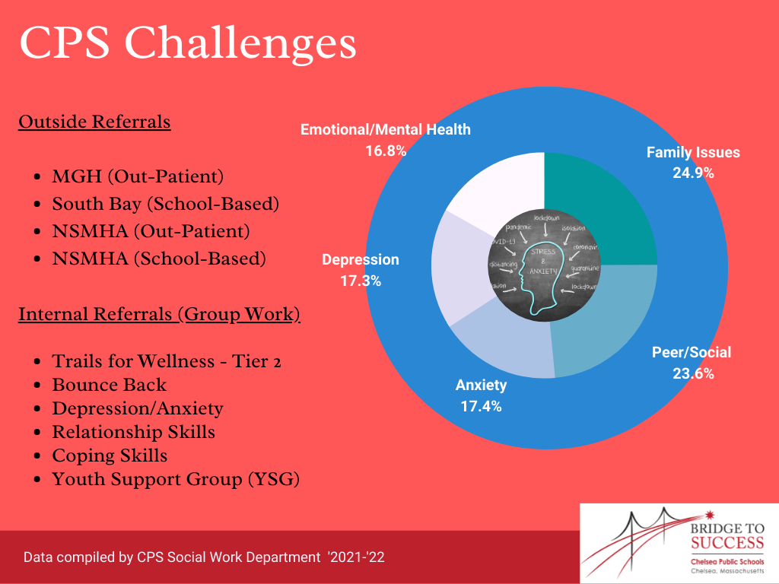
Chelsea Public School Challenges
6

Slide 7

Promising Practices
Holliston used the SEL / MH funds to ignite, energize, and empower our educators, families, and students in what we would refer to the Safe and Supportive School framework.
We created an SEL / MH team that utilized two reflection points of the Safe and Supportive school framework & CASEL’s SEL Guide to Schoolwide SEL as starting points.
  We began to research the multitude of SEL Curriculums available in our current educational landscape.
  We narrowed it down to 2 curriculums that stood out to this team, and we are excited to pilot, experience, and gather additional feedback.
We worked with an organization named “And Still we Rise” and co-developed PD for our Student Service providers (SAC’s, School Counselors, BCBA’s, School Psychologist and a few others).
  Focused on enhancing our culturally proficient student support delivery so that we can build stronger connections across racial, cultural, and linguistic connections in support of social emotional well-being.
Developed a “Data Dialogue process” with the EDC, and our local stakeholders to collaboratively assess data for to improvement and to consider new possible options for our students and our larger Holliston community in response to rising mental health needs.
This grant also provides a secondary impact of grant funding - deepening and aligning.
Notes:
We created an SEL / MH team that utilized the reflection points of the Safe and Supportive school framework & CASEL’s SEL Guide to Schoolwide SEL as starting points.
We began to research the multitude of SEL Curriculums available in our current educational landscape.
We narrowed it down to 2 curriculums that reallyy stood out to this team, and we are excited to pilot, experience, and get additional feedback.
We worked with an organization named “And Still we Rise” and co-developed PD for our Student Services providers (SAC’s, School Counselors, BCBA’s, School Psychologist and a few others).
The goal was aimed at developing the skills necessary to provide culturally proficient student support focused on building stronger connections across racial, cultural, and linguistic connections to social emotional well-being.
Develop a “Data Dialogue process” with the EDC, local stakeholders and our HPS school department as we collaboratively attempted to improve and consider new possible options and access for students and our larger Holliston community in response to rising mental health needs.
The secondary impact of grant funding - deepening and aligning.
We worked with an organization named “And Still we Rise” and co-developed PD for our Student Services providers (SAC’s, School Counselors, BCBA’s, School Psychologist and a few others). The goal was aimed at developing the skills necessary to provide culturally proficient student support in FY22 and they are continuing this professional development series this year and will look to build stronger connections across racial, cultural, and linguistic connections to social emotional well-being.
The undocumented impact of grant funding - provides possibility for deeper connections with other aspects that touch this work through other initiatives MTSS academies, our new strategic plan, and as a way to help deepen and align.

Slide 8
Challenges
The reality of increased MH needs across the board, less MH providers, and the transitioning to virtual / online spaces for treatment and supports.
Learning how to “pace” or “salsa” (dance), everything we have talked about are equal priorities, but to do things well you have to constantly be adjusting your pace, ensuring you connect our educator's passion and spirit to wherever we are going.
Establishing new trajectories – MH data & “Equity” work is not just “school-work” its community work, the gaps in services, systemic inequities, the current social structures are ones in which schools and communities must unite to set new trajectories. This may not have always been the norm!

Slide 9




Thank you
THANK YOU
781.338.3010
achievement@doe.mass.edu
www.doe.mass.edu/sfs
Office of Student & Family Support (SFS)

