Slide 1
Alternative Assessment Pilot Evaluation
James Cowan, Dan Goldhaber, Roddy Theobald
National Center for the Analysis of Longitudinal Data in Education Research (CALDER)
October 25, 2022

Slide 2
Alternative Assessments
Approved by Board vote on October 20, 2020 as an alternative method for candidates to demonstrate subject matter knowledge and communication and literacy skills.
CLST Alternatives: DESE has approved five alternatives to the CLST. Each of the alternatives includes a reading and writing subtest and candidates can substitute a passing score on these tests for the CLST requirements.
MTEL Flex: MTEL Flex is offered to candidates receiving a near-passing score on one of six MTEL subject tests. Candidates submit a written analysis of a topic covered by the relevant test.
Preparation Program Attestation: The Preparation Program Attestation option is currently approved for candidates at four providers in MA. Candidates submit materials documenting their understanding of content knowledge for review by a program coordinator.
Performance Review Program for Initial Licensure (PRPIL) Expansion: Intended for candidates already working in the field on a teaching waiver. Candidates submit a portfolio documenting their content knowledge for external review.

Slide 3
Alternative Assessments
Approved by Board vote on October 20, 2020 as an alternative method for candidates to demonstrate subject matter knowledge.
CLST Alternatives: DESE has approved five alternatives to the CLST. Each of the alternatives includes a reading and writing subtest and candidates can substitute a passing score on these tests for the CLST requirements.
MTEL Flex: MTEL Flex is offered to candidates receiving a near-passing score on one of six MTEL subject tests. Candidates submit a written analysis of a topic covered by the relevant test.
Preparation Program Attestation: The Preparation Program Attestation option is currently approved for candidates at four providers in MA. Candidates submit materials documenting their understanding of content knowledge for review by a program coordinator.
Performance Review Program for Initial Licensure (PRPIL) Expansion: Intended for candidates already working in the field on a teaching waiver. Candidates submit a portfolio documenting their content knowledge for external review.

Slide 4
Key Findings
MTEL Alternatives disproportionately serve candidates holding emergency licenses issued during the COVID-19 pandemic (CLST Alternatives: 24%, MTEL Flex: 36%). Similar proportions of candidates worked as teachers at the time.
Through summer 2022, about 6% of candidates submitting a CLST during the pilot used at least one of these tests. About 7% of all candidates submitting an MTEL and 18% of all eligible candidates have participated.
Pass rates on the CLST Alternative are about the same as candidates with similar prior testing histories. Pass rates on the MTEL Flex are about 9 percentage points higher.

Slide 5
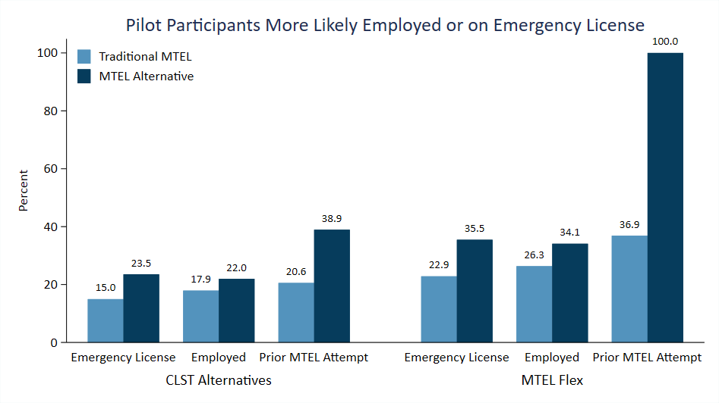
Pilot Participants More Likely Employed or on Emergency License

Slide 6
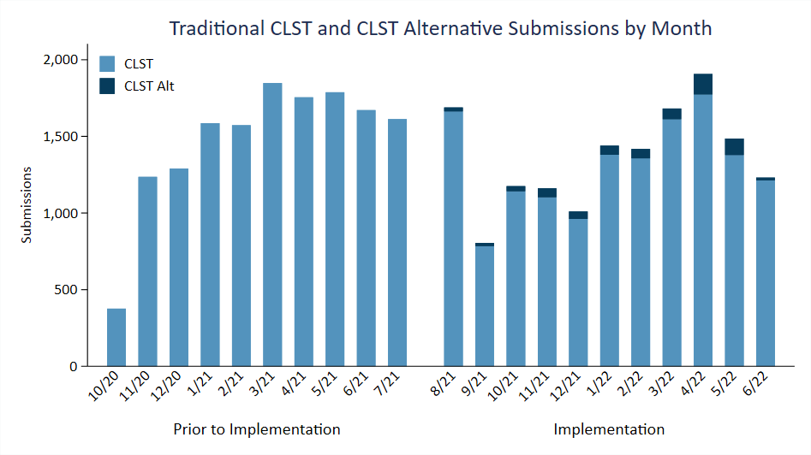
Traditional CLST and CLST Alternative Submissions by Month

Slide 7
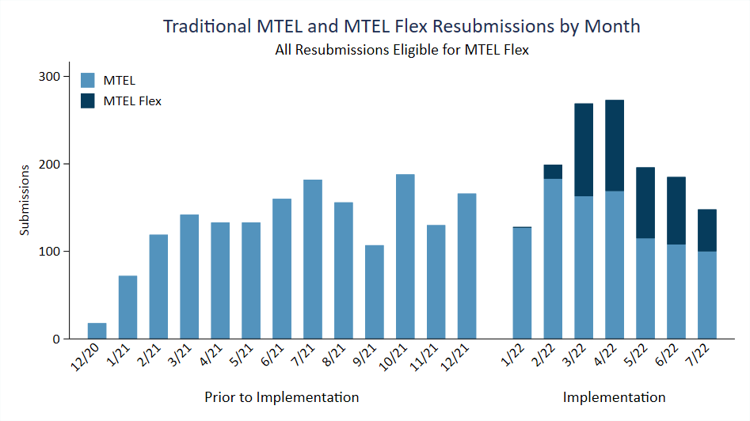
Traditional MTEL and MTEL Flex Resubmissions by Month

Slide 8
Alternative Assessment Fields and First Time Pass Rates
Test | License Fields | First-Time Pass Rate
CLST: Reading | All Fields | 84%
CLST: Writing |  | 84%
General Curriculum: Multi-Subject | ECE/Elementary (Grades PK–6) Moderate Disabilities* Severe Disabilities* Deaf & Hard of Hearing (Foundations of Reading for Oral/Aural only)* Visually Impaired (General Curriculum only)* | 69%
General Curriculum: Mathematics |  | 53%
Foundations of Reading |  | 56%
English | English (Grades 5–12)* | 81%
History | History (Grades 5–12)* | 77%
English as a Second Language | English as a Second Language* | 51%
Spanish | Spanish* | 84%
Notes: The license field indicates the fields for which the MTEL is the primary testing requirement. All fields apply to all grade levels unless noted otherwise.
* Indicates licensure shortage areas for the 2022–23 school year (U.S. Department of Education, 2022).

Slide 9
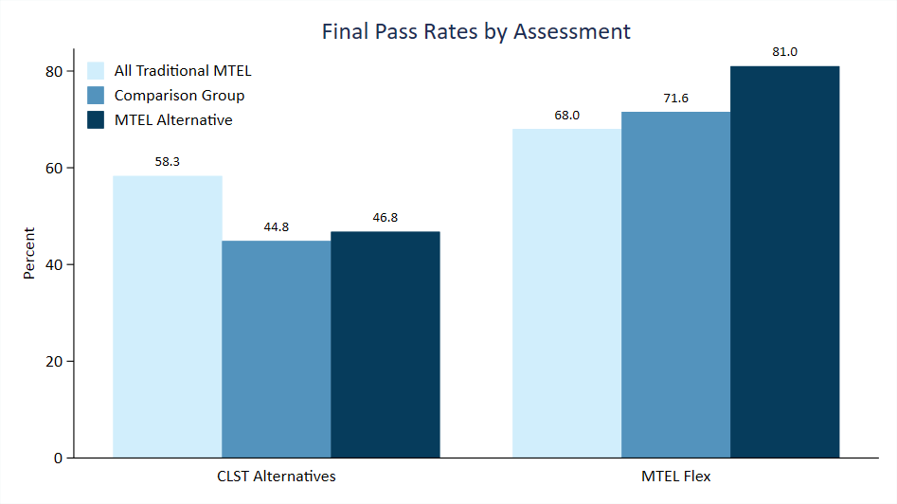
Final Pass Rates by Assessment

Slide 10
Next Steps and Future Research Questions
What are the effects of the alternative assessments on meeting career milestones (program completion, licensure, employment)?
How effective are teachers certified under the alternative assessments?
What are the implications of the alternative assessments for the diversity of the teacher workforce?
What are candidate experiences in the Program Attestation and PRPIL options?
How are preparation providers implementing the Program Attestation option?

Slide 11
James Cowan, Dan Goldhaber, Roddy Theobald
National Center for the Analysis of Longitudinal Data in Education Research

Slide 12
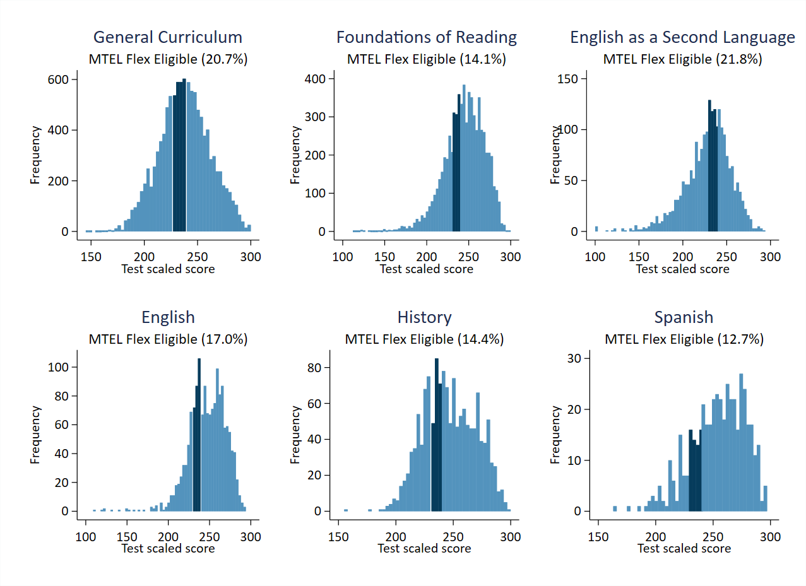
Submissions Eligible for MTEL Flex
Note: Histogram of all MTEL subject test submissions after 10/20/2020. Dark blue shading indicates region eligible for MTEL Flex.

Slide 13
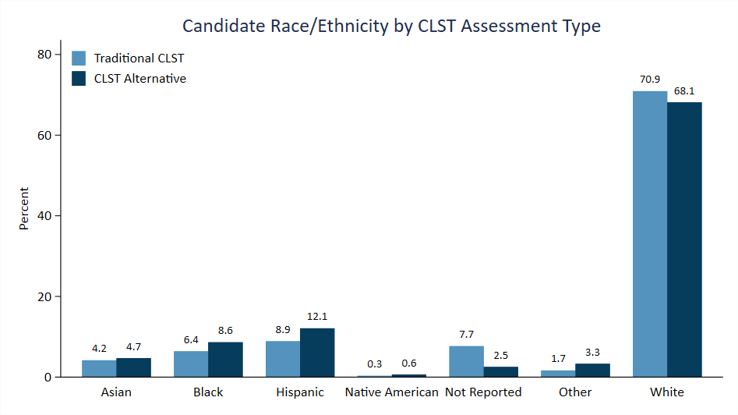
Candidate Race/Ethnicity by CLST Assessment

Slide 14
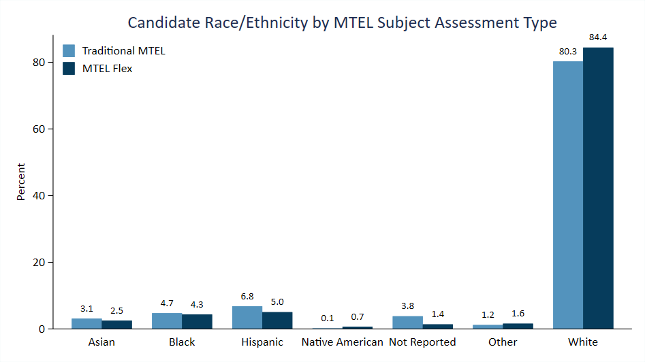
Candidate Race/Ethnicity by MTEL Subject Test Assessment

