Slide 1
Student Opportunity Act
Presentation to Massachusetts Board of Elementary and Secondary Education
January 24, 2023

Slide 2




01. Framing/bACKGROUND
Agenda
Framing/Background
Implementation of Legislation
Snapshot of Plan Amendments
Implementation Notes
05
Considerations moving forward

Slide 3



Overarching Goal of Student Opportunity Act
To ensure that that every student in the Commonwealth has access to a high-quality public education regardless of zip code

Slide 4
The SOA has two key components
Fiscal: Changes to Chapter 70 funding
Policy Updates:
Focus on closing gaps for student groups least-well served
Investment in education
Revised funding formula reflects equitable distribution of state education funds
Implementation of evidence-based practices

Slide 5
Fiscal Commitments of the SOA
Over 1 Billion Dollar investment
Revise Funding Formula
21st Century Educational Trust Fund
Increases in FY22 and FY23 = $547 million ($177m and $370m)
Department provides grant funding to support high-quality implementation of specific evidence-based program areas
Legislation commits to adding well over a billion dollars by 2027 to address the state’s overall underinvestment in education
Raising per pupil funding for to districts, and even more for districts with high concentrations of students living in poverty;
Raising per pupil funding for English learners; more for those in high schools;
Raises the assumed percentages of students with disabilities for each district;
Increasing funding for health care costs of active employees and retirees
21st Century Advisory Council provides input on "educational program" supported by funds.

Slide 6
Chapter 70 funds are being distributed as intended by the SOA Legislation
In FY22, the 25 LEAs receiving $1.5 million or more in additional Chapter 70 funds accounted for 83% of the increased funding.
This group primarily composed of large urban districts and Gateway Cities (e.g., Lynn, Fall River) as well as 5 Regional Vocational Technical Schools

Slide 7
SOA policy updates to support gap closing:
Data systems: Charges EOE with collecting and publishing data on student preparedness for post-graduate success in college and workforce
Advisory Groups: Directs DESE to establish a data advisory commission to help improve the use of data to inform strategies that strengthen teaching, learning and resource allocation
Plans: Requires districts to develop gap-closing plans every three years

Slide 8
Implementation timeline: Districts in Year 2 of a 3-year cycle, with pandemic backdrop
November 19, 2019:
SOA Legislation Signed Into Law
April 1, 2020:
Original SOA Plan Due Date
Dec 14, 2020: FY21 state budget is signed; includes no additional Ch 70 funds
January 15, 2021:
Revised Original SOA Plan Due Date
July 16, 2021: ~$177 million in additional Chapter 70 funds allocated to districts
April 1, 2022: Robust SOA Plan Amend-ments due
July 16, 2021: ~$370 million in additional Chapter 70 funds allocated to districts
April 1, 2023: End of Year 2 Progress Reports due
FY20
FY21
FY22
FY23
March 2020:
Schools Close Due to Pandemic
July 2020: ESSER I funds totaling over $194 million allocated to districts
August 2021: ESSER II funds totaling almost $740 million allocated to districts
Sept 2021:
All Schools Return to in-person learning
Fall 2022
ESSER III funds totaling almost $1.66 billion allocated to districts

Slide 9
Two key budget allocation considerations
SCOPE
TIMING
Student Opportunity Act signed
November 26, 2019
First round of additional Chapter 70 funding
July 16, 2021
Funding (In Millions)

Slide 10
02. Implementation of legislation
Agenda
Framing/Background
Implementation of Legislation
Snapshot of Plan Amendments
Implementation Notes
05
Considerations moving forward

Slide 11
Reminder about Legislative Requirements of 3-Year Gap-Closing Plans
Legislation Required
DESE Plans Included
EBPs: Identification of evidence-based programs to address identified gaps
Budget: Investments supporting implementation of EBPs & gap-closing
Metrics: for measuring progress towards meeting targets & family/care-giver engagement
Stakeholder Engagement: consult stakeholders, effect and measure increased parent engagement, including but not limited to underserved groups.
Gap-Analysis: analysis of existing gaps in learning experiences and outcomes
EBPs: Identification of evidence-based programs to address identified gaps
Budget detail: Investments supporting implementation of EBPs
Metrics: for measuring progress towards targets
Family/caregiver engagement in content: Description of steps taken by district for meaningful family/caregiver engagement
Stakeholder engagement in process: Description of Stakeholder engagement in plan development and implementation processes.

Slide 12
DESE Guidance to Districts
DESE Plans Included
DESE Guidance to Districts
Gap-Analysis: analysis of existing gaps in learning experiences and outcomes
EBPs: Identification of evidence-based programs to address identified gaps
Budget detail: Investments supporting implementation of EBPs
Metrics: for measuring progress towards targets
Family engagement in content: Description of steps taken by district for meaningful family/caregiver engagement
Stakeholder engagement in process: Description of Stakeholder engagement in plan development and implementation processes.
Focus on Gap-Closing
"Conduct a robust analysis of state and local data, disaggregated by student group, to identify gaps in learning experiences and outcomes."

Slide 13
DESE Guidance to Districts
DESE Plans Included
DESE Guidance to Districts
Gap-Analysis: analysis of existing gaps in learning experiences and outcomes
EBPs: Identification of evidence-based programs to address identified gaps
Budget detail: Investments supporting implementation of EBPs
Metrics: for measuring progress towards targets
Family engagement in content: Description of steps taken by district for meaningful family/caregiver engagement
Stakeholder engagement in process: Description of Stakeholder engagement in plan development and implementation processes.
Select from a vetted list:
Leverage DESE's provided list of 21 "EBPs" with compiled evidence of efficacy in gap-closing.
Less is more.
Select a few evidence-based program areas and implement them well

Slide 14
DESE Guidance to Districts
DESE Plans Included
DESE Guidance to Districts
Gap-Analysis: analysis of existing gaps in learning experiences and outcomes
EBPs: Identification of evidence-based programs to address identified gaps
Budget detail: Investments supporting implementation of EBPs
Metrics: for measuring progress towards targets
Family engagement in content: Description of steps taken by district for meaningful family/caregiver engagement
Stakeholder engagement in process: Description of Stakeholder engagement in plan development and implementation processes.
EBP implementation is crucial for gap-closing:
Describe the investments from multiple funding sources that support the plan’s implementation, not just how additional Chapter 70 funds will be used
Provide budget information for FY22 only

Slide 15
DESE Guidance to Districts
DESE Plans Included
DESE Guidance to Districts
Gap-Analysis: analysis of existing gaps in learning experiences and outcomes
EBPs: Identification of evidence-based programs to address identified gaps
Budget detail: Investments supporting implementation of EBPs
Metrics: for measuring progress towards targets
Family engagement in content: Description of steps taken by district for meaningful family/caregiver engagement
Stakeholder engagement in process: Description of Stakeholder engagement in plan development and implementation processes.
Multiple methods of monitoring progress: Select progress monitoring metrics for both interim and longer term outcomes

Slide 16
DESE Guidance to Districts
DESE Plans Included
DESE Guidance to Districts
Gap-Analysis: analysis of existing gaps in learning experiences and outcomes
EBPs: Identification of evidence-based programs to address identified gaps
Budget detail: Investments supporting implementation of EBPs
Metrics: for measuring progress towards targets
Family engagement in content: Description of steps taken by district for meaningful family/caregiver engagement
Stakeholder engagement in process: Description of Stakeholder engagement in plan development and implementation processes.
Family and Stakeholder engagement is not a one-off, but rather a meaningful and regular part of any continuous improvement cycle.

Slide 17
Year 1 of Implementation: Plan Amendments
January 2021
DESE collected original plans
July 2021
First stream of funding available
April 2022
Plan Amendments Collected from 311 districts
May-June 2022
DESE staff reviewed all plans and provided written feedback
July 2022
Districts provided an opportunity to revise Plans based on feedback
August 2022
DESE posted plans publicly on an interactive SOA Plan Dashboard
DESE conducted a robust plan amendment process in spring 2022, and provided feedback on all plans before public posting in summer 2022.

Slide 18
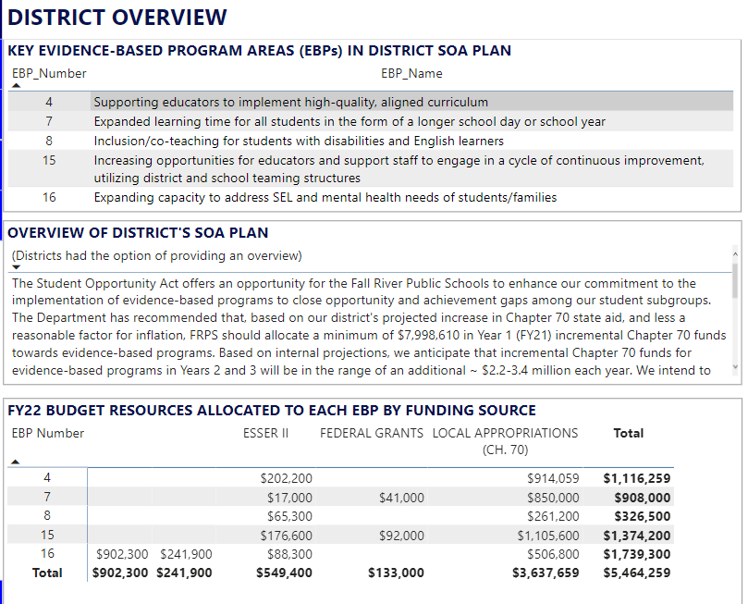
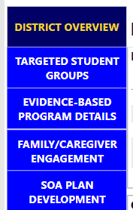
SOA Dashboard allows public access to key elements of the plan, aligned to legislation

Slide 19
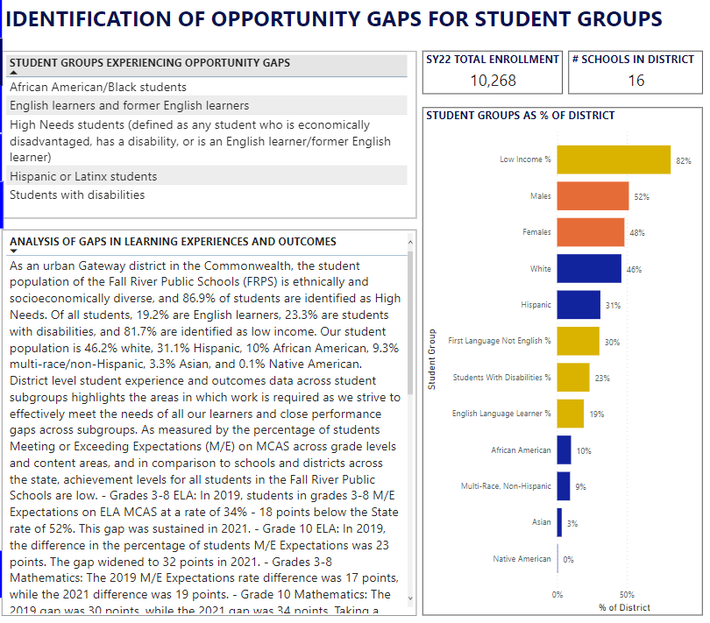
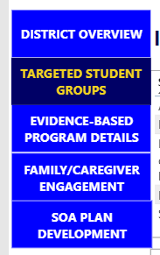
SOA Dashboard allows public access to key elements of the plan, aligned to legislation

Slide 20
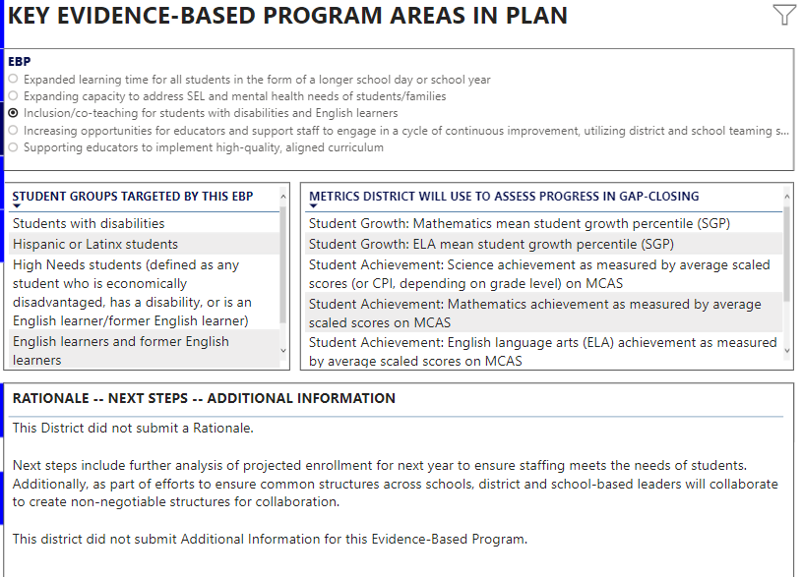
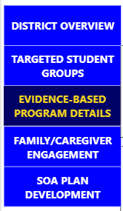
SOA Dashboard allows public access to key elements of the plan, aligned to legislation
For each EBP, we have a pop-up screen that can be selected that provides more budget details and transparently shares the district's self-reported score on the implementation rubric.

Slide 21
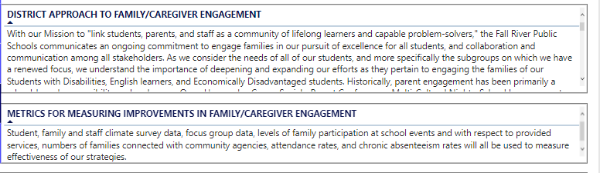
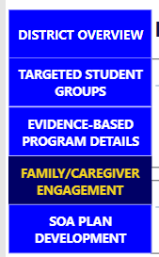
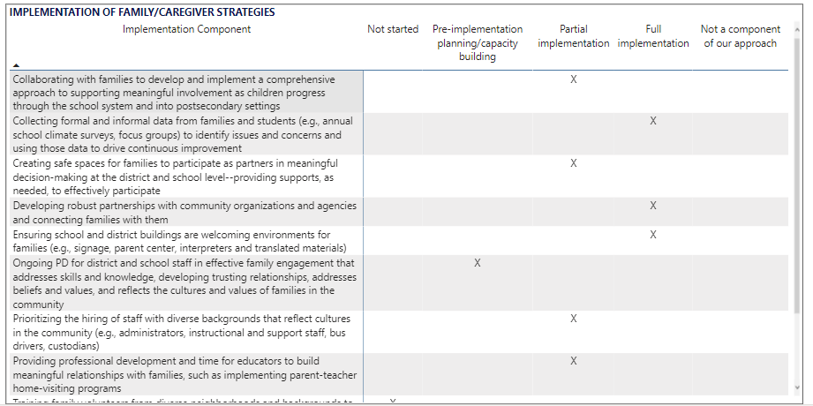
SOA Dashboard allows public access to key elements of the plan, aligned to legislation

Slide 22
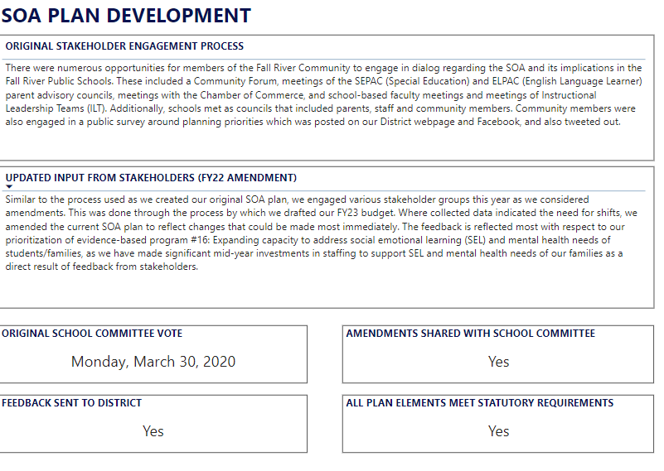
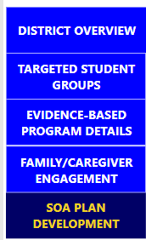
SOA Dashboard allows public access to key elements of the plan, aligned to legislation

Slide 23
SOA Dashboard allows public access to key elements of the plan, aligned to legislation

Slide 24
Year 1 of Implementation: Additional DESE Actions
Issued multiple rounds of EBP and rural innovation grants
Developed new College and Career Outcomes Dashboard
Launched and consulted SOA advisory committees and 21st Century Education Trust Fund
Provided a myriad of opportunities to learn about and engage in effective implementation of each EBP

Slide 25
03. Snapshot of Plan Amendments
Agenda
Framing/Background
Implementation of Legislation
Snapshot of Plan Amendments
Implementation Notes
05
Considerations moving forward

Slide 26
SOA plans are targeting the student groups the legislation intends them to target

Slide 27
Evidence-based Program Areas most often appearing in district plans

Slide 28
Reported Investments in EBPs in FY22
Evidence-based program area | Total $ | Total % of reported $
HQIM | $74,195,293 | 22%
Co-teaching & Inclusion | $68,281,163 | 20%
SEL/Mental Health | $49,991,834 | 15%
Early Literacy | $28,915,991 | 9%
Cycle of Continuous Improvement | $17,844,929 | 5%
Pre-K/Full K | $16,136,492 | 5%
Acceleration Academies | $13,203,185 | 4%
This approach to reporting allows us to see a significantly greater scope of investments in the EBPs than if we focused solely on increased Chapter 70 funding.
The total investments reported for just these 7 EBPs is more than the entire increase in Chapter 70 in FY22.
Funding sources: ESSER I, ESSER II, ESSER III, Local funding (including Chapter 70), Other Federal grants (e.g., Title grants), other state grants (e.g., GLEAM grants), Mass Business Authority Funds, Other

Slide 29
Additional Context on Budget Reporting & Analysis
District Reporting
DESE Analysis
Plan deadline (April 1) is well before districts receive annual allocations.
Districts blend and braid numerous funding sources in order to support their gap-closing efforts.
Legislation was designed to correct an inequitable funding formula.
Annually: DESE receives EOY spending reports in the fall.
DESE releases preliminary spending reports in March/April and more final versions the following October
In the coming months, we will be able to triangulate how spending pre-SOA (FY21) compares to post-SOA (FY22)

Slide 30
Digging Deeper Into Implementation
HQIM Example
HQIM Implementation Components
Building systems for ongoing two-way communication with families and stakeholders regarding materials and student progress
District has a process in place for frequently monitoring of the extent to which the intended curriculum is being delivered in classrooms across the system
Engaging in a curricular landscape analysis to assess the extent to which the district is implementing high-quality, standards-aligned core curriculum materials, as defined by CURATE or a similar independent, research-based, third-party reviewer
Regularly scheduled and ongoing professional learning and support for educators to implement new materials effectively, utilizing grade-appropriate, well-scaffolded assignments
School teams (e.g., grade-level teams, ILT) receive training and support to effectively utilize collaborative planning time to utilize data (e.g., from formative and summative assessments, looking at student work, classroom observation data) to engage in a continuous cycle of improvement
Schools have a team (e.g., instructional leadership team, curriculum implementation team) tasked with leading, planning, and monitoring the implementation and outcomes of curricular materials
Utilizing a regular selection and adoption process that allows ample time for teachers and administrators to reflect upon the evidence base

Slide 31
SOA plans required an update on Stages of Implementation for EBPs
HQIM Implementation Components | Not Started | Pre- Implement | Partial | Full | N/A
Building systems for ongoing two-way communication with families and stakeholders regarding materials and student progress |  |  | X
District has a process in place for frequently monitoring of the extent to which the intended curriculum is being delivered in classrooms across the system |  | X
Engaging in a curricular landscape analysis to assess the extent to which the district is implementing high-quality, standards-aligned core curriculum materials, as defined by CURATE or a similar independent, research-based, third-party reviewer |  |  |  | X

Slide 32
04. Implementation Notes
Agenda
Framing/Background
Implementation of Legislation
Snapshot of Plan Amendments
Implementation Notes
05
Considerations moving forward

Slide 33
What does the research tell us about effective practices?
Once EBPs are selected in a plan, what factors should be top of mind as we support with effective implementation?
How can we leverage Evidence-Based Programs to support gap-closing?
What are the best practices for supporting change in a complex system like a school or district?

Slide 34
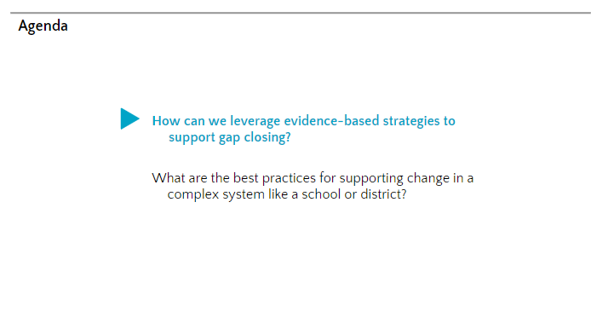
Agenda

Slide 35
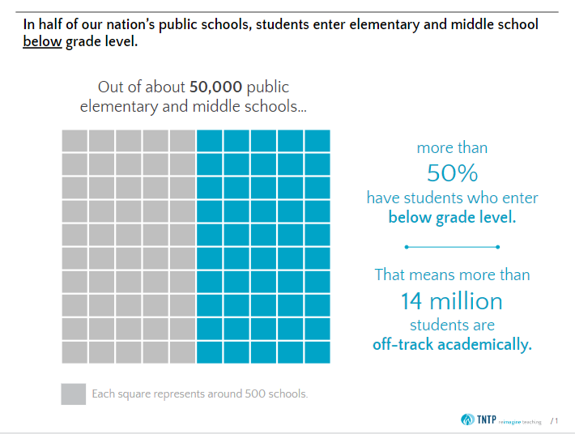
In half of our nation’s public schools…

Slide 36
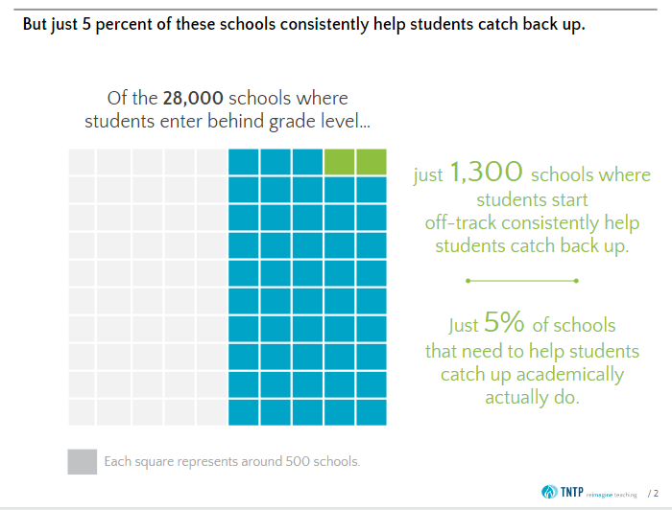
Of the 28,000 schools where students enter behind grade levels

Slide 37
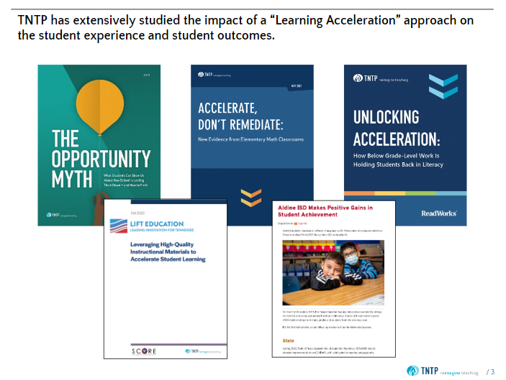
TNTP Learning Acceleration

Slide 38
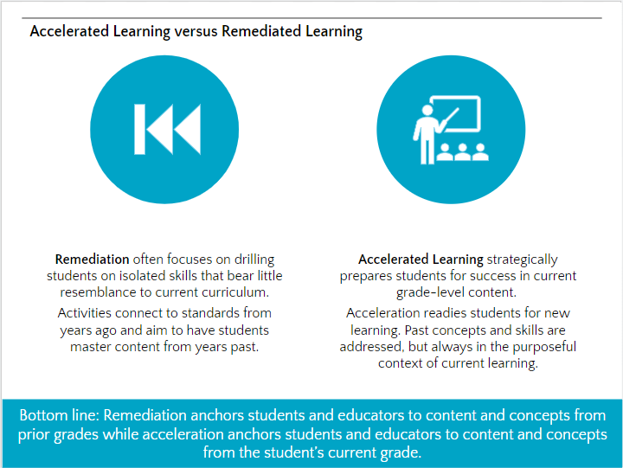
Accelerated Learning vs Remediated Learning

Slide 39

The Opportunity Myth

Slide 40
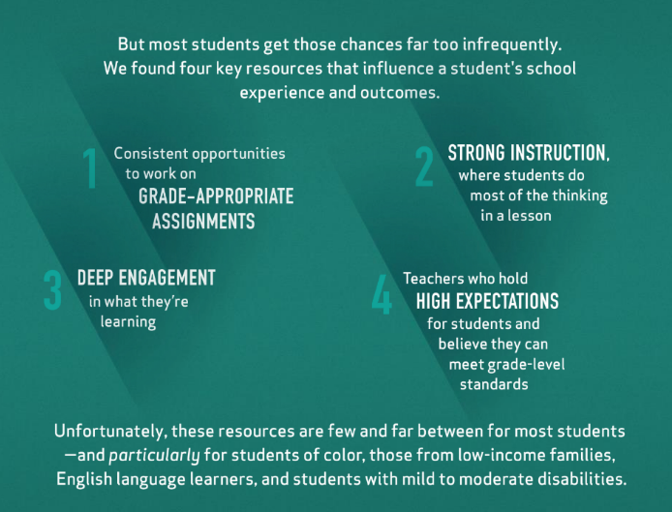
TNTP

Slide 41
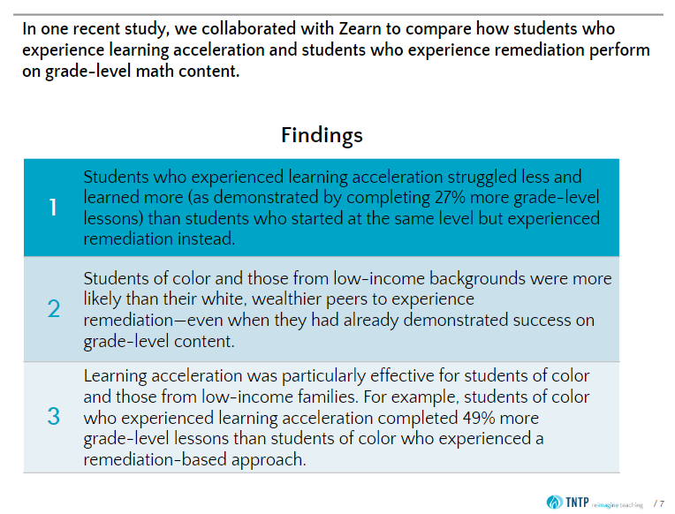
Findings

Slide 42
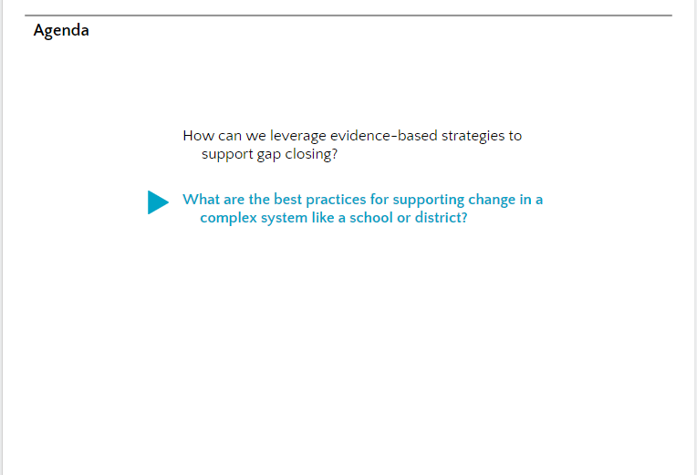
What are the best practices for supporting changes in a complex system…..

Slide 43
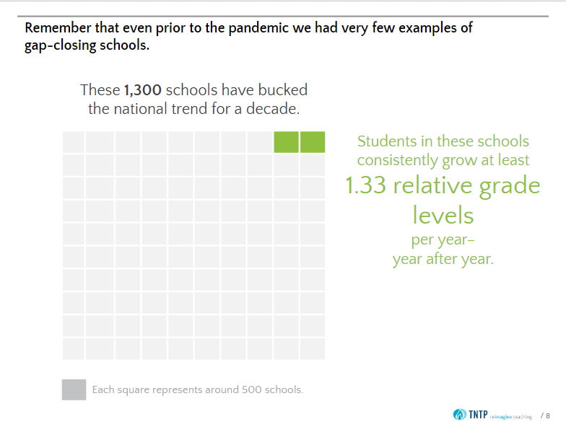
These 1300 schools have bucked the national trend for a decade

Slide 44
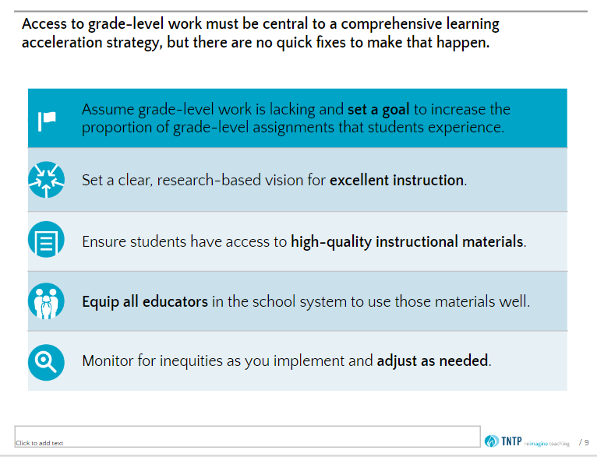
Access to grade level work

Slide 45
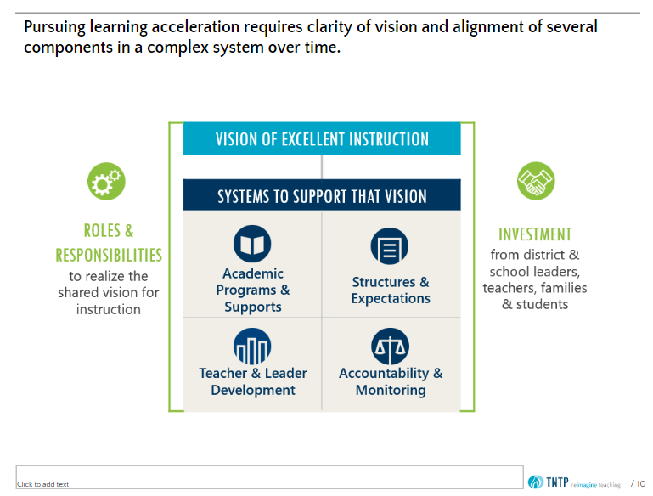
Pursuing learning acceleration

Slide 46
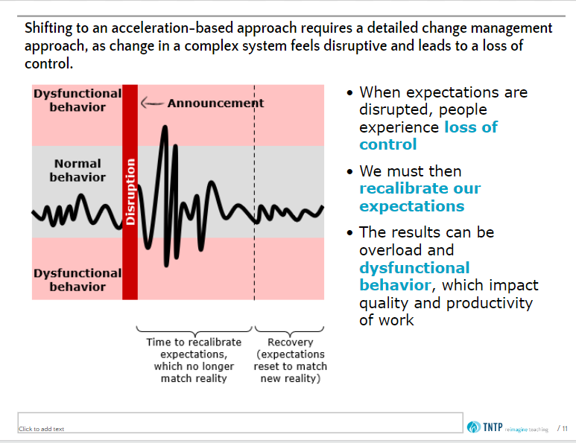
Acceleration-based approach

Slide 47
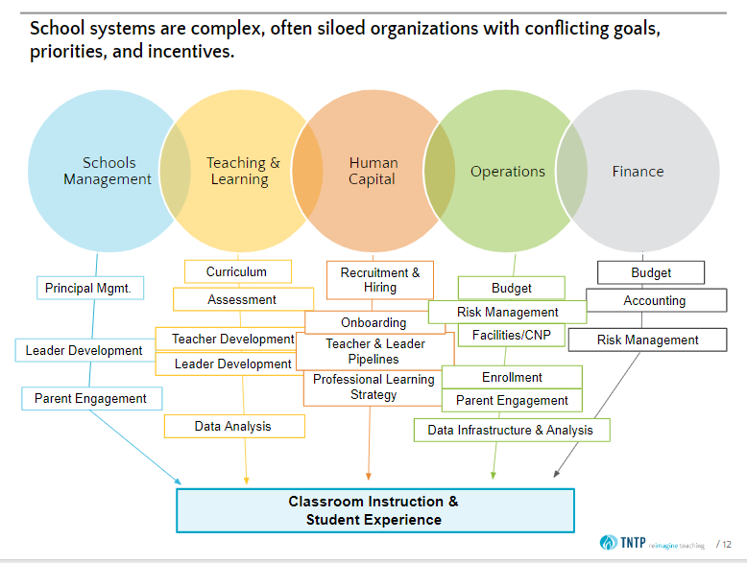
Classroom instruction and student experience

Slide 48
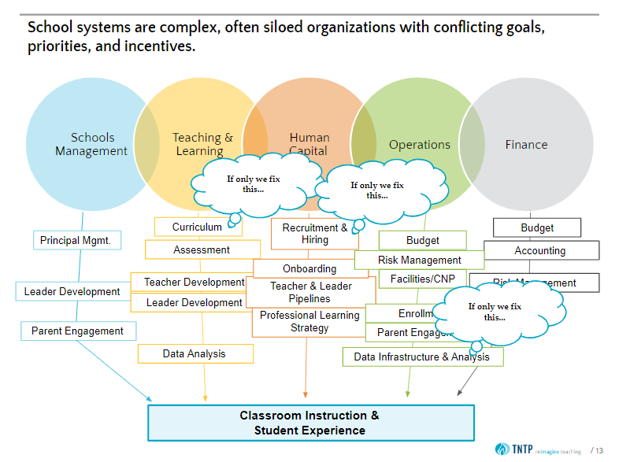
Classroom instruction and student experieince

Slide 49
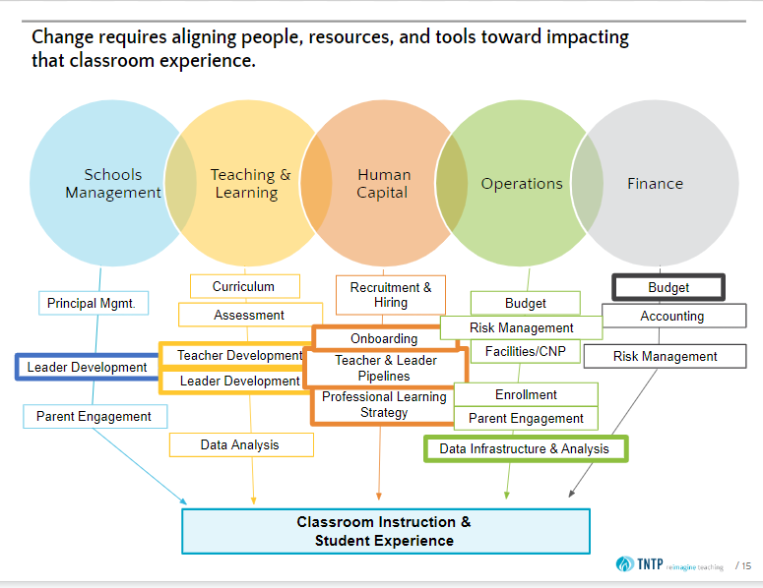
Classroom instruction and student experience

Slide 50

In half of our nation’s public schools…

Slide 51
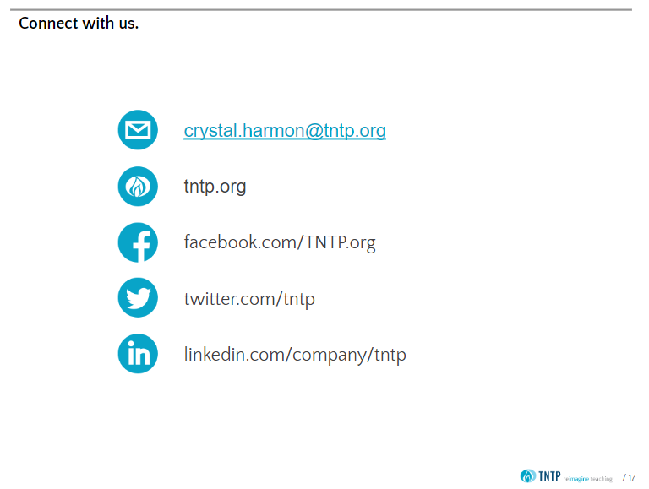
Contact info

Slide 52
What does the research tell us about effective practices?
How can we leverage Evidence-Based Programs to support gap-closing?
What are the best practices for supporting change in a complex system like a school or district?
A learning acceleration approach focuses on implementing our EBPs in a manner that promotes access to grade appropriate assignments, strong instruction, deep engagement and high expectations.
Support to districts in managing complex change will be an important lever for effective implementation.
Once EBPs are selected in a plan, what factors should be top of mind as we support with effective implementation?

Slide 53
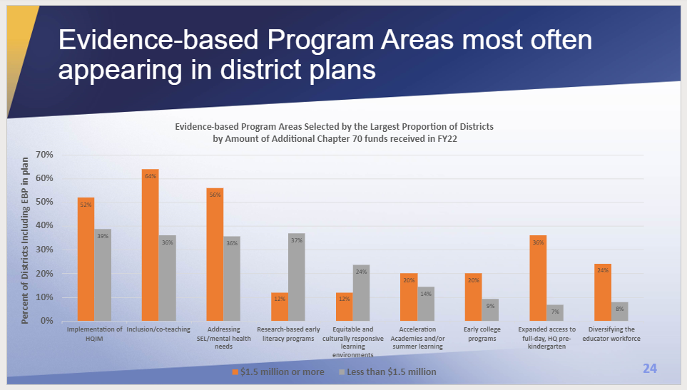
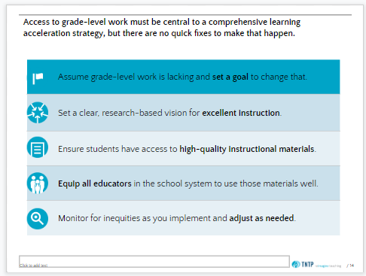
Deep dive: implementing one EBP in light of the research on effective practices
Implementation of High Quality Instructional Materials is a high-frequency evidence-based program area within our state
DESE has sought to provide implementation support in a manner consistent with the evidence-base
Deep dive into: High Quality Instructional Materials

Slide 54
Sample of Additional DESE Supports for HQIM Implementation
Resources
Assistance
Evaluation and Selection Networks
Learning Acceleration Network
Grants
HQIM Implementation grants
Regional Assistance
GLEAM Grants
CURATE
Monitoring & Data Collection:
District review standards
Early Literacy Screeners
OpenSciEd Curriculum Pilot
Appleseeds Curriculum Pilot
Investigating History Curriculum Pilot
MTSS Academies
ImplementMA E-learning modules
Accelerating Literacy Grant
Acceleration Math Opportunity
Curriculum Profiles
Acceleration Roadmap
Deep Dive: Assistance for HQIM Implementation

Slide 55
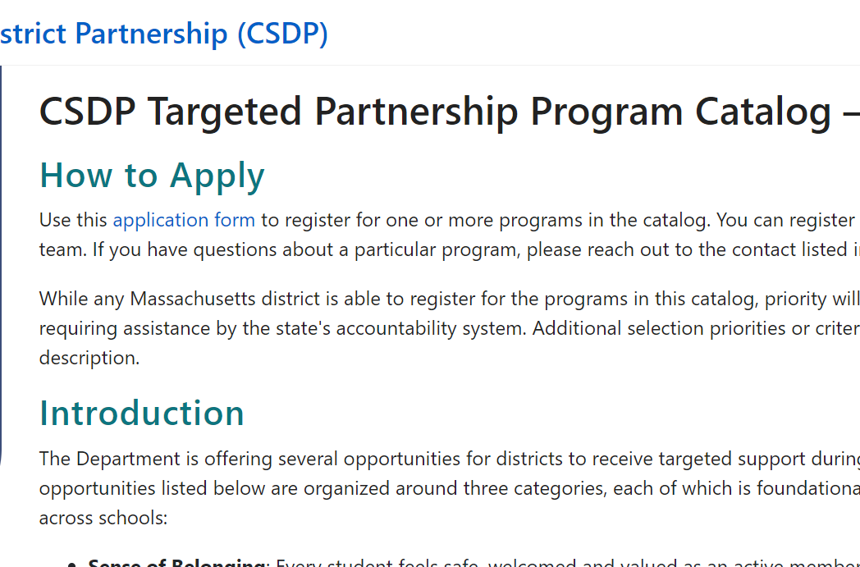


Assistance Case-Studies: Implementation of High-Quality Instructional Materials (EBP)
Learning Acceleration Network (LAN)
Regional Assistance (Statewide System of Support)

Slide 56
Learning Acceleration Network (LAN)
Purpose: Leverage Acceleration Roadmap content while implementing EBPs in pursuit of gap-closing.
Details: 18 districts, serving just under 100,000 student, receive coaching, customized in-person support days, and cohort meetings.
Progress Monitoring: ongoing continuous improvement cycles, with a mid-year stepback.

Slide 57
Learning Acceleration Network (LAN)
Coaching | Customized In-Person Support Days | Cohort Meetings
District instructional leadership teams meet 2x per month with a TNTP coach. Meetings are between 1-2 hours, and focus on building capacity and systems to increase effective acceleration practices using an evidence-based PDSA Cycle for continuous improvement. | TNTP coaches travel to districts 4x per year to provide a day of customized support. Structure of the support depends on district goals, but have included: Co-observations focused on instructional look-fors aligned to acceleration goals Co-leading PD for school leaders or teachers | Districts attend differentiated content-specific sessions that build knowledge and skills to implement their instructional priority. ELA Math HQIM Scaffolding Instruction District teams also attend all-cohort meetings to share best practices, participate in consultancies, and engage in supported team planning time.
Weekly DESE meetings ensure alignment with other DESE support activities the districts participate in (GLEAM, Regional Assistance, ImplementMA).

Slide 58
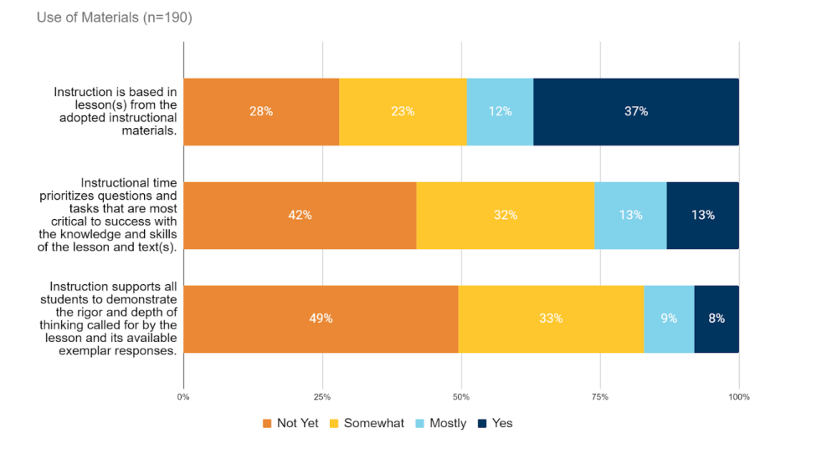
LAN: Snapshot of Progress Monitoring
Nearly 200 classrooms observed
Quantitative and Qualitative Data compiled

Slide 59
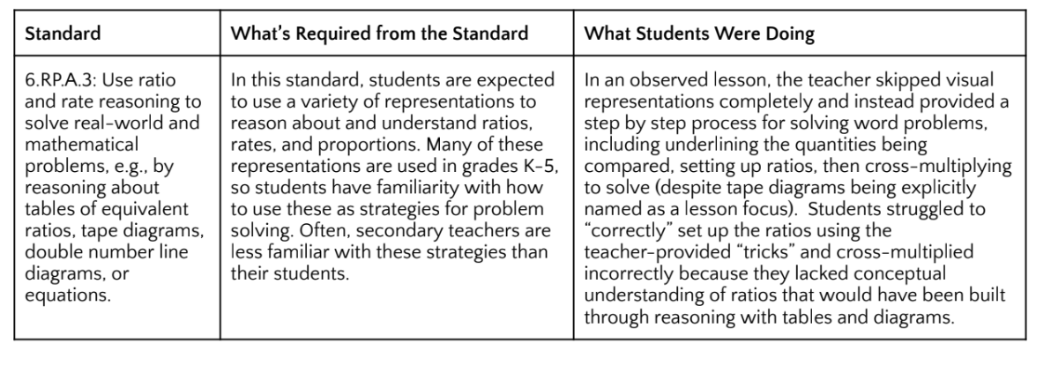
LAN: Snapshot of Progress Monitoring
In this case study we see that student misconceptions in the lesson were due to an overly procedural (rather than conceptual) explanation that was below the rigor of the standard.
Review of the case study allows us to reflect on high-leverage district support to improve the implementation of the EBP (HQIM)
Nearly 200 classrooms observed
Quantitative and Qualitative Data compiled

Slide 60

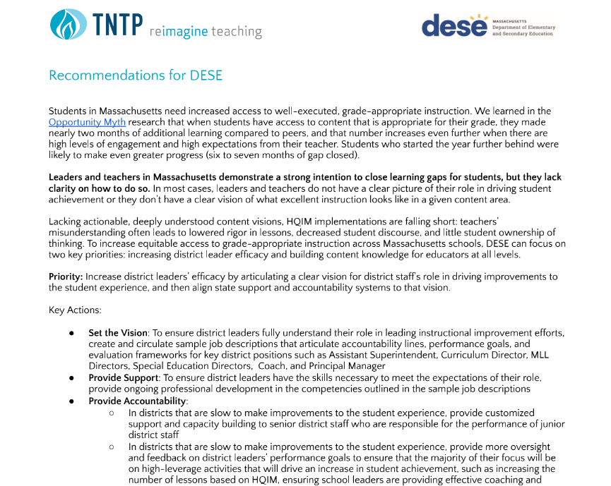
LAN: Impact of Progress Monitoring
Progress Monitoring allows us to make adjustments to LAN in real-time to better support gap-closing in specific districts
Progress Monitoring also allows for a mid-year step-back to reflect on state-wide trends and implications for DESE

Slide 61
Assistance Case-Studies: Implementation of High-Quality Instructional Materials (EBP)
Learning Acceleration Network (LAN)
Regional Assistance (Statewide System of Support)

Slide 62
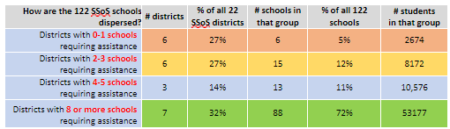
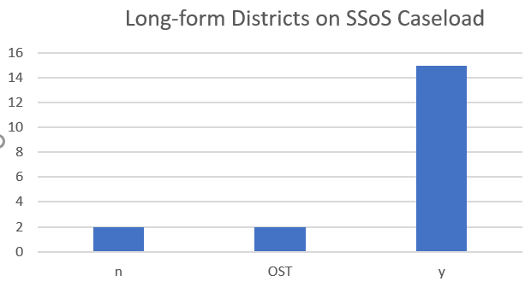
An Equity-Centered Assistance Model supports with implementation of EBPs for Gap-Closing
SSoS caseload supports 22 districts with 122 schools requiring assistance, serving over 75,000 students in MA
17 SSoS or OST districts receive over 1.5 million in SOA investments

Slide 63
An Equity-Centered Assistance Model supports with implementation of EBPs for Gap-Closing
Plan for next school year
Identify key priorities & benchmarks
SSOS launches support towards those priorities
Provide assistance + monitor progress
Component of Model | Resources and Opportunities
Support districts to identify clear priorities anchored in culturally responsive grade appropriate instruction and sense of belonging | Annual Planning and Prioritization Institute supports districts in identifying an instructional priority that will support implementation of their EBPS
Target support in service of those priorities, with a particular focus on supporting school and district ILTs, HQIM adoption and implementation | Catalog of DESE Support provided. Regional Assistance Teams deployed to provide implementation support and progress monitor implementation.

Slide 64
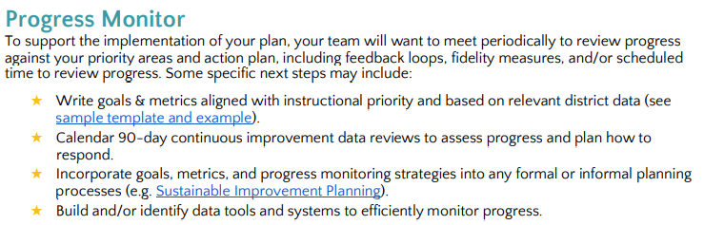
Progress monitoring is an essential part of our support to districts

Slide 65
One district's perspective
What does it look like in one of our larger, more complex districts to implement SOA?
What factors affect SOA implementation in the full landscape of budget, accountability, and assistance that work together to support gap closing?

Slide 66

Fall River Public Scools

Slide 67
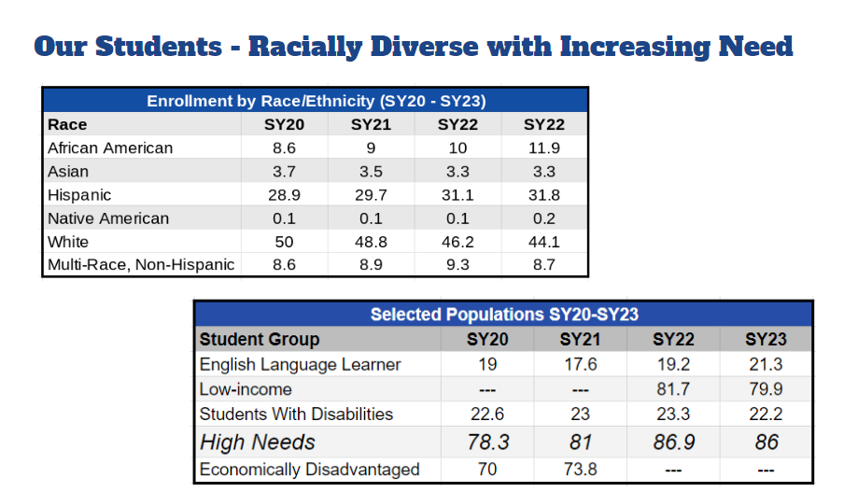
Our students

Slide 68
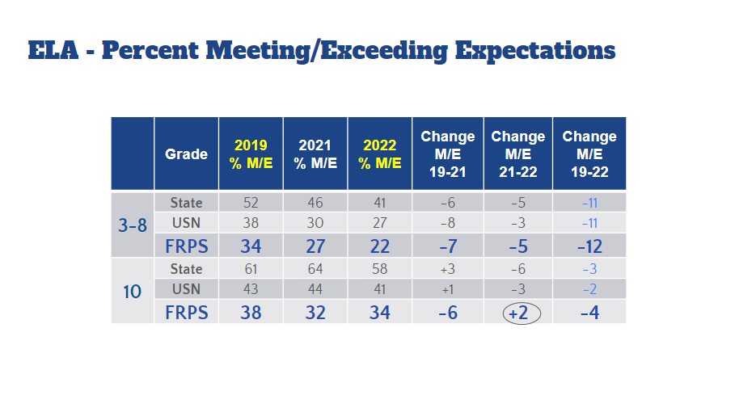
ELA percent meeting/exceeding expectations

Slide 69
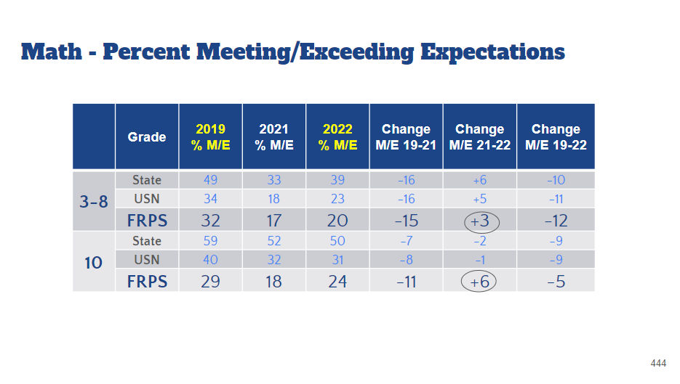
Math percent meeting/exceeding expectation

Slide 70
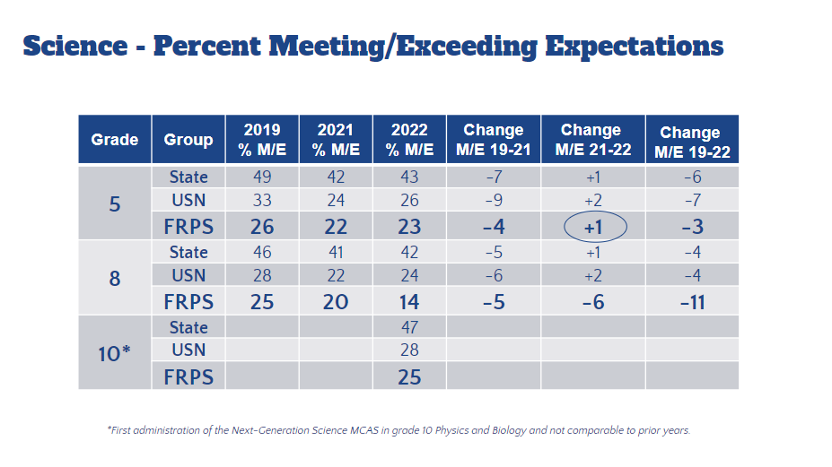
Science percent meeting/exceeding expectations

Slide 71
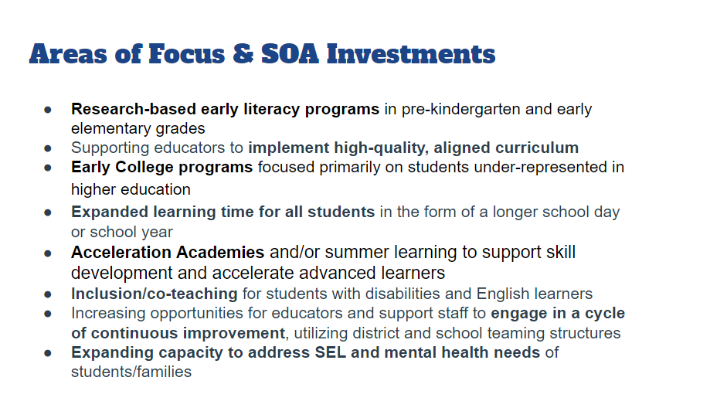
Area of focus and soa investments

Slide 72
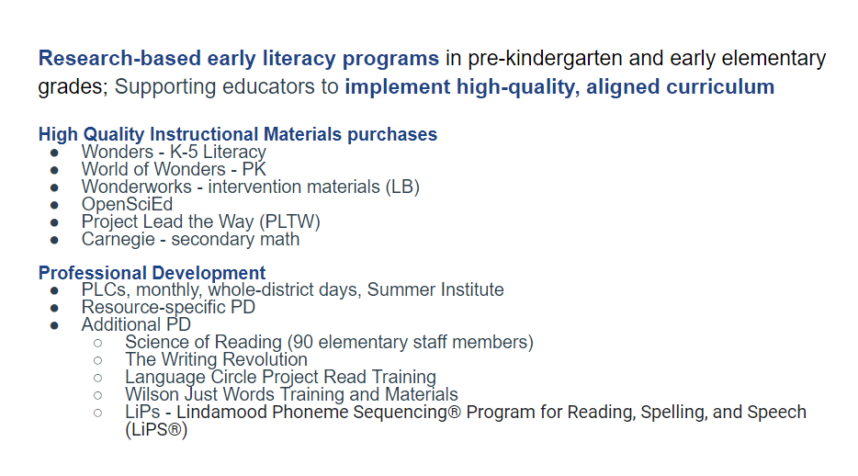
Research based early literacy programs

Slide 73
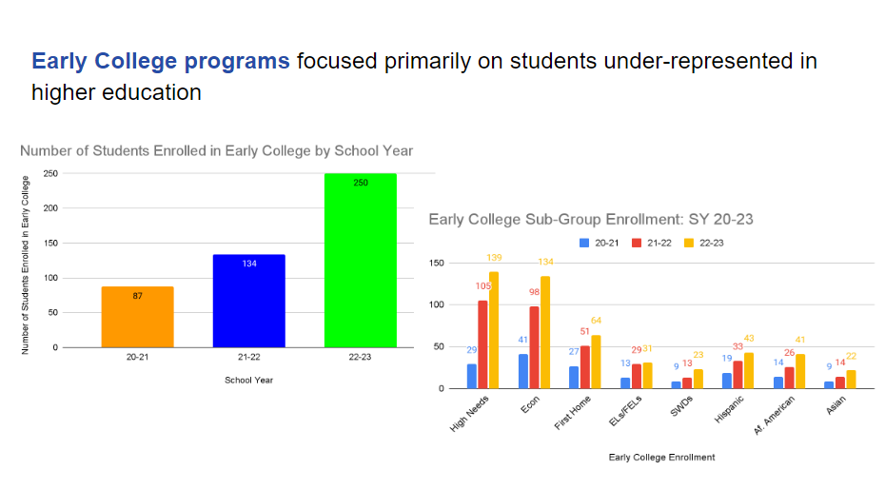
Early college programs

Slide 74
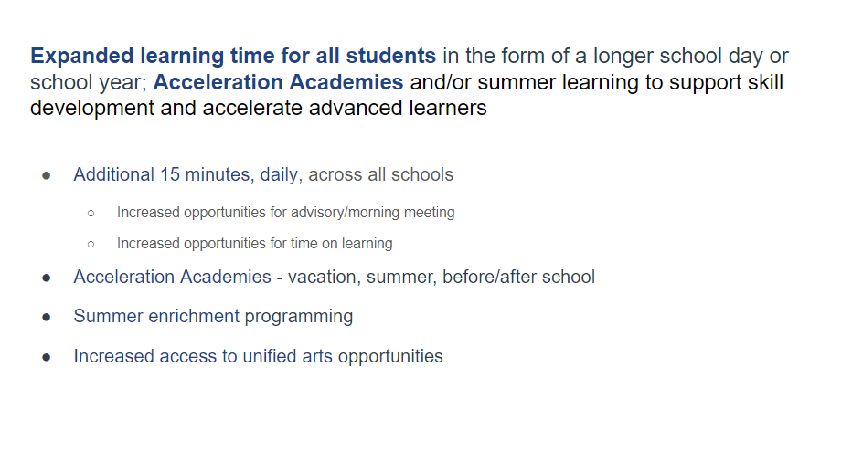
Expanded learning time for all students

Slide 75
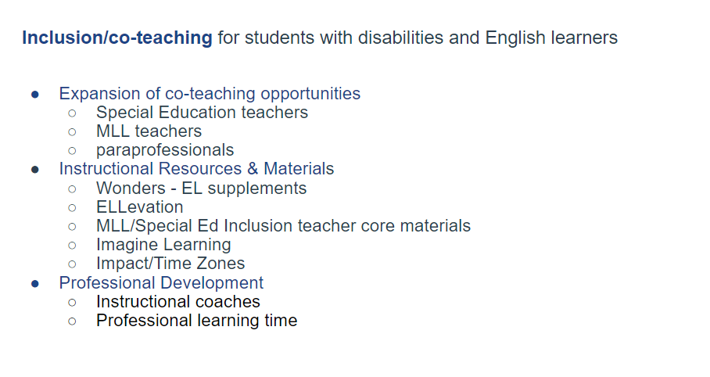
Inclusion/co-teaching

Slide 76
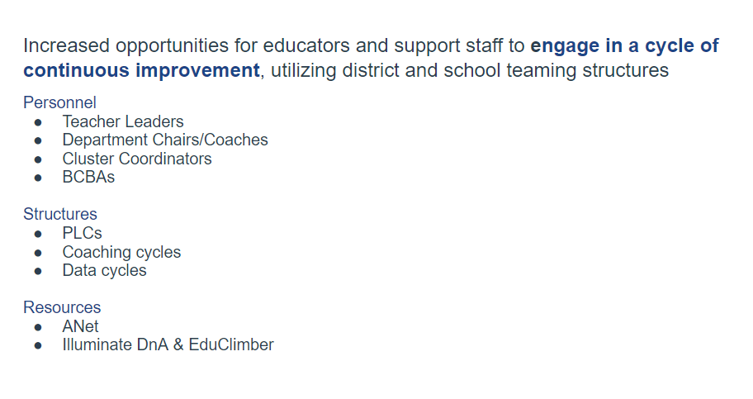
Engage in a cycle of continuous improvement

Slide 77
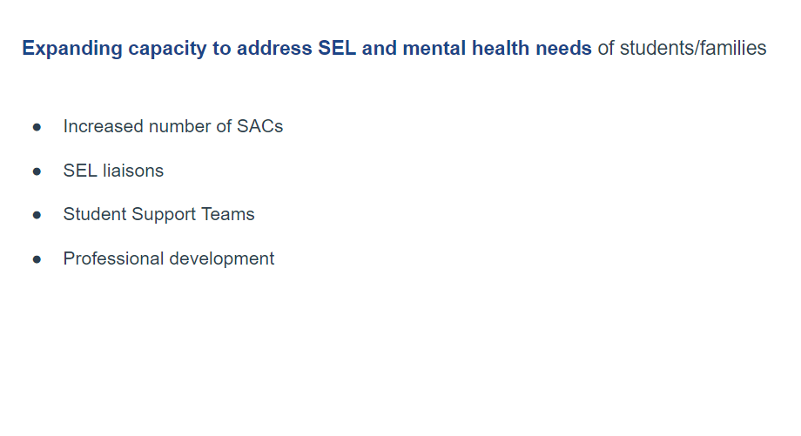
Expanding capacity to address SEL and mental health needs

Slide 78
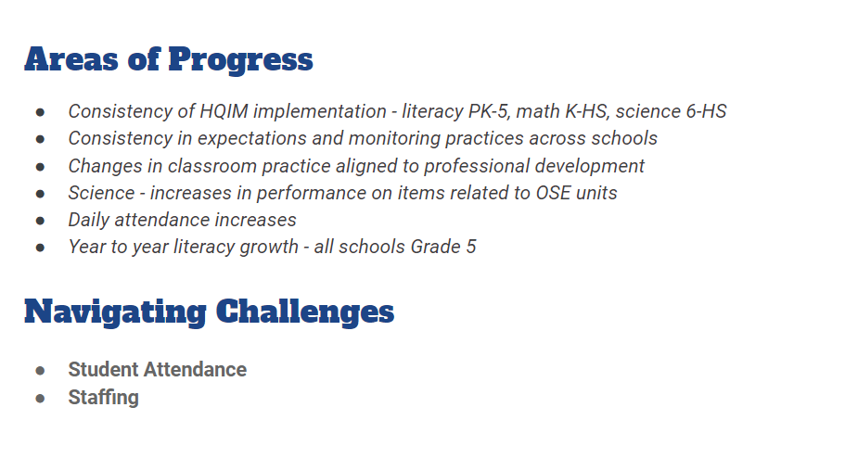
Areas of progress and navigating challenges

Slide 79
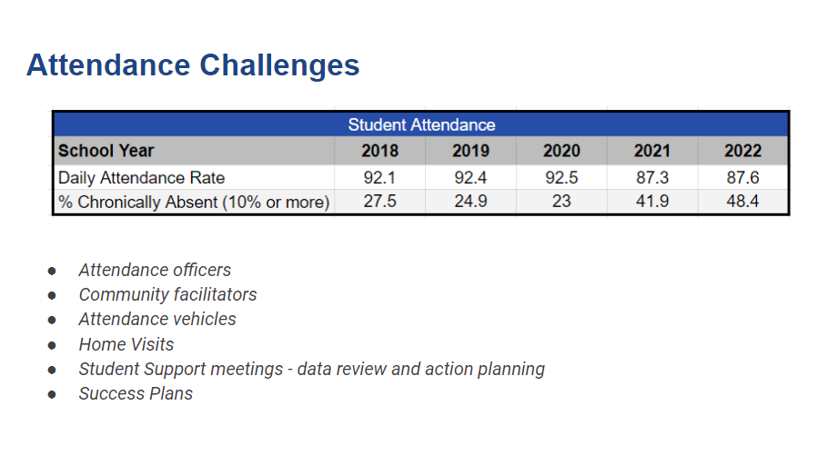
Attendance challenges

Slide 80
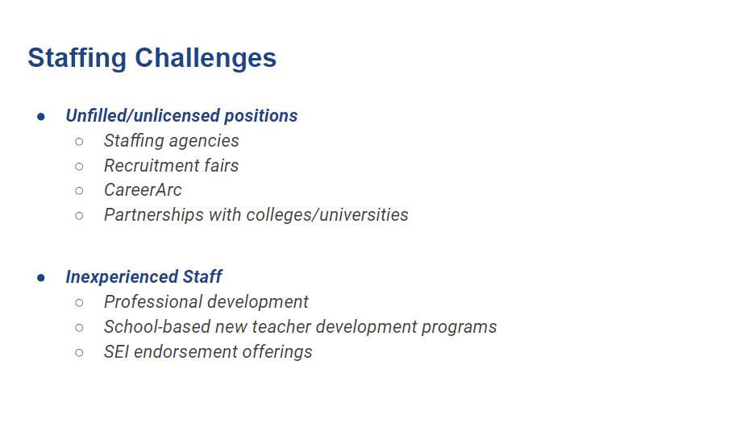
Staffing challenges

Slide 81

Moving forward

Slide 82

Collaborative partnersho

Slide 83
One district's perspective
What does it look like in one of our larger, more complex districts to implement SOA?
What factors affect SOA implementation in the full landscape of budget, accountability, and assistance that work together to support gap closing?

Slide 84
Considerations moving forward
Agenda
Framing/Background
Implementation of Legislation
Snapshot of Plan Amendments
Implementation Notes
05
Considerations moving forward

Slide 85
Considerations Moving Forward
Further analysis conducted this spring and summer:
  Analysis of EOY spending reports to analyze how spending has shifted as a result of SOA
  Districts will submit SOA Progress Reports on April 1, 2023
Looking ahead: move towards a more effective, consolidated approach to gap closing
  New plans will be due in spring 2024
  Leverage ESSER-funded evaluations of evidence-based program areas aligned with SOA

Slide 86
Thank you!
Q&A

Slide 87

Appendix

Slide 88
Reference slides: Greater than 1.5 mil annual investment
Large Urban Districts and Gateway Cities (19):Boston, Brockton, Chelsea, Chicopee, Everett, Fall River, Fitchburg, Haverhill, Holyoke, Lawrence, Lowell, Lynn, New Bedford, Quincy, Randolph, Revere, Springfield, Taunton, Worcester
Regional Vocational Technical Schools (5): Greater Lowell Regional, Greater Lawrence, Greater Fall River, Greater New Bedford, Southeastern Regional
Other (1) Westborough

Slide 89
21st Century Grant Funding
FY21 EBP Grant – Fund Code 117 – 82 districts, $3.7M
  Acceleration Academies
  Diversifying the educator workforce
  Early College programs
  Early literacy programs
FY22 Rural Innovation and Efficiencies Grant – 3 Collaboratives, $1M
FY23 EBP Grant – Fund Code 117/225B – TBD
  Co-teaching and Inclusion
  Early Literacy
  Expanded Learning Time
  Hiring staff

Slide 90
New and Revised/Expanded Evidence-Based Program Areas
New Evidence-Based Program Areas:
Culturally responsive teaching and other strategies that create equitable and culturally responsive learning environments for students
English Learner Education programs, including dual language (DL) and transitional bilingual education (TBE) programs
Reconfigured Evidence-Based Program Areas
Expanded learning time for all students in the form of a longer school day or school year
Increasing opportunities for educators and support staff to engage in a cycle of continuous improvement, utilizing district and school teaming structures
Increasing opportunities for all students to engage in arts, enrichment, world languages, athletics, and elective courses
Developing effective family/school partnerships
Notes:
This year we are adding some program areas that were included in ESSER III applications that we thought were important to include. We have also, separated some categories that were combined last year into distinct categories, and we have substantially expanded one category that was very narrowly focused .
Two that you may recognize from the ESSER III applications are the new evidence-based program areas that you see in green text. These are:
Culturally responsive teaching and other strategies that create equitable and culturally responsive learning environments for students, and
Language support programs, including dual language (DL) and transitional bilingual education (TBE) programs
We see these as important additions. The culturally responsive teaching and other strategies program area is particularly germane to SOA plans, as we challenge ourselves as a state and at the district and school level to close gaps in learning experiences for students from historically underserved populations. The second elevates the important role of asset-based language support programs, particularly for our students who are English learners.
Moving on to reconfigured evidence-based program areas:
Expanded learning time for students was included in the original SOA legislation. Key building blocks of ELT programs were pulled apart and incorporated into several different evidence-based program areas last year; we opted to give it its own category this year.
The next two program areas –were combined into a single category last year. We opted to separate them because each has its own independent evidence-base and serve different functions
Well-implemented teaming structures play a key role at the district, school and teacher/support team level in building collaborative environments that use the continuous cycle of improvement to do things like improve instruction, monitor and support the implementation of strategies/curriculum, support distributed leadership in districts and schools
Arts, enrichment, languages, athletics, and elective courses are often the first courses to get cut when budgets are tight or when a school shows up as a school in need of targeted/focused support in DESE’s accountability system. These types of cuts disproportionally impact students of color, English learners, and students living in economically distressed communities – and there is a research and evidence base that demonstrates meaningful positive impacts on students’ social emotional learning, academic achievement, and art learning
The Developing effective family-school partnerships program area dramatically expands what was a relatively narrow focus on developing home school relationships through parent/teacher visiting programs. We know many districts are focusing on these kinds of partnerships and wanted to expanded it so that we could capture the many other important kinds of partnering that are going on.

Slide 91
Evidence-based programs: 21 examples of high-quality programs
Enhanced Core Instruction
Expanded access to full-day, high-quality pre-kindergarten for 4-year-olds, including potential collaboration with other local providers
Research-based early literacy programs in pre-kindergarten and early elementary grades
Early College programs focused primarily on students under-represented in higher education
Supporting educators to implement high-quality, aligned curriculum
Expanded access to career-technical education, including “After Dark” district-vocational partnerships and innovation pathways reflecting local labor market priorities
Culturally responsive teaching and other strategies that create equitable and culturally responsive learning environments for students.
Expanded learning time for all students in the form of a longer school day or school year
Notes:
The next three slides list all 21 of the evidence-based program areas. I won’t read through all of them now, but we did want you to see that evidence-based program areas continue to be organized in four broad areas: Enhanced Core Instruction

Slide 92
Evidence-based programs: 21 examples of high-quality programs (cont.)
Targeted Student Supports
Talent Development
Inclusion/co-teaching for students with disabilities and English learners
Language support programs, including dual language and transitional Bilingual education programs (TBE)
Acceleration Academies and/or summer learning to support skill development and accelerate advanced learners
Dropout prevention and recovery programs
Diversifying the educator/administrator workforce through recruitment and retention
Leadership pipeline development programs for schools
Strategies to recruit and retain educators/ administrators in hard-to-staff schools and positions
Increasing opportunities for educators and support staff to engage in a cycle of continuous improvement, utilizing district and school teaming structures
Notes:
Targeted Student Supports, and Talent Development

Slide 93
Evidence-based programs: 21 examples of high-quality programs (cont.)
Conditions for Student Success
Expanding capacity to address SEL and mental health needs of students/families
Increasing opportunities for all students to engage in arts, enrichment, world languages, athletics, and elective courses
Developing effective family/school partnerships
Community partnerships for in-school enrichment and wraparound services
Labor-management partnerships to improve student performance
Facilities improvements to create healthy and safe school environments
The above evidence-based programs correspond to the program categories outlined in the SOA legislation.
Notes:
and Conditions for Student Success.
While we’re on this slide, I do want to mention that we changed the name of one program area – last year number 16 was known as: Increased personnel and services to support holistic student needs; this year it’s been renamed Expanding capacity to address social emotional learning and mental health needs of students and families to reflect the elevated focus on social emotional learning and mental health needs of students and families since the pandemic started.
The full list of evidence-based practice areas, organized by category, appears at the beginning of the SOA guidance document for developing and submitting SOA plans and at the beginning of the SOA evidence-based program description resource, both of which are posted on our SOA District Resources page. This resource includes a 1-2 page summary for each evidence-based program area that highlights the evidence-base, high quality program components and/or implementation considerations, and contact information for who you can reach out to at DESE if you have any questions.

Slide 94

Effectiveness of learning acceleration vs remediation

Slide 95

Learning acceleration

Slide 96

acceleration

Slide 97

Stages of resistance to positively perceived change

Slide 98
SY22-23 LAN Snapshots
 | District 1 (>1.5mil investmt) | District 2 (<1.5 mil investmt) | District 3 (>1.5mil investmnt)
Instructional Priority | Secondary math classes are implementing high-quality instructional practices, particularly classrooms serving currently underserved students. | Increase student ownership in grade-appropriate tasks through use of Amplify CKLA. | Teachers prioritize tasks that drive students to deeply engage with most complex aspects of texts in adopted HQIM.
Current Coaching/ PDSA Focus | Supporting coaches to observe and provide high-leverage feedback to teachers | Facilitate PLCs on data collection to drive planning purposeful instruction | Facilitate PLCs on lesson internalization and task prioritization
On-Site Support | Co-observations of math classes and support follow-up coaching and planning meetings | Co-observations of schools using CKLA to inform PDSA focus and improvement cycle | Co-observations of ELA classes at two priority schools to inform PDSA focus and improvement cycle
Content-Specific Cohort Meetings | Strong Math Instruction Standards of effective math instruction Observation tools and look-fors | HQIM Implementation Setting a vision for implementation Aligning PD to the vision | Strong ELA Instruction Shifts in ELA for strong instruction Text-dependent tasks Observation tools and look-fors

