Slide 1
Massachusetts Inclusive Concurrent Enrollment Initiative
Board of Elementary and Secondary Education
April 25, 2023
Jamie Camacho, Director of Special Education Planning and Policy, DESE
Mary Price, Director of Massachusetts Inclusive Concurrent Enrollment Initiative, DHE

Slide 2
Agenda
Overview of MAICEI and M.G.L.
Brian Heffernan- MassBay Community College
Christine Lenahan- Salem State University Program
Joxiah Pacheco- Salem State University
Notes:
Joxiah Pacheco- His first name is pronounced Josiah.

Slide 3
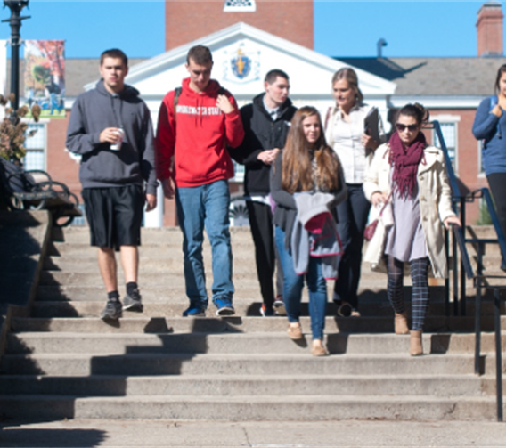
What is the Massachusetts Inclusive Concurrent Enrollment Initiative? (MAICEI)
MAICEI historically funds partnerships between public institutes of higher education and local school districts that are designed to offer inclusive college options for students identified as having an intellectual disability, autism, or developmental disability.
Source: MAICEI

Slide 4
Alternate Pathway to College
Traditional
Matriculated
Placement tests, essays
Pursuing a degree
Reasonable accommodations
Alternate
Non-
Matriculated
Person-centered planning
Individual support plan
Focus on employment goals

Slide 5
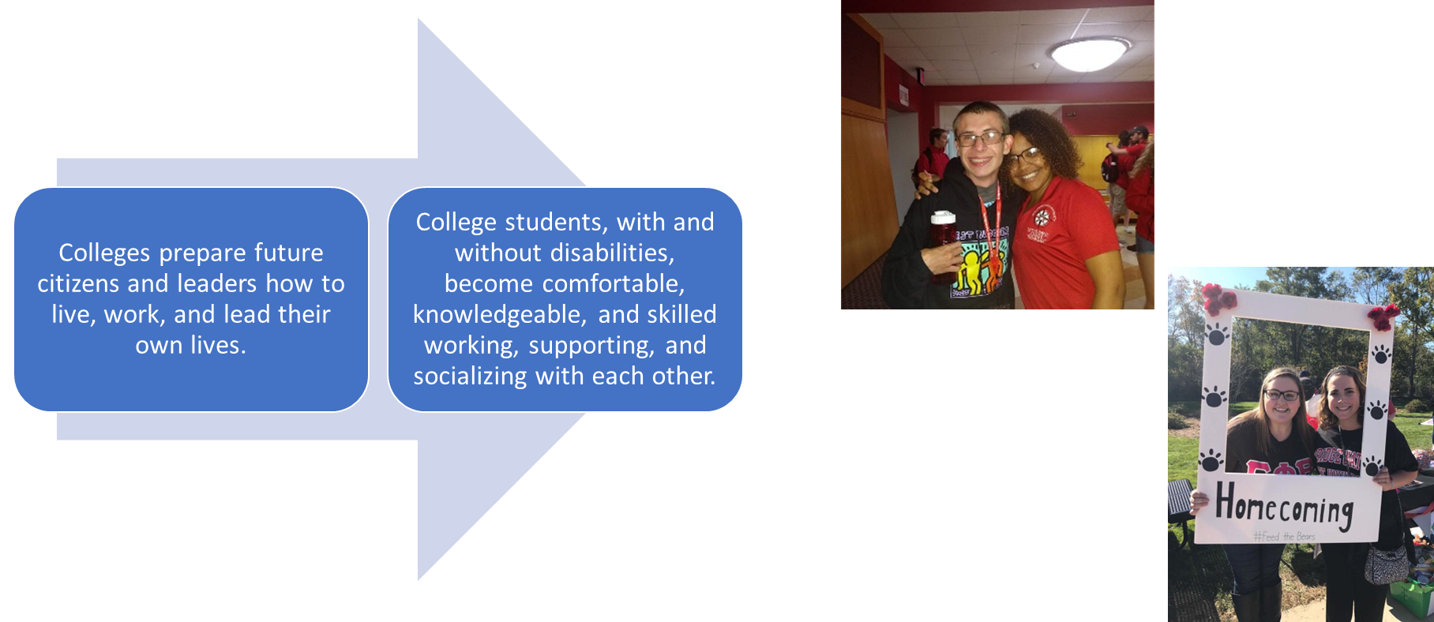
Why is the MAICEI Program important for the Higher Education Community?
Notes:
Secondary Transition: A coordinated set of activities for a child with a disability that is designed to be within a results-oriented process, that is focused on improving the academic and functional achievement of the child with a disability to facilitate the child’s movement from school to post-school activities, including postsecondary education, vocational education, integrated employment (including supported employment), continuing and adult education, adult services, independent living, or community participation.- IDEA 2004: 34 CFR 300.43

Slide 6
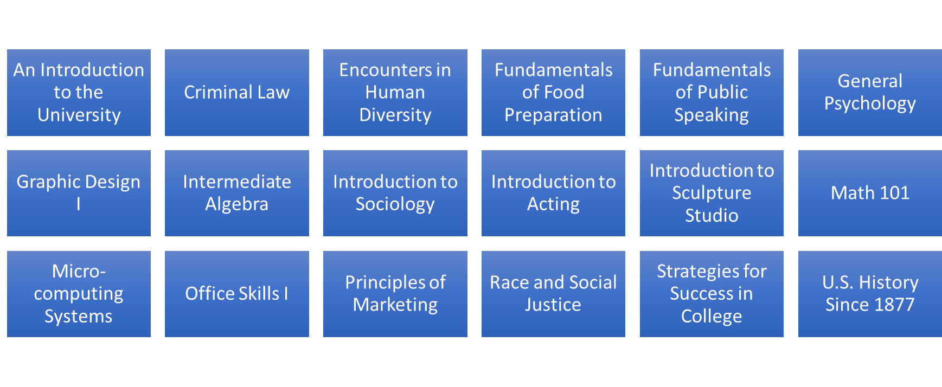
Example of Inclusive Courses in MAICEI Programs
*Includes credit and non-credit bearing courses

Slide 7
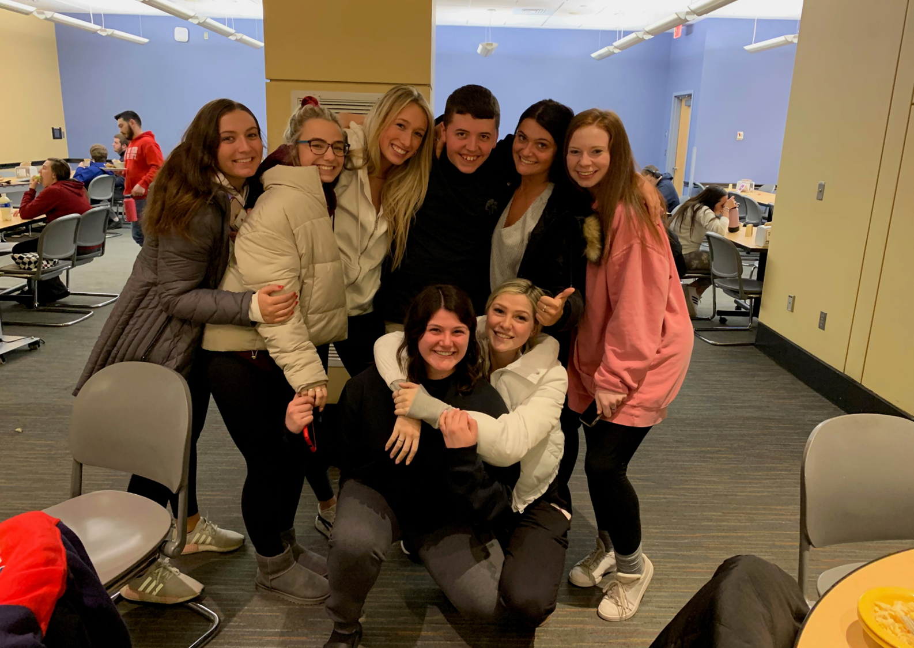
Current Massachusetts MAICEI Campuses
Bridgewater State University
Bridgewater State Residence Life
Bristol Community College
Cape Cod Community College
Framingham State University
Northern Essex Community College
Holyoke Community College
Massasoit Community College
Mass Bay Community College
Mass College of Art & Design
Middlesex Community College
Salem State University
Salem State Residence Life
UMASS Amherst
UMASS Boston
Westfield State University

Slide 8
Massachusetts General Law Inclusive Secondary Education
Removes barriers precluding persons with Intellectual Disabilities and Autism from participating in state colleges and universities
Requires all state colleges and universities to establish guidelines for student selection
Expands the Partnership Leadership Team by including state disability agencies

Slide 9
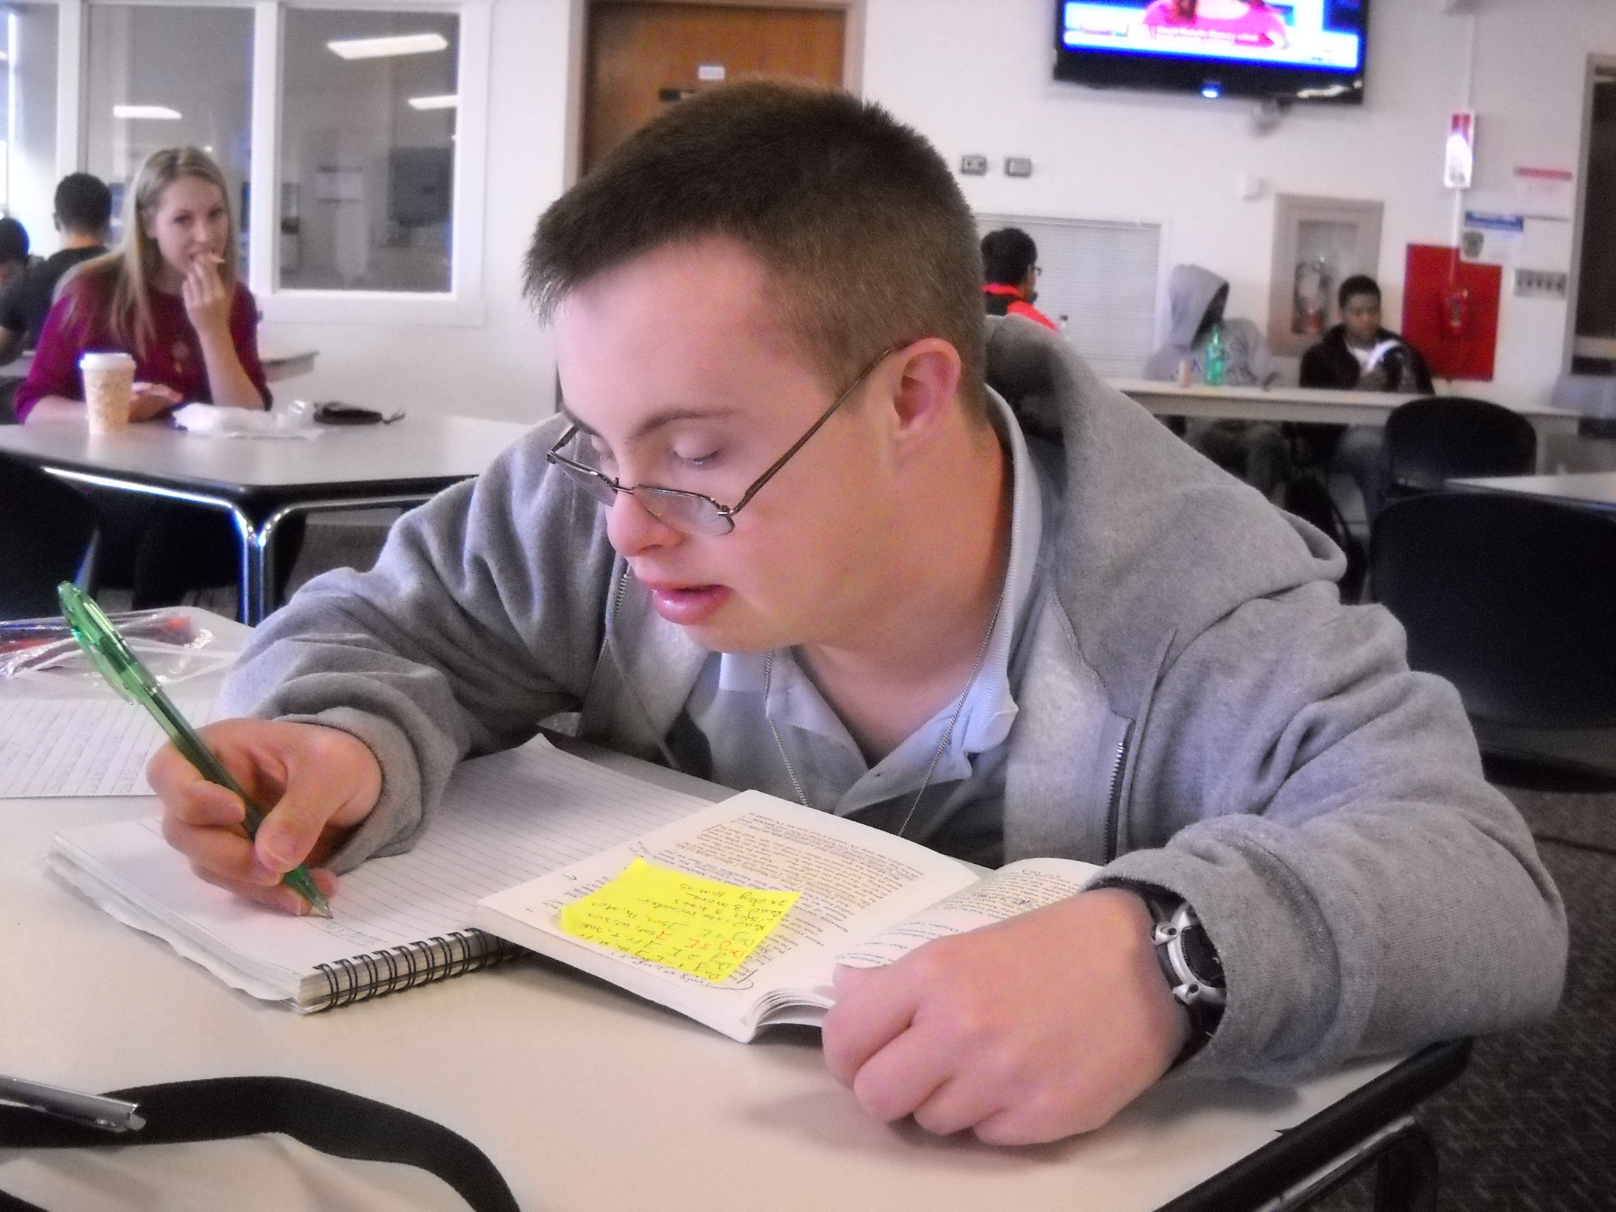
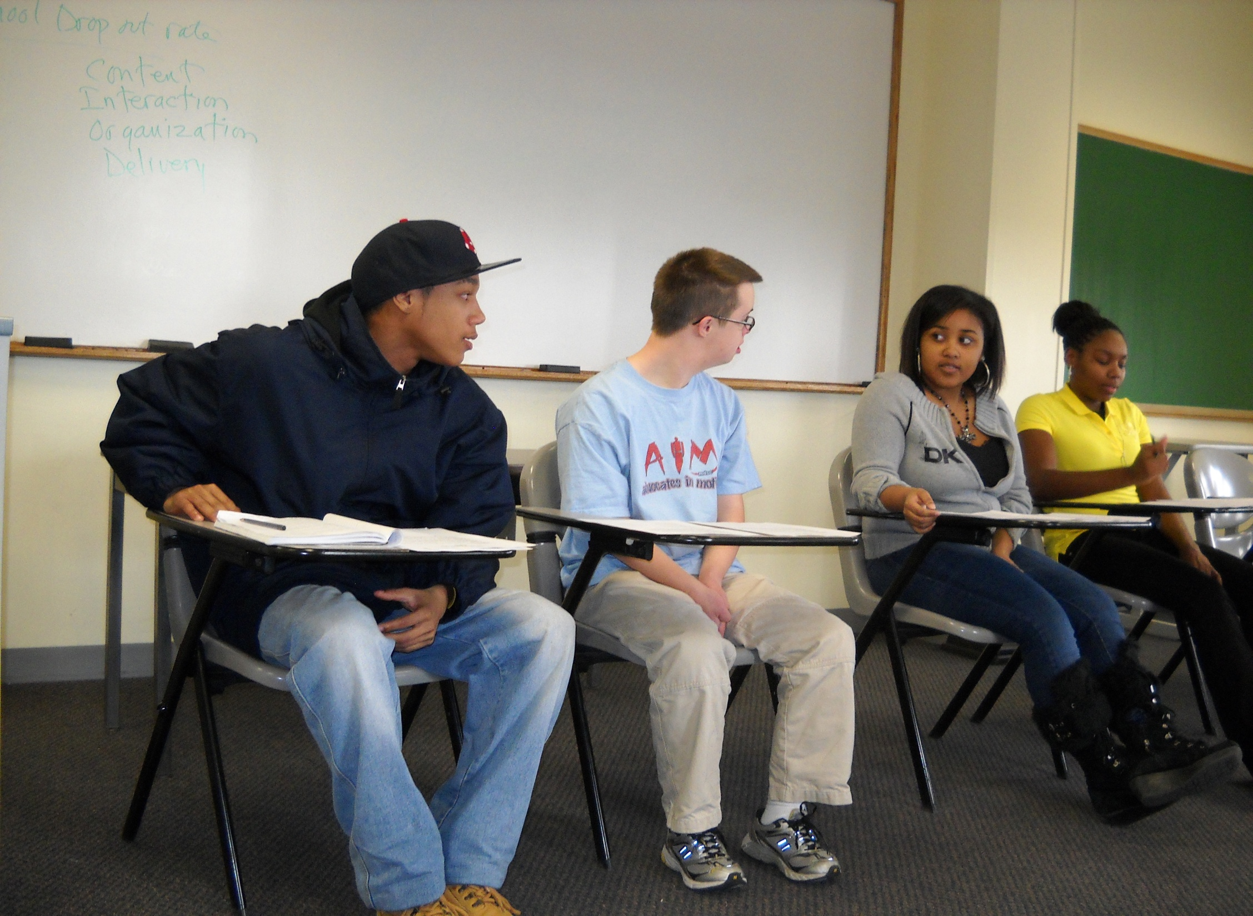
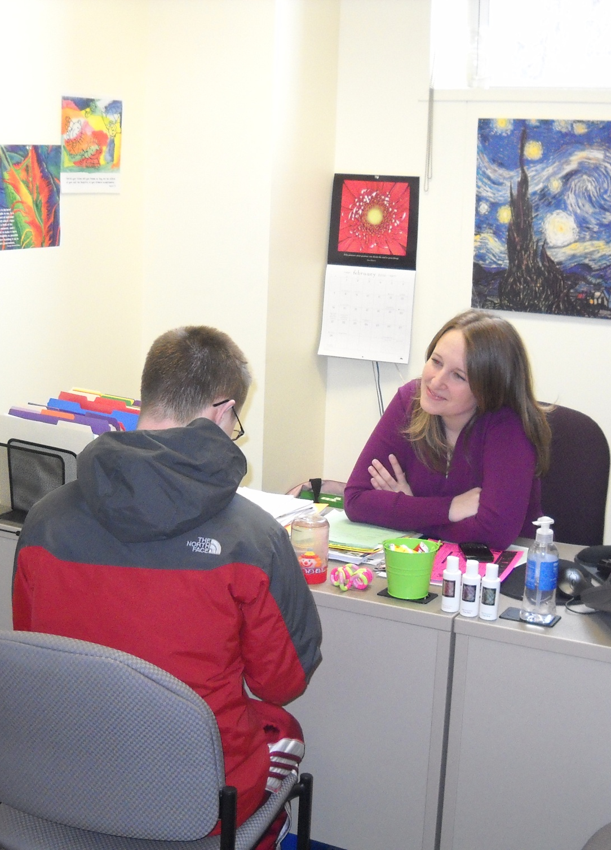
MassBay Community College

Slide 10
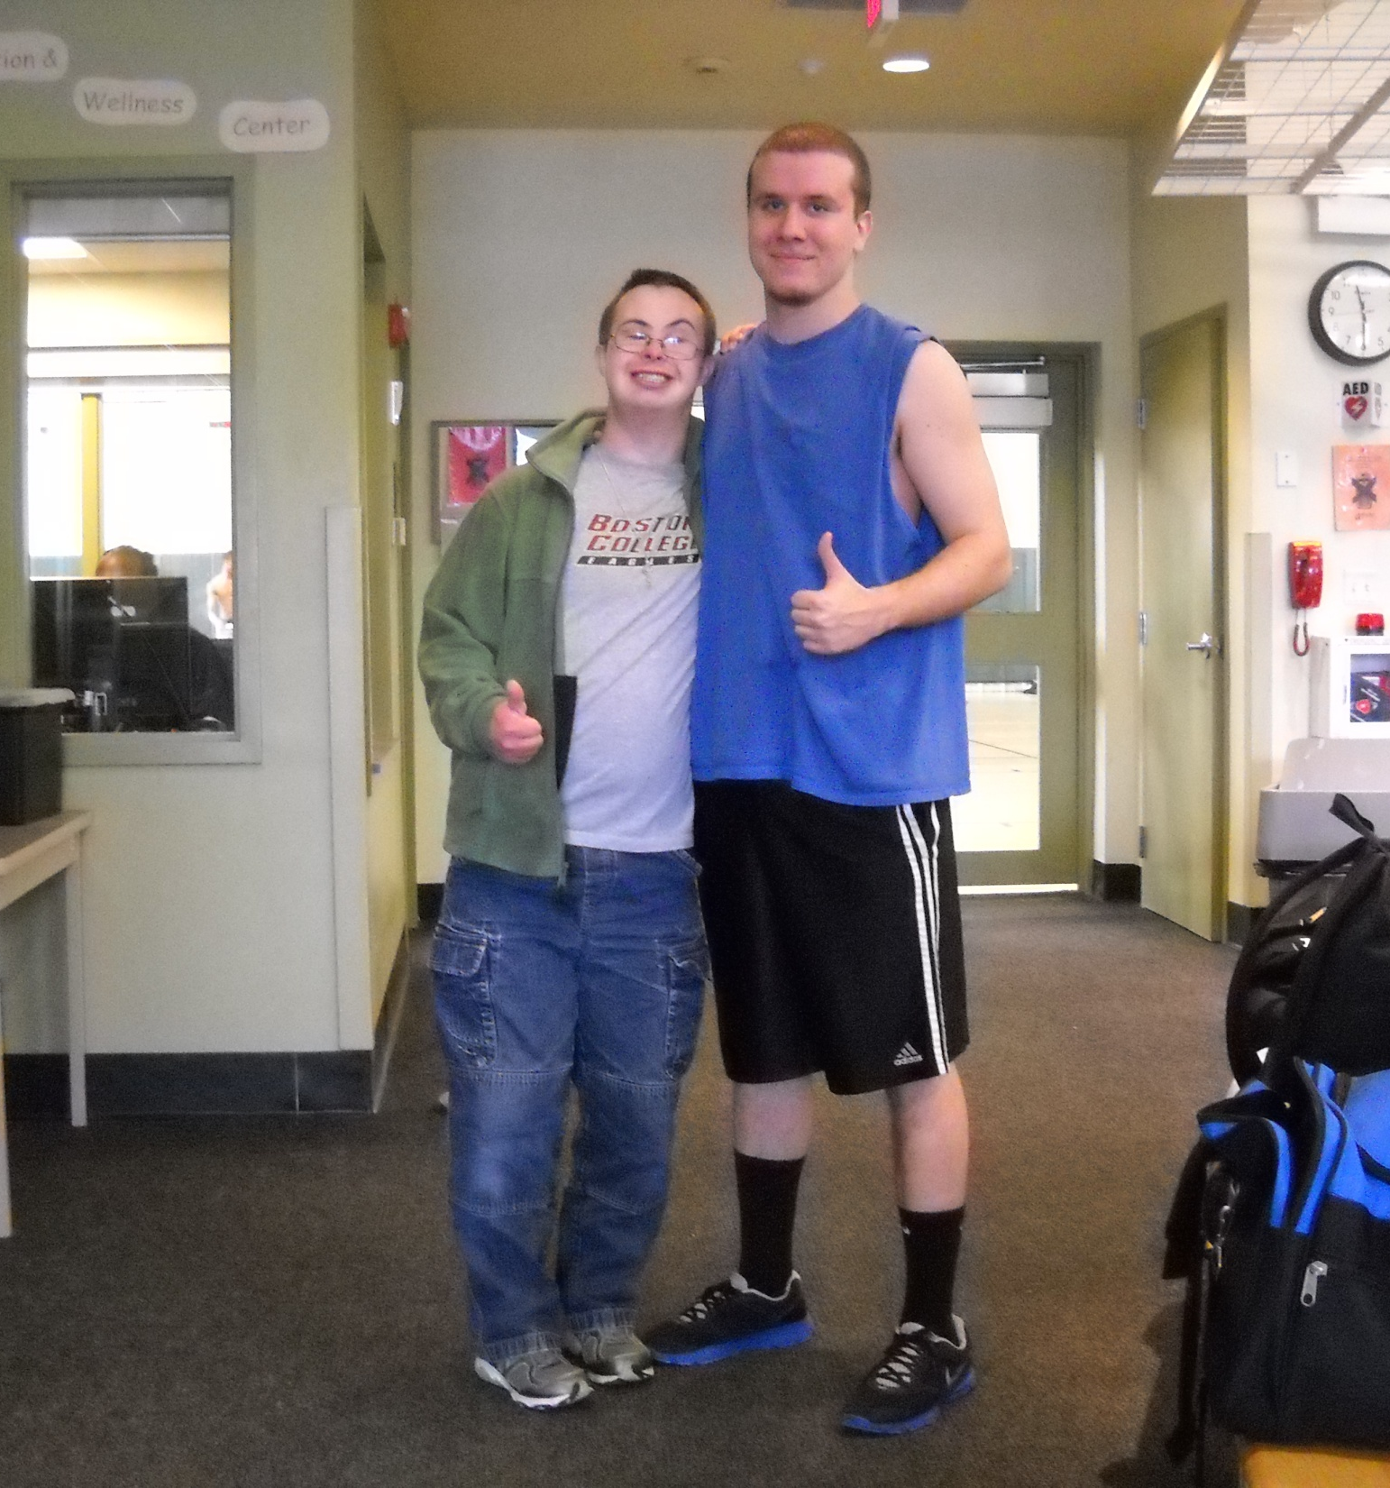
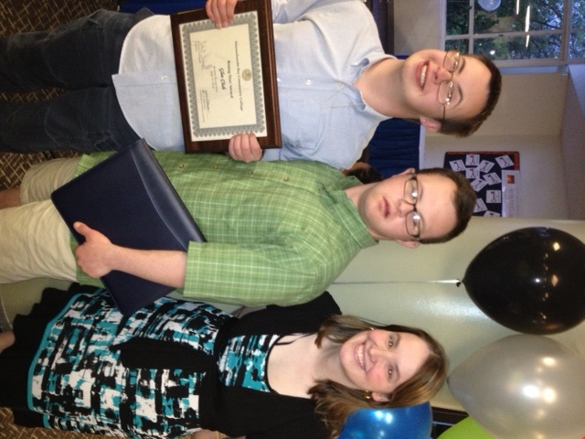
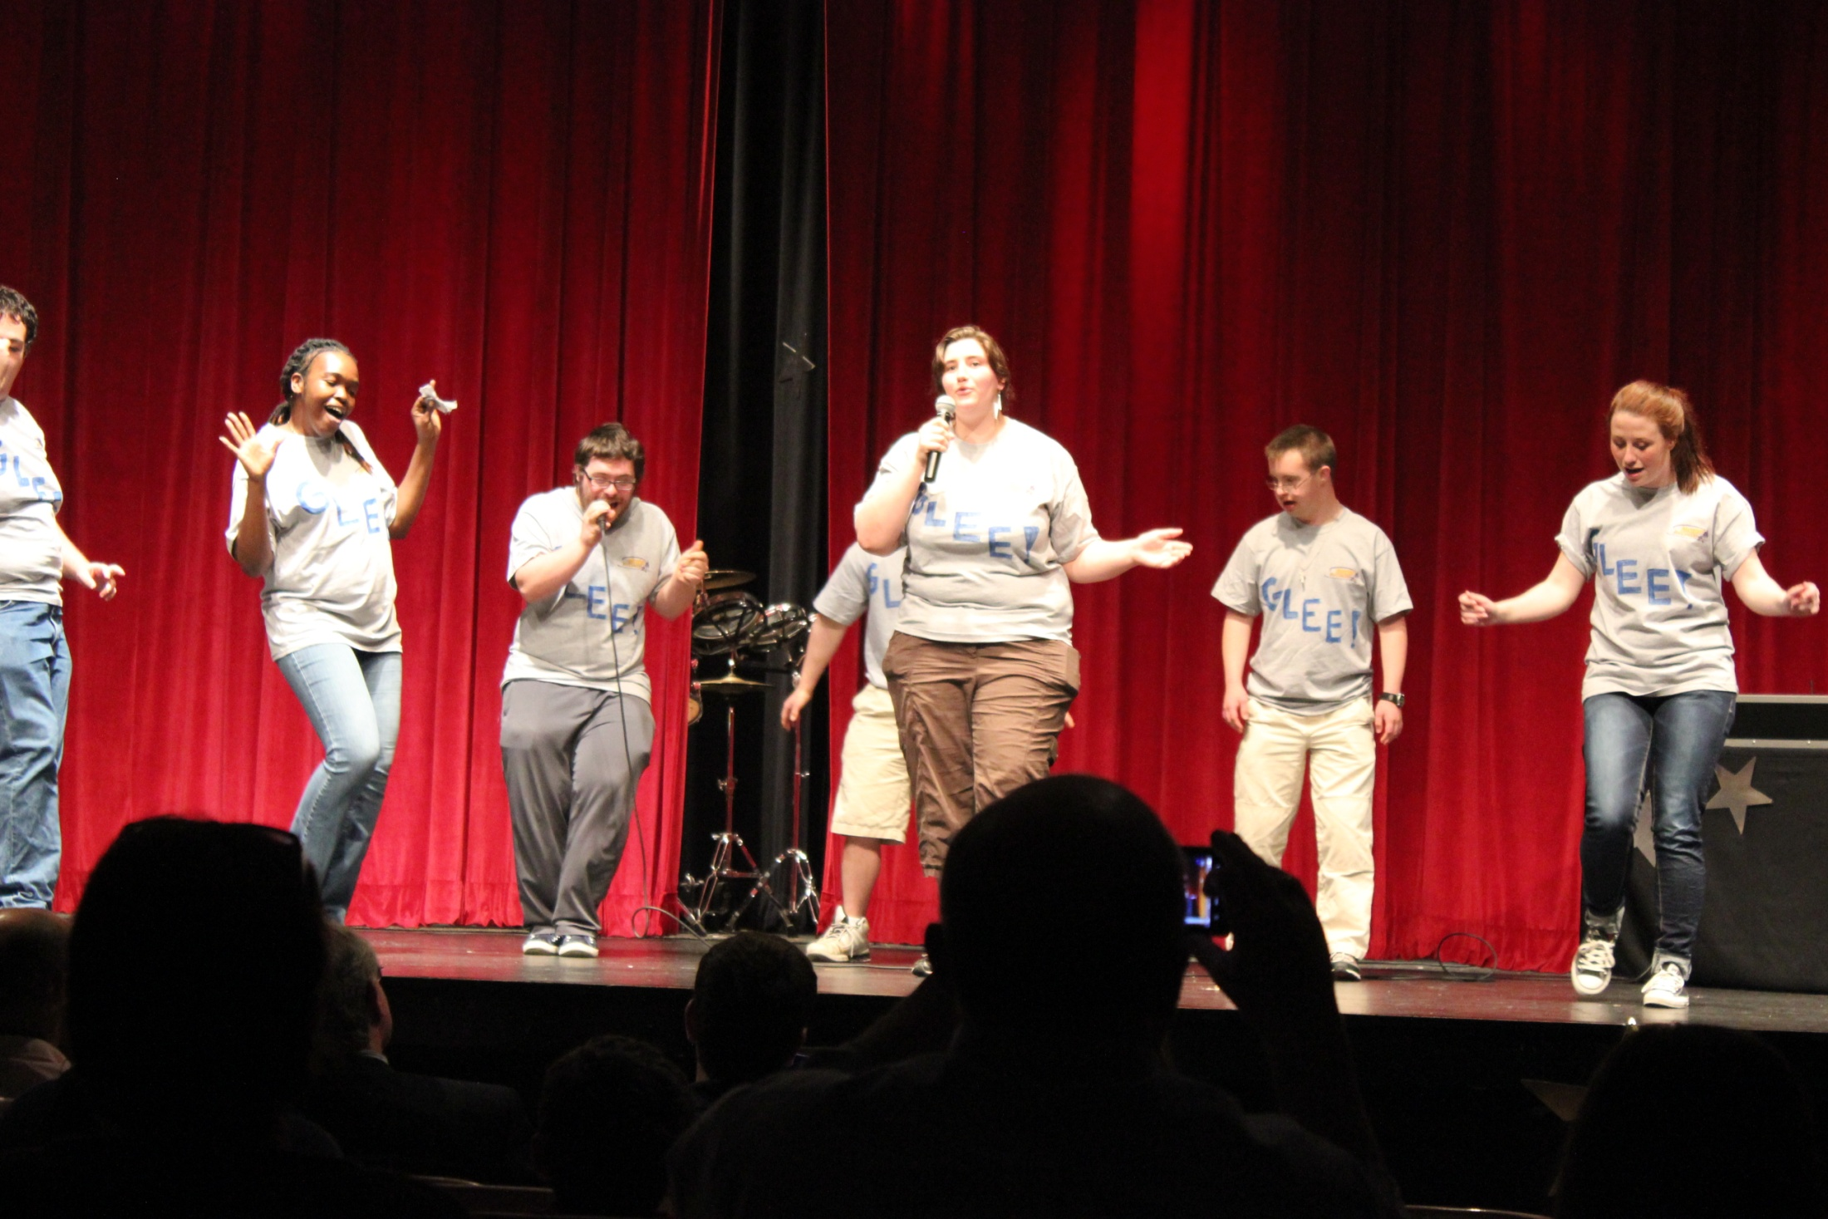
MassBay Social Life

Slide 11
Early Jobs:
Volunteer Positions

Slide 12
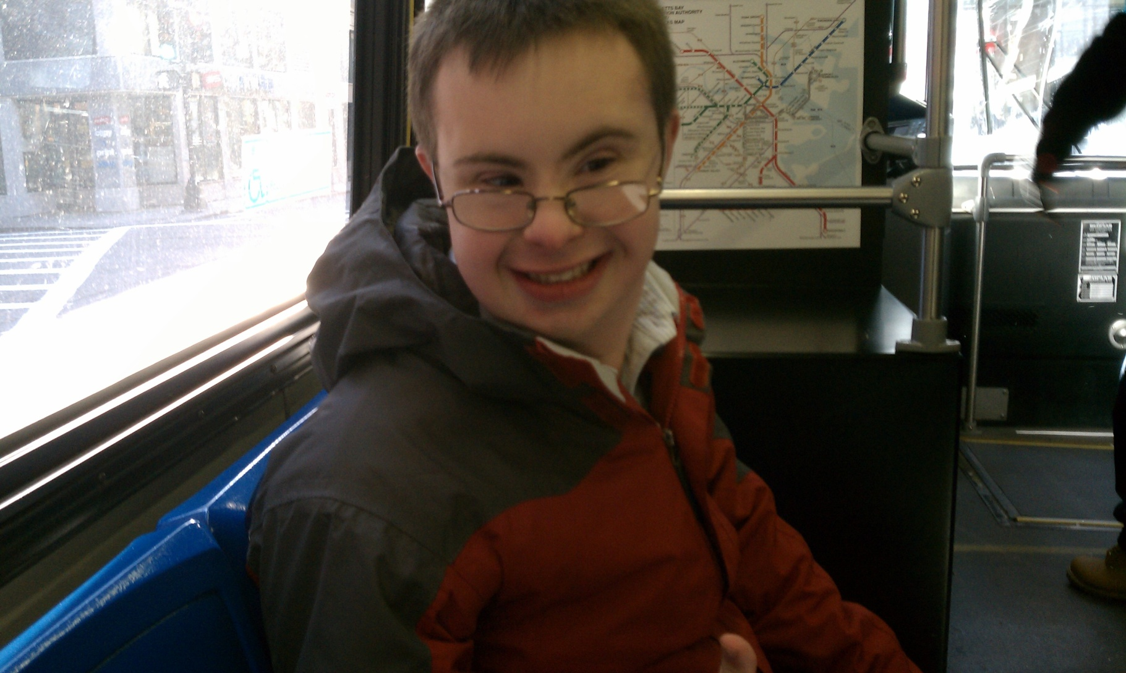
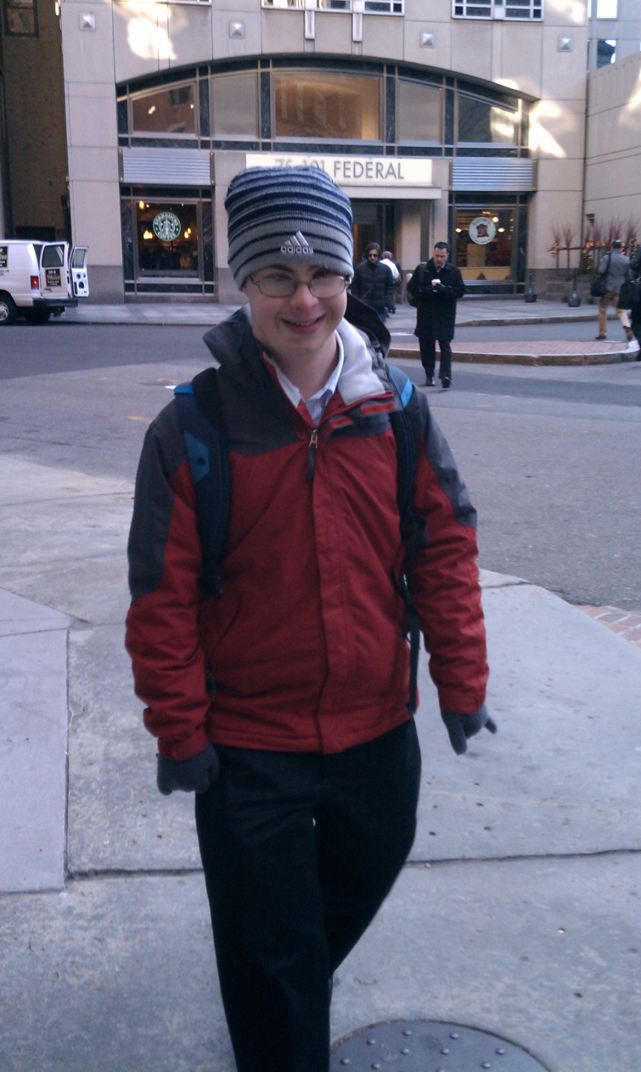
Public
Transportation

Slide 13
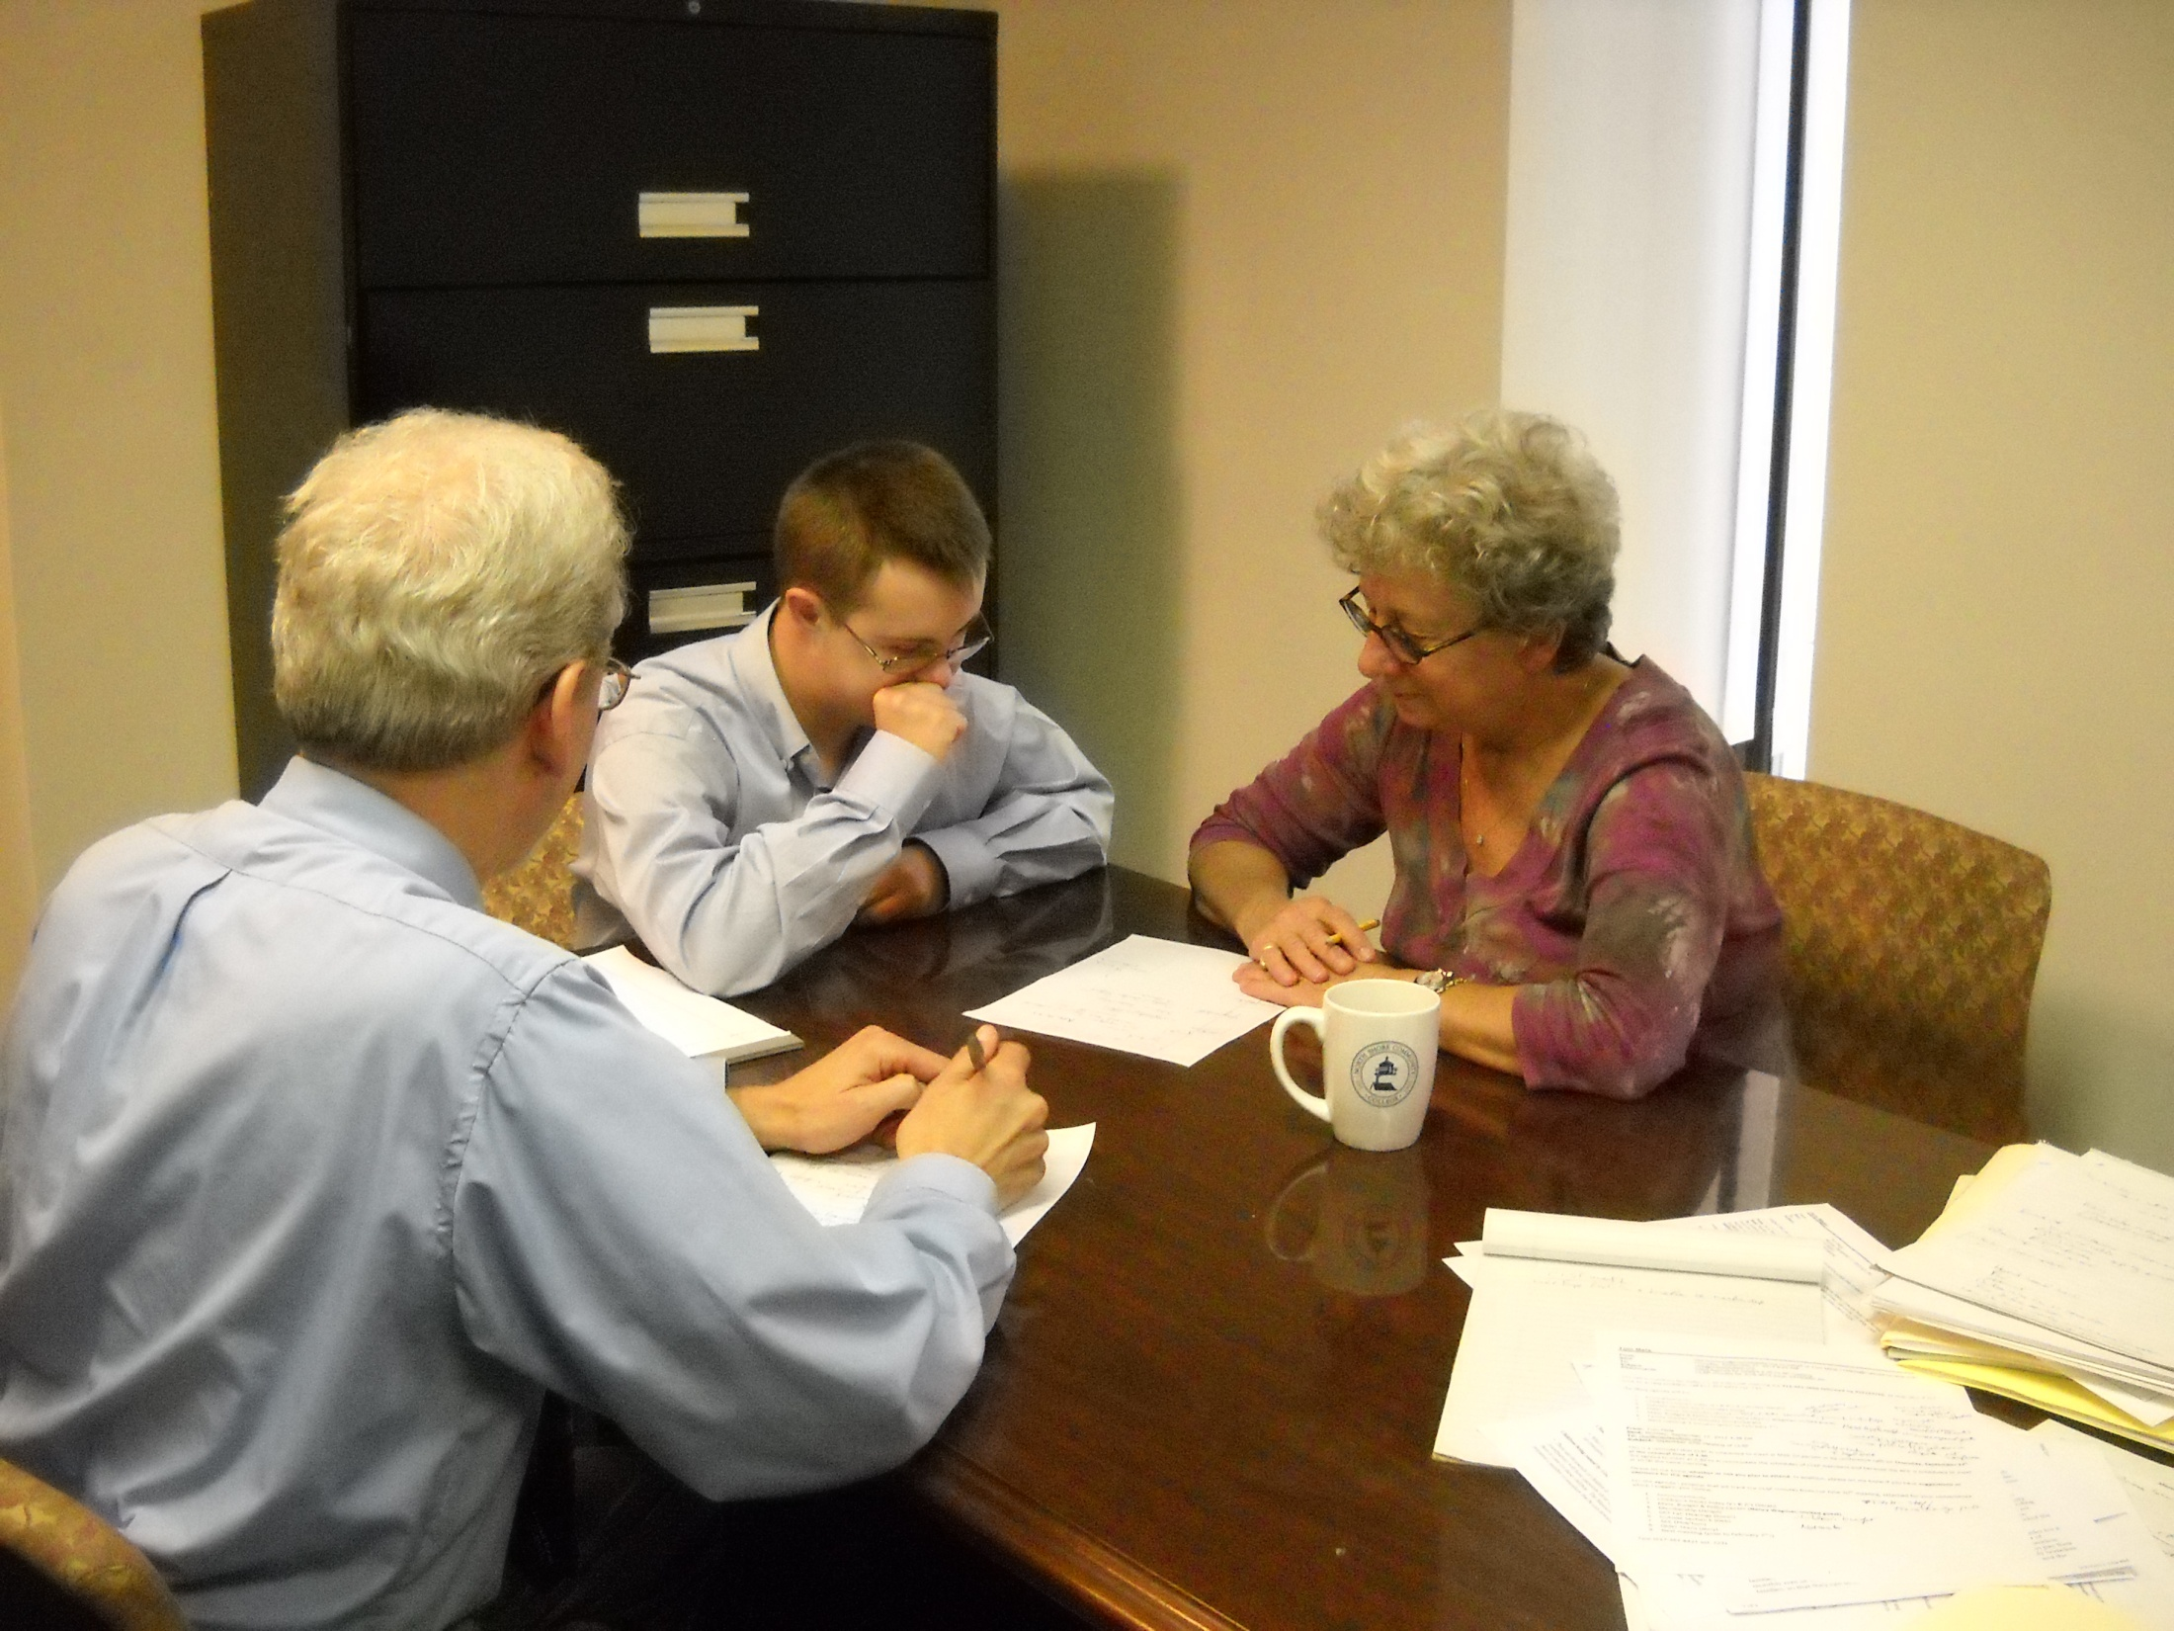
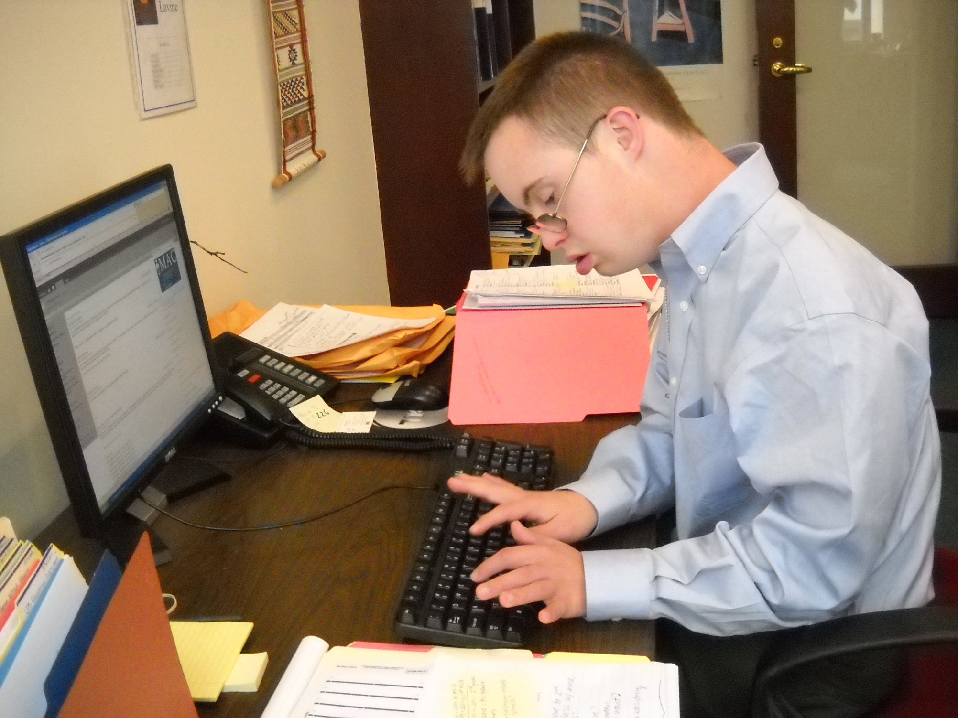
Advocacy and Outcomes

