Slide 1
Two Steps Forward, One Step Back:
Resuming Progress in MA Education Reform
Thomas J. Kane
Harvard University
Presentation to the
Massachusetts Board of Elementary and Secondary Education
June 27, 2023
Notes:
The author, Christopher Booker, argues that all literature follows one of seven basic story lines: overcoming the monster, rags to riches, the quest, etc.
Whether or not he’s right about that, I have observed that the education policy debate does follow a formula: on one side, those proposing a given reform declare the status quo unsustainable, by arguing that outcomes are getting worse or have been stagnant for a long time. On the other side of the debate, those opposing the reform lament the inefficacy of the preceding reform proposals. It’s a common pattern of policy argumentation, not unique to education. But notice, that in this structure, both sides stipulate that the status quo is not working, albeit for different reasons.
It’s the nature of democracy. But, over time, such argumentation has a corrosive effect on our institutions. Whether it’s immigration or gun control or education, observers gradually conclude that it’s a hopeless quagmire. And, most dangerously, politicians gradually retreat from it, seeing little value in risking their personal capital in pushing structural reform.
So, today, I’m going to argue….

Slide 2
Nationally, achievement rose 1990-2013
22 points
11 points
Context:
B-W gap = 33 points
(in 1990)
NAEP Scale Points
6 points
29 points
B-W gap = 32 points
(in 1990)
Source:
NAEP Data Explorer

Slide 3
Massachusetts achievement also rose, although recent losses are larger.
26 points
17 points
Context:
B-W gap = 33 points
(in 1990)
NAEP Scale Points
11 points
28 points
B-W gap = 32 points
(in 1990)
Source:
NAEP Data Explorer

Slide 4

Education is the “balance wheel of the social machinery”
Education is the “balance wheel of the social machinery.” -Horace Mann
VS.
More discretionary income at the top,
income-based residential segregation
School accountability,
School finance reforms
But the balance wheel was under strain.

Slide 5
Nationally, racial gaps were narrowing.
Grade 8 Math
Grade 4 Math
NAEP Scale Points
NAEP Scale Points
Source:
NAEP Data Explorer

Slide 6
As they were in Massachusetts.
(Except for B-W Gap in 8th grade math.)
Grade 8 Math
Grade 4 Math
NAEP Scale Points
NAEP Scale Points
Source:
NAEP Data Explorer

Slide 7
On NAEP, math improved at all income levels…
NAEP Scale Points
NAEP Scale Points
For methodology, see Hashim, Kane, Kelley-Kemple, Staiger, “Have Income-based Achievement Gaps Widened or Narrowed?”
NBER Working Paper No. 27714.

Slide 8
…especially for low-income families.
19 points
20 points
NAEP Scale Points
NAEP Scale Points
34 points
26 points
For methodology, see Hashim, Kane, Kelley-Kemple, Staiger, “Have Income-based Achievement Gaps Widened or Narrowed?”
NBER Working Paper No. 27714.

Slide 9
Reading improved for low- and middle- income families.
NAEP Scale Points
NAEP Scale Points
For methodology, see Hashim, Kane, Kelley-Kemple, Staiger, “Have Income-based Achievement Gaps Widened or Narrowed?”
NBER Working Paper No. 27714.

Slide 10
Reading improved for low- and middle- income families.
NAEP Scale Points
31 points
NAEP Scale Points
15 points
For methodology, see Hashim, Kane, Kelley-Kemple, Staiger, “Have Income-based Achievement Gaps Widened or Narrowed?”
NBER Working Paper No. 27714.

Slide 11
In MA, high poverty districts improved the most
MCAS Scale Points
MCAS Scale Points
7 pts
11 pts
13 pts
14 pts
Data provided by John Papay, Brown.

Slide 12

Those Born in States with Large NAEP Benefited
Those Born in States with Large NAEP ↑ Benefited
Source: E. Doty, T.J. Kane, T. Patterson & D. Staiger “What Do Changes in State Test Scores Imply for Later Life Outcomes?” NBER Working Paper No. 30701, December 2022.

Slide 13







What has the increase in achievement been worth
What has the increase in achievement been worth?
(For one cohort of 8th graders of 2013)
Increase in 8th grade NAEP since 1992
8.3% gain
Per s.d.
PV life
Earnings
$$×$$
# of 8th graders
$$×$$
$$×$$
$$=$$
$6.4 billion
.8 s.d.
.083
$1.2 million
80k
$$×$$
$$×$$
$$×$$
$$=$$

Slide 14
What has increased NAEP score been worth summing over all cohorts, 1993-2019?
What has increased NAEP score been worth
summing over all cohorts, 1993-2019?
Sum = $107 billion

Slide 15
Education reform did not fail.
Between 1990 and 2013, the U.S. saw large improvement in 4th and 8th grade math at all income levels, but especially for low-income students. Racial/ethnic gaps narrowed.
In states with large NAEP increases (like MA), income/educational attainment improved, while teen motherhood/incarceration/arrests declined.
Two current challenges:
Respond to pandemic achievement losses.
Resume progress in Massachusetts education.

Slide 16
The pandemic losses increased inequality in MA
The pandemic losses increased inequality in MA
Source: Harvard CEPR and Stanford SEDA, EducationRecoveryScorecard.org

Slide 17
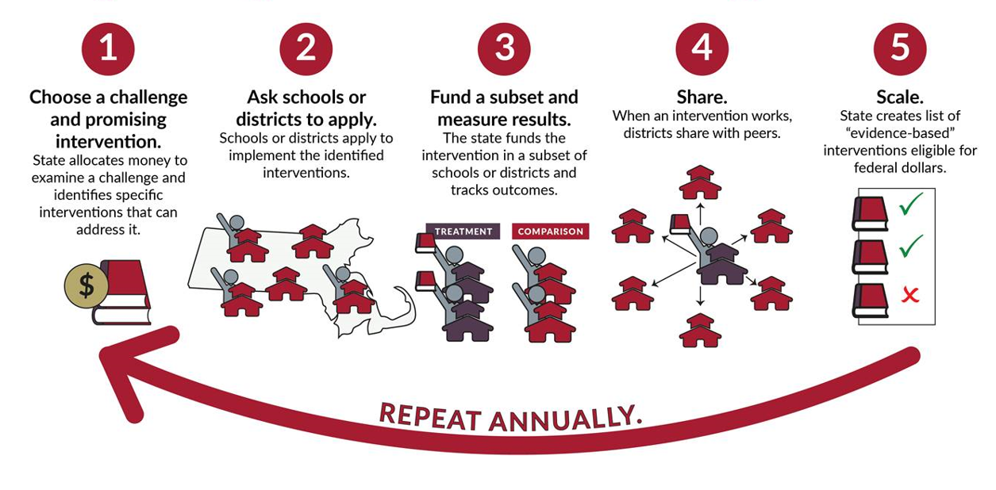
How MA could resume improvement:
State Innovation Fund
Similar to the 21st Century Education Trust Fund in the Student Opportunity Act of 2019.

Slide 18
Appendix Slides

Slide 19
Before 2019, every state had improved in math.

Slide 20
And many states improved in reading.

Slide 21
Between 2019 and 2022, the U.S. gave up 40% of pre-pandemic progress in 8th grade NAEP Math!
Source: E. Doty, T.J. Kane, T. Patterson & D. Staiger “What Do Changes in State Test Scores Imply for Later Life Outcomes?”
NBER Working Paper No. 30701, December 2022.

