Slide 1
Historical Overview of MCAS: where it started, where we have been, and where we are going
September 19, 2023

Slide 2
Where it started: McDuffy v. Secretary of Education - June 1993
McDuffy decision established the state constitutional standards against which education reform efforts in Massachusetts would be judged
SJC held that the Commonwealth had failed to meet its constitutional obligation “to cherish… the public schools and grammar schools in the towns.“ Mass. Const., pt. II, ch. V, § II , citing, among other things, the Report of the Committee on Distressed School Systems and School Reform published by the Massachusetts Board of Education in 1991.

Slide 3
Where it started: McDuffy v. Secretary of Education - June 1993
The court stated that “[a]n educated child must possess 'at least the seven following capabilities:
(i) sufficient oral and written communication skills to enable students to function in a complex and rapidly changing civilization;
(ii) sufficient knowledge of economic, social, and political systems to enable students to make informed choices;
(iii) sufficient understanding of governmental processes to enable the student to understand the issues that affect his or her community, state, and nation;
(iv) sufficient self-knowledge and knowledge of his or her mental and physical wellness;
(v) sufficient grounding in the arts to enable each student to appreciate his or her cultural and historical heritage;
(vi) sufficient training or preparation for advanced training in either academic or vocational fields so as to enable each child to choose and pursue life work intelligently; and
(vii) sufficient level of academic or vocational skills to enable public school students to compete favorably with their counterparts in surrounding states, in academics or in the job market.'

Slide 4
Where it started: Massachusetts Education Reform Act - June 1993
At its most basic level, the Education Reform Act required the following elements:
the establishment of high standards that each student would be expected to meet
a statewide assessment system to measure progress
an accountability system to hold schools and districts responsible for progress in meeting the new standards
the establishment of the competency determination
a new school finance system designed to make available an adequate level of resources to each school district irrespective of each community’s fiscal capacity

Slide 5
Where we were: NAEP achievement in 1990s
 | MA Math G4 rank* | MA Reading G4 Rank* | MA Math G8 rank* | MA Reading G8 Rank*
1992 NAEP | 7 | 3
1996 NAEP | 6 | 4 | 12
1998 NAEP |  |  |  | 4
*Ordinal rank of state scores

Slide 6
MCAS debuts in 1998
MCAS first administered in 1998 after development time and field testing
Administered in grades 4, 8, and 10
Grade and Subject | Proficient or Higher | Advanced | Proficient | Needs Improvement | Warning/ Failing | Average Raw/ Scaled Score | Students Included (#)
 | STATE | STATE | STATE | STATE | STATE | STATE
GRADE 04 - ENGLISH LANGUAGE ARTS | 20 | 1 | 19 | 66 | 15 | 230 | 74,452
GRADE 04 - MATHEMATICS | 34 | 11 | 23 | 44 | 23 | 234 | 75,235
GRADE 04 - SCIENCE AND TECH/ENG | 48 | 6 | 42 | 40 | 12 | 238 | 75,230
GRADE 08 - ENGLISH LANGUAGE ARTS | 55 | 3 | 52 | 31 | 14 | 237 | 68,486
GRADE 08 - MATHEMATICS | 31 | 8 | 23 | 26 | 42 | 227 | 69,014
GRADE 08 - SCIENCE AND TECH/ENG | 28 | 2 | 26 | 31 | 41 | 225 | 68,995
GRADE 10 - ENGLISH LANGUAGE ARTS | 38 | 5 | 33 | 34 | 28 | 230 | 60,857
GRADE 10 - MATHEMATICS | 24 | 7 | 17 | 24 | 52 | 222 | 61,430
GRADE 10 - SCIENCE AND TECH/ENG | 22 | 1 | 21 | 42 | 36 | 225 | 61,437

Slide 7
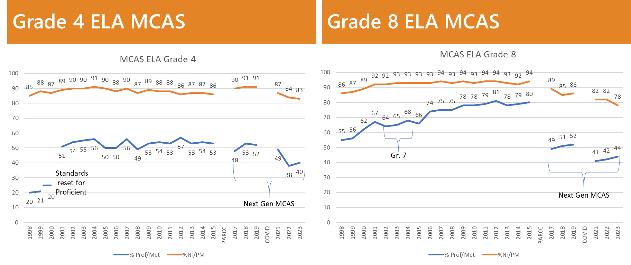
Where have we been: historical ELA MCAS data

Slide 8
Where have we been: historical Math MCAS data

Slide 9
Important Milestones
Class of 2003 – first class with competency determination requirement in ELA and Math
Class of 2010 – STE added to the Competency Determination and threshold for ELA and Math raised
2010 –Introduction of growth model
2017 – development of fully computer-based, Next-Generation MCAS for grades 3-8
2019 – first year of Next-Generation MCAS for grade 10 ELA and Math
2022 – Next-generation tests in HS Science administered (delayed by pandemic)
2022 – CD threshold raised for class of 2026 including parental notification of EPP and improved DESE communication around CD appeals process

Slide 10
Graduation rates at an all-time high

Slide 11
Dropout rates decreased since MCAS began

Slide 12
Why are these data important?
MCAS scores remain the only consistent measure of student achievement in Massachusetts to identify both strengths and challenges
Allows for targeted resource allocation and not guessing
MCAS scores reflect likelihood for future earning success in the labor market

Slide 13
Why are these data important?
Research done by Learning Heroes in 2018 indicated a disconnect in parent perception of their child’s achievement
88% of Massachusetts parents report that their child is at or above grade level in math. In reality, 48% of Massachusetts students in grades 3-8 were at or above grade level in math in 2018.
88% of Massachusetts parents report that their child is at or above grade level in reading. In reality, 51% of Massachusetts students in grades 3-8 were at or above grade level in 2018.

Slide 14
Where are we going?
Full integration of computer-based, Next-Generation MCAS with new procurement ongoing and expected to be awarded in fall 2023
Procurement requirements maintain strengths of program and propose changes to some areas

Slide 15
Educator Involvement in MCAS
Strong and ongoing participation by educators is a hallmark of the MCAS program
265 educators annually (475 unique members since 2017) review and provide feedback on test items at multiple points in the development process, serving as:
Assessment development committee members
Bias and sensitivity committee members
Expert reviewers
280 educators participated on standard setting panels between 2017 and 2022, providing their expertise in determining what students should know and be able to do at each achievement level

Slide 16
Proposed Changes – New Science Assessment
Move toward replacing current science tests in grades 5 and 8 with new science assessment that encourage the “doing of science”
Groups of questions linked into storylines that have more real-world purpose, show diverse students and adults working on science, and include an interactive simulation so students can do experiments, collect data or conduct observations.
Timeline
FY24 – Field test
FY25 – Field test
FY26 - Operational

Slide 17
Proposed Changes – New Civics Assessment
Implement civics assessment in grade 8
Multiple, interrelated components designed to balance testing time, content representation, and the measurement of deeper learning; measuring students’ understanding of civics and the foundations of the Massachusetts and U.S. governments
Timeline
FY24 – Field test
FY25 - Operational

Slide 18
Proposed Changes – Improved access
Provide translated versions of the assessments in additional grades and additional languages
Currently offer Spanish tests in math and science at high school
Proposed
Offer Spanish in grades 3-8 in math and science
Potentially phase in additional languages for grades 3-8 and HS math and science

Slide 19
Proposed Changes – Return of Results
Improve turnaround times
Increase use of automated scoring to provide results back more quickly
Consider rolling return of results to parents by eliciting proposals for online portal/mobile site
Provide connections to other resources and information
Improve resources around uses and interpretation of results

Slide 20
Proposed Changes – Testing Time
Average testing time in grades 3-8 is around 7 hours for ELA and Math and 9 hours with Science (~1% of required instructional hours)
ELA accounts for about 4 hours
Implement revisions to ELA test to continue to bring down the amount of time spent on testing
Reduction in number of essays
Introduction of standalone items to test language standards

