Slide 1
Competency Determination Overview and Impact

Slide 2
Agenda
Summary
CD Value
CD Graduation Impact
The CD Value section is from analysis completed by Professor John Papay and presented to the DESE Board at the April 2022 meeting and from additional analysis recently provided. Professor Papay is Associate Professor of Education and Economics at Brown University and is Director of the Annenberg Institute.
The CD Graduation Impact analysis is from data provided by DESE Associate Commissioner Rob Curtin.

Slide 3
Summary MCAS and the CD have substantial value in predicting certain key life outcomes for students in all student groups, while helping policy-makers and educators prioritize needs
CD scores are on average predictive of certain important life outcomes
Of approximately 70,000 students in the statewide graduating class
96% earn the CD
3% don’t earn the CD and also don’t meet local district graduation requirements
1% don’t earn the CD and meet local district graduation requirements
Most students who pass do so on their 1st attempt (usually Grade 10), and almost all pass on the 2nd or 3rd attempt (usually Grade 11)
A significant number of Grade 12 dropouts have passed the CD
A relatively small number of districts have a disproportionate number of total MA students not earning the CD
Of the 51 states (including D.C.)
49 states including MA have comprehensive state-mandated graduation requirements
48 of 49 states have course and other requirements (some also require tests)
MA is the only one of the 49 states whose only state requirement is a test (the CD)
2 states have no state-mandated graduation requirements

Slide 4
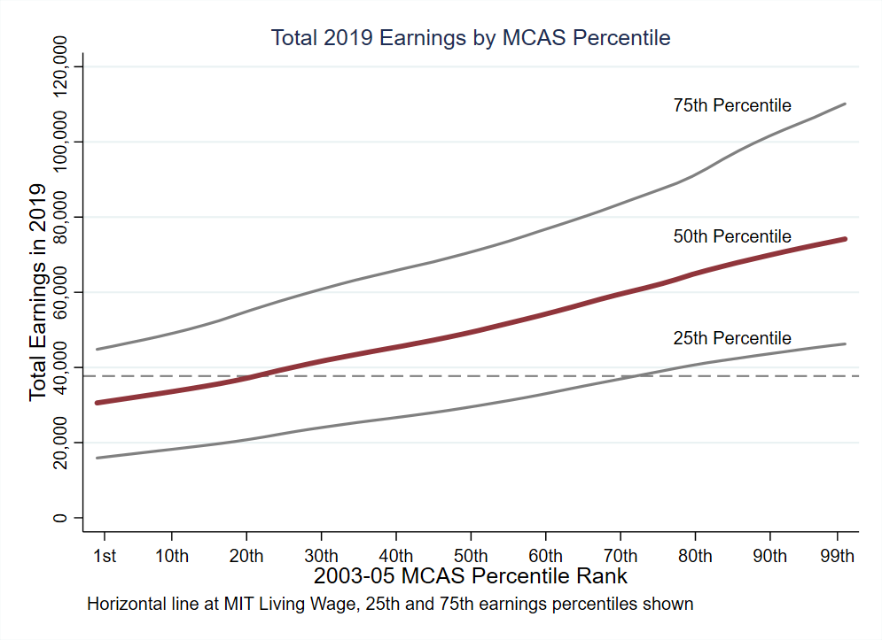
Grade 10 MCAS scores help predict future earnings
CD Value
We look at median annual earnings ~ age 30 for students at each MCAS score
Students with higher MCAS scores go on to earn substantially more in the labor market.
There is substantial variation in earnings at each MCAS score point (MCAS scores explain about 13% of the variation in earnings).
Living Wage
NOTE: We only observe in-state earnings reported to the UI system. This excludes self-employed individuals or those who work for the federal government or military. Living Wage from MIT estimates for two working parents with two children.

Slide 5
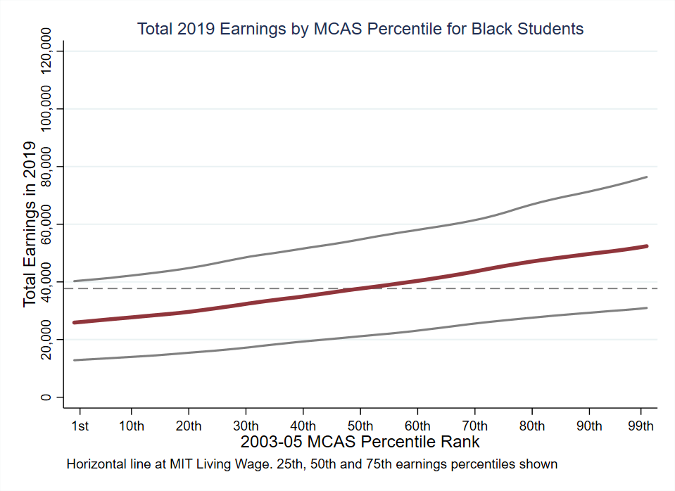
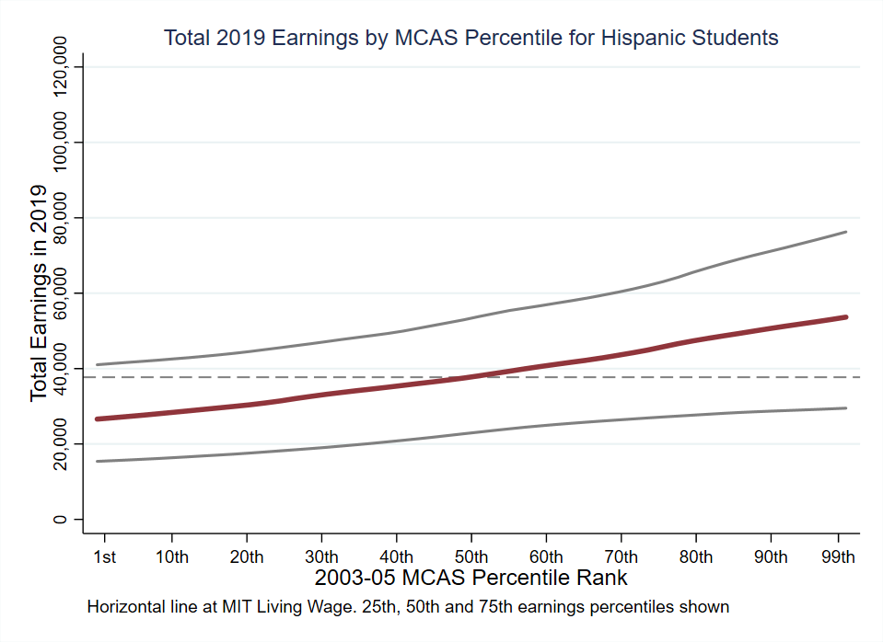
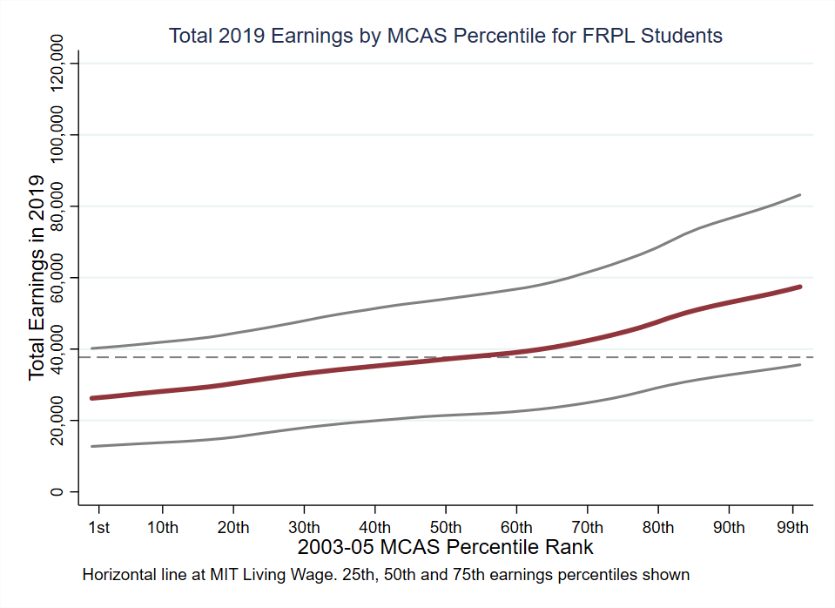
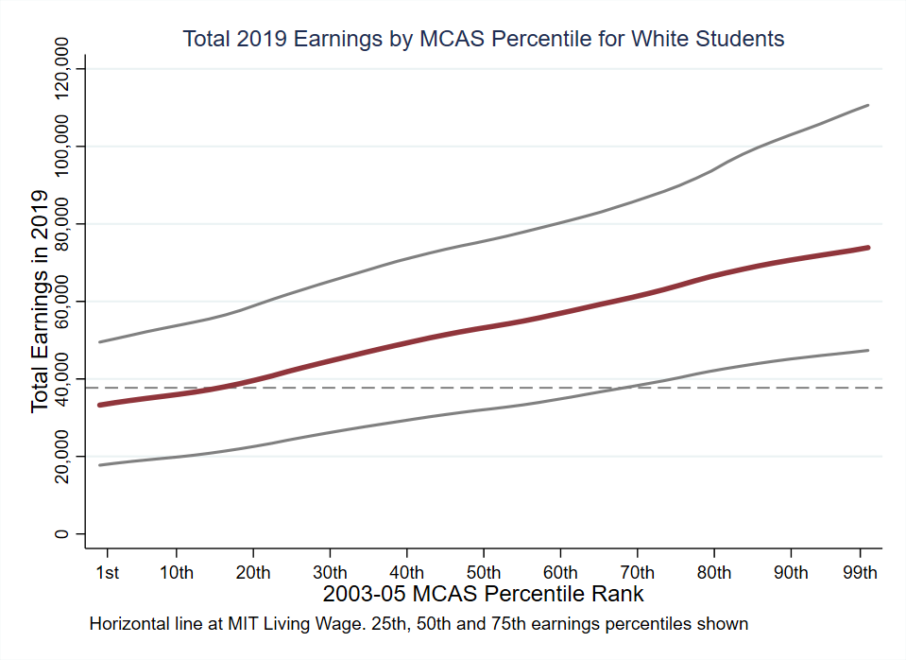
CD Value: This relationship between higher Grade 10 MCAS scores and higher earnings exists across different student groups
CD Value
This relationship between higher Grade 10 MCAS scores and higher earnings exists across different student groups

Slide 6
Grade 10 MCAS scores help predict earnings among similar students with the same education level and demographics
CD Value
Estimated average 2019 earnings by MCAS math percentile and educational attainment
for demographically similar students who attended the same high school
We compare students with similar demographics from the same high school.
Among students with the same education level, students with higher MCAS scores have higher earnings.
We also see large returns to educational attainments (particularly four-year college degrees) for students at the same MCAS score level.
4-Year College Graduates
Terminal High School Graduates
High School Dropouts
Notes:
We see the same pattern for 2-year college graduates. We tend to focus on 4-year colleges in the report because of the large returns to a bachelor’s degree, although we are actively engaged in some research looking at the experiences of students in Massachusetts two-year colleges because they are the most common form of post-secondary education for low-income students.

Slide 7
When comparing students with similar Grade 8 scores and similar demographic characteristics who attend the same high school, those with higher Grade 10 scores have better future incomes
CD Value
75th percentile
$64,000
(+21%)
Students scoring at the state average on Grade 8 MCAS
$53,000
State average
Age 30
Earnings
Grade 10
MCAS

Slide 8
The same relationship can be seen among different student groups
CD Value
Student Group | Increase in Age 30 Earnings for students whose Grade 8 MCAS score was at the mean and increased in Grade 10 to the 75th percentile
 | Percentage (%) | Dollar Earnings ($)
Black | 15.5% | $61,215
Hispanic | 15.9% | $61,427
Asian | 24.3% | $65,879
White | 19.4% | $63,282
ED | 16.3% | $61,639
EL | 6.3% | $56,339
IEP | 10.5% | $58,565
10th Grade Mean: $53,000

Slide 9
The likelihood of enrolling and/or graduating increases significantly at different achievement levels….
CD Value
Educational attainments for 2011 Math test-takers
 | Pass/Fail | Proficient/ Needs Improvement | Meets/Partially Meets | State Avg.
HS Graduation | 79% | 89% | 93% | 91%
Any College Enroll | 46% | 61% | 74% | 75%
4-yr College Enroll | 11% | 28% | 49% | 55%
Any College Grad | 12% | 24% | 40% | 48%
4-yr College Grad | 5% | 18% | 33% | 43%
NOTE: We measure HS graduation within 3 years of taking the 10th grade test, college attendance within 4 years, and college graduation within 7 years.

Slide 10
…and that relationship exists among different student groups
CD Value
Student Group | Pass/Fail | Proficient/Needs Improvement | Meets/Partially Meets | State Average
Black Students
HS Graduation | 66% | 77% | 88% | 86%
Any College Enrollment | 43% | 59% | 65% | 70%
Hispanic Students
HS Graduation | 55% | 76% | 84% | 81%
Any College Enrollment | 33% | 48% | 59% | 60%
White Students
HS Graduation | 83% | 93% | 95% | 93%
Any College Enrollment | 49% | 67% | 80% | 78%
ED Students
HS Graduation | 58% | 78% | 87% | 83%
Any College Enrollment | 36% | 45% | 56% | 60%

Slide 11
Agenda
Summary
CD Value
CD Graduation Impact
The CD Value section is from analysis completed by Professor John Papay and presented to the DESE Board at the April 2022 meeting and from additional analysis recently provided. Professor Papay is Associate Professor of Education and Economics at Brown University and is Director of the Annenberg Institute.
The CD Graduation Impact analysis is from data provided by DESE Associate Commissioner Rob Curtin.

Slide 12
96% of the graduating class consistently earned the CD and met local district graduation requirements
CD Graduation Impact
70,927
72,352
69,919
69,990
68,579
2,752
2,582
2,757
2,668
68,175
69,197
67,337
67,233
65,911

Slide 13
Of the 4% of the graduating class that did not earn the CD, approximately 3/4 did not meet local district requirements and can’t receive a graduation diploma regardless of the CD requirement
CD Graduation Impact
Students Not Earning the CD
2,752
2,582
2,757
2,668
Met local req.
73%
74%
74%
72%
73%
72%
Did not meet
local req.
2018

Slide 14
A high percent of each student group in the graduating class earns the CD
CD Graduation Impact
Number of Students:
6,409
10,868
4,334
46,836
19,492
3,052
11,397

Slide 15
Most students in all student groups who do not earn the CD also do not meet local district graduation requirements
CD Graduation Impact

Slide 16
Among students with IEPs, the percent of students not earning the CD is much higher for those with the most significant needs
CD Graduation Impact
Number of Students:
1,116
2,229
5,272
2,837

Slide 17
The percent of EL students not meeting the CD generally declines the more years the student is considered EL
CD Graduation Impact

Slide 18
Most Grade 12 dropouts have already earned the CD
CD Graduation Impact
Grade 12 Dropouts
Year | # Dropouts |  |  | % of Dropouts
 | w/ CD | w/o CD |  | w/ CD | w/o CD
2019 | 847 | 521 |  | 62% | 38%
2018 | 995 | 512 |  | 66% | 34%
2017 | 862 | 363 |  | 70% | 30%
2016 | 1,037 | 431 |  | 71% | 29%
2015 | 975 | 381 |  | 72% | 28%

Slide 19
14 districts account for 50% of 2019 Grade 12 dropouts, with 51% of dropouts in those 14 districts having met the CD
CD Graduation Impact
Notes:
Slight

Slide 20
15 districts account for 50% of students not earning the CD. Of the 28% in those 15 districts with a Certificate of Attainment, more than 80% are in 9 districts
CD Graduation Impact
2,752 students
1,374 students
Methuen
Fitchburg
Holyoke
Leominster
Boston Day
Methuen
Fitchburg
Holyoke
Everett
Lowell
New Bedford
Lawrence
Fall River
Lynn
Worcester
Brockton
Springfield
Boston
Leominster
Boston

Slide 21
There are some differences among student groups receiving CAs, with each group having a much higher percent not meeting district requirements
CD Graduation Impact

Slide 22
Most districts have few students with a CA. 15 districts have 11+ students with a CA, and in this group most students did not meet local requirements
CD Graduation Impact
240 districts
15 districts
3
8.3%
62%
20.8%
48.3%
38%

Slide 23
In the 15 largest CA districts, almost every student group has a much larger portion of students not meeting district requirements
CD Graduation Impact

Slide 24
Most students who earn the CD do so on their first attempt (usually Grade 10), with almost all passing on their 2nd or 3rd attempt (usually Grade 11)….
CD Graduation Impact

Slide 25
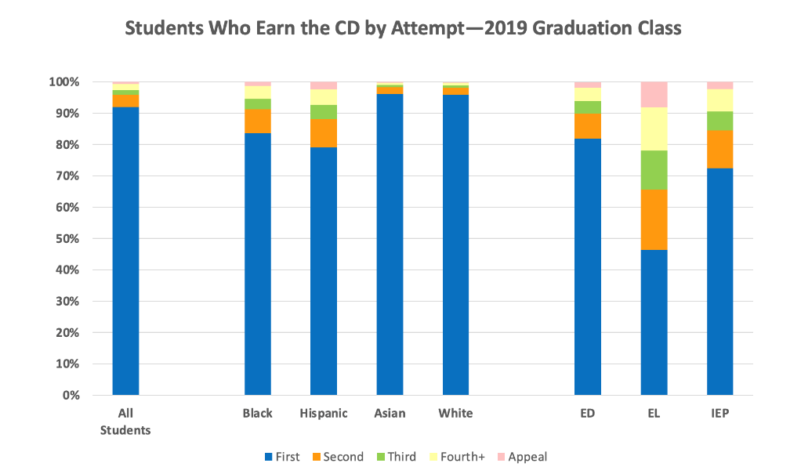
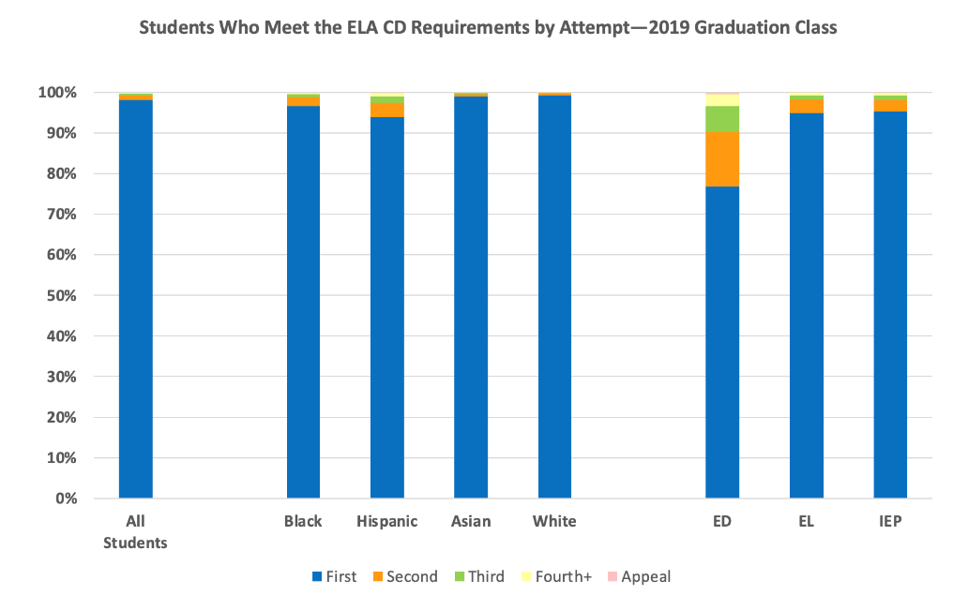
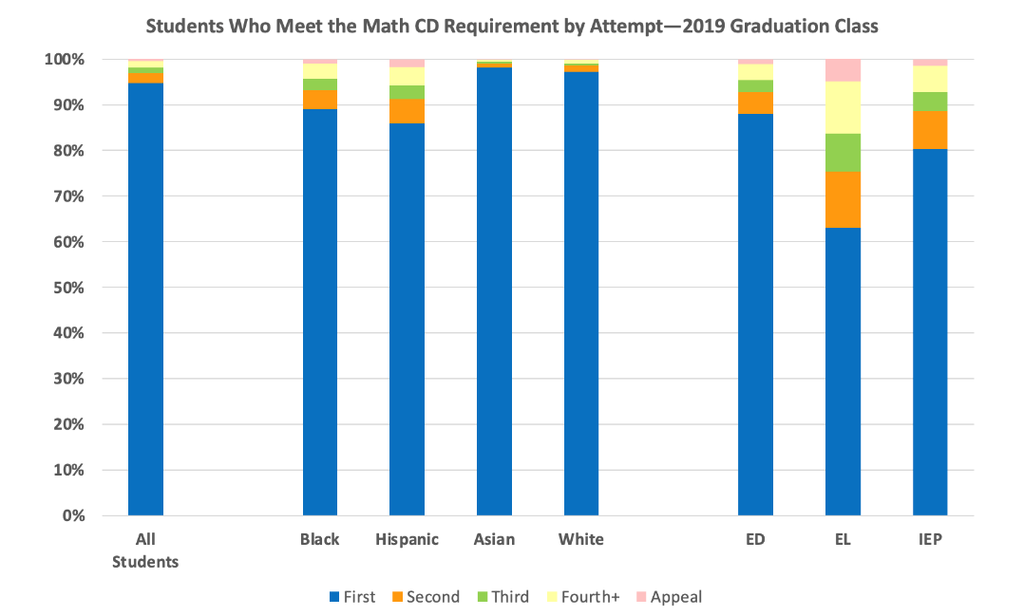
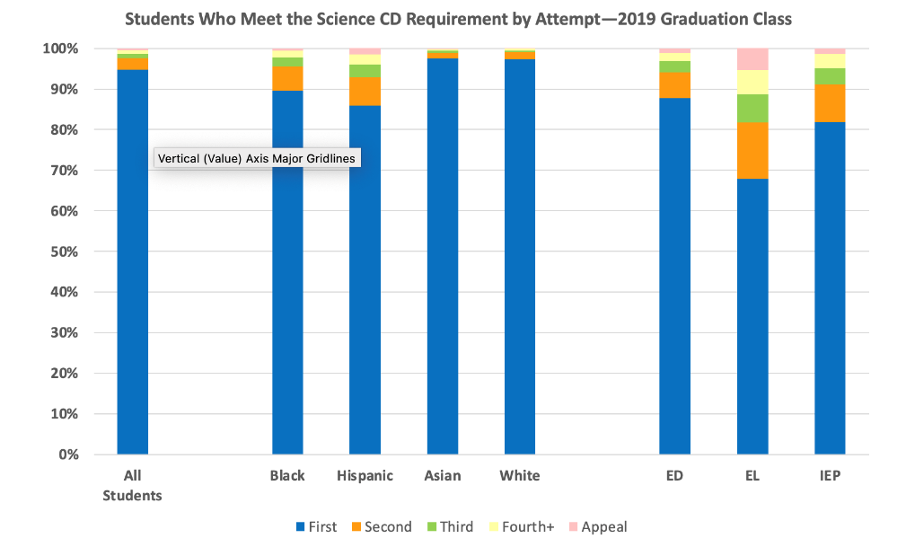
….with each individual test having even higher pass rates by attempt
CD Graduation Impact

Slide 26
20% of students who earn the CD do so with an EPP, with some student groups being more dependent on the EPP
CD Graduation Impact
Met CD
with EPP in
one or more
subjects
Met CD
without EPP

Slide 27
49 of 51 states (including D.C.) have state-mandated comprehensive graduation requirements, with MA the only 1 of the 49 requiring only passing an assessment
CD Graduation Impact
51
1 w/partial and 1 w/no state requirements
Of these 49 with state-mandated requirements:
-48 have comprehensive course requirements
- 9 also require passing core-curriculum tests
- 9 also require passing a civics test
– Only MA has a requirement of passing the CD

Slide 28
Summary MCAS and the CD have substantial value in predicting certain key life outcomes for students in all student groups, while helping policy-makers and educators prioritize needs
CD scores are on average predictive of certain important life outcomes
Of approximately 70,000 students in the statewide graduating class
96% earn the CD
3% don’t earn the CD and also don’t meet local district graduation requirements
1% don’t earn the CD and meet local district graduation requirements
Most students who pass do so on their 1st attempt (usually Grade 10), and almost all pass on the 2nd or 3rd attempt (usually Grade 11)
A significant number of Grade 12 dropouts have passed the CD
A relatively small number of districts have a disproportionate number of total MA students not earning the CD
Of the 51 states (including D.C.)
49 states including MA have comprehensive state-mandated graduation requirements
48 of 49 states have course and other requirements (some also require tests)
MA is the only one of the 49 states whose only state requirement is a test (the CD)
2 states have no state-mandated graduation requirements

