Slide 1
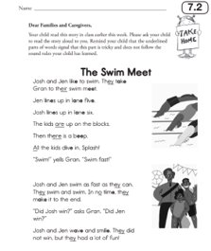
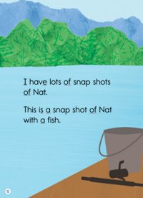
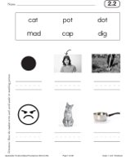
Early Literacy Update November 21, 2023

Slide 2
Curriculum Matters
EL Education
MyView

Slide 3
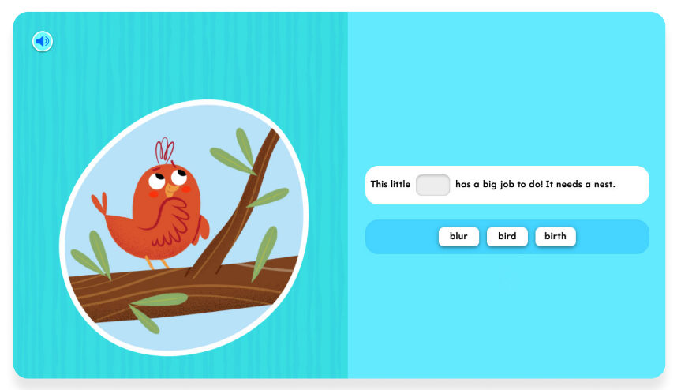
Wonders
Into Reading

Slide 4
Characteristics of high-quality curricular materials for early literacy
Standards Alignment
Classroom Application
Accessibility for Students
Usability for Teachers
Text Quality & Organization
Classroom Tasks & Instruction

Slide 5
LEAs reporting using high-quality instructional materials for ELA/Literacy in at least one elementary grade
 | 2022 | 2023
LEAs reporting information on elementary curriculum | 83 | 203
LEAs reporting using HQIM in at least one elementary grade | 24 | 87

Slide 6
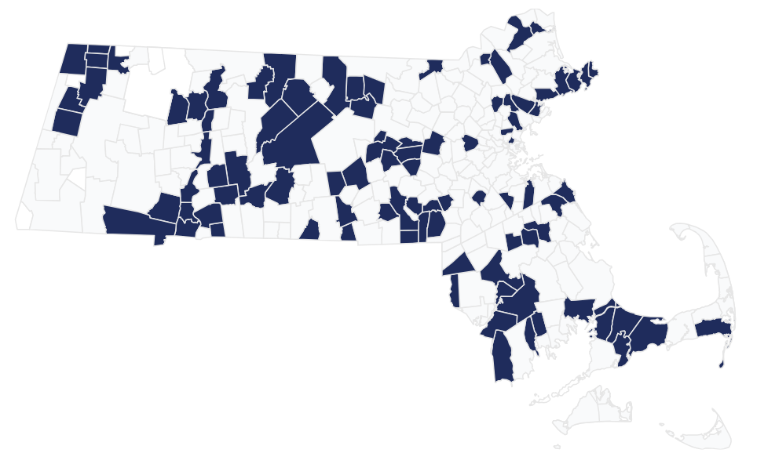
87 LEAs report using high-quality instructional materials for ELA/Literacy in at least one elementary grade in 2023
87 LEAs report using high-quality instructional materials for ELA/Literacy in at least one elementary grade in 2023

Slide 7
DESE has provided numerous financial supports for HQIM adoption
GLEAM grant
Accelerating Literacy grant
HQIM Implementation grant
HQIM Purchase grant
Student Opportunity Act – EBP grant
Appleseeds – free curricular materials for reading foundational skills, grades K-2

Slide 8
DESE supports and resources
ImplementMA Guide
Online hub for selection, adoption, implementation resources
Early Grades Literacy Grant
A year of collaborative PD and coaching with new HQIM
Professional Learning Partner Guide
List of vetted PD partners, each specializing in particular HQIM
Evaluating and Selecting High Quality Curricular Materials Network
Helps district teams through a rigorous selection process and prep to successfully launch
Statewide System of Support
Through District Instructional Leadership Teams, supports districts with schools requiring assistance to prioritize adoption of HQIM

