Slide 1
Supports for Newly Arrived Students
Experiencing Homelessness
June 18, 2024
Komal Bhasin, Chief Schools Officer
Allison Balter, Director, Office of Language Acquisition
Kristen McKinnon, Assistant Director, Student and Family Support

Slide 2
Agenda
Massachusetts Context
Whole-Child Supports
Instructional Supports
District Presentation

Slide 3
Massachusetts Context: Students Experiencing Homelessness
More than 31,000 Massachusetts public school students experienced homelessness this year.
~85% of Massachusetts public schools served at least one student experiencing homelessness this year.

Slide 4
Massachusetts Context:
How Students Experience Homelessness
Primary Nighttime Residence | 2022 | 2023
Shelters | 6,404 | 9,425
Doubled-up | 16,470 | 18,656
Unsheltered (e.g., cars, parks, campgrounds, etc.) | 292 | 471
Hotels/Motels | 2,048 | 2,263
Total Students Experiencing Homelessness | 25,214 | 30,815

Slide 5
Massachusetts Context: Collaboration
  Alone, we can do so little; together, we can do so much." - Helen Keller
Partnerships
Governor's Office (GOV)
Executive Office of Education (EOE)
Executive Office of Housing and Livable Communities (EOHLC)
Office of Refugees and Immigrants (ORI)
Executive Office of Health & Human Services (EHS)
Department of Public Health (DPH)
Executive Office for Administration & Finance (A&F)
Department of Transitional Assistance (DTA)
Massachusetts Municipal Association (MMA)
Massachusetts Association of School Superintendents (MASS)
Massachusetts Association of School Superintendents Task Force (MASS Task Force)

Slide 6
Agenda
Massachusetts Context
Whole-Child Supports
Instructional Supports
District Presentation

Slide 7
Whole Child Supports: Existing/Ongoing Supports for Students Experiencing Homelessness
Monthly office hours
In-person and virtual technical assistance
Professional learning communities & networking opportunities to learn and share best practices
Direct technical assistance to district homeless liaisons from DESE's Homeless Education State Coordinator

Slide 8
Whole Child Supports: Funding for Districts Welcoming Newly Arrived Students in the EA Shelter System
  $1,000 per student to meet immediate needs
    Awarded to date: ~$3.4 million
  $104.89 reimbursement per student per day enrolled
    Expended to date: ~$23 million
  Accelerated payment for eligible districts to address transportation cost for ‘school of origin’
    Expended to date: ~$700,000

Slide 9
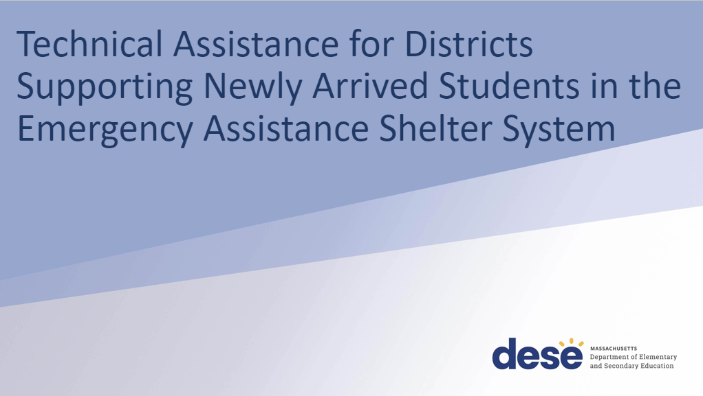
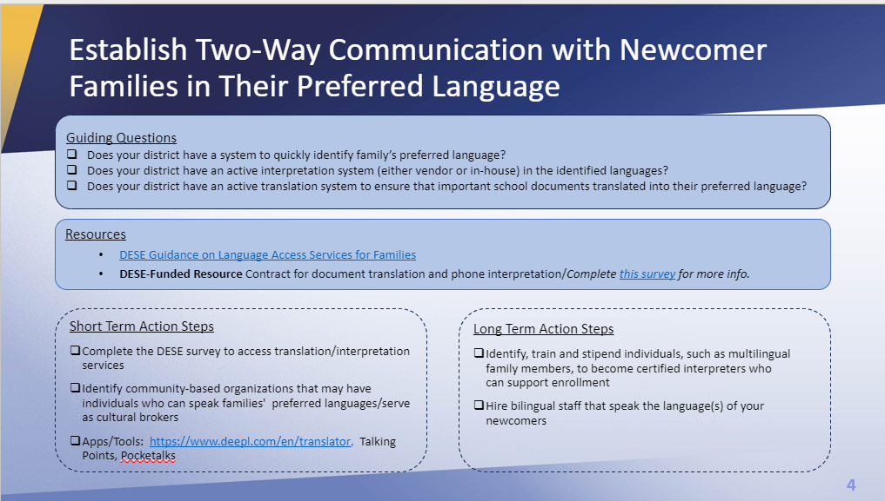
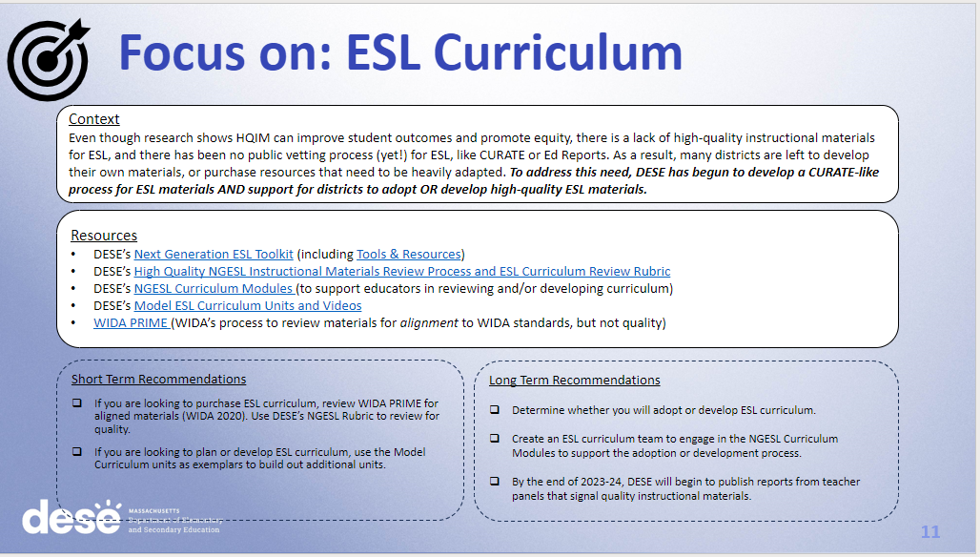
Agenda
Massachusetts Context
Whole-Child Supports
Instructional Supports
District Presentation

Slide 10
New Instructional Supports for Districts Welcoming Newly Arrived Students
Development of supports is ongoing and informed by meetings with districts, our MASS Task Force, and other stakeholders, including direct visits from the DESE team.
Translation and interpretation
In-person and virtual technical assistance
Building educator capacity
    RETELL Courses
    ESL Certification Grant
    ESL MTEL Modules
Professional development and coaching
Needs assessment & direct technical assistance by DESE staff

Slide 11



Instructional Supports:
Ongoing, Tailored Professional Learning
Supporting newcomer students
Confianza led two year-long virtual Communities of Practice (~20 district teams) to help districts learn from each other, unpack best practices for newcomer support, and action-plan for their context.
Family engagement for newly arrived students
FCSN hosted 5 webinars, two 10-hour virtual training courses, and a monthly virtual Community of Practice for districts focusing on newcomer family engagement.
Individualized consultation and capacity-building
SupportEd provided individualized technical assistance, including an in-person needs assessment and follow-up consultation, for 10 districts who want to dig deeper into their programs and practices.

Slide 12
Agenda
Massachusetts Context
Whole-Child Supports
Instructional Supports
District Presentation

Slide 13
District Presentation
Dr. Steven Zrike, Salem Public Schools
Ellen Wingard, Executive Director of Student Supports

Slide 14


Salem Public Schools
Welcoming Newcomers
6.18.24

Slide 15

Anchored By Our Strategic Plan and Core Values
Belonging – We believe all members of our community are valued and that our relationships are built on empathy and respect
Equity – We believe in promoting social justice to ensure an inclusive school community where all members are empowered and engaged
Opportunity – We believe all students should receive a personalized experience to achieve academic success, find joy in their learning, and have multiple choices for their post-secondary plans.

Slide 16

Setting the Tone and Expectation
New families are an asset, never a burden- families enhance the richness of the community
Consistently message and remind others of the benefits of welcoming new community members
Meet with families to listen and learn about their experiences, their talents and their needs

Slide 17
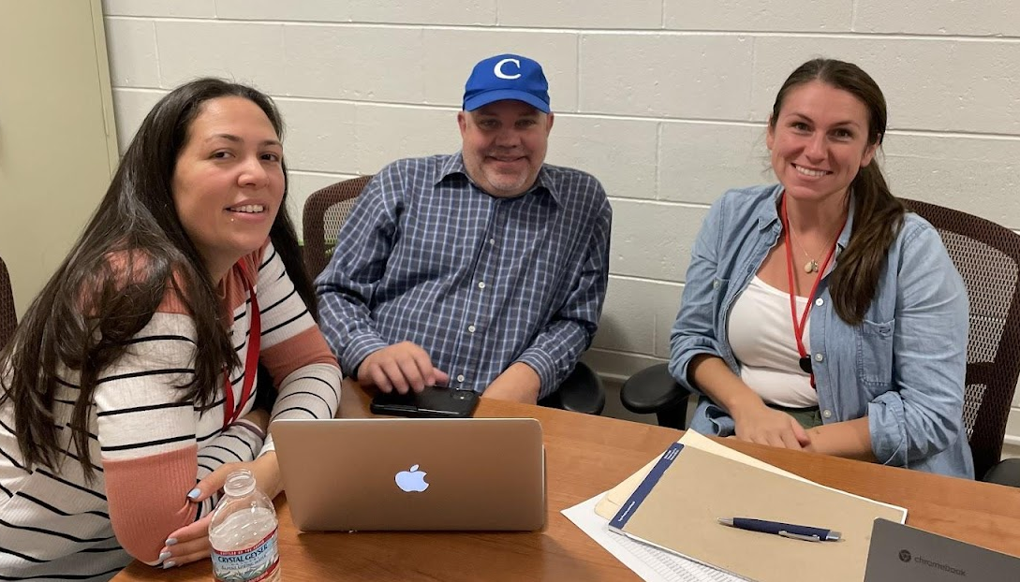
Context- Emergency Shelter System
298 McKinney Vento identified students in the Salem Public Schools (8% of our overall population)
82 SPS students at the Salem State emergency shelter site (29 students remaining at shelter site)
All 82 students remaining in the Salem Public Schools
Students assigned to 8 different schools
Students speak 4 different languages

Slide 18
Our Response
Mobilized cross-departmental district team, school based support teams, partnership with city officials and DESE resources to ensure cohesion and optimal support.
Support From DESE
Family Resources: clothing, personal hygiene, school supplies, etc. (Fund 301 Grant)
Transportation (Emergency Assistance for Homeless Families Grant)
Language Access (Emergency Assistance for Homeless Families Grant)
ML staffing (Emergency Assistance for Homeless Families Grant)
Staff training
Adult Career Technical Programming

Slide 19
Our Response
City/District Partnership
Role of district and school based student support coordinators and family engagement facilitators
  Ongoing case management
Responsive Services
  Parent Child Plus Programming
  Physical and Mental Health Supports
  Food and Basic Needs
  Health Van
  ESL Classes
  Legal consultation
  After school and summer programs

