Slide 1
Board of Elementary and Secondary Education: CTE Admission Study Session
October 28, 2024

Slide 2
Agenda
CTE in High School Context
Elizabeth Bennett, Associate Commissioner, College, Career, and Technical Education
Relevant Federal and State Legal Framework
Caitlin Looby, Counsel
CTE Admissions Research Topics
Shaun Dougherty, Professor, Education and Policy, Boston College
CTE Enrollment Data Overview
Rob Curtin, Chief Officer for Data, Assessment, and Accountability
CTE Admission Overview
Elizabeth Bennett, Associate Commissioner, College, Career, and Technical Education
Nicole Smith, Director, College, Career, and Technical Education

Slide 3
CTE in High School Context

Slide 4
MA DESE: Educational Vision
What principles guide our work?
What does that look like in practice?
All students in Massachusetts, particularly students from historically underserved groups and communities are valued.
Culturally and linguistically sustaining classroom and school practices
High expectations with targeted support
Learning experiences
Individualized supports
Enable students to excel at grade level and beyond
Are relevant, real-world and interactive
Are known and valued
All students

Slide 5
Multiple Opportunities for Career Connected Learning

Slide 6
Pathway Enrollment
Approximately 26% of MA’s 287,938 high school students are in a pathway, including:
55,728 in Career Technical Education (CTE)
10,042 in Locally Approved Career Connections
8,241 in Early College
6,955 in Innovation Career Pathways
There are 92 schools with CTE, offering 1,050 approved programs.

Slide 7
CTE School Models
Multiple Models:
Regional CTE schools and Agricultural Schools (29)
Enroll students from multiple districts
Municipal CTE Schools (5)
In a single district
Comprehensive High Schools with CTE (58)
In a single district

Slide 8
State & Federal Legal Framework

Slide 9
History and Changes to Regulatory Language
Beginning in 2003, our regulations required CTE programs to use 4 admissions criteria:
Grades
Discipline record
Attendance
Recommendation
And allowed an optional 5th criterion:
Interview

Slide 10
History and Changes to Regulatory Language
In 2021, the Board voted to approve a revised regulation that removed the statewide, 4-criteria selective admission policy
New regulation permits schools to set policies so long as they comply with federal and state law / guidelines
If a school does not comply, DESE will take actions it deems necessary to achieve compliance
This could include a requirement to institute an admissions lottery.
See 603 CMR 4.03(6)(a)

Slide 11
History and Changes to Regulatory Language
The revised admission regulation also:
Prohibits use of selective criteria when there are enough seats
Prohibits considering excused absences and minor disciplinary offenses
Incorporates language from the Federal Guidelines that prohibit discrimination in CTE admissions
Institutes new data-reporting requirements and superintendent attestation that policy complies with federal and state requirements

Slide 12
Key Federal Requirements
Federal Guidelines require DESE to conduct periodic civil rights compliance reviews called Methods of Administration (MOA).
Strengthening Career and Technical Education for the 21st Century Act (Perkins V) requires DESE to report civil rights data to U.S. Department of Education’s Office for Civil Rights (OCR).
OCR’s 2020 Memorandum of Procedures (MOP) permitted state agencies to streamline these processes for the first time.

Slide 13
Legal Authority: MOA Process
Federal Guidelines (Appendix B to Part 100 of Title VI) prohibit schools from using selective admissions criteria “that have the effect of” disproportionately excluding certain protected classes. Guidelines at IV.K.

Slide 14
Since 2021 Regulatory Changes
Regional schools after the regulation change:
25 of 29 districts kept selective criteria
E.g., grades, discipline, attendance
Most still require a recommendation and/or an interview
Many adjusted how they score, or shifted weight assigned to criteria
Two adopted a full or partial qualified lottery.
Two agricultural schools removed grades and recommendations as selective criteria
One municipal CTE school implemented a qualified lottery

Slide 15
CTE Admissions Research Framework

Slide 16
Selective Admissions & High School CTE
Shaun M. Dougherty
Boston College
October 21, 2024

Slide 17
Students benefit from CTE when provided the opportunity
Brunner et al. (2023) use admission to statewide system of 16 CTE-dedicated high schools to estimate impact of being admitted on later outcomes
Students are ranked on an application score and admitted in descending order until all seats are filled
Application scores consist of middle school test scores, attendance, and discipline data
Dougherty. S. M.
Selective Admission CTE
2024 DESE

Slide 18
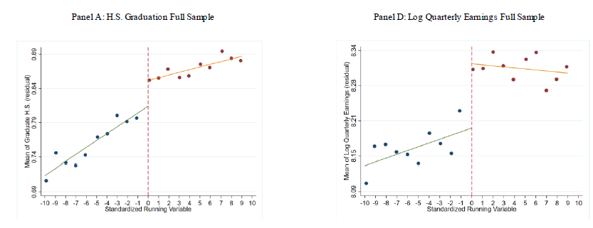
Admitted students see positive impacts
An eighth-grade student who was less likely to graduate is more likely to graduate having been admitted to CTE.
Dougherty. S. M.
Selective Admission CTE
2024 DESE

Slide 19
Random admission generates more equitable access
In 2019 as part of technical assistance, ran simulations for some MA schools with two versions:
Proposed some schools for technical assistance modifications of criteria weights (i.e. points for grades, attendance etc.)
Lottery
Outcome:
Tweaking selective criteria in simulated admissions sometimes resulted in a student population that looks less like the sending districts
The simulated lottery resulted in a student population that looks more like the sending districts
Dougherty. S. M.
Selective Admission CTE
2024 DESE

Slide 20
Is selective admission essential to participate in high quality CTE?
To prove this, one would have to show that:
Students participating in high quality CTE who were admitted through a non-selective process could not participate
Students who were NOT admitted could not participate
Simply showing better outcomes among students admitted through a selective process does not prove this point
When criteria chosen for selection are correlated with the outcomes you can no longer attribute success exclusively to the treatment
Dougherty. S. M.
Selective Admission CTE
2024 DESE

Slide 21
Thank you
Shaun M. Dougherty
Shaun.Dougherty@bc.edu

Slide 22
DESE Demographic and Indicator Data

Slide 23
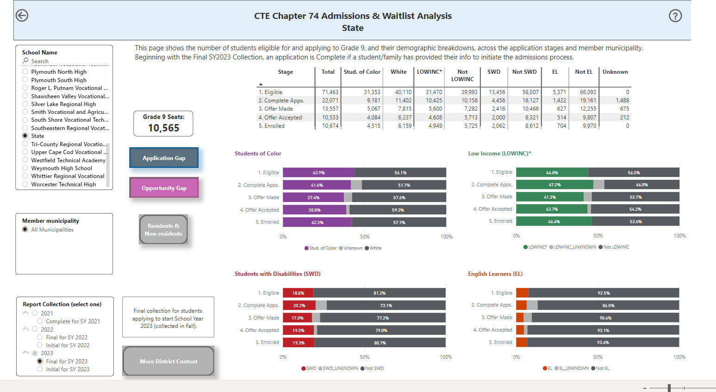
CTE-ART: Career Technical Education Analysis and Review Tools
CTE-ART: Career Technical Education Analysis and Review Tools - College, Career and Technical Education (mass.edu)

Slide 24
Statewide Demographics
Student demographics have changed since 2020
DESE compared changes for grade 9-12 students in Regional and Municipal CTE Schools to all other schools
CTE Schools – schools that are "wall-to-wall" CTE (N = 37,300 grade 9-12 students in 2024)
Non-CTE Schools – schools that are comprehensive or do not have "wall to wall" CTE (N = 252,407 grade 9-12 students in 2024)
Intent was to determine if demographic gaps exist between CTE and non-CTE schools

Slide 25
Students of Color in Grades 9-12
Growing gaps in the percentage of students of color served between non-CTE Schools and CTE schools.
 | 2020 % Enrolled | 2024 % Enrolled | % Change
Non-CTE Schools | 40.1% | 46.8% | 16.8%
CTE Schools | 37.0% | 42.0% | 13.5%
 | +3.1 | +4.8
*2024 difference in grade 9 enrollment only was 3.1 percentage points

Slide 26
English Learners in Grades 9-12
Growing gaps in the percentage of English learners served between non-CTE schools and CTE schools.
 | 2020 % Enrolled | 2024 % Enrolled | % Change
Non-CTE Schools | 7.7% | 10.1% | 31.2%
CTE Schools | 4.7% | 4.8% | 2.1%
 | +3.0 | +5.3
*2024 difference in grade 9 enrollment only was 4.1 percentage points​

Slide 27
Students with Disabilities in Grades 9-12
Shrinking gaps in the percentage of students with disabilities served between non-CTE schools and CTE schools.
 | 2020 % Enrolled | 2024 % Enrolled | % Change
Non-CTE Schools | 15.9% | 17.9% | 12.6%
CTE Schools | 20.9% | 20.2% | -3.3%
 | -5.0 | -2.3

Slide 28
Low-Income Students in Grades 9-12
There were different methodologies used in 2020 and 2024. CTE schools generally serve higher percentages of low-income students, but the gap is shrinking.
 | 2020 % Enrolled | 2024 % Enrolled | % Change
Non-CTE Schools | 28.9% | 40.2% | N/A
CTE Schools | 34.5% | 43.4% | N/A
 | -5.6 | -3.2

Slide 29
Impact of Certain Indicators as Admission Requirements
Examined two key indicators often used for admission (attendance and discipline) to see if there is an impact on selected populations.
Examined statewide 7th grade attendance and discipline rates as a proxy to determine if there is a differentiated impact for certain groups
Many schools use an 18-month process (7th grade and half of 8th grade) but DESE is unable to replicate half of 8th grade

Slide 30
2024 7th Grade Attendance
Group | Chronic Absenteeism Rate | Pct. Point Gap
Students of color | 21.0% | 7.0
White students | 14.0%
Students with disabilities | 25.8% | 10.8
Non-students with disabilities | 15.0%
English learners | 26.7% | 10.5
Non-English learners | 16.2%
Low-income students | 27.2% | 18.3
Non-low-income students | 8.9%

Slide 31
2024 7th Grade Discipline
Group | Percent of Students Suspended | Pct. Point Gap
Students of color | 9.2% | 5.1
White students | 4.1%
Students with disabilities | 11.2% | 6.0
Non-students with disabilities | 5.2%
English learners | 9.4% | 3.3
Non-English learners | 6.1%
Low-income students | 11.0% | 8.3
Non-low-income students | 2.7%

Slide 32
Conclusions from 7th Grade Data
Data show that students in certain groups are more likely to be impacted by admissions criteria related to attendance and discipline.
Data shown are indicative of impact within one indicator and would only grow when multiple indicators are used (e.g., attendance and discipline).
Absence of attendance and discipline criteria would improve chances of admission for students in selected populations.

Slide 33
CTE Admission Overview: Challenges and Potential Solutions

Slide 34
CTE Admissions – Comprehensive View
Awareness
Recruitment
Admission
Retention & Success

Slide 35
Start with Students and Families
Challenges expressed included:
In 2021-2022, DESE commissioned studies of MA families with a focus on communities whose primary language is not English.
Secondary Options and Family Engagement (FCSN, 2021) Secondary Options and Family Engagement Findings (FCSN, 2022)
Navigating Processes
Bias & Identification
Interviews
Accommodations
Awareness
Opportunity

Slide 36
Awareness
Awareness
Recruitment
Regulations | Challenges | Potential Solutions
Admission policies: Plan to attract new students Available in primary language of the home Middle schools: Permit CTE schools to provide information to students Cannot unreasonably withhold student access to CTE information on middle school site Cannot count tours as unexcused absences | Differing levels of access to information at middle schools Middle and CTE schools not collaborating on policies | Revise regulations and guidance to address school and community concerns Clarify language such as “unreasonably withhold” Say more about recruitment expectations Highlight role of student agency in MyCAP Promote use of accurate and inclusive language “CTE” not “voke”

Slide 37
Admission
Admission
Regulations | Challenges | Potential Solutions
School committee approves policy, superintendent attests compliance to DESE | No two processes are the same Varying timelines Application deadlines from December to April Admission decisions from January to August | More consistent statewide approach for student application processes

Slide 38
Admission
Admission
Regulations | Challenges | Potential Solutions
Cannot consider excused absences or minor discipline DESE monitors for compliance with state and federal laws | DESE reviews school-reported enrollment data to identify potential disproportionate exclusion of protected classes of students. Data show that students in certain groups are more likely to be impacted by admissions criteria related to attendance and discipline. Growing gaps in the percentage of English learners served | Statewide proactive approach to admissions process that eliminates the use of selective criteria

Slide 39
Retention & Success
Retention & Success
Regulations | Challenges | Potential Solutions
School policies must have a plan Include specific strategies Promote equal opportunities Attract, enroll, and retain a student population with comparable academic and demographic profile to sending districts | Retention approaches differ school to school Students with disabilities May be removed from CTE coursework for services rather than served in their CTE setting | Clarify special education in CTE settings

Slide 40
Next Steps

Slide 41
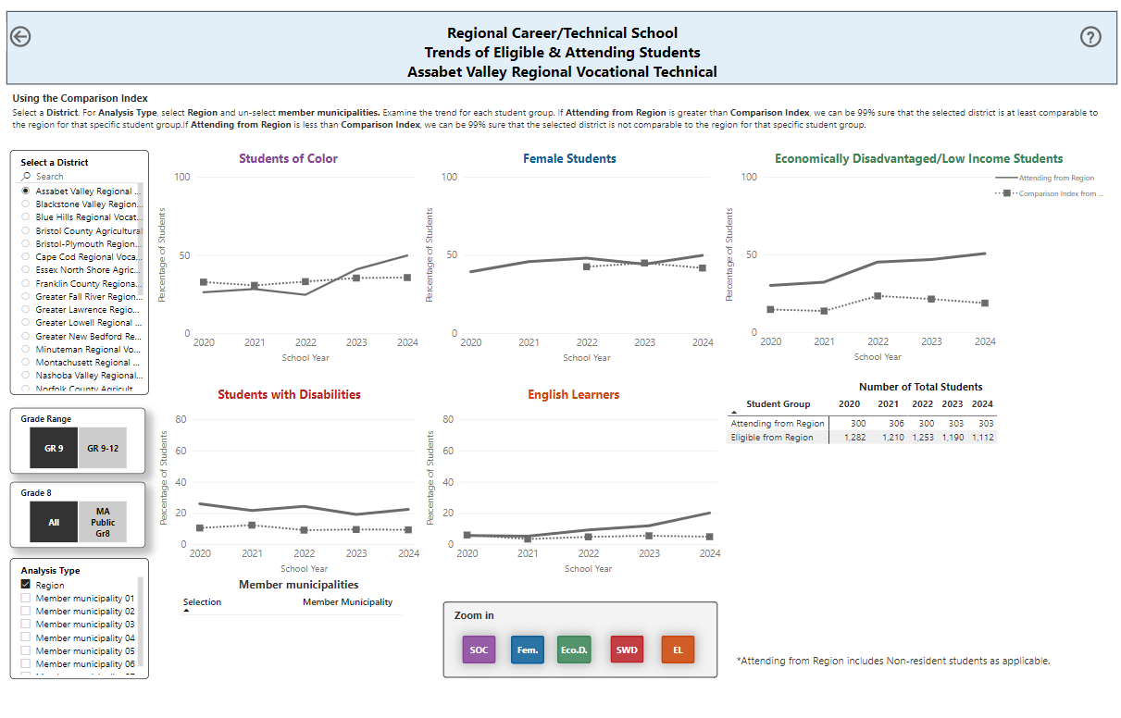
Assabet – Lottery

Slide 42
Worcester – Lottery

