Slide 1
BESE CTE Admission Study Session 2
November 15, 2024

Slide 2
Agenda
Context for Career Technical Education (CTE)
Recap of research from previous study session
Legal standard review
Updated data and information
  Awareness and recruitment
  Admission

Slide 3
Context for CTE

Slide 4
MA DESE: Educational Vision
What principles guide our work?
What does that look like in practice?
All students in Massachusetts, particularly students from historically underserved groups and communities are valued.
Culturally and linguistically sustaining classroom and school practices.
High expectations with targeted support.
Learning experiences
Individualized supports
Enable students to excel at grade level and beyond
Are relevant, real-world and interactive
Are known and valued
All students

Slide 5
Educational Vision and CTE
CTE embodies relevant, real world and interactive learning.
DESE believes that every 8th grade Massachusetts student can excel in a CTE high school program with the right tools and resources.

Slide 6
Recap of Research from Previous Study Session

Slide 7
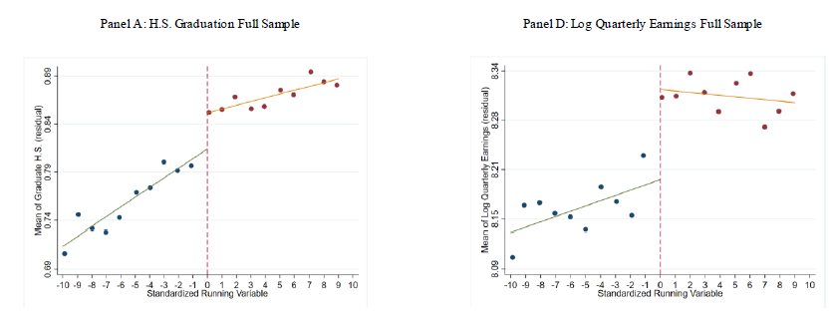
We know students benefit when they have access.
Students admitted to CTE schools are more likely to graduate and later have higher earnings than similar applicants who are not admitted.
Dougherty. S. M.
Selective Admission CTE
2024 DESE
Notes:
Talking points re: MA CTE School success:
MA CTE Schools have outcomes we want for all students.
MA Statewide graduation rate – 89.2%. Aggregate graduation rate of CTE Wall to Wall schools is 96.6%.
Higher attendance rate (93.9%)
Backup
Original statement, also accurate: An eighth-grade student who was less likely to graduate is more likely to graduate having been admitted to CTE.
8th grader A and B have similar profiles, different only by a point or a few points different in the cut score. 8th grader A has much better outcomes having been accepted to CTE.

Slide 8
Career Technical Education (C74) Programs
Signature components include at least 900 hours of immersive learning time, co-operative education and work-based learning in partnership with local employers, and opportunities to earn high-value industry recognized credentials.
  55,728 Students in CTE.
Notes:
34 schools hereafter “CTE Schools”
Massachusetts Career and Technical Education Programs (CTE) prepare students to graduate with skills and credentials that will provide them with advanced employment opportunities if the enter the workforce immediately upon graduation.
Regional CTE schools and Agricultural Schools (29) – Example, Minuteman Tech, Franklin County Tech
Municipal CTE Schools (5) = Putnam HS
Comprehensive High Schools with CTE (58) – Attleboro
Multiple Models:
Regional CTE schools and Agricultural Schools (29)
Enroll students from multiple districts
Municipal CTE Schools (5)
In a single district
Comprehensive High Schools with CTE (58)
In a single district

Slide 9
Career Technical Education (C74) Programs
  There are 92 schools with CTE, offering 1,050 approved programs. Multiple school models:
      Regional CTE schools and agricultural schools (29)
      Municipal CTE schools (5)
      Comprehensive high schools with CTE (58)
Hereafter, the 34 regional CTE, agricultural, and municipal schools will be referred to as “CTE Schools.”
Notes:
34 schools hereafter “CTE Schools”
Massachusetts Career and Technical Education Programs (CTE) prepare students to graduate with skills and credentials that will provide them with advanced employment opportunities if the enter the workforce immediately upon graduation.
Regional CTE schools and Agricultural Schools (29) – Example, Minuteman Tech, Franklin County Tech
Municipal CTE Schools (5) = Putnam HS
Comprehensive High Schools with CTE (58) – Attleboro
Multiple Models:
Regional CTE schools and Agricultural Schools (29)
Enroll students from multiple districts
Municipal CTE Schools (5)
In a single district
Comprehensive High Schools with CTE (58)
In a single district

Slide 10
Legal Standard Revisited

Slide 11
Federal Legal Standard
Federal:
  “Guidelines for Eliminating Discrimination and Denial of Services on the Basis of Race, Color, National Origin, Sex, and Handicap in Vocational Education Programs.”
    Appendix B to Part 100 (Title VI)
  Prohibits use of criteria “that have the effect of disproportionately excluding persons of a particular race, color, national origin, sex, or handicap” from admission to CTE programs.
Notes:
“Federal Legal Standard” slide 10
The U.S. Department of Education’s Office for Civil Rights has issued Guidelines that prohibit using selective criteria that disproportionately exclude protected student groups.
If disproportionate exclusion occurs, schools must demonstrate two things
The criteria have been validated as essential to participation in a given program
Alternative criteria without that disproportionate effect are unavailable

Slide 12
History and Changes to State Regulatory Language
Beginning in 2003, our regulations required CTE programs to use 4 admissions criteria:
  Grades
  Discipline record
  Attendance
  Recommendation
And allowed an optional 5th criterion:
  Interview
Notes:
“History and Changes to State Regulatory Language”
As part of this discussion, I would like to remind the Board of some of the changes that were made to the CTE admission regulations
Here is the relevant language of the regulation in effect prior to 2003:
Each school desiring to obtain approval for a M.G.L. c. 74 vocational technical program shall submit its admissions criteria in writing. No criteria shall discriminate on the basis of sex, race, religion, color, national origin or special needs. Provision shall be made to accommodate special needs as required by M.G.L. c. 7IB and 603 CMR 28.00. Admissions criteria shall comply with the requirements of St 1971, c. 622, M.G.L. c. 76, §§ 5 and 16 and 603 CMR 26.00, and M.G.L. c. 71A and 603 CMR 14.00. Requirements are specified in the Division’s "Guidelines for the Admissions Policies for Selective Secondary Schools" and the "Guidelines for the Admissions Policies of Comprehensive High Schools with Five or more M.G.L. c. 74 Programs," and are incorporated into 603 CMR 4.00 by reference. Prior academic record shall not be the sole criterion in determining admissions. In making admission decisions, schools shall consider a number of factors including a student’s interest in pursuing the program of study and the ability to benefit therefrom. Admissions criteria shall give priority to students who have been previously enrolled in a vocational
technical program in another city, town or district who wish to enroll in the same program of study. Vocational technical education offered under M.G.L. c. 74 is public education. Except where specifically authorized to do so by state law, schools desiring to offer a vocational technical program shall not charge tuition or fees.

Slide 13
History and Changes to Regulatory Language
In 2021, the Board voted to approve a revised regulation that removed the statewide, 4-criteria selective admission policy requirement.
New regulation permits schools to set policies so long as they comply with federal and state law / guidelines.
If a school does not comply, DESE will take actions it deems necessary to achieve compliance.
  This could include a requirement to institute an admissions lottery.
    See 603 CMR 4.03(6)(a).
Notes:
In 2021, the Board removed the requirement that schools had to use four criteria (grades, attendance, discipline record, and counselor recommendation) as part of their application process
The Board determined that applying state-prescribed admissions criteria was not in the best interests of students, families, and vocational schools and programs.

Slide 14
History and Changes to Regulatory Language
The revised admission regulation also:
  Prohibits use of selective criteria when there are enough seats.
  Prohibits considering excused absences and minor disciplinary offenses.
  Incorporates language from the Federal Guidelines that prohibit discrimination in CTE admissions.
  Institutes new data-reporting requirements and superintendent attestation that policy complies with federal and state requirements.
Notes:
The Board also prohibited the consideration of excused absences and minor behavior or disciplinary infractions.
The 2021 amendments to the regulations were designed to promote equitable access to CTE schools.
We are now having these study sessions to look at the question: What impact has the most recent regulation change had on addressing equitable access to CTE admissions?
For purposes of 603 CMR 4.03(6)(a), a "minor behavior or disciplinary infraction" means any student conduct other than conduct for which suspension or expulsion was imposed pursuant to M.G.L. c.71 §37H or §37H1/2, or for which suspension or expulsion for more than 10 days was imposed pursuant to M.G.L. c.71 §37H3/4.
After regulation change, DESE published extensive guidance for schools and families
Topics include:
Raising awareness for all students
Admission do’s and don’ts
Supporting students and families
Analyzing student population data
Model policy templates

Slide 15
State Regulations and Local Policy
603 CMR 4.03(6)(a)
  “Vocational schools and programs that use selective criteria shall not use criteria that have the effect of disproportionately excluding persons of a particular race, color, national origin, sex, gender identity, sexual orientation, religion, or disability unless they demonstrate that
  such criteria have been validated as essential to participation in vocational programs; and
  alternative equally valid criteria that do not have such a disproportionate adverse effect are unavailable.”
Locally determined policies include how criteria is used and weighted.
Notes:
The Department’s current CTE regulations incorporate the same standard that USED employs.
But the discussion we are having now goes beyond legal compliance, this is about access to public education.
CTE schools are public schools, and all students should have equal access to them.
Yes, they are limited resources, and the Department and individual schools are working to increase the number of seats so that hopefully, every student that wants CTE can get CTE.
But in the meantime, we believe it is important to improve student access to CTE.
If asked: “does the legal standard say we should look at enrollment or application data?”
For compliance with OCR’s civil rights review process, we look at enrollment data. We look at admissions data with schools when we are providing technical assistance.
However, this discussion isn’t limited to compliance with OCR’s process, it’s about student access to CTE.
Here is an analogy. We recently revised Massachusetts’ IEP process for students with disabilities, not because we were out of compliance, but because improving special education is the right thing to do.
Improving access to CTE is the right thing to do.

Slide 16
CTE Admissions – Comprehensive View
Awareness & Recruitment
Admission
Retention & Success
Notes:
Application of regulation

Slide 17
Awareness and Recruitment

Slide 18
CTE Regulations Address Requirements for Middle Schools
603 CMR 4.03(6)
  Sending districts shall offer vocational schools and programs opportunities to provide middle school students with information about vocational programs and careers on-site at their middle schools, as well as through mail and email.
  Sending districts may not count middle school student tours of vocational schools or programs during the school day as unexcused absences if the vocational school or program confirms the student's participation, and may not unreasonably withhold student access to tours of vocational schools and programs during the school day.

Slide 19
CTE Schools’ Awareness Activities
Access to mail and email lists of 7th and 8th grade students from sending schools.
Visits to meet with middle school students in sending schools.
Tours of CTE schools for students from sending schools.
Open houses and events outside of school hours.
Middle school counselor events.
MyCAP as an emerging awareness activity.

Slide 20



My Career and Academic Plan (MyCAP)
Who Am I?
Personal/Social Domain
DISCOVER:
Skills
Interests
Talents
Strengths
PLAN:
Course-taking
Career Development
Post-secondary options
ACT:
AP, Early College
Contextual Learning experiences
Applications and decision-making
Where Am I Going?
Career Development
How Do I Get There?
Academic and Postsecondary Planning
Student driven and school, family and community supported

Slide 21
CTE Middle School Access Survey
23 of 34 CTE schools responded to DESE’s recent survey about middle school access.
Reporting CTE schools requested access to visit 8th grade students from 318 middle schools. Of those requests, 57 visits were denied.
Of 185 tours offered to sending middle schools, 45 tours were denied.
Six of 23 reported challenges obtaining mailing information.
Notes:
Survey sent following last board meeting to CTE Schools. Survey aligned to requirements of the regulations (slide 19)
DESE has followed up with all who have requested intervention by reaching out to sending districts and supporting collaboration between sending and receiving districts to increase access.

Slide 22
Admission

Slide 23
Commonly Used Selective Criteria Since 2021
CTE Schools predominately use a combination of these selective criteria:
  Grades
  Discipline record
  Attendance
  Recommendation
  Interview

Slide 24
Recommendations and Interviews
  Families say:
  Challenges for bilingual students and students with language-based or executive functioning deficits to be able to “shine” in an admissions interview, where required.
  (FCSN, Career & Technical Education: What Families Need to Know, 2022)
Nearly all CTE schools require at least one of these two selective criteria:
  Sending school recommendation
  Interviews

Slide 25
Examples of Topics for Sending School Recommendations
Kindness – Shows kindness in regard to the feelings, beliefs, rights, and traditions of others. Demonstrates leadership qualities and engages in activities promoting a positive school culture.
Success - Works collaboratively with other students towards a common goal. Communicates effectively and appropriately with peers and adults.
Work Readiness - Demonstrates a work ethic that displays their best effort in every task they complete and often seeks to take on extra work for the benefit of enrichment and growth.
Honesty - Acts with honesty, integrity, shows resiliency, and maintains a positive attitude in all situations.
Accountability - Follows rules, takes personal responsibility, and is accountable for their educational expectations in all instances.
Notes:
In addition to evaluating grades, discipline, and attendance, all schools not using a lottery require either an interview or recommendation or both that is scored for selective criteria. At one school using a lottery, the recommendation and interview is still required, but not scored.
This slide speaks to the content and scoring of recommendations.
School counselors (or teachers, other caring adult in the building) must complete rubrics, some are likert scales like these examples while some are open response on topics such as these examples.
These are example topics for sending school recommendations forms.
Topic with full points of likert scale is listed here
These come from multiple CTE Schools to show examples from across the state.

Slide 26
Sample CTE School Interview Questions
Tell me some things you might do outside of school to fill your time. How are these things important to you?
Describe a trusted adult. Can you give examples of how we might see these qualities in you.
Think about your future career goals meaning what you might want to do after graduating from high school if you are accepted?
How do you think coming to this school instead of another high school will help you be more prepared for achieving your career goals?
Notes:
In addition to evaluating grades, discipline, and attendance, all schools not using a lottery require either an interview or recommendation or both that is scored for selective criteria. At one school using a lottery, the recommendation and interview is still required, but not scored.
This slide speaks to the content and scoring of interviews.
Adults from the CTE school ask questions such as these examples of 12 and 13 year old students to determine a score of whether students would be a “good fit” for the CTE School.
Some interviews may be held at the middle school or CTE school, and may or may not include a familiar adult.
Some middle schools are able to dedicate resources to support interview prep with students, others are not. Some families are able to support interview prep, others are not. (more on this Monday from school counselors)

Slide 27

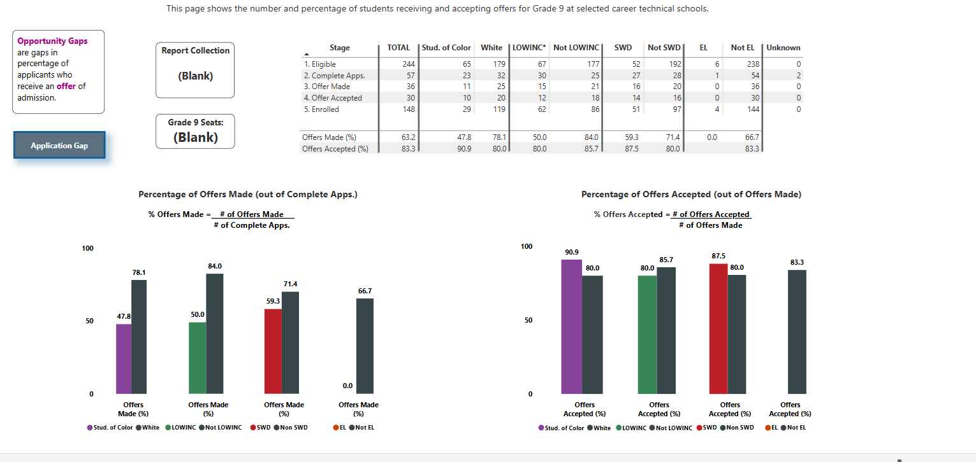
Opportunity Gap Tool
Notes:
The 2021 regulations introduced data collection
The tools developed from that annual collection have been publicly available since 2022 on DESE’s website
The tools reflect information gathered at all stages of admission – including Eligible students, complete applications (Awareness) Offers Made (Admission) and Accepted, Enrolled

Slide 28
Statewide Composition Index Analysis
Composition Index is a tool for comparing applicants to admitted students in a standardized way.
Combines individual results for 34 schools from 2021-2024.
Calculates any disproportionality of offers of admission by comparing admissions data for selected student populations vs. their peers.
Next slide provides an index analysis for English learners. See charts in appendix for more detail.
Notes:
Additional Notes if needed:
The calculations on the previous slide are influenced by n-sizes, which may vary student group from student group.
The graphs presented on the previous slide illustrate gaps in school admission data for each student group.
The Composition Index uses the same application and waitlist data to calculate the disproportionality of offers of admission.
The Composition Index normalizes the data, taking into consideration n-sizes and proportionality, so that trends can be analyzed and interpreted in a standardized fashion for each student group.

Slide 29
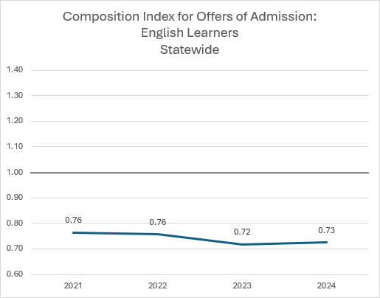
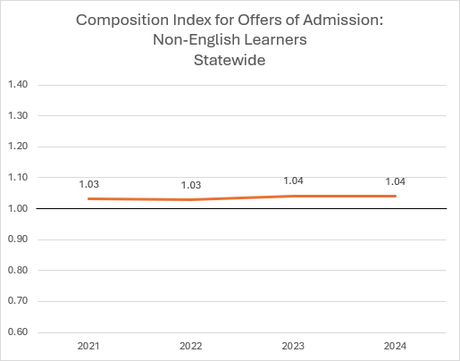
English Learner Students Admitted at Lower Rates Than Peers Who Are Not English Learners

Slide 30
Composition Index Findings
In each school year from 2021-2024:
  English learners (EL) were admitted at lower rates than non-EL peers.
  Low-income students were admitted at lower rates than non-low-income peers.
  Students with disabilities (SWD) were admitted at lower rates than non-SWD peers.
  Students of color were admitted at lower rates than white peers.

Slide 31
Frequency Findings
In 2024, for the 34 CTE schools, admittance rates were lower for nearly all schools for specific student populations.

Slide 32
Frequency Findings
0 of 34 schools admitted students with disabilities (SWD) at the same rate or higher than their non-SWD peers.
3 of 34 schools admitted low income at the same rate or higher than their non-low-income peers.
7 of 34 schools admitted students of color at the same rate or higher than their white peers.
8 of 34 schools admitted English learners at the same rate or higher than their non-English learner peers.

Slide 33
Frequency Findings: English learners
Among the available applicant pool of English learners from 2021-2024 for 34 CTE Schools:
  22 of 34 schools made fewer than 20 offers to English learners.
  20 of 34 schools made fewer than 10 offers to English learners.

Slide 34
Enrollment in CTE and non-CTE schools
Reminder of definitions:
CTE Schools – 34 schools that are "wall-to-wall" CTE including regional (26), agricultural (3), and municipal (5)
Non-CTE Schools – high schools that are comprehensive or do not have "wall to wall" CTE

Slide 35
Students of Color in CTE and Non-CTE Schools
Grade 9 | 2020 % Enrolled State | 2024 % Enrolled State | 2020 % Enrolled Sending | 2024 % Enrolled Sending
Non-CTE Schools | 43.1% | 48.8% | 44.3% | 49.8%
CTE Schools | 38.9% | 45.7% | 38.9% | 45.7%
 | +4.2 | +3.1 | +5.4 | +4.1
Grade 9-12 | 2020 % Enrolled State | 2024 % Enrolled State | 2020 % Enrolled Sending | 2024 % Enrolled Sending
Non-CTE Schools | 40.1% | 46.8% | 41.0% | 47.8%
CTE Schools | 37.0% | 42.0% | 37.0% | 42.0%
 | +3.1 | +4.8 | +4.0 | +5.8
Notes:
CTE Schools – schools that are "wall-to-wall" CTE (N = 37,300 grade 9-12 students in 2024)
Non-CTE Schools – schools that are comprehensive or do not have "wall to wall" CTE (N = 252,407 grade 9-12 students in 2024)

Slide 36
English Learners in CTE and Non-CTE Schools
Grade 9 | 2020 % Enrolled State | 2024 % Enrolled State | 2020 % Enrolled Sending | 2024 % Enrolled Sending
Non-CTE Schools | 9.9% | 11.1% | 10.7% | 11.5%
CTE Schools | 6.5% | 7.0% | 6.5% | 7.0%
 | +3.4 | +4.1 | +4.2 | +4.5
Grade 9-12 | 2020 % Enrolled State | 2024 % Enrolled State | 2020 % Enrolled Sending | 2024 % Enrolled Sending
Non-CTE Schools | 7.7% | 10.1% | 8.1% | 10.4%
CTE Schools | 4.7% | 4.8% | 4.7% | 4.8%
 | +3.0 | +5.3 | +3.4 | +5.6

Slide 37
Students with Disabilities in CTE and Non- CTE Schools
Grades 9-12 | 2020 % Enrolled State | 2024 % Enrolled State | 2020 % Enrolled Sending | 2024 % Enrolled Sending
Non-CTE Schools | 15.9% | 17.9% | 15.8% | 17.8%
CTE Schools | 20.9% | 20.2% | 20.9% | 20.2%
 | -5.0 | -2.3 | -5.1 | -2.4

Slide 38
Low Income Students in CTE and Non-CTE Schools
Grades 9-12 | 2020 % Enrolled State | 2024 % Enrolled State | 2020 % Enrolled Sending | 2024 % Enrolled Sending
Non-CTE Schools | 28.9% | 40.2% | 29.9% | 41.4%
CTE Schools | 34.5% | 43.4% | 34.5% | 43.4%
 | -5.6 | -3.2 | -4.6 | -2.0

Slide 39
CTE Access Research Revisited
In 2019, ran simulations for some MA schools with two versions:
  Proposed some schools for technical assistance modifications of criteria weights (i.e., points for grades, attendance etc.).
  Lottery
Outcome:
  Tweaking selective criteria in simulated admissions sometimes resulted in a student population that looks less like the sending districts.
  The simulated lottery resulted in a student population that looks more like the sending districts.
2024 DESE
Notes:
Performance measures are related to social factors
The characteristics of those admitted (overall) are unlikely to resemble those who were not admitted
Competitive admissions processes can have a chilling effect on applications
Avery, C., & Pathak, P. A. (2022). Missing “one-offs” in high school choice in New York City. More Equal by Design: Economic Design Responses to Inequality.
Nathanson, L., Corcoran, S., & Baker-Smith, C. (2013). High School Choice in New York City: A Report on the School Choices and Placements of Low-Achieving Students. Online Submission.
Pathak, P. A.(2013): “Comments on Hoxby and Avery (2013),” Brookings Papers on Economic Activity, 51-65.
Questions for AF

Slide 40
Next Steps

Slide 41
Monday Meeting Preview
Hear from those closest to student experience including:
  CTE school superintendents
  Sending school and district leadership
  Middle school counselors
  Parent who is also a School Committee member and CTE Advisory Council member

Slide 42
Appendix

Slide 43
Composition Index: A Tool for Comparing Applicants to Admitted Students
 | Student Group | Complete Apps* | Offered | Numerator | Denominator | Composition Index
 | All Students | 100 | 50
Scenario 1 | non-SWD | 60 | 30 | 0.6 | 0.6 | 1
 | SWD | 40 | 20 | 0.4 | 0.4 | 1
Scenario 2 | non-SWD | 60 | 40 | 0.8 | 0.6 | 1.33
 | SWD | 40 | 10 | 0.2 | 0.4 | 0.5
Scenario 3 | non-SWD | 60 | 45 | 0.9 | 0.6 | 1.5
 | SWD | 40 | 5 | 0.1 | 0.4 | 0.25
Scenario 4 | non-SWD | 60 | 50 | 1 | 0.6 | 1.7
 | SWD | 40 | 0 | 0 | 0.4 | 0

Slide 44
English Learner Students Admitted at Lower Rates Than Peers Who Are Not English Learners

Slide 45
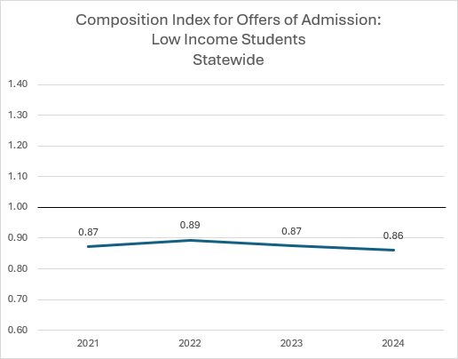
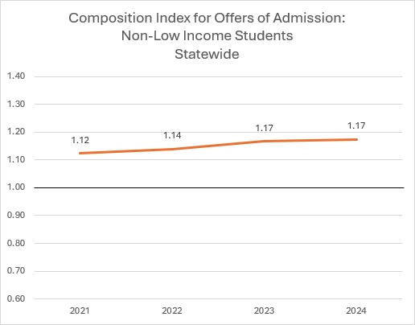
Low Income Students Admitted At Lower Rates Than Non-Low Income Peers

Slide 46
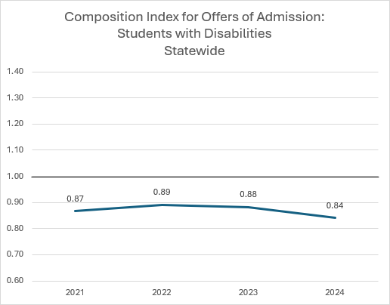
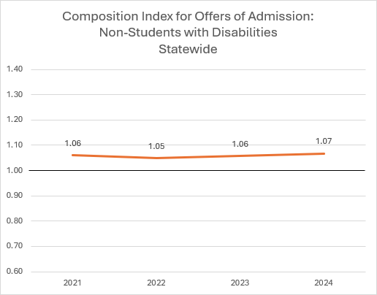
Students With Disabilities Admitted At Lower Rates Than Peers Without Disabilities

Slide 47
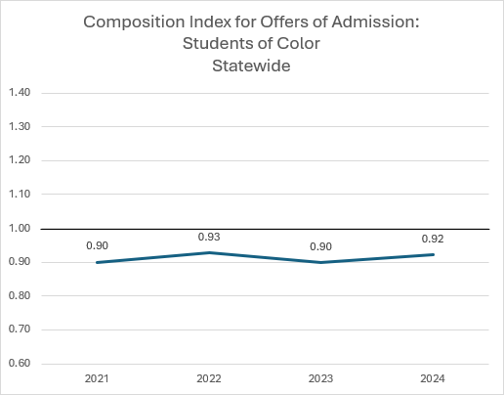
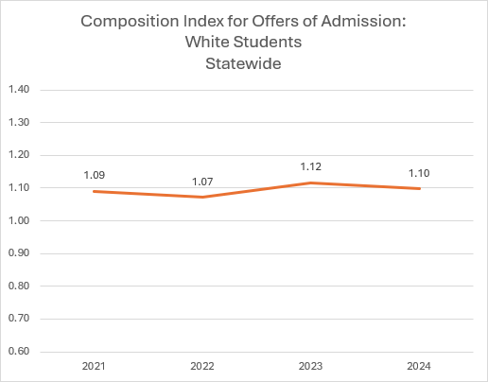
Students of Color Admitted at Lower Rates Than White Peers

