Slide 1

DESE's Educational Vision and Advancing Student Learning
BESE Update
November 19, 2024

Slide 2
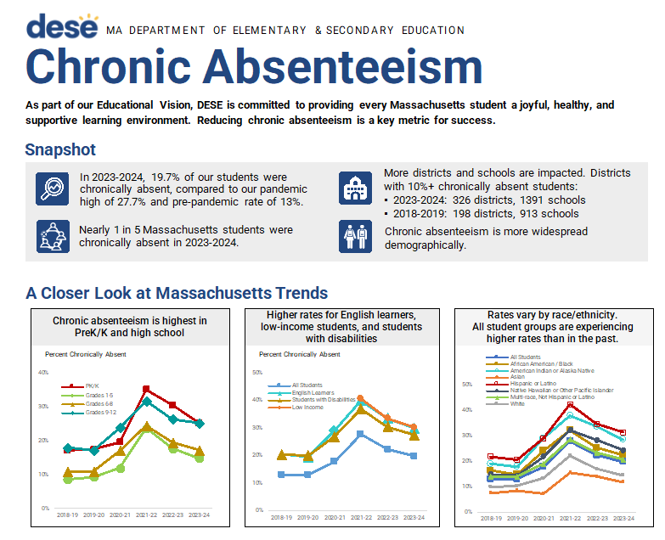
Educational Vision Update
Held quarterly Stocktake meetings in late October
Strategic Objective 1: Discussed DESE's approach/theory of action for addressing chronic absenteeism.
Strategic Objective 2: Analyzed HQIM adoption by grade band and content area.
Strategic Objective 3: Identified example policies and programs to expand and strengthen pipelines for diverse and effective educators.
Notes:
Since we last met in October we were able to hold our second quarterly stocktake meetings. As I have previously shared, these stocktake meetings provide a structured and systematic way to drive improvement and evidence-informed decision making.
The focus of our stocktakes in October was to review progress on our aligned metrics and to discuss potential areas of focus and programming for the upcoming school year.
In strategic objective 1, we discussed DESE's crystalized approach/theory of action for addressing chronic absenteeism. This theory of action was memorialized in a 2 page document (which you can see a snapshot of here) which is posted online and has been shared broadly. We discussed amplifying this work by building out DESE's definition of root cause analysis and gathering existing and new resources to support root cause analysis. We also continue to explore Massachusetts specific causes of chronic absenteeism and what the role of an SEA may be in addressing transportation as a potential root cause.
In the strategic objective 2 stocktake, we analyzed HQIM adoption by grade band and content area. As we continue to enhance our data collection related to curriculum in use, we are able to better disaggregate the data to identify areas of concern. What we found in our analysis was that some grade bands and content areas have already exceeded the adoption targets we set for this year
Lastly, in the strategic objective 3 stocktake, the team had a robust conversation about policies and programs to expand and strengthen pipelines. This included discussion of expanding the new Registered Teacher Apprenticeship program as gathering data to track pipleline expansion activities and their impact on hard-to-staff roles across the state.
These strategic step-back meetings provide an opportunity to more closely analyze data and make evidence based decisions. I truly appreciate these meetings and look forward to sharing more after our next round in March.

Slide 3
Advancing Student Learning Update: Diverse and Effective Workforce
Diverse and effective workforce – instructional coaching proposal design, resources, and evaluation
Statewide training for pairs of instructional coaches and school leaders in evidence-based, culturally and linguistically sustaining instructional practices
300 pairs per year
Development of supporting resources and guidance (look for tools, guidance on instructional coaching models, research and evaluation, etc.)
Notes:
Next I want to follow up on the proposals I presented to you last month as we continue to flesh them out and plan.
Also as a part of our proposals related to a diverse and effective workforce, I shared the idea of a statewide instructional coaching training on evidence based and culturally and linguistically sustaining instructional practices. This month the advancing student learning working group focused on this proposal including intentional participation and evaluation of the impact on students.
This proposed initiative is the culmination of many discussions and conversations about how to build knowledge and improve instruction through evidence-based, culturally and linguistically sustaining practices. We are trying to balance breadth with depth through an approach that centers the key role of school-level teacher leaders and administrators in setting and supporting instructional expectations.
Highlights from S.O. 3 Discussion
Narrow and specify the look-fors of CLSP; develop a process to define those look-fors, and promote inter-rater reliability in observing what they look like in practice
When implementing this program, be intentional about research and evaluation design. Consider who will receive the treatment (training) and how to evaluate intended impact (teacher behavior / student impact)
DESE should consider sharing guidance on what an instructional coaching model should be
Consider evidence-based practices for cultivating buy-in and changing adult behavior. Teachers/leaders may be challenged in changing behavior if they are stressed, feel overwhelmed, are unclear of expectations, or do not believe in the initiative
Consider how to role this out productively at scale. Those who first volunteer may not be those that most need it; how can we reach those that are hesitant/resistant?

Slide 4
Advancing Student Learning Update: Academic Support and Intervention
Academic support and intervention – high dosage tutoring and conditions for success:
Full implementation of high-quality instructional materials
Strong tiered systems of support
Regular screening and data analysis
Adequate technology
Coordinated scheduling
Solid routines and expectations
Requirement to launch in early October
Notes:
Last month I shared our plan to, pending investment, implement high dosage tutoring for targeted students as a part of our academic support and intervention efforts. This month I had the opportunity to visit a high dosage tutoring program in Waltham where I learned.....

Slide 5


Focus on: Core Functions
FY26 Budget Proposal and Report
Commonwealth of Massachusetts Virtual Schools: Funding
Felix Commonwealth Virtual School Return of Certificate
Setting expectations
Supporting implementation and catalyzing innovation

