Slide 1
Early Literacy High-Dosage Tutoring
January 28, 2025

Slide 2
Early Literacy High-Dosage Tutoring
Agenda
High-Dosage Tutoring Model
DESE Program and Impact
One8 High-Dosage Tutoring Program and Evaluation
District Perspective

Slide 3
Early Literacy High-Dosage Tutoring
DESE's High-Dosage Tutoring Model:
Individual or small group (five students or fewer) for grades K-3
Focused on foundational skills using evidence-based approaches to instruction
Supplemental to regular instructional time during or after school
Delivered through a structured model with a specific duration and frequency (75-120 min/week in cycles of at least 10 weeks)
Virtual or in-person

Slide 4
Early Literacy High-Dosage Tutoring
5 Providers
Springboard
Literacy Lab
Catapult
Ignite
On Your Mark
46
districts and charter schools
16,958+
student seats

Slide 5
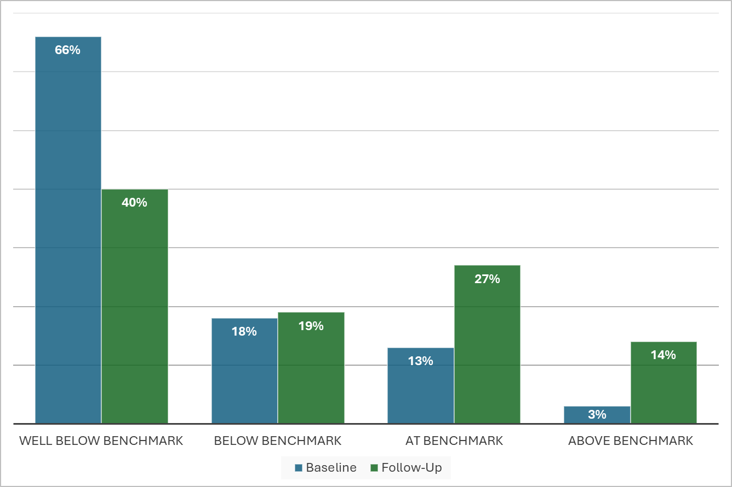
Early Literacy High-Dosage Tutoring 23-24
Baseline and Follow-Up DIBELS Reading Levels of Students Served Across the Five Vendors*
*5,244 students

Slide 6
An Evaluation of Ignite Reading in Massachusetts
Board of Elementary and Secondary Education
January 28, 2025
Amanda Neitzel, PhD

Slide 7
Study Overview
Goals:
Evaluate the impact of Ignite Reading on early literacy outcomes.
Gather stakeholder perceptions on program value and integration.
Research Design:
Mixed-methods approach
Quasi-experimental framework

Slide 8
Participants

Slide 9
High Dosage Tutoring Model Studied
Ignite Reading
Programmatic Support
Virtual “1 to 1” instruction
Daily, 15-minute tutoring sessions conducted in school
Students have the same tutor throughout the program
evidence-based literacy curriculum
Progress monitoring every 14 weeks
Monthly data meetings with school/district leaders to review progress
Program manager working closely with districts/schools and HDT provider to
collect and monitor data,
craft policy,
troubleshoot implementation issues
Eligibility requirements for districts
District champions and stipended school champion roles
In-person and virtual cohort convenings – to ensure milestone alignment and share best practices

Slide 10
Key Quantitative Findings: One-Group Pre-Post Analysis

Slide 11
Key Quantitative Findings: One-Group Pre-Post Analysis
*Students Across Demographics Gained Over Five Additional Months of Learning

Slide 12
Key Quantitative Findings: One-Group Pre-Post Analysis
*Students With the Highest Attendance Gained The Most

Slide 13
Key Quantitative Findings: One-Group Pre-Post Analysis
29% of students
moved from Intensive to Benchmark:
*Overall Attendance Rate: 89%

Slide 14
Key Quantitative Findings: Two-Group Comparison Analysis

Slide 15
Key Quantitative Findings: Two-Group Comparison Analysis
Group | Effect Size
Overall | +0.21 SD
African American Students | +0.24 SD
Hispanic Students | +0.14 SD
Other Students | +0.32 SD
White Students | +0.18 SD
English Learners | +0.31 SD
*Students Across Demographics Closed Skills Gaps At Meaningful Rates

Slide 16
Key Qualitative Findings
Overall Impressions from Participants
Supporting Conditions to Enhance Success
The Substantial Instructional Value of One-to-One Tutoring
Perceived Impacts on Early Literacy Skills
Integration with Multi-Tiered Systems of Support
Navigating Teacher Buy-in, Communication, Logistics, and Other Conditions to Support Success
Building teacher and school buy-in early
“School Champions” and planning
Leveraging school and teacher expertise in…
Integrating tutoring as part of existing MTSS/RTI frameworks
Strategizing tutoring delivery and implementation
Navigating technology use with young students
Leveraging Ignite Reading resources and support

Slide 17
Key Quantitative Findings: Two-Group Comparison Analysis
*Results Compare Favorably to Other Interventions

Slide 18
Questions?
Amanda Neitzel, aneitzel@jhu.edu

