Slide 1
DESE's Educational Vision BESE Update April 29, 2025

Slide 2
Focus on Strategic Objective 3: Diverse and Effective Workforce
3.1 Develop an increased and robust pipeline of diverse and well-prepared educators and leaders
3.2 Create the conditions to sustain and retain diverse and effective staff, particularly those who entered the field through alternative pathways
3.3 Implement opportunities for all staff to engage in a cycle of continuous improvement, utilizing effective teaming structures
Milken Educator Award

Slide 3
Focus on Strategic Objective 2: Deeper Learning
2.1 Select and skillfully implement high-quality and engaging instructional materials that support culturally and linguistically sustaining practices and foster deeper learning
2.2 Use the MTSS process to implement academic supports and interventions that provide all students, particularly students with disabilities and English learners, equitable access to deeper learning
2.3 Reimagine the high school experience so that all students are engaged and prepared for post-secondary success
2.4 Develop a coherent and holistic range of programming that is responsive to the needs and interests of diverse learners
Open SciEd

Slide 4
Milken Educator Award
Jillian Levreault | Southbridge Middle School
Jeffrey Villar | Southbridge Public Schools
Sarah Houle | Southbridge Middle School
Caitlin Haapaoja | DESE

Slide 5
OpenSciEd in Massachusetts
April 29, 2025
Erin Hashimoto-Martell, Associate Commissioner
Nicole Scola, Assistant Director, Science & Technology/Engineering
Casandra Gonzalez, Science & Technology/Engineering Content Specialist
Kimberly Laliberte, Director of Science, Fall River Public Schools

Slide 6
Agenda
Massachusetts and OpenSciEd partnership
How OpenSciEd is different
District Experience: Fall River

Slide 7
DESE Educational Vision
What does that look like in a classroom?
All students
Are known and valued
Learning experiences
Are relevant, real-world and interactive
Individualized supports
Enable students to excel at grade level and beyond

Slide 8
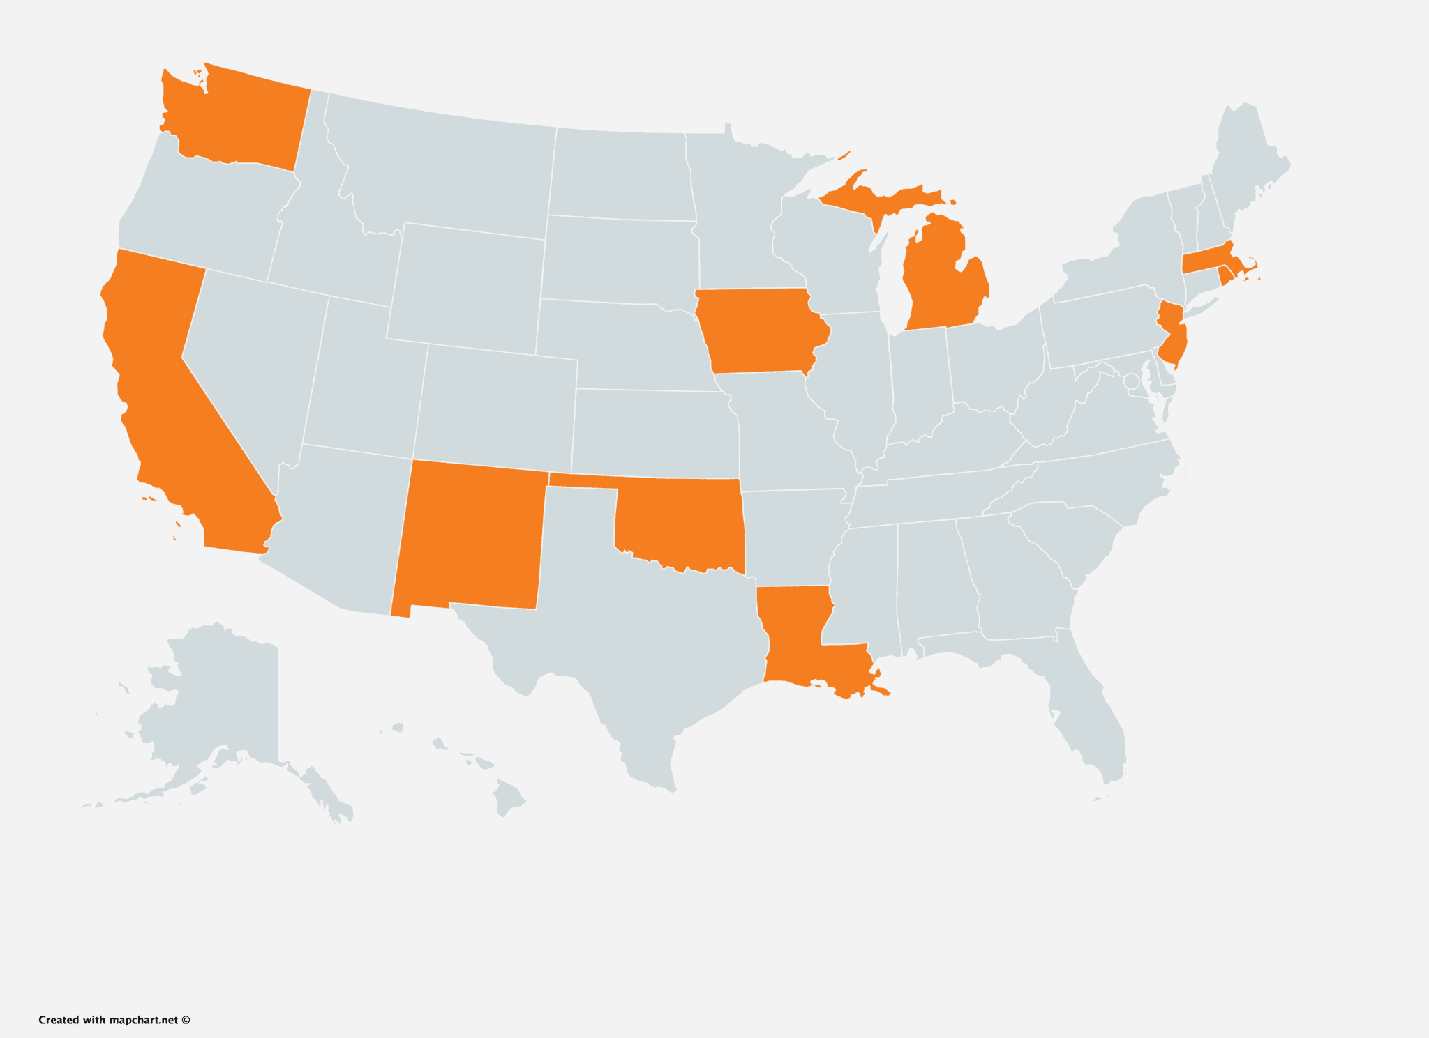
Massachusetts as a Partner State
National collaboration of partner states and national experts
MA science team on steering committee for development & design of materials
MA teachers participate in professional learning
MA teachers and students provide feedback on the materials in the development process
Partner States in the development of the curriculum

Slide 9
OpenSciEd Curriculum Development Timeline
2018
Middle School
Teachers used and provided feedback on draft materials through 2021
2021
High School
Teachers used and provided feedback on draft materials through 2023
2023
Elementary
Teachers using and providing feedback on draft materials through 2026
Districts are currently adopting the finalized materials
Spring 2025 Implementation professional learning offered to districts
Districts implementing the finalized curriculum

Slide 10
OpenSciEd in MA
250+ K-12 educators piloted, attended professional development and provided feedback on the materials
Over15,000 K-12 students provided feedback on materials to support alignment to the MA Curriculum Frameworks
90+ districts have adopted OpenSciEd
Middle school curriculum reviewed by CURATE
Districts have received support through state/federal funding & private foundation grants

Slide 11
What is OpenSciEd?
K-12 high-quality national science curriculum
Researched-based, free open-source educational resource (OER)
Every unit starts with an authentic, real-world situation or problem
Students ask questions, conduct investigations, analyze data, and design solutions to unpack and address the focal issue
Classrooms center discourse and collaborative problem-solving
Grounded in principles of equity

Slide 12
Example Units

Slide 13
What's Next?
Continued K-12 support through DESE's networks and programming
Continued collaborations with OpenSciEd
Grant support for middle school adoption and implementation offered through the One8 Foundation
High school units slated for CURATE review in Spring 2026

Slide 14
Fall River Curriculum Adoption Timeline
2019 OpenSciEd district selection process
2020 Adopted middle school OpenSciEd
2021 Participated in high school materials trial & feedback for Biology, Physics, & Chemistry
2023 Participated in elementary materials trial and feedback
2026 Full implementation K-5, 6-8, HS Biology, Physics, Chemistry

Slide 15
Impact in the Fall River Schools
146 teachers, 25 administrators across 15 schools were trained and currently implementing OpenSciEd K-12
Successful use with all students including students with disabilities in sub-separate and inclusion classrooms, and multi-language learners from levels 1 and above including newcomers
Increase in item level performance on Grade 8 Science MCAS after 1-year
Increased retention of science routines, practices, and content knowledge for students and teachers after 1-year

Slide 16
Thank you

