Slide 1
Artificial Intelligence in MA K12 Schools
BESE Discussion
April 29, 2025
Jackie Gantzer, Director of School Support & EdTech
AJ Coté, Assistant Director of EdTech
Paula Moore, Digital Literacy and Computer Science Lead
Greg Kulowiec, AI Consultant

Slide 2
Agenda
Generative AI in Schools
MA K12 AI Task Force
DESE Multi-Year Strategy
Questions & Discussion

Slide 3
What do we mean by AI?
“AI is simultaneously revolutionary and something that’s been quietly helping us out for years.”
- Kent Walker, President of Global Affairs - Google & Alphabet
Reactive
Tools that respond to specific inputs or situations without learning from past experiences (e.g. Home assistants, robot vacuum, chess-playing computer).
Predictive
Tools that analyze historical data and experience to predict future events of behaviors (e.g. Netflix recommendations, credit-scoring systems).
Generative
Tools that generate new content or outputs, often creating something novel from learned patterns (e.g. text, image, and audio generators).

Slide 4
Early Approaches to AI in MA Schools
Educators using AI for planning, assessments, and grading
Special educators using AI to help write or update IEPs
Students using AI to help with or complete classwork
District administrators using AI to streamline operational workflows
Schools and districts developing policies around AI usage
Families asking about student data privacy with AI

Slide 5
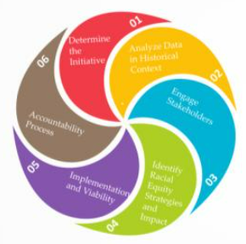
MA K12 AI Task Force (Launched Summer 2024)
Task Force Charge: Provide recommendations for ways the state can support schools and districts as they address the opportunities and challenges presented by artificial intelligence.
REDT Six-Step Process
Define the initiative
Analyze data and historical context
Engage stakeholders
Create proposal with racial equity strategies embedded
Create implementation plan and assess viability
Ensure accountability and impact

Slide 6
Task Force Membership
The MA AI K-12 Task Force is made up of ~20 educators representing a broad range of perspectives.

Slide 7
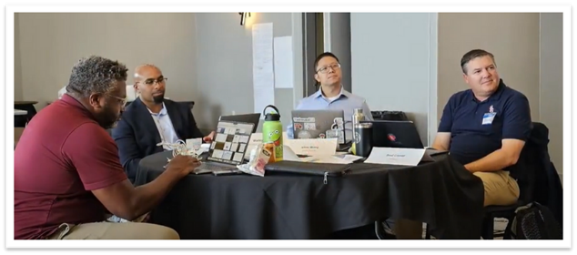
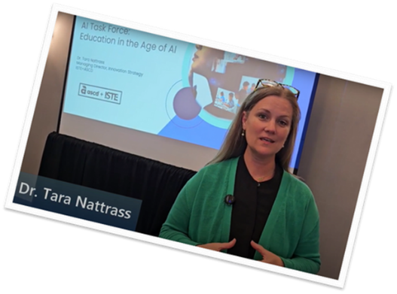
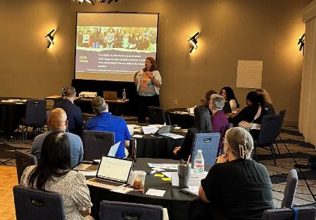
Task Force Approach
Full-day, in-person kick off meeting
Context setting
Review of pre-existing resources
Discussion of priority areas
Collect and analyze information from stakeholder listening sessions and surveys
Brainstorm DESE actions to address emerging themes and needs
Clarify and prioritize recommendations for their alignment to the DESE vision, urgency, and potential impact, with considerations for implementing with a focus on equity​

Slide 8
Stakeholder Hopes & Fears
Classrooms are more innovative and creative
Creating efficiencies in “mundane” tasks
Supporting differentiated learning
Real-world application / Solving big challenges
Students learn how to learn how to safely and effectively use AI
Workforce exposure and preparedness
Hopes
Fears
Loss of skills – content, creativity, critical thinking, etc.
Misinformation, reliability, and bias of information
Data security and privacy
Ethical and responsible use
(In)Equity of access to tools and experiences
Lower quality of instruction
Job displacement
Loss of human connection

Slide 9
Task Force Recommendations
Recommendations were synthesized into 8 actions across three primary categories.
I. Resource Creation and Curation | II. Professional Development | III. Policy Supports
Create resources for stakeholders to build AI literacy Develop a list of recommended AI tools and resources Create or recommend an enterprise AI tool | Offer a variety of professional learning opportunities Provide turnkey training on student data privacy | Create sample district guidelines and policies Embed tech integration, including AI, into educator preparation programs Incorporate AI literacy into MA curriculum frameworks

Slide 10
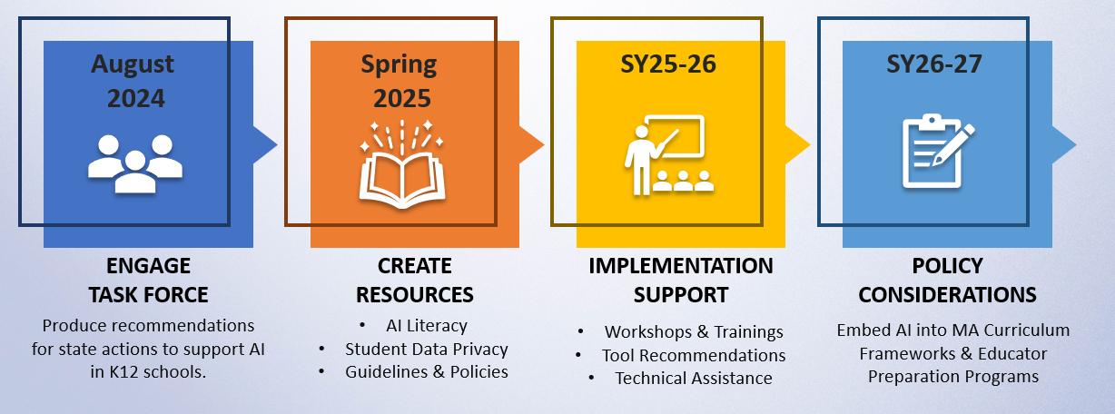
DESE’s AI Strategy
Notes:
Accessible

Slide 11
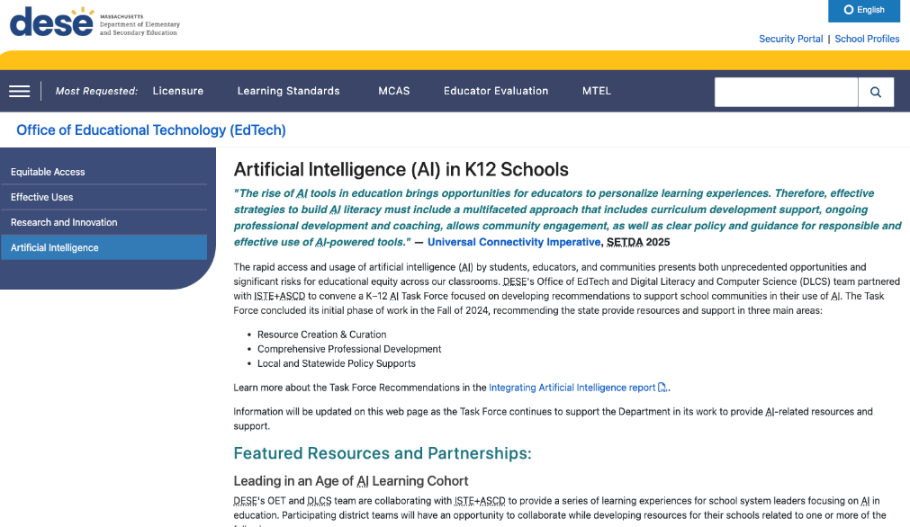
Artificial Intelligence Web Page www.doe.mass.edu/edtech/ai/
Task Force Recommendation Report
Professional Learning Opportunities
Vetted Resources

Slide 12
MA K12 AI Task Force (Ongoing)
Task Force Charge: Inform DESE’s implementation efforts while centering our educational vision and equity.
REDT Six-Step Process
Define the initiative
Analyze data and historical context
Engage stakeholders
Create proposal with racial equity strategies embedded
Create implementation plan and assess viability
Ensure accountability and impact
AI Literacy
Student Data Privacy
Guidelines & Policies

Slide 13
Questions & Discussion
What do you see as the biggest risks or gaps that we should be considering or prioritizing?
Are you aware of any promising efforts in districts or other organizations that we could learn from or collaborate with?

