Slide 1
Proposed Amendments to Regional School District Regulations, 603 CMR 41.00
April 29, 2025

Slide 2
Presenters
John J. (Jay) Sullivan, Associate Commissioner for District and School Finance
Lucy Wall, DESE Legal Counsel
Christine M. Lynch, Former Director of Regional Governance/Management Consultant
Michelle Griffin, Regional Governance Coordinator

Slide 3
Agenda
Background
Regional School Districts (RSD)
Proposed Changes to RSD Regulations
Questions/Comments

Slide 4
Background
Regional School District (RSD) Law:
Allows for formation of RSDs between two or more cities and towns via agreement to operate one school district.
Requirements for one RSD school committee and one RSD budget.
Components of regional agreements and amendments; approval requirements.
(M.G.L. c. 71, §§ 14 – 16I; initially passed in 1949)
RSD Regulations:
603 CMR 41.00
Most recently amended by the Board: May 19, 2009

Slide 5
Regional School Districts
FY25: 84 RSDs in MA
58 Academic RSDs with 170 member cities and towns (serving 97,218 students).
26 Career Technical/Vocational RSDs with 235 member cities and towns (serving 30,901 students).
Only 54 Municipalities in MA are not in a regional school district.

Slide 6
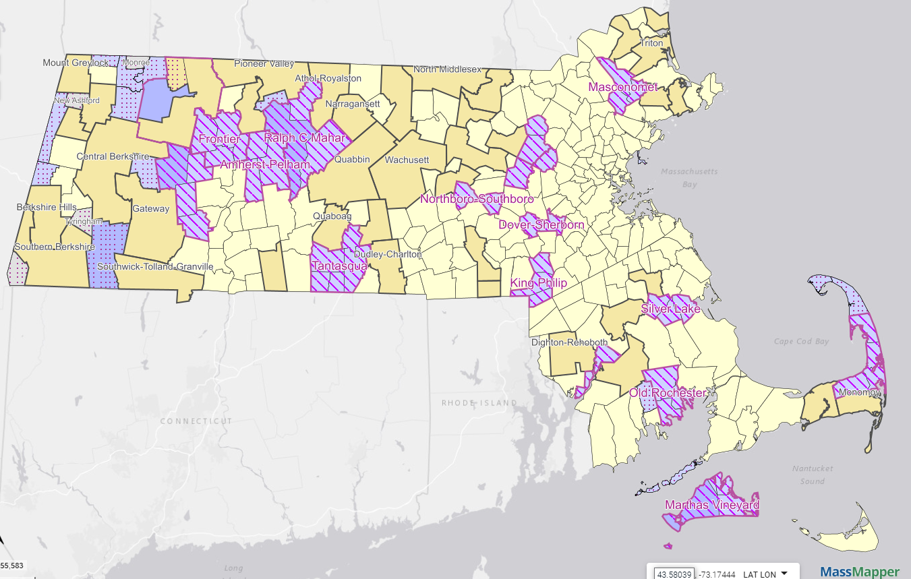
Academic Regional School Districts
Academic Regional School Districts

Slide 7
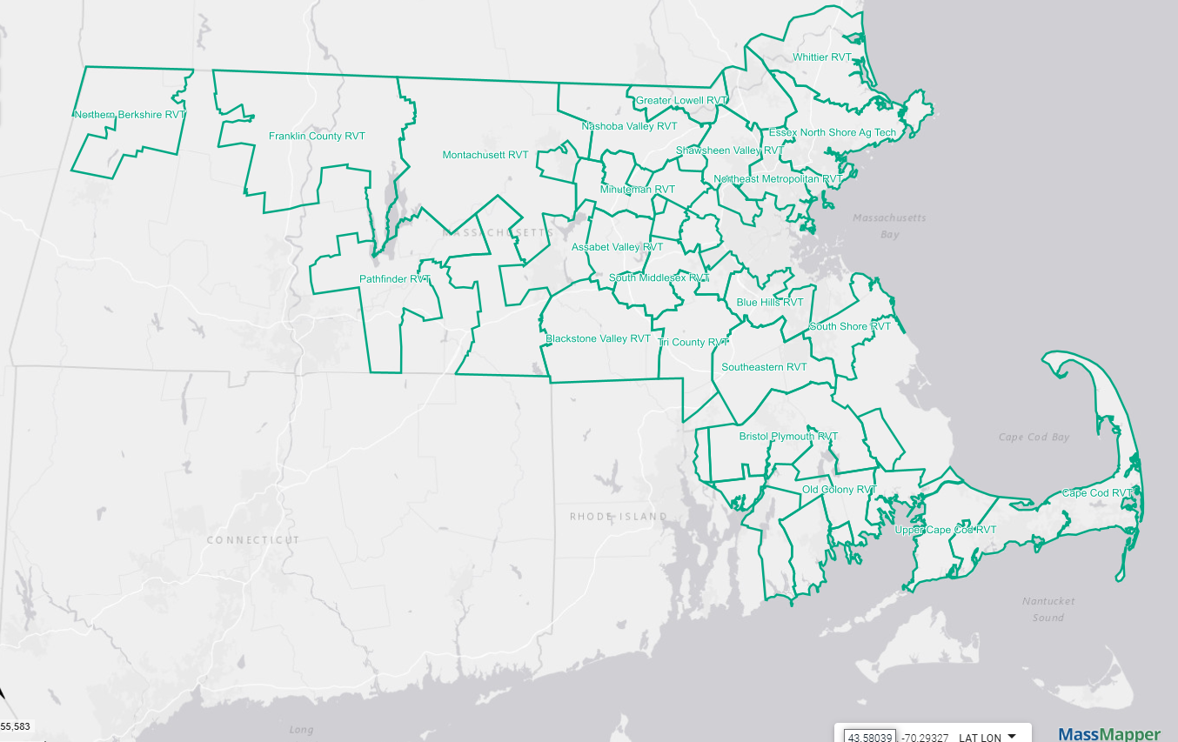
Career Technical/Vocational RSDs

Slide 8
Proposed Changes to RSD Regulations Include:
1. Streamlining the approval of RSD agreements and amendments to RSD agreements.
2. Clarifying provisions surrounding the creation and approval of RSD budgets.
3. Clarifying provisions related to Commissioner Fiscal Oversight, when required by RSD law.

Slide 9
Proposed Changes to RSD Regulations Include:
4. Addition of new provisions for waiver and severability.
5. Technical Updates.

Slide 10
Anticipated Next Steps
Public comment may be submitted via an online form, or sent via email to RegionalGovernance@mass.gov, or sent via mail to Regulations Public Comment, c/o Commissioner’s Office, Department of Elementary and Secondary Education, 135 Santilli Highway, Everett, MA 02149.
The deadline for the public comment period is June 28, 2025 at 5:00pm.
The Board is expected to vote on the proposed amendments at its regular monthly meeting scheduled for September 2025.

Slide 11
Questions/Comments?

Slide 12
Thank you!

