Slide 1
Innovation Career Pathways Overview: What We Can Learn from North Attleborough High School
June 24, 2025

Slide 2
Presenters
Name | Role
Elizabeth Bennett | Associate Commissioner for College, Career, and Technical Education
Jennifer Gwatkin | Coordinator, Innovation Career Pathways
Max Kinney | Engineering Teacher, Advanced Manufacturing Advisor, North Attleborough High School
Stacia Williams | Science Curriculum Leader, Biology Teacher, Advanced Manufacturing Coordinator, North Attleborough High School
Tristan Arkerson | Student, North Attleborough High School
Josiah De La Cruz | Student, North Attleborough High School

Slide 3
Agenda
Innovation Career Pathways Overview
Innovation Career Pathways at North Attleborough High School

Slide 4
What are Innovation Career Pathways?
Innovation Career Pathways (ICP) connect student learning to one of six broadly-defined industry sectors
Pathways are designed around equity

Slide 5
Broad Industry Sectors
Advanced Manufacturing
Business / Finance
Clean Energy
Environmental / Life Sciences
Healthcare / Social Assistance
Information

Slide 6
Current Pathways by Sector
SECTOR→ YEAR↓ | Advanced Manufacturing | Business & Finance | Information | Health Care & Social Assistance | Environmental & Life Sciences | Clean Energy
2024 | 53 | 41 | 42 | 47 | 34 | 5
2025 | 66 | 50 | 47 | 59 | 37 | 10

Slide 7
Funding for Innovation Career Pathways
DESE Planning Grants ($15,000 max award)
DESE Implementation Grants for newly designated programs ($75,000 max award)
DESE Support Grants for designated programs in Year 2 and beyond ($50,000 max award)
Technology & Equipment: Workforce Skills Cabinet Skills Capital grant program (administered by EOE)

Slide 8
Spotlight on North Attleborough High School
Max Kinney – Engineering Teacher, Advanced Manufacturing Advisor
Stacia Williams – Science Curriculum Leader, Biology Teacher, Advanced Manufacturing Coordinator
Tristan Arkerson – Student
Josiah De La Cruz – Student

Slide 9
6/24/25

Slide 10
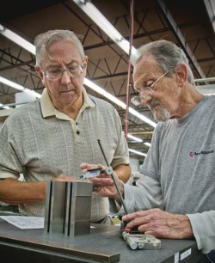
The “Silver Tsunami”
THE FACTS | WHAT WE NEED
2018 Southeastern MA Labor Market Blueprint: 39% of manufacturing employees were aged 55+, the highest percentage across key industry sectors in the region Sector added nearly 5,000 new jobs in the region between 2021-2023. | There is rising demand for skilled workers just as a wave of retirement looms. We need young talent with in-demand technical skills.

Slide 11
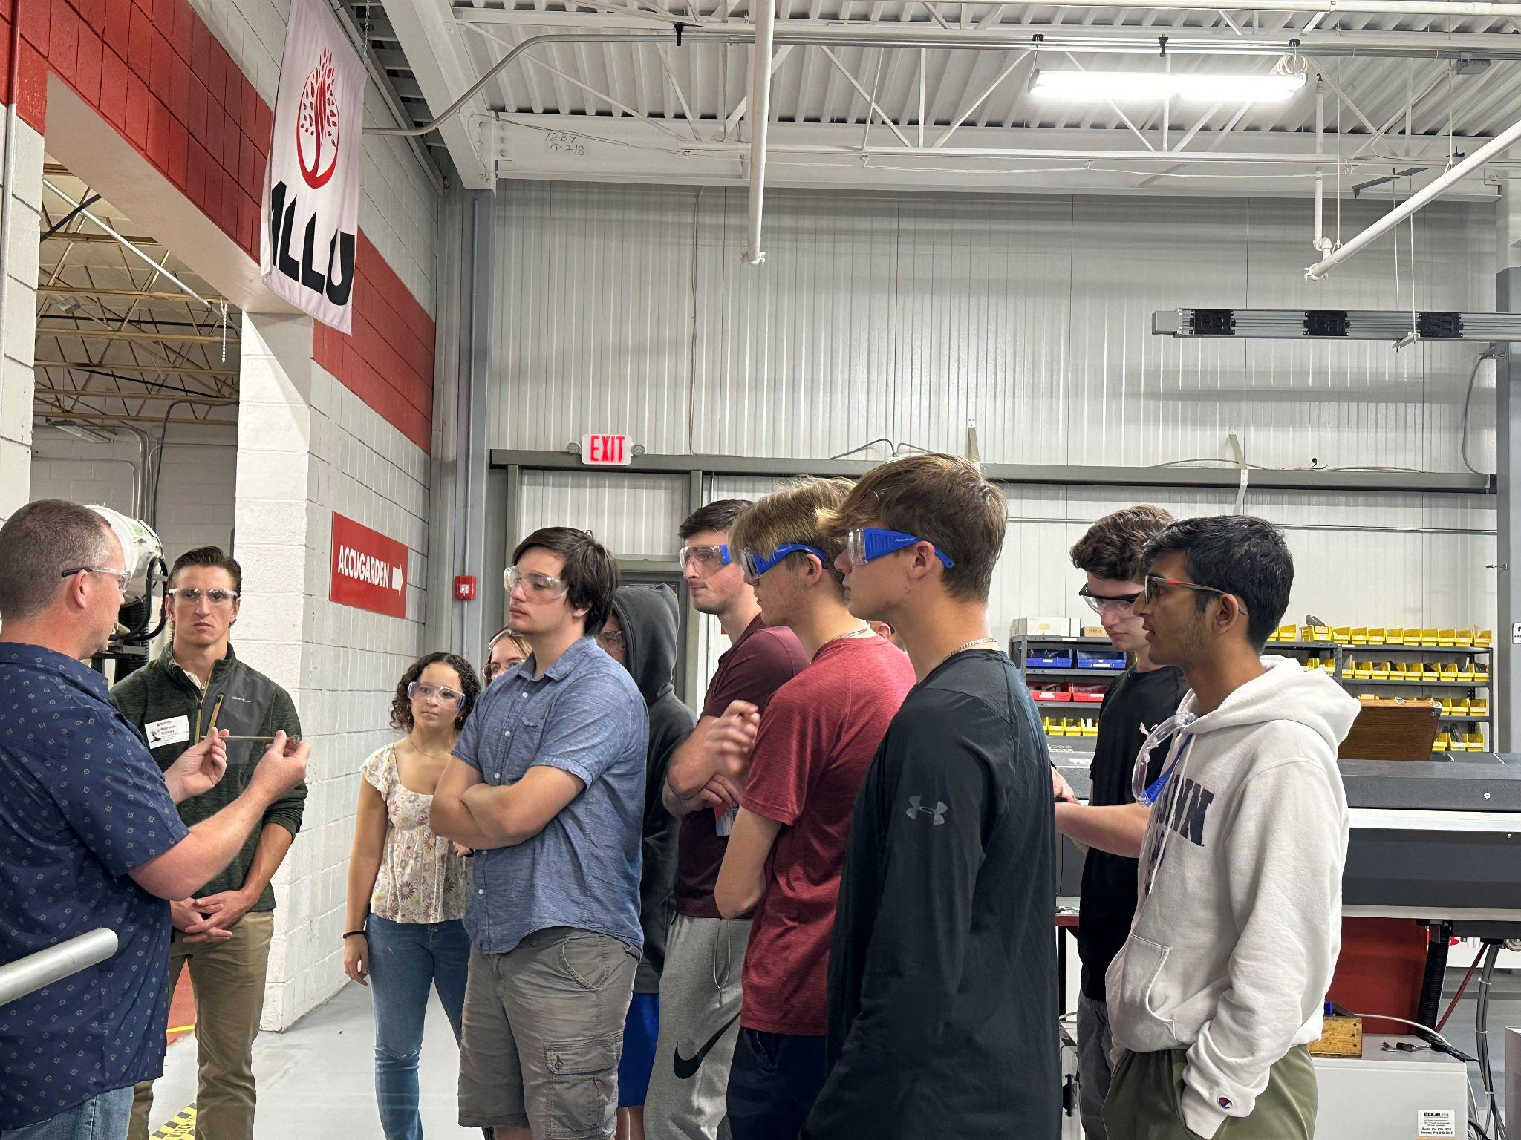
Information about our program
VISION:
The Advanced Manufacturing pathway at NAHS empowers students with the technical skills, industry exposure, and real-world experiences needed to succeed in modern engineering and manufacturing careers.
Through a rigorous, hands-on curriculum - featuring advanced coursework, technical training, and industry certifications - students build strengths in:
Problem-solving
Innovation
Collaboration
We prepare future-ready graduates - equipment to lead, create, and thrive in a fast-changing, technology-driven world.

Slide 12
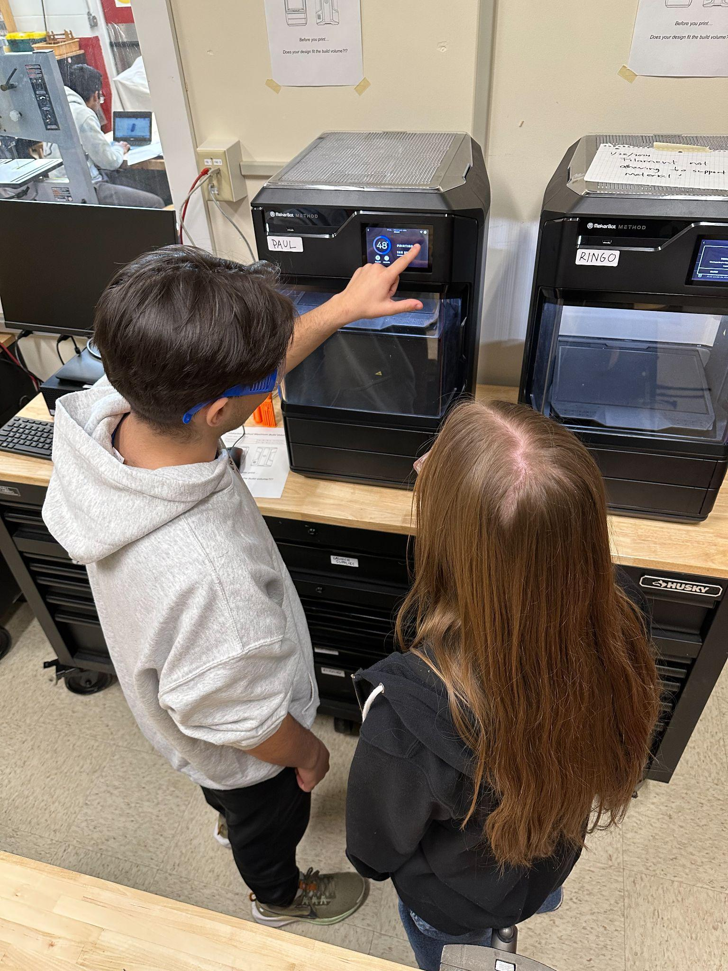
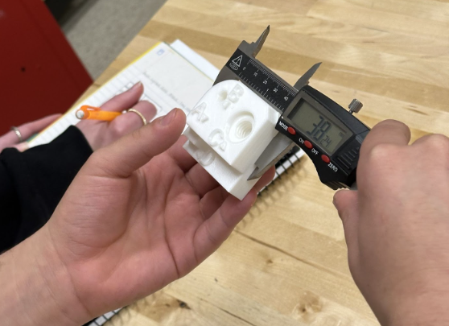
Coursework and Certifications
Industry-recognized certifications
OSHA 10 Hour General Industry
Autodesk Certified User (ACU) - Fusion
Proof of product development skills using 3D CAD, CAM, and CAE tools to explore design ideas
Latest enhancement to our pathway
Increasing accessibility with project-based learning
All students successfully participate while attaining different levels of mathematical or analytical understanding
Courses
Introduction to Engineering Design (IED)
Principles of Engineering (POE)
Other courses
Various levels of Physics
AP Computer Science

Slide 13
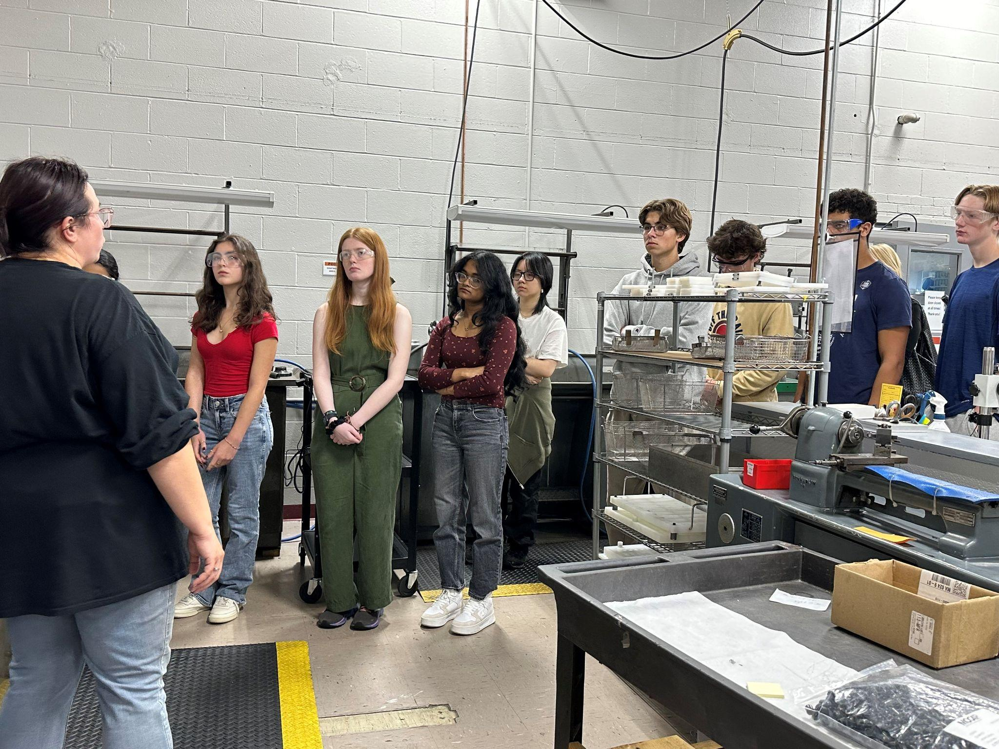
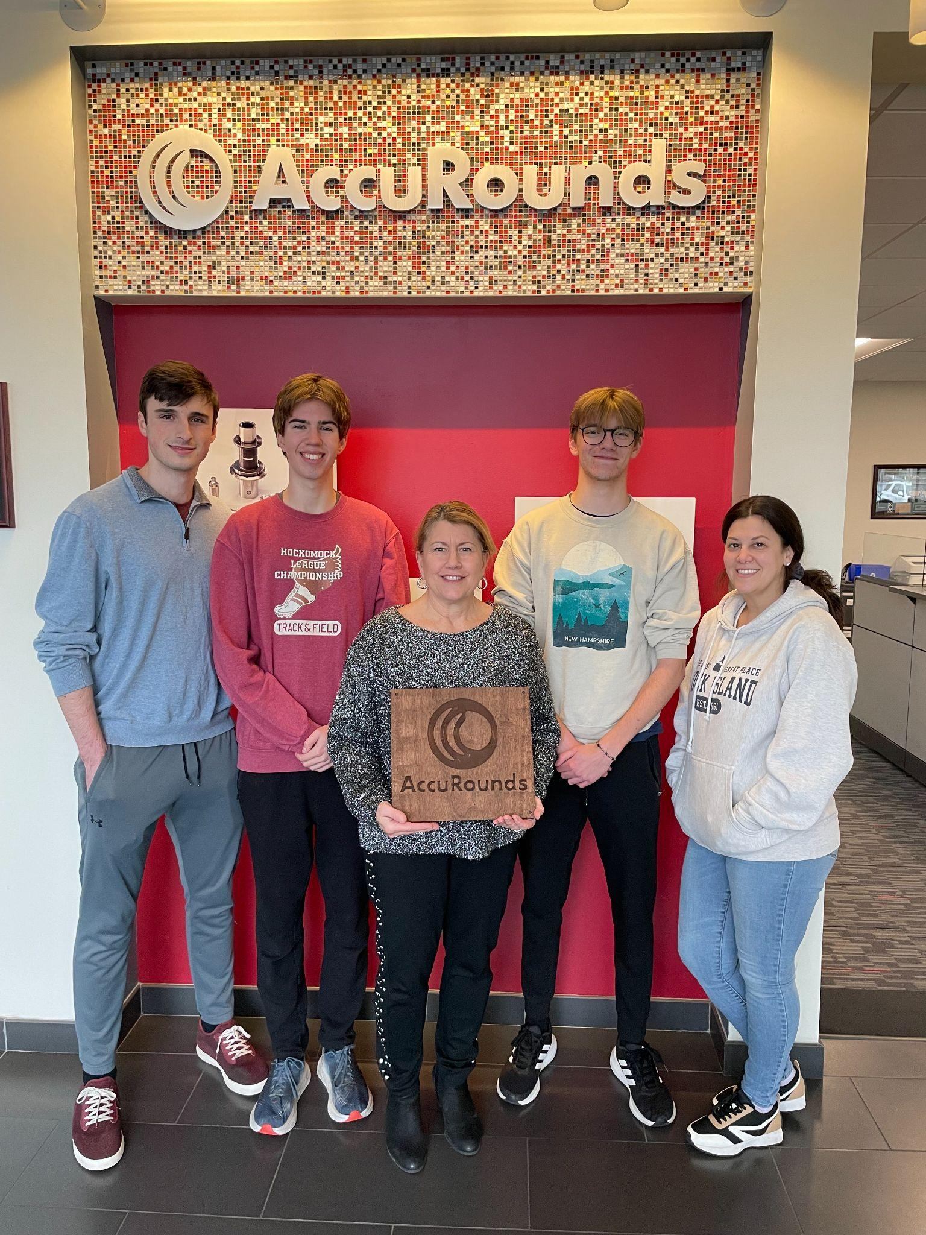
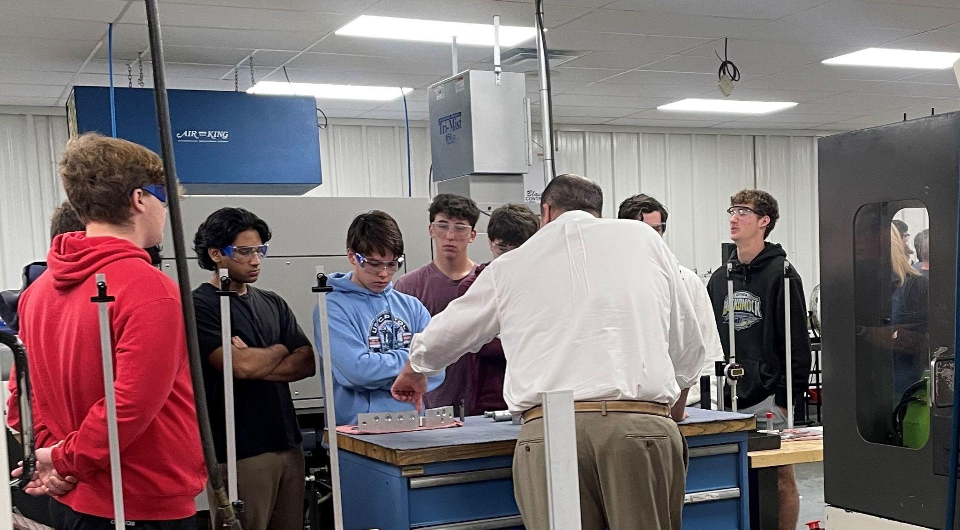
Experiences
Tours of local advanced manufacturing facilities
Accurounds (Avon)
North Easton Machine Company (Easton)
Massachusetts Manufacturing Mashup
Shoutout Secretary Tutwiler!
Capstone Project
Presentations and Recruitment Opportunities
Electric Boat, Navy Nuclear Engineering Program, Swoveralls, UMASS Professor
Internships
E.A. Dion (Attleborough)

Slide 14
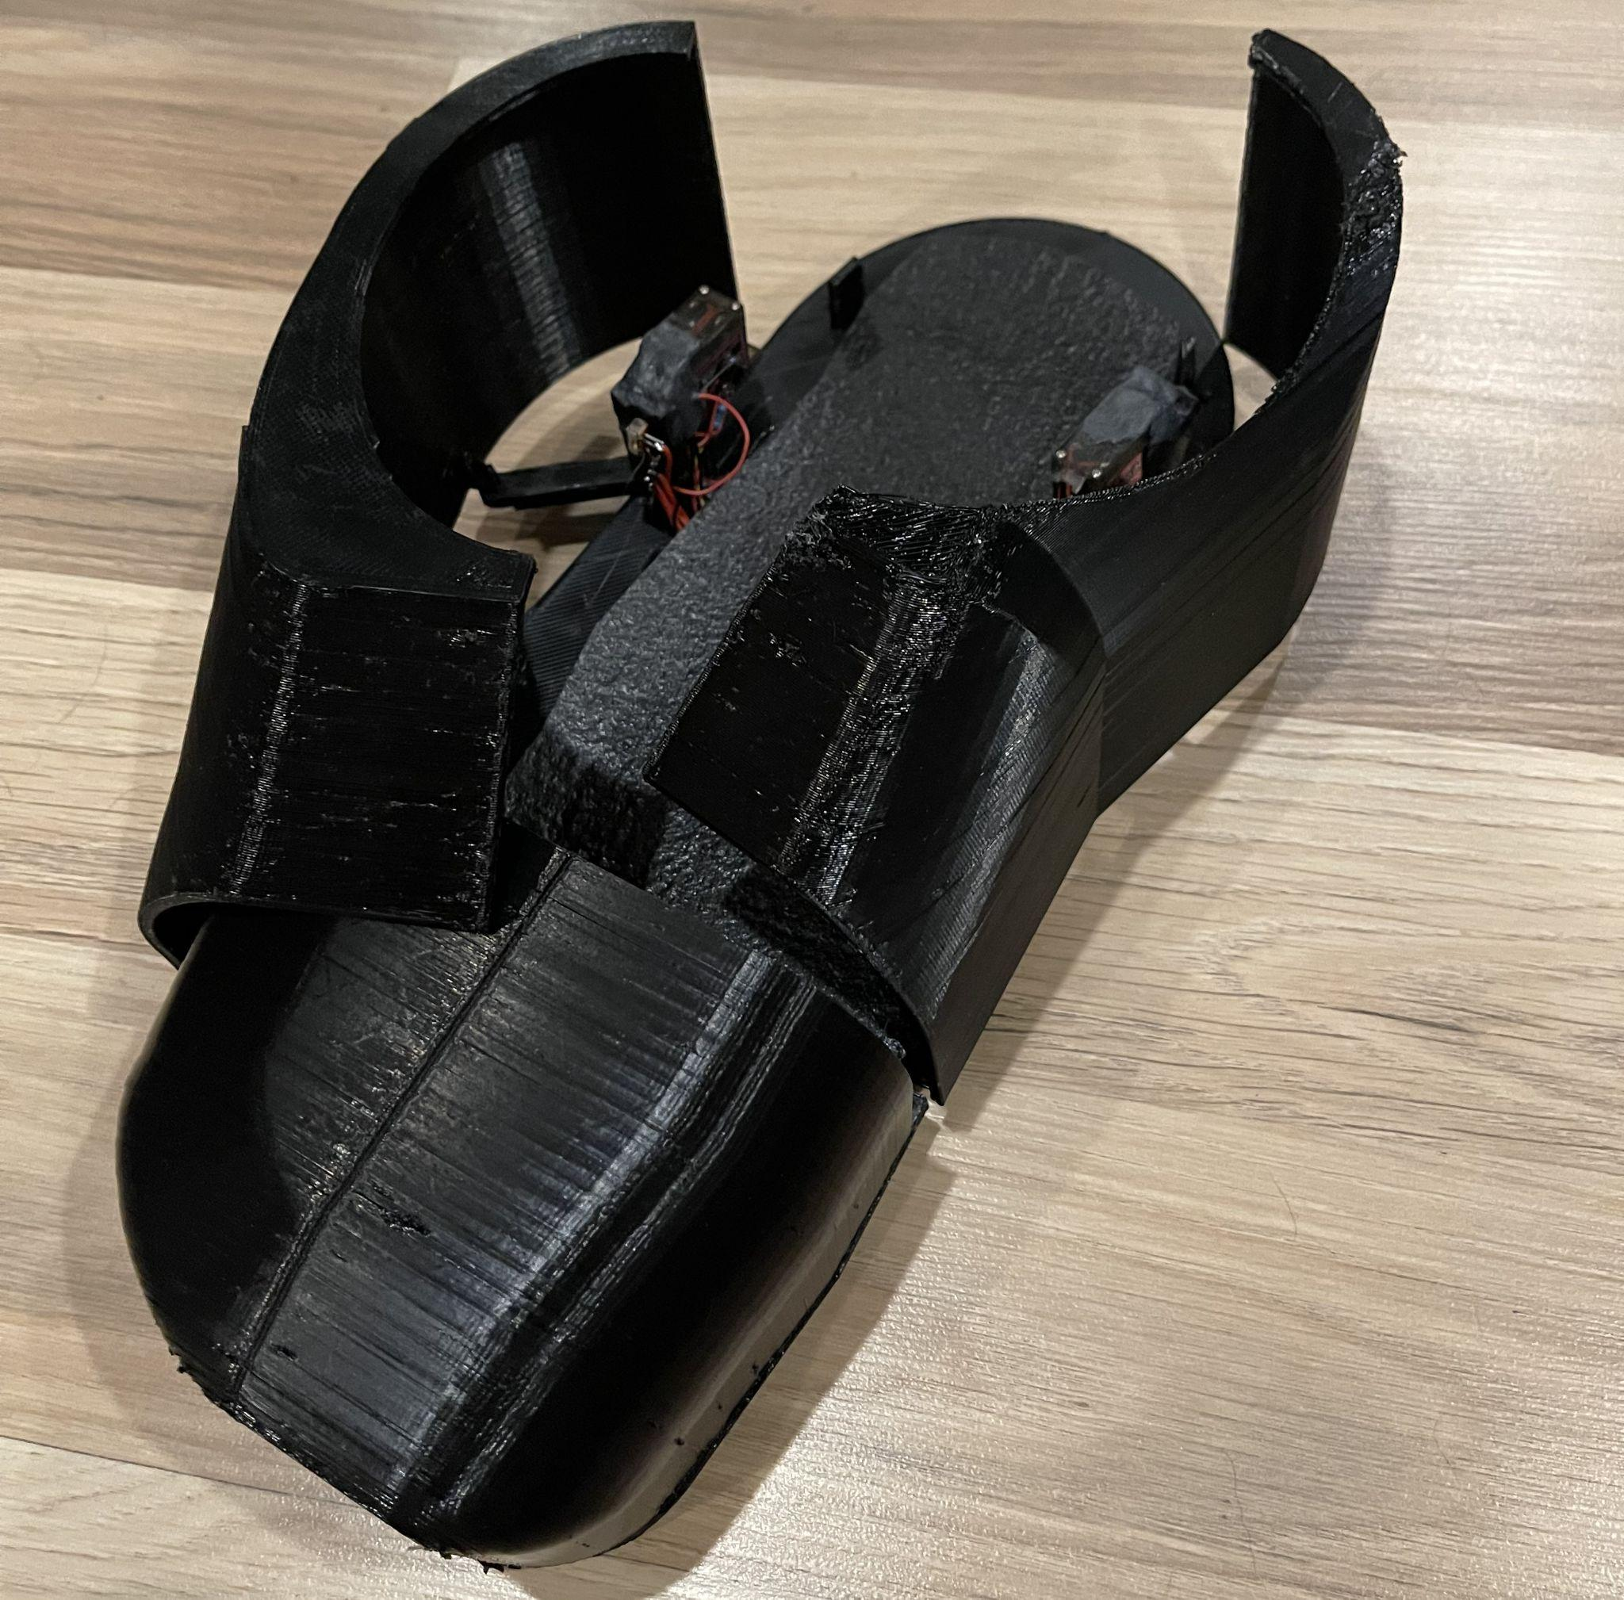
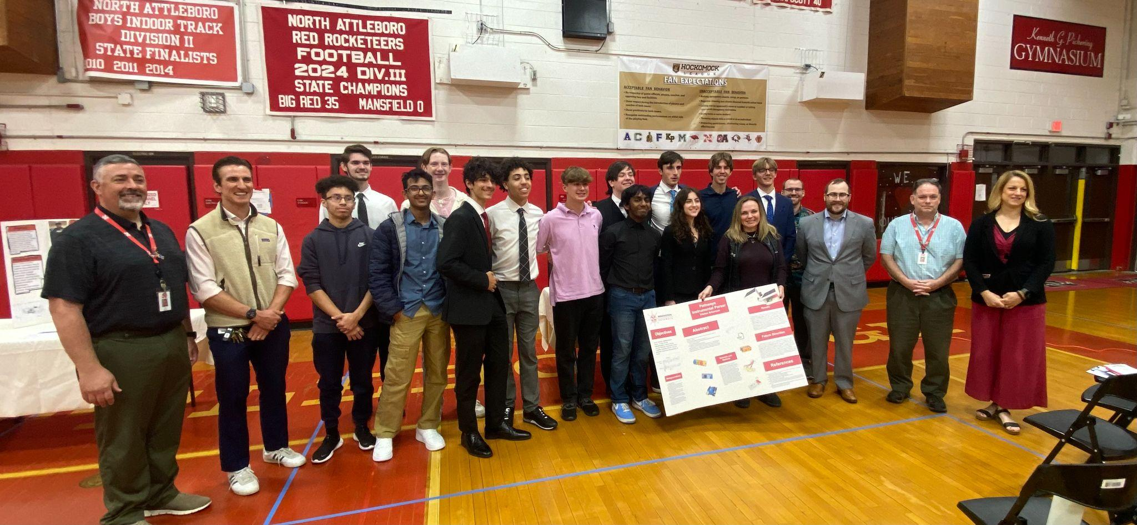
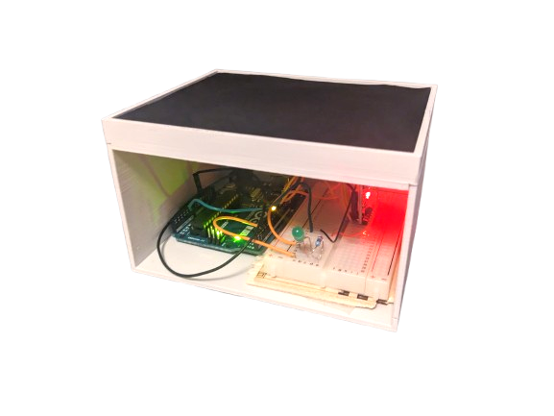
Student Impact and Outcomes
“The skills and experiences I gained through the program have been truly invaluable.”
“Thanks to the hands-on knowledge I developed… I felt confident leading testing for our team.”
“Innovation Pathways made a lasting impact on my academic journey.”
“Having already taken an idea from concept to prototype in high school made me far more prepared…”
“...helped shape my engineering mindset and gave me the confidence I needed”

Slide 15
How Innovation Pathways Lead to Success for All Students
By offering a structured and accessible curriculum, the program ensures that all students—regardless of background—have the opportunity to gain industry-relevant skills that are in high demand. The program helps students discover their strengths, connect learning to life goals, and graduate with both a diploma and a professional edge—making success achievable and personal for every learner.
Multiple Pathways to Success: Whether students plan to attend college, enter the workforce, or pursue technical training, the program supports diverse post-secondary goals. Dual enrollment and AP options challenge academically driven students, while technical courses and certifications provide immediate job-readiness for those choosing to enter the workforce directly after graduation.
Hands-On, Engaging Learning
The program emphasizes real-world applications of engineering and manufacturing through hands-on projects and technical instruction, helping students connect classroom learning to tangible career outcomes. This approach can boost motivation and engagement for students with different learning styles.
Workplace Learning & Industry Connections
Partnerships with local employers provide students with mentorship, job shadowing, and project experience—building soft skills and professional networks early. These experiences often lead to internships, job offers, or valuable references, giving students a head start in their careers.
Capstone Experience Builds Confidence
The senior capstone project allows students to apply their accumulated knowledge to a meaningful, self-directed project. This not only reinforces what they've learned, but also fosters independence, critical thinking, and confidence—traits that are essential for lifelong success.

Slide 16
Thank you

