Slide 1
SSAC End of Year Report (2024-25)
Ioannis Asikis, SSAC Chair & Student Board Member

Slide 2
Presentation Objectives
Reflect on SSAC’s Yearlong Journey: Highlight how student voices shaped data-informed, equity-centered priorities statewide
Discuss Regional & Statewide Work: Findings, themes, and policy recommendations from all five RSACs and SSAC workgroups
Emphasis on Collaboration: Demonstrate how stakeholder engagement, student-led research, and inter-regional coordination created real impact

Slide 3
Today’s Agenda
➢ SSAC Overview ➢ Expanding Our Reach ➢ Community Dialogue
➢ Regional Council Takeaways ○ Greater Boston ○ Western Mass ○ Southeast Mass ○ Northeast Mass ○ Central Mass
➢ State SSAC Takeaways ○ Mental Health ○ School Connectedness
➢ Shared Statewide & Regional Themes ➢ Closing Reflections & Questions

Slide 4
What is the State Student Advisory Council (SSAC)?
The SSAC is a group of students elected by their peers from schools throughout Massachusetts who are helping make decisions about state educational policy and student rights. These students are initiating and carrying through projects to make changes in local schools.
Student Representatives from schools serve on Regional Student Advisory Councils (RSACs). Each region elects delegates to the State Student Advisory Council (SSAC). The SSAC initiates projects, analyzes data, and connects students across Massachusetts.
The chairperson represents the ideas of all students in Massachusetts and is a communication link from the Board to the SSAC.

Slide 5
Expanding Our Reach
In-person Meetings Held Across the State: Leicester, Worcester, Everett, Methuen
Virtual Access: Hybrid model maintained throughout to promote accessibility
Meeting Frequency Increased: Regular touchpoints built momentum
Why This Matters: Greater regional representation = more comprehensive student voice at the table

Slide 6
Revisiting the Community Dialogue
This was a cornerstone of our work this year and deserves emphasis once more.
The Community Dialogue allowed the SSAC to:
Engage directly with stakeholders and professionals across education and mental health
Ground our policy conversations in data representative of thousands of students
Move beyond small internal surveys to widely validated metrics like the Youth Risk Behavior Survey (YRBS)
Ensure our priorities are based on statewide trends and student needs
This is a major step forward from previous SSAC years where feedback was largely limited to a handful of our own delegates

Slide 7
Diving Into the Data
20% - were chronically absent (absent 18 days or more) last school year
Youth Risk Behavior Survey (YRBS) - 2023
Among the group’s top concerns were the percentage of Massachusetts high school students who reported on the survey:
15% - said they were electronically bullied
16% - said they had considered, planned, or attempted suicide
31% - said their mental health was most of the time or always not good
7% - said they did not go to school because they felt unsafe at school or on their way to or from school
71% - said there is at least one teacher or other adult in their school that they can talk to if they have a problem

Slide 8
Representation at Community Dialogue
Identified by Our Delegates
Massachusetts Department of Mental Health (DMH)
Massachusetts Service Alliance (MSA)
Massachusetts School Mental Health Consortium (MASMHC)
Methuen Public Schools
Department of Elementary and Secondary Education (DESE)
State Student Advisory Council (SSAC)
Safe and Supportive Schools Commission (SaSS)
Massachusetts Association of Student Representatives (MASR)

Slide 9
Mental Health & Connectedness - Greater Boston Regional Student Advisory Council
Mental Health
34% of students felt prolonged sadness or hopelessness 12.7% seriously considered suicide
Rates 2–3x higher among LGBTQ+ students
Root Causes: • Academic & social pressure • Identity-based marginalization • No clear “first step” for support
Recommendations: • Peer mentoring programs • Anonymous check-in tools • Classroom-based mental health days & dialogue
School Connectedness
61% of students feel they belong at school
Chronic absenteeism continues to rise post-COVID
Students need flexibility beyond IEP/504 plans
Root Causes: • Rigid policies & academic pressure • Burnout & low motivation • Poor student-teacher connection
Recommendations: • Flex periods & intervention blocks • Empathy-based staff training • Embed student voice in decisions • Promote DCAP-like flexible policies

Slide 10
Increasing Safety, Belonging - Western Mass Regional Student Advisory Council
Safety & Belonging
7% of students skipped school due to feeling unsafe
16% experienced bullying on school property
~30% said behavior rules were unclear or unenforced
Root Causes:
Bullying & inconsistent discipline
Untrained staff & climate issues
Low visibility of support systems
Recommendations:
Early alternatives to suspension
Anonymous reporting & staff accountability
DESE oversight of school discipline practices
Academic Pressure & Wellness
AP overload, poor time management, and burnout
English learners face added barriers
Solutions:
Wellness Blocks for emotional recharge
Peer Support Groups to reduce stigma
Low-stress after-school spaces (clubs, tutoring)
Staff Training to detect and respond to student stress
Broader Takeaways:
School-day structure directly impacts student wellbeing
System-wide scheduling reform (e.g., NJ-style WIN periods) shows promise for addressing burnout and improving support

Slide 11
Mental Health - Southeastern Mass Regional Student Advisory Council
Focus Areas:
Mental health as the root cause behind chronic absenteeism
Disconnect between resource availability and student awareness
Community Dialogue Approach:
Kicked things off with an interactive Data Party to discuss student survey results
Hosted school administrators and gathered multi-perspective feedback
Prioritized actionable, de-stigmatized solutions grounded in real student needs
Key Recommendations:
Mental Health Blocks: Designated periods for mindfulness, therapy dogs, art, or peer group support
Peer Support Groups: Informal, non-mandatory sessions with student-led check-ins
In-Class Integration: Wellness check-ins embedded in health curricula; mental health treated like physical health in attendance policy
Student-Friendly Outreach: Digital platforms, newsletters, and integrated classroom dialogue

Slide 12
Mental Health - Northeastern Mass Regional Student Advisory Council
Focus Areas:
Disconnect between available mental health resources and student awareness
Stigma and fear preventing students from seeking help
Mental health struggles contributing to chronic absenteeism and academic disengagement
Community Engagement Approach:
Conducted a YPAR study with 7 teachers and 3 administrators at Dracut High School
Created school-specific infographics and decision trees for where to go when facing mental health concerns
Collaborated with school counselors and adjustment staff to identify visibility gaps
Focused on bridging the perception gap between students and staff
Key Recommendations:
Resource Infographics & Decision Trees: Visually clear pathways for where and how to get help
Normalization Through Curriculum: Embed mental health discussions in required PE and wellness classes
Statewide Sharing: Encourage DESE to share student-designed tools across districts

Slide 13
Mental Health - Central Mass Regional Student Advisory Council
Focus Areas:
Stigma and lack of education around mental health and medication
Need for prevention-first approaches, not just crisis response
Desire for more relatable, student-led mental health programming
Community Engagement Approach:
Hosted a virtual panel with DESE specialists, counselors, trauma experts
Developed and analyzed student surveys to identify local gaps
Researched CDC-backed strategies and peer-reviewed best practices
Key Recommendations:
Offer basic mental health and suicide prevention training for staff (and optionally students)
Peer-led groups to replace traditional assemblies
Add Psychology as a 9th grade elective
Run short, anonymous student surveys to track changing needs

Slide 14
Statewide Student Workgroups – Bridging the Themes
This year, SSAC Workgroups aligned closely with regional councils in two key focus areas:
Mental Health
Connectedness to School (via Attendance)
Each workgroup operated independently but reflected the same needs identified across Massachusetts:
Better access to support
Improved staff training
Stronger relationships between students and schools

Slide 15
State Mental Health Workgroup
What They Did:
Created teacher reference cards and student-facing infographics
Outreached to DESE’s Office of Student and Family Support
Recommended expanding YMHFA (Youth Mental Health First Aid) access across districts
Core Insights:
Stigma and workload are key stressors
16% of students seriously considered suicide; 12% made a plan
Teachers are underprepared to identify early warning signs
Policy Recommendations for BESE:
Increase funding & access for YMHFA training across all districts
Build a statewide mental health data dashboard
Circulate mental health visuals and tools statewide
Address racial and socioeconomic disparities in mental health outcomes

Slide 16
State School Connectedness Workgroup
What They Did:
Hosted dialogue at DESE with staff and experts
Analyzed DESE data linking attendance → engagement → academic success
Root Causes of Absenteeism Identified:
Unsafe school environments (bullying, trauma, isolation)
Economic hardship (students working, caregiving)
Lack of personal connection or cultural relevance in school
Key Recommendations:
Tie extracurricular eligibility to minimum daily attendance
Diversify staff to reflect student identities
Introduce safe, private times for students to get help during the day
Encourage student-led outreach campaigns (e.g. through student organizations, digital tools)

Slide 17
Bringing It All Together
Key Shared Themes Across All Regions:
Mental Health Is Foundational
Students across the state are stressed, anxious, and often unsupported
Mental wellness must be as normalized and accessible as physical wellness
Awareness ≠ Access
Nearly all regions noted a disconnect between resources and utilization
Solutions included infographics, peer-led support, and new ways of scheduling access
Systemic Change Must Start Early
Practices like building community in the classroom, regular check-ins, mental health blocks: all these are most effective when embedded across a student’s full school experience, not treated as add-ons
Stigma Is a Barrier
Even when resources exist, fear, shame, or exposure keep students silent
Students want private, normalized, and opt-in ways to seek help

Slide 18
Alignment Across All Levels
Theme | Regional Councils | State Workgroups
Mental Health Access | Peer-led groups, wellness blocks, resource visibility | Staff training, DESE partnerships, statewide tools
Connectedness/Attendance | Flex periods, belonging, cultural shifts | Attendance-based eligibility, relational support
Stigma Reduction | In-class conversations, anonymous reporting | Teacher cards, student visuals, school-wide education

Slide 19
SSAC Feedback for Coming Years
What Went Well:
Diverse voices & perspectives
Introduction of Office Hours
Strong workgroups & structure
Clear communication
Community Dialogue & Data Party
Areas to Improve:
More evening meetings
Strong regional leadership
Focus on implementation

Slide 20
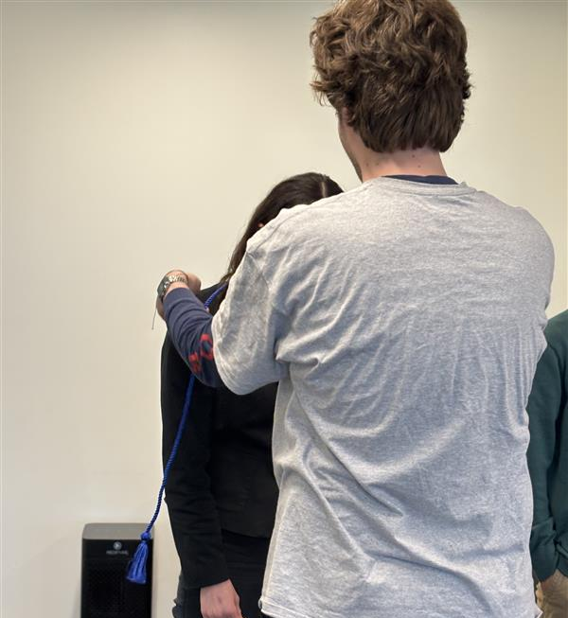
Questions?
Thank You For Such an Incredible Year!
Seniors receiving their Service Tassels at our Final SSAC Meeting

