Slide 1
Amendments to Regional School District Regulations, 603 CMR 41.00
Presented to the Board of Elementary and Secondary Education
September 30, 2025

Slide 2
Presenters
John J. (Jay) Sullivan, Associate Commissioner for District and School Finance ​
Christine M. Lynch, Former Director of Regional Governance/Management Consultant ​
Michelle Griffin, Regional Governance Coordinator
Lucy Wall, DESE Legal Counsel

Slide 3
Agenda
Proposed changes to regulations presented in April
Summary of public outreach and public comment
Additional proposed changes to regulations in response to public comment
Comments and questions from the Board

Slide 4
Regional School Districts
FY26: 84 Regional School Districts (RSDs) in MA
58 Academic RSDs with 170 member cities and towns (serving 97,218 students in FY25)
26 Career Technical/Vocational RSDs with 235 member cities and towns (serving 30,901 students in FY25)
Only 54 municipalities in MA are not in a regional school district

Slide 5
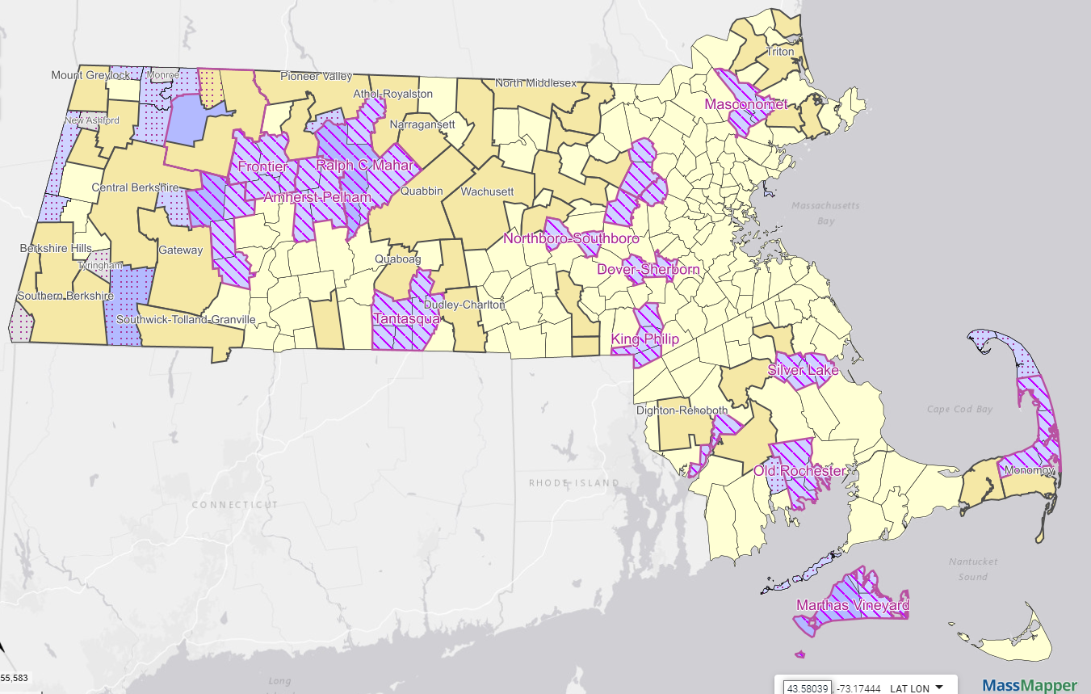
Academic Regional School Districts
Academic Regional School Districts
Notes:
Yellow, purple; The majority of partial are 9-12 or 7-12; there are a handful of partial districts the elem level
A few years old, obtained from Mass GIS website

Slide 6
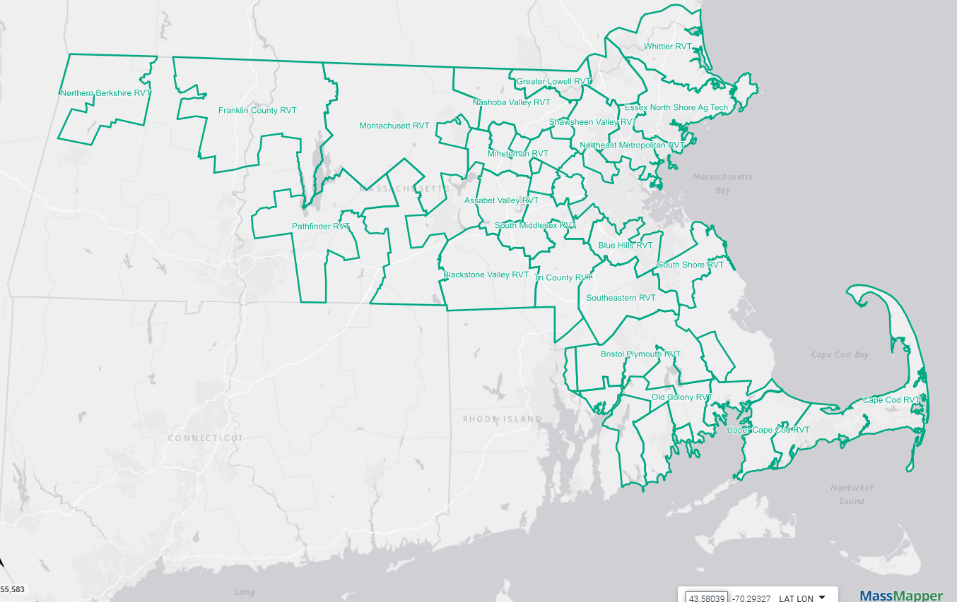
Career Technical/Vocational RSDs
Career Technical/Vocational RSDs

Slide 7
Changes to Regional School District Regulations Proposed in April 2025
Streamlining the approval of RSD agreements and amendments to RSD agreements
Clarifying provisions surrounding the creation and approval of RSD budgets
Clarifying provisions related to Commissioner Fiscal Oversight, when required by RSD law
Addition of new provisions for waiver and severability
Technical updates

Slide 8
Public Outreach and Public Comment
Office of Regional Governance offered informational sessions on the proposed changes to five partner agencies and held sessions with:
Mass. Association of Regional Schools
Mass. Association of School Business Officials
Mass. Association of School Committees
Public comments received from a total of six individuals
Three individuals submitted public comment through the survey tool: an administrator at a regional school district; a parent/community member/former school committee member; and an individual who did not specify affiliation.
Five individuals submitted public comment via email: two superintendents of regional school districts; one individual did not specify affiliation; and two individuals who also submitted comment via the survey tool.

Slide 9
Summary of Public Comment
Public comment was limited (six individuals)
Included in public comment were similar concerns about the following areas:
Clarification of local votes related to a regional school district reorganization (specifically, withdrawal).
Questions about the votes related to alternative assessment method (for apportionment of costs) and budget.
Questions about applicability and intention of waiver provision.

Slide 10
Changes Made in Response to Public Comment
Concern was expressed that language lacked clarity concerning whether member municipalities must approve a withdrawal from a regional school district.
Changes were made to the language in 603 CMR 41.03(2)(a), (c), (d), and (new subsection) (e) and 41.03(3) to clarify that local votes are required for all amendments related to school district reorganization.

Slide 11
Additional Changes Made
Editorial changes were made to clarify language:
Changed “his/her” to Commissioner in several places.
Recognized that several areas required edits to make language consistent across the regulations.

Slide 12
Public Comment – No Changes Made
Alternative Assessment Comments:
requested changes to the statute;
requested changes that DESE believes are not required by law; or
represented misinterpretations of the current and proposed regulation.
Waiver Comments:
requested additional stipulations be placed on the ability of local officials to request a waiver; or
expressed that the regulation allowing a member municipality to request a waiver might take authority away from a regional school committee and provide more flexibility to member municipalities.
Other Individual Comments:
Additional comments are outlined in the Appendix.

Slide 13
Comments and Questions

Slide 14
Appendix

Slide 15
Brief Summary of Public Comment* 603 CMR 41.01 and 41.02
41.01 – Definitions
Request to include language that the vote to approve a budget by each member municipality must be separate from the vote to utilize the alternative assessment method.
41.02 – Reorganization Procedure
Request for model long-range plan.
Question about whether withdrawal is considered a reorganization.
Request for a “regional school district withdrawal board” (similar to a regional school district planning board, as required by statute).
* The full review of public comments and the public comments themselves have been provided to the Board under different covers.

Slide 16
Brief Summary of Public Comment 603 CMR 41.03 and 41.04
41.03 - Department Approval
Request for “fast-track” amendment approval process.
Request for provision for appeal or advisory review process for Commissioner decisions.
Request for clarification of member municipality approval of withdrawals from regional school districts.
41.04 – Municipal Representatives in Regional School District Bargaining
Request for additional requirements related to collective bargaining.

Slide 17
Brief Summary of Public Comment 603 CMR 41.05 and 41.06
41.05 – Regional School District Budgets
Concern about alternative assessment method lacking transparency and suggestions for amendment to M.G.L. c. 71, § 16B.
Question about where regulations require a school committee to clarify use of alternative assessment method.
Concern about removal of language that was interpreted by commenter to allow a member municipality to approve a budget without a positive vote.
41.06 – Excess and Deficiency
Request to limit use of excess and deficiency by removing newly proposed language, which clarifies current practice.

Slide 18
Brief Summary of Public Comment 41.07 and 41.08
41.07 – Fiscal Control/Oversight
Support of language change (from “control” to “oversight”).
41.08 - Waiver
Question about applicability of newly proposed waiver provision to member municipalities.
Proposal to limit ability of local (school district and municipality) officials to request waivers.
Concern about transparency, accountability, and use of waivers.

Slide 19
Brief Summary of Public Comment General Comments and Questions
General comments/questions:
Support of amendments.
Question about DESE authority to enforce a proposed amended agreement not approved by member municipalities.
Suggestion that DESE codify how weighted voting is to be counted and validated in both school committee actions and municipal approval of budgets or agreements, to reduce ambiguity and potential legal disputes.
Suggestion to encourage creation of stabilization funds.
Request for additional extension of public comment period.
Question about whether proposed amendments will impact two-town regional school districts differently.

