Slide 1

Update on STEM Initiatives
Presented to the Board of Elementary and Secondary Education
October 28, 2025

Slide 2
Presenters
Erin Hashimoto-Martell – Associate Commissioner
High-Dosage Tutoring in Mathematics
Dr. Fabrice Kandjanga – Math Specialist
Dr. Ian Stith – Assistant Director of Math
Kate Lally – Supervisor of Mathematics, Grades K–12, Haverhill Public Schools
Science Curriculum Adaptation Project for Special Educators (SCAPE)
Dr. Casandra Gonzalez – Science Specialist
Nicole Scola – Assistant Director of Science
Kara Larcome – Curriculum Director, Grades K–12, North Andover Public Schools
Lyn O'Neil – Special Education Director, North Andover Public Schools

Slide 3
Agenda
High-Dosage Tutoring in Mathematics
Science Curriculum Adaptation Project for Special Educators (SCAPE)

Slide 4
High-Dosage Tutoring in Mathematics

Slide 5
Program Design SY23 - 25
Contracted service model
Imagine Learning*, Carnegie Learning, Mind Education, Catapult, SAGA Innovations
Grades 4 and 8
Virtual and In-person tutoring
12-week cycles, 90 minutes per week
2 to 3 Cycles per year
Aligned with HDT recommendations by EdResearch for Recovery
Coordinated with Early Literacy High-Dosage Tutoring
*Imagine Learning was the sole vendor for SY24-25

Slide 6
Program Reach/Budget
Program Reach Category | SY23-24 | SY24-25
Budget | $2M* | $2.1M*
Districts | 54 | 54
Schools | 170 | 145
Students | 3,512 | 3,237
*Program funded via ESSER

Slide 7
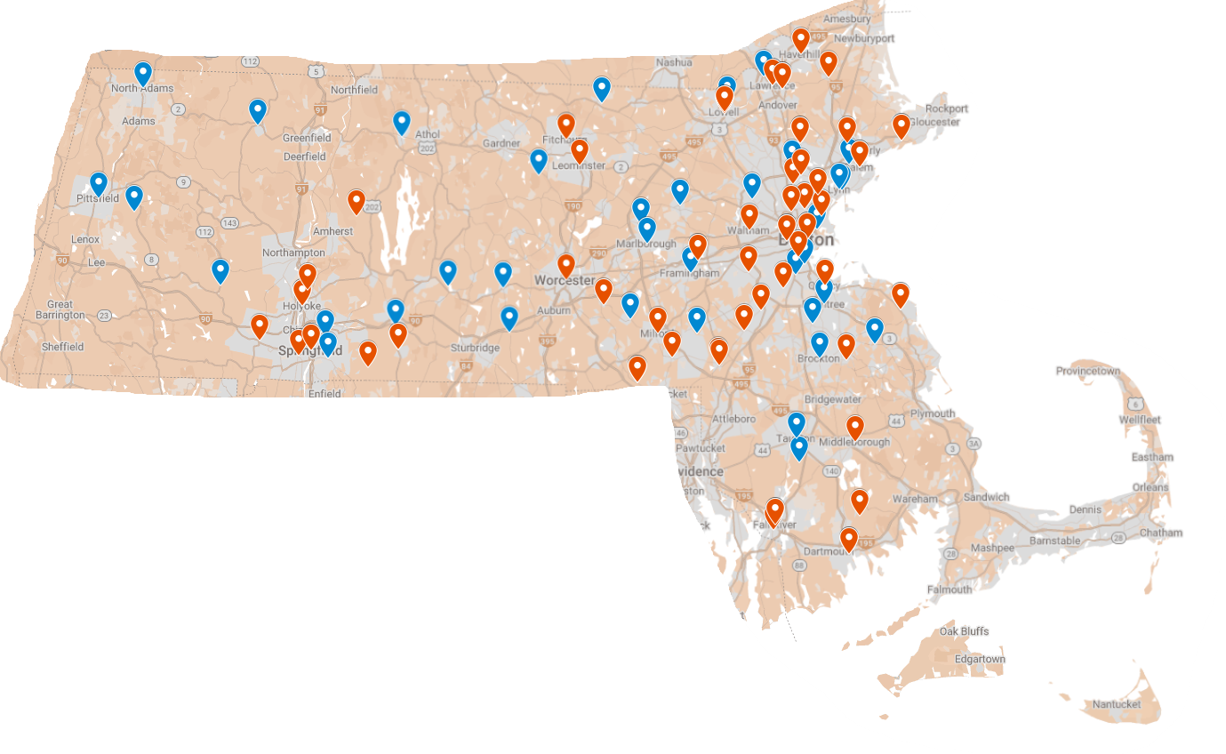
Tutoring Program Reach
2023-24
2024-25

Slide 8
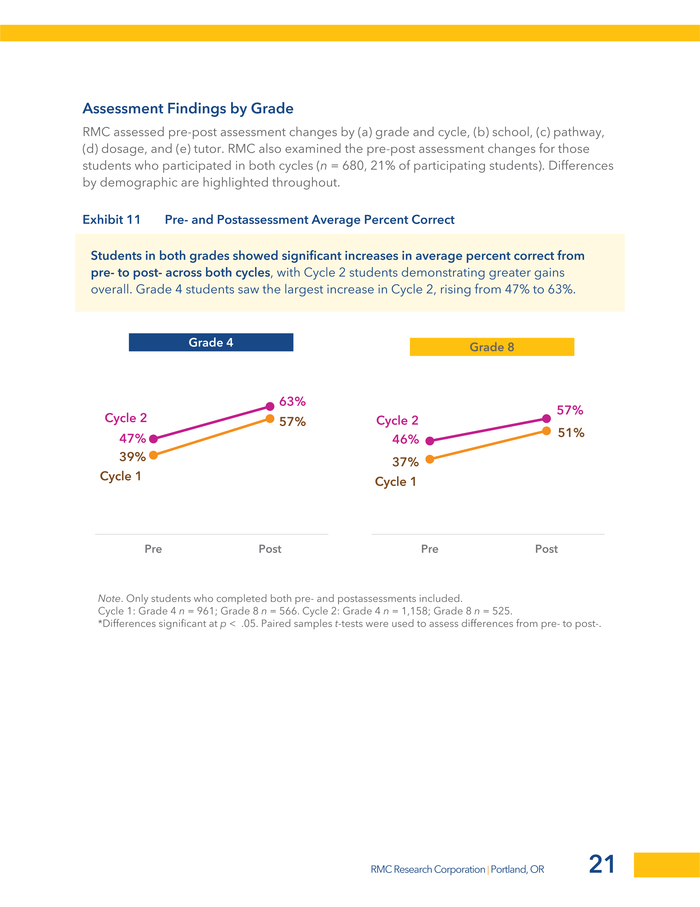
Year 2 Overall
In SY24-25, Students in both grades showed increases in average percent correct from pre- to post-assessment across both cycles
Note. Only students who completed both pre- and post-assessments included. Cycle 1: Grade 4 n = 961; Grade 8 n = 566. Cycle 2: Grade 4 n = 1,158; Grade 8 n = 525.

Slide 9
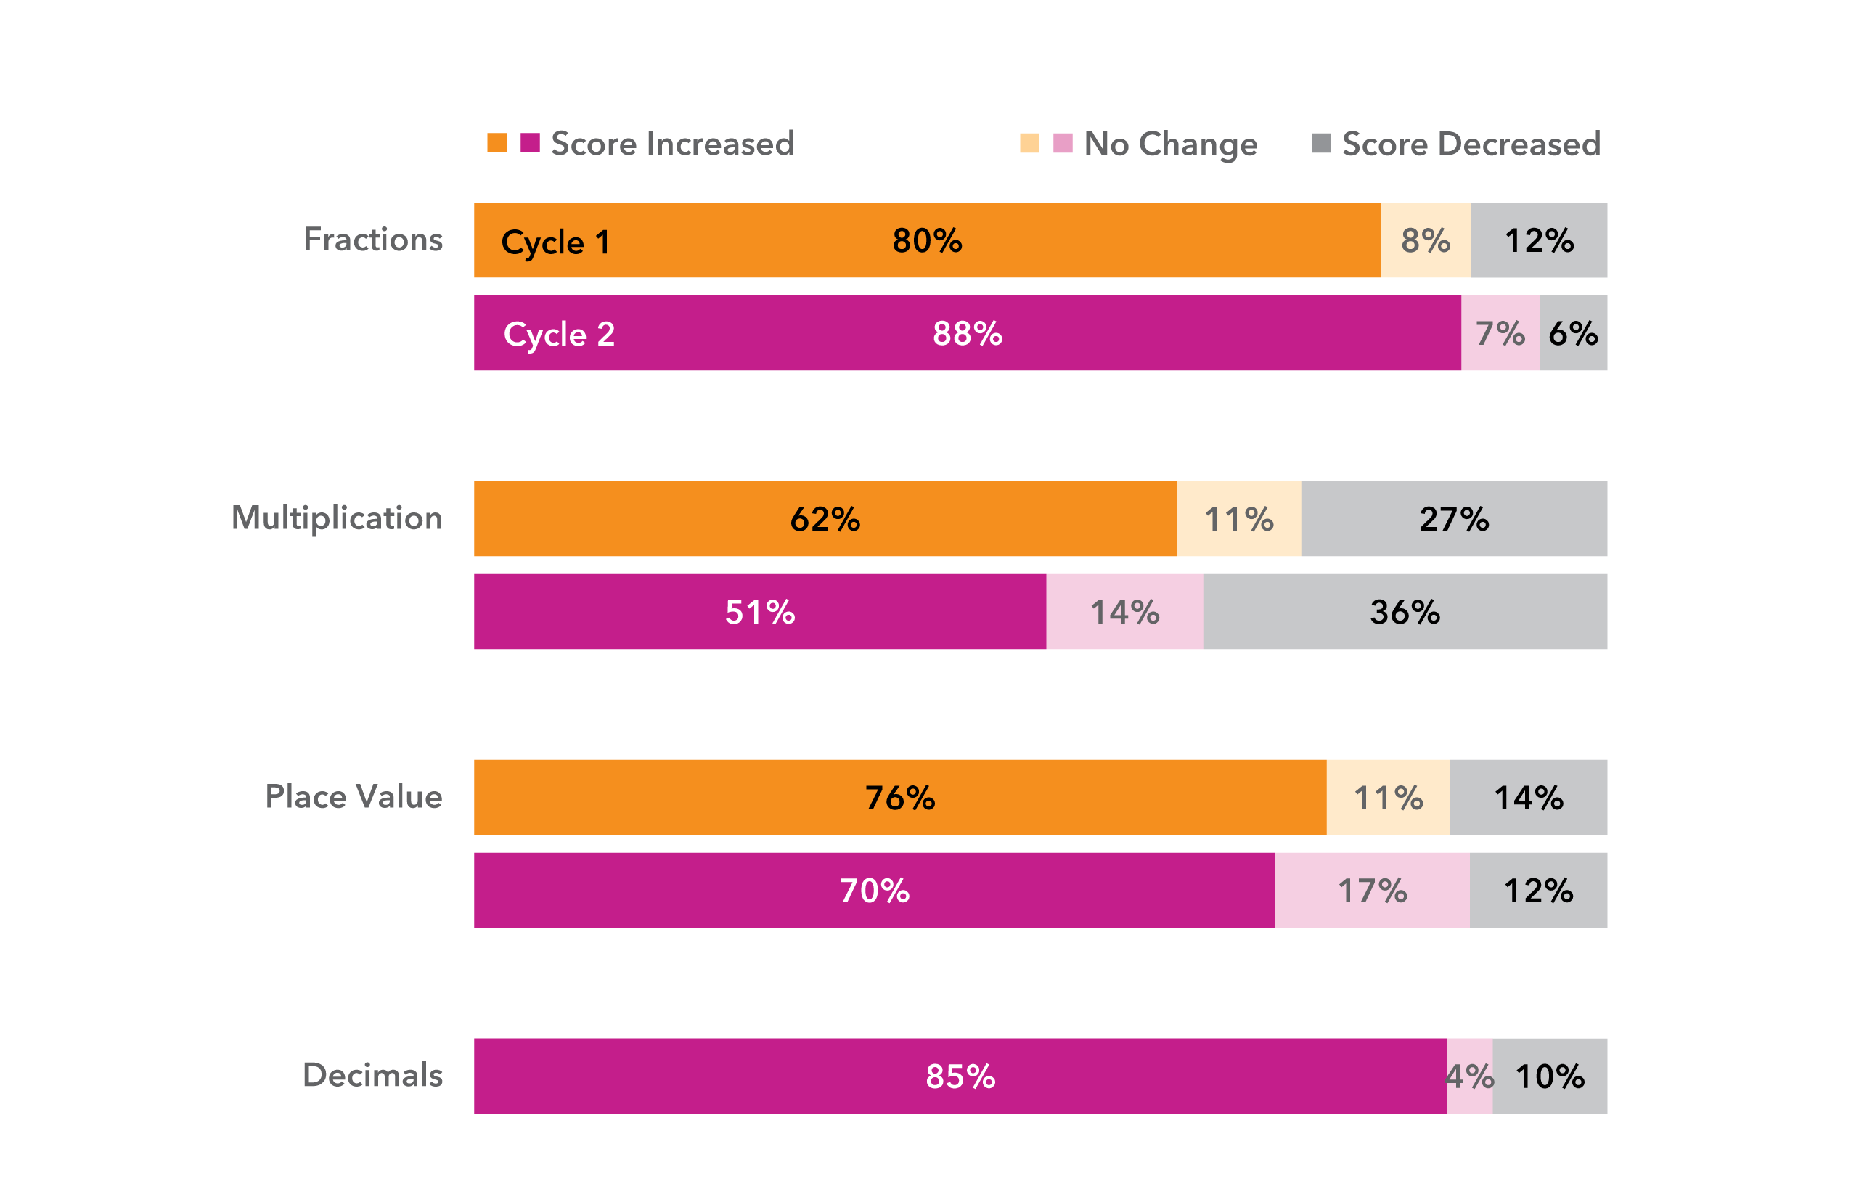
Grade 4 Pathways
Grade 4 students showed improvement across both cycles for all content areas
(4%—30% increase in average percent correct)
The strongest Grade 4 gains were in Fractions and Decimals, with over 80% of students increasing their scores.
Fewer students made gains in Multiplication, with 27% of Cycle 1 students and 36% of Cycle 2 students showing a decrease in scores from pre- to post-assessment.

Slide 10
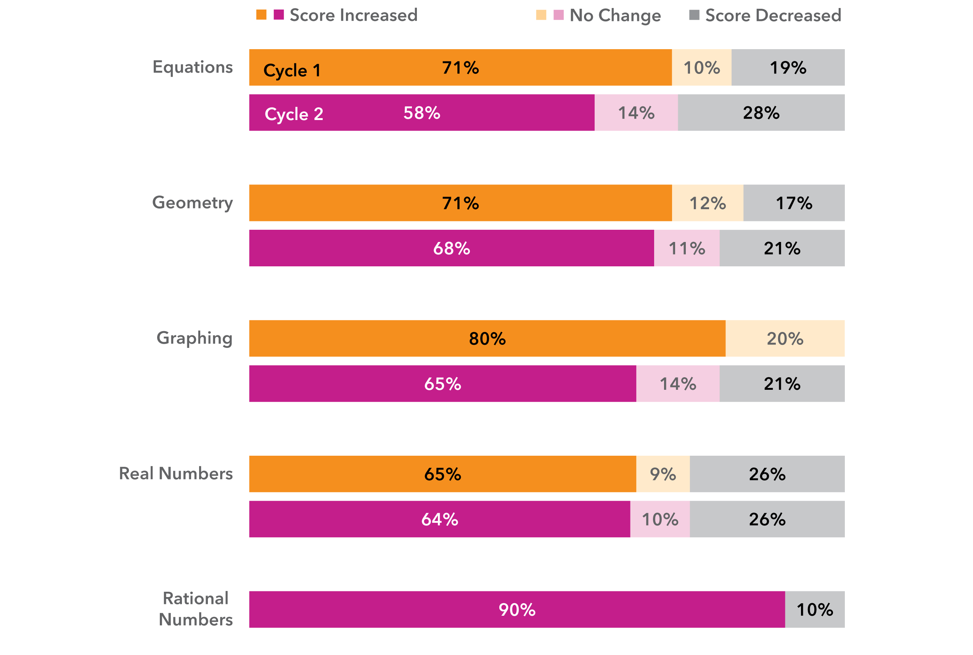
Grade 8 Pathways
Grade 8 students showed improvement across both cycles for all content areas
(10%—21% increase in average percent correct)
The strongest Grade 8 gains were in Real Numbers, with 90% of students increasing their scores.
Though Grade 8 students showed gains across pathways, the gains were smaller than those of Grade 4 students.

Slide 11
District Highlights - Haverhill
Over 200 students participating over cycles 1 and 2
Academic growth:
Cycle 1:
58% of students grew more than 1.5 grade levels in i-Ready
Over 30% of students achieved a Student Growth Percentile above the 60th percentile
Cycle 2:
72% of students grew more than 1.5 grade levels in i-Ready
Over 35% of students achieved a Student Growth Percentile above the 60th percentile

Slide 12
Lessons Learned – Haverhill
Improvement of student identification between cycles
Focus on 4th grade
“The students that participate in HDT are raising their hands more and saying they know how to do it now.” - Grade 8 teacher
“I don’t have to remind students to log on for their session!” - Grade 4 teacher
“ I like Math now.” - Grade 8 student
“ I feel like I can participate in class with others more.”
- Grade 4 student
“ I can ask questions in my small group so I can understand.” - Grade 8 student

Slide 13
Lessons Learned
Schedule and student attendance/interest is more challenging in Middle School setting
Schedule tutoring during the school day rather than after school
Keep groups to a 1:1–1:4 ratio
Maintain consistent tutor-student pairings to build trust and momentum
Align tutoring topics to current classroom units
Site lead/coach is vital
Build a positive culture
Direct hiring of tutors by vendors rather than district hiring

Slide 14
Moving Forward
DESE funded program has concluded. Districts identifying local funding to sustain high-dosage math tutoring.
DESE supporting through approved high-dosage math tutoring vendors via Master Contract Agreement
Strengthening integration with Multi-Tiered Systems of Support through the Tiered Math Academy
Additional analysis of program impact is underway

Slide 15
Science Curriculum Adaptation Project for Special Educators (SCAPE)

Slide 16
SCAPE Project Overview
2022 & 2023 – Teacher Professional Development
4-day teacher professional development for elementary special educators on a high-quality science unit
Teachers collaborated to develop online “bank” of adapted materials
Collaboration with the Office of Student Assessment Services, MCAS Alt
2024-2026 – Building Leader Capacity (Scale-up)
District Leadership teams (Science and Special Education Leaders) participate in a yearlong institute (workshops, check-in sessions, and coaching) throughout the year
District teams develop an implementation plan
Collaboration with the Office of Special Education Planning and Policy Contact Information (SEPP)

Slide 17
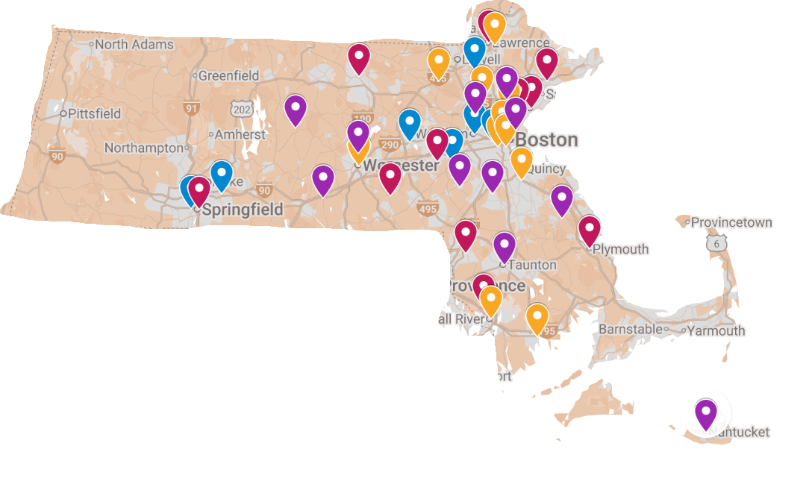
Program Reach (2022-2026)
Blue: 2022
Red: 2023
Gold: 2024
Purple: 2025

Slide 18

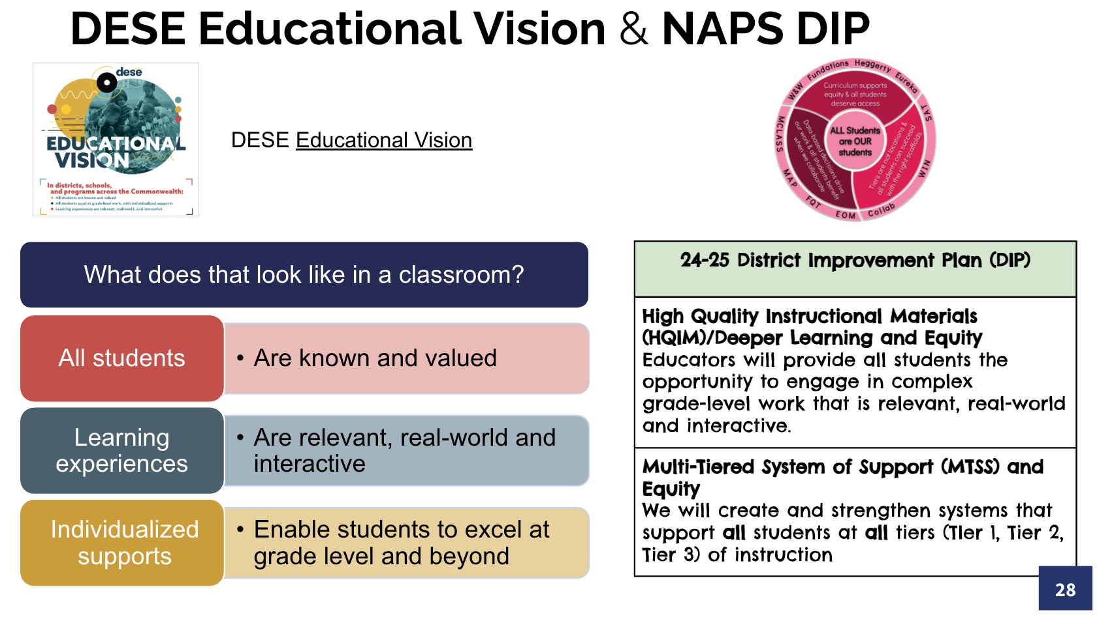
District Highlight – North Andover
Our SCAPE Team included Curriculum Director, Special Education Director, Biology Teachers (general and special education)
Goal: Equip all Biology & Special Ed teachers with HQIM + UDL strategies
Implementation Plan included
Professional Development time on DCAP
Science Classroom Walkthroughs utilizing “Look-fors”

Slide 19
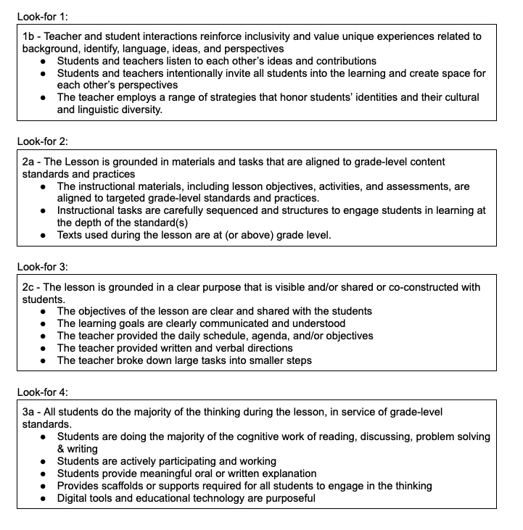
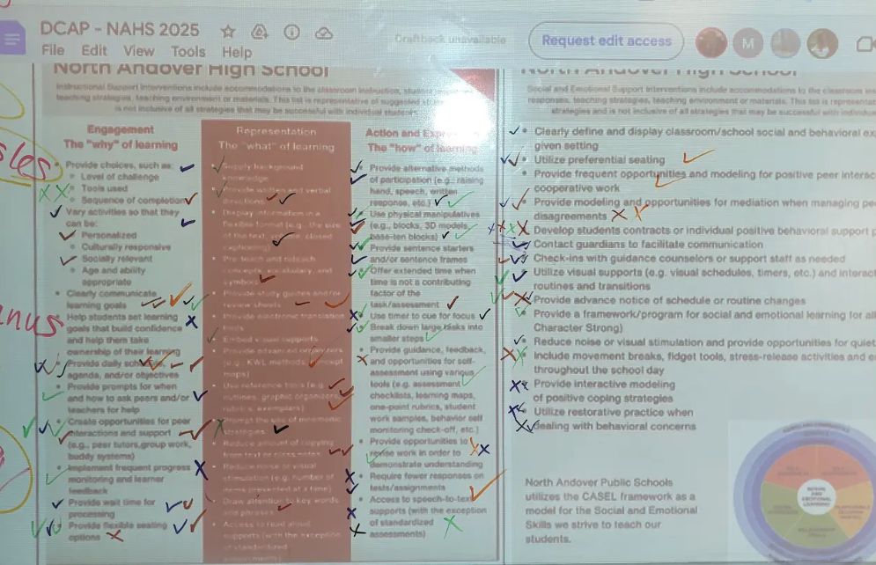
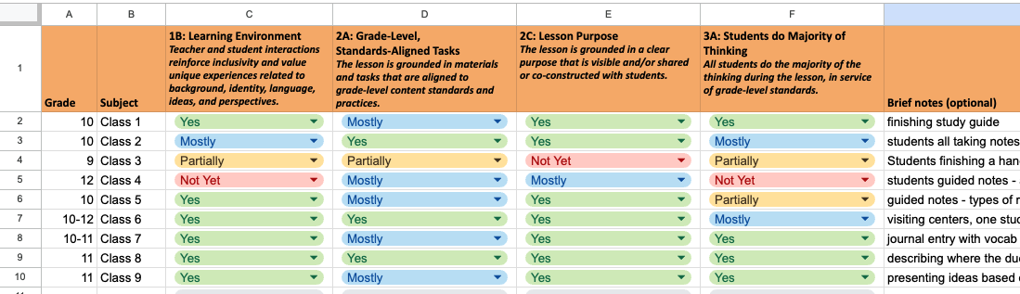
District Highlight – North Andover
DCAP Use Analysis - Proactive strategies to provide access for all students
Class Visit data identified strengths and areas for growth (DESE Observation tool)

Slide 20
District Highlight – North Andover
Outcomes
Improvements in our 3rd round of observations
Pilot of OpenSciEd Biology Curriculum
Identified professional development needs for 2025-2026
Cohort support was invaluable!
Ongoing support and accountability ensured follow-through of our work

Slide 21
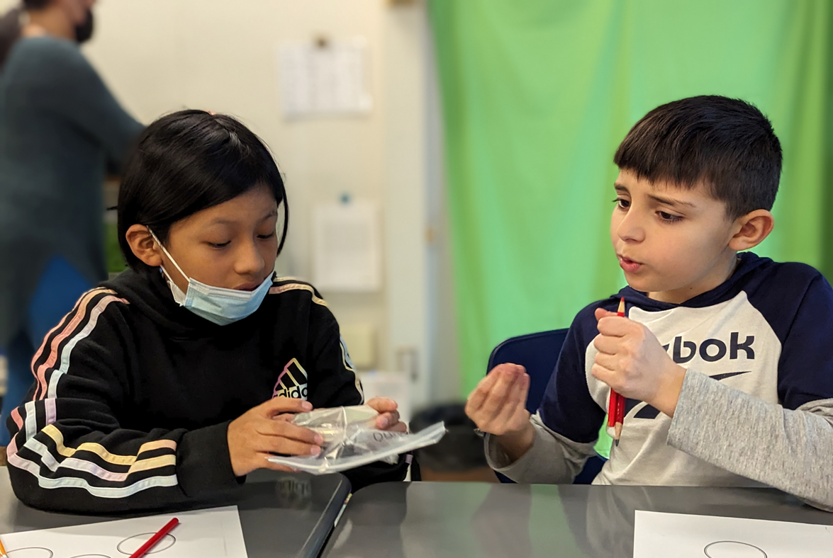
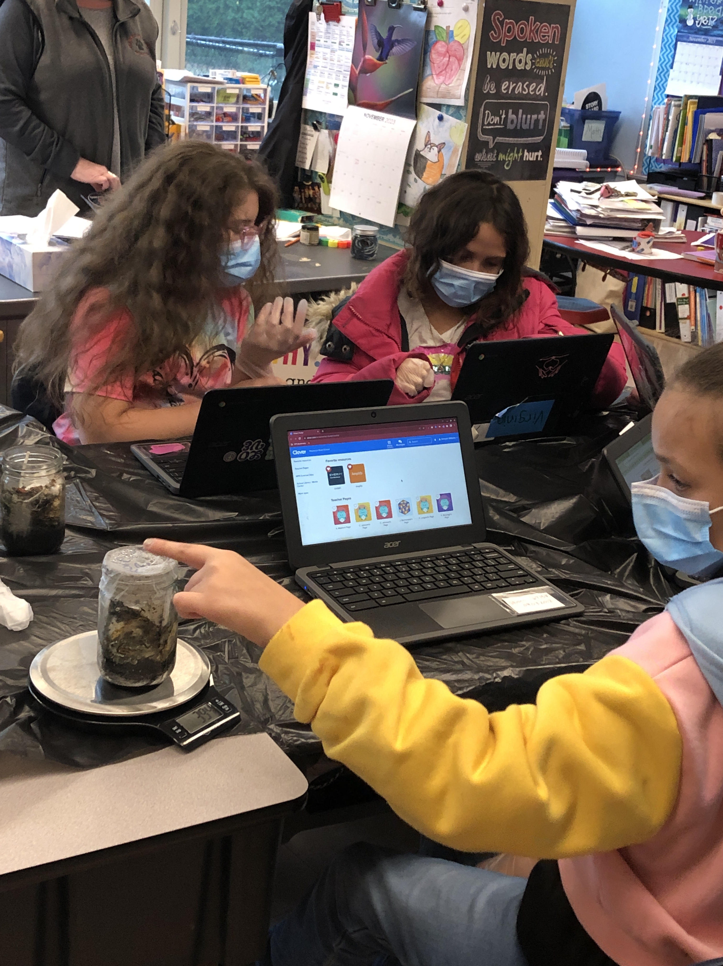
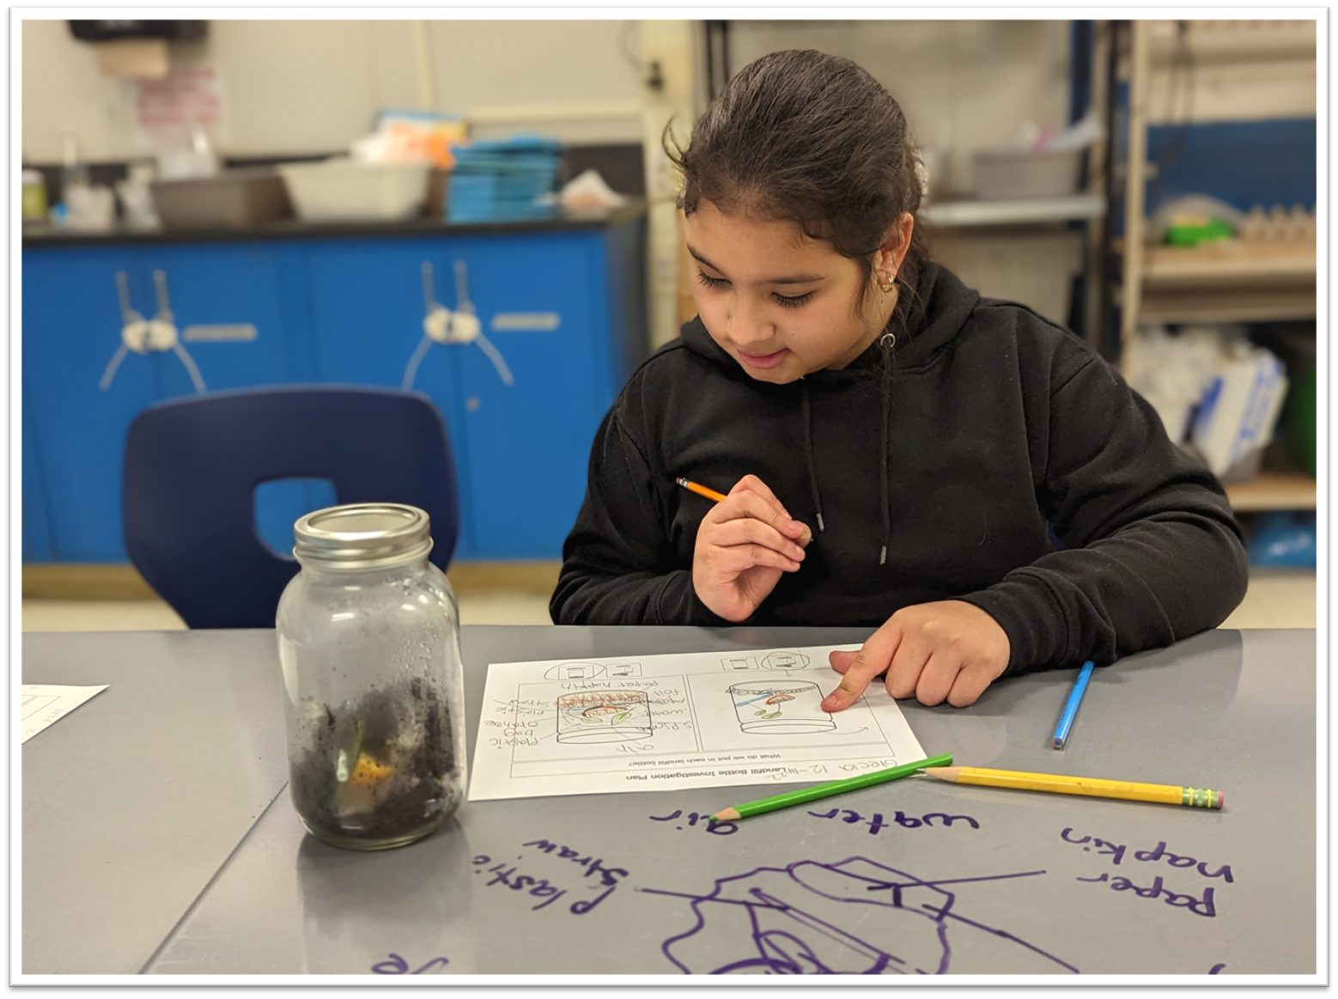
Lessons Learned
Students with disabilities CAN access science high-quality instructional materials (HQIM) and show growth
Science & special education teachers AND leaders need:
time and resources to co-plan
common visioning/implementation support
aligned, ongoing, collaborative professional learning
Credit: Angela Palo, Boston Public Schools; Kristen Langord, Worcester Public Schools

Slide 22
Next Steps
SCAPE Institute SY2025-26
11 districts are participating
Districts attended the kick-off professional learning in September
Districts began working on their draft implementation plans and receive ongoing support and coaching though out the year
By the end of June districts will complete their plans and proceed with data-informed, district-wide professional learning for science and special educators
Cohort 1 (from 24-25) receiving light coaching and implementation support; remain connected to the network

Slide 23
Thank You

Slide 24
Program Reach/Budget
Program Reach Category | Summer 22 | Summer 23 | SY24-25 | SY25-26
Budget | $32,000 | $40,000 | $170,000 | $175,000
Districts | 10 | 16 | 11 | 11
Schools | 12 | 18 | 30+ | TBD*
Teachers | 13 | 18 | 300+ | TBD*
*SCAPE districts spend their program year learning and preparing to deliver in-district PL and provide support. The total number of schools engaged and teachers trained are collected at the end of the program year.

