Slide 1
Proposed Amendments to Regulations on State Seal of Biliteracy, 603 CMR 31.04
Presented to the Board of Elementary and Secondary Education

Slide 2
Today’s Presenters
Allison Balter, Director of the Office of Language Acquisition
Johanna Wakelin, Associate General Counsel

Slide 3
Today’s Agenda
Background on the State Seal of Biliteracy
Purpose of Amendments
Overview of Proposed Changes
Next Steps
Comments & Questions

Slide 4
Background on the State Seal of Biliteracy
Established under the 2017 LOOK Act to recognize graduates proficient in English and another language.
Original criteria for demonstrating English proficiency were based on meeting the English Language Arts (ELA) standard for the competency determination (CD).
Question 2 (Nov 2024) removed MCAS score as CD requirement.
Regulations must now align with amended state law.

Slide 5
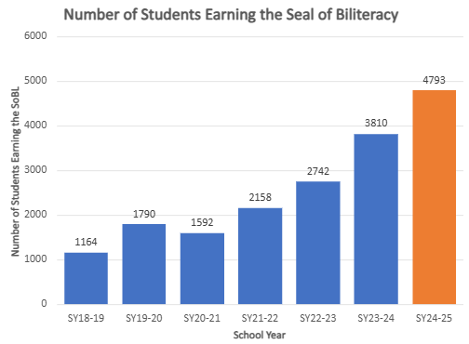
Over 18,000 MA graduates have earned the Seal of Biliteracy since 2018-19.
In 2024-25, 4,793 graduates earned the Seal – nearly 1,000 more than the previous year. This represents 6.9% of all graduates.
Notes:
Since the LOOK Act established the Seal, over 18,000 MA graduates have earned the state Seal of Biliteracy. We just got final numbers for school year 2024-25 and are excited to share that in 2025, 4,793 graduates earned the Seal—nearly 1,000 more than the previous year. That means 6.9% of all graduates demonstrated high levels of proficiency in English and another language, up from 5.7% in 2024 and just 2.3% in 2021. In only four years, the percentage of students earning the Seal has tripled, reflecting a statewide commitment to valuing multilingualism.

Slide 6
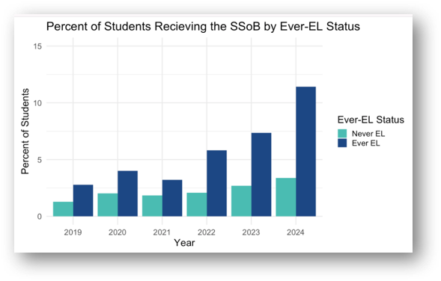
The Seal of Biliteracy is an equity success for students ever identified as English learners.
Ever-ELs continue to complete the Seal at higher rates that never-ELs.
Notes:
Growth was evident across nearly every student group. The Seal of Biliteracy is an equity success for students ever identified as English learners. We see here that students who were ever identified as EL complete the Seal at higher rates than never-ELs (even if absolute numbers are smaller). In 2024, 11% of Ever-ELs graduated with the Seal compared to 3% of Never-ELs. In 2025, we saw 14.1% of Ever-ELs earn the Seal. 15.7% of students whose first language is not English earned the Seal in 2025. This demonstrates the strength and resilience of multilingual learners in our schools and honors the linguistic superpowers they bring. It’s important that we continue both increasing the number of graduates earning the Seal of Biliteracy and ensuring that the Seal honors the rich linguistic assets of our multilingual students.

Slide 7
Purpose of Amendments
Align Seal regulations with the updated Competency Determination law.
Clarify district responsibilities and streamline procedures.
Provide flexibility for demonstrating proficiency in English and other languages to strengthen equitable access for multilingual learners and students who may enroll in Massachusetts schools after 10th grade.
Maintain the Seal’s rigor and integrity.

Slide 8
Overview of Proposed Changes
Remove outdated Competency Determination references.
Clarify and streamline procedures for notification, transcripts, and terminology.
Expand pathways to demonstrate English proficiency.
Support equitable access to the Seal statewide.

Slide 9
Key Amendment 1: Annual Notification
31.04 (1)(b)
Add the word “annual” to require yearly written notice to families.
Makes all students are aware of the Seal of Biliteracy program each year.

Slide 10
Key Amendment 2: Transcript Clarification
31.04 (1)(c)
Replace “diploma or the transcript, or both” with “transcript.”
Enables higher education institutions to verify and honor the Seal.
Districts may still display the Seal on diplomas if desired.

Slide 11
Key Amendment 3: Inclusive Terminology
31.04 (2)(b)
Replace “foreign language” with “language other than English.”
Aligns with the 2021 World Languages Framework.
Reflects inclusive and asset-based language.

Slide 12
Key Amendment 4: Assessment Timing
31.04 (2)(b)(1)
Specify that assessments for languages other than English must be taken during or after grade 8.
Aligns with Seal standards in other states.
Maintains consistency and comparability of results.

Slide 13
Key Amendment 5: English Proficiency Criteria
31.04 (2)(a)
Remove outdated CD-based language.
Establish three updated criteria using grade 10 ELA MCAS as a primary measure, consistent with state law.
Authorize DESE to approve additional nationally recognized assessments of English proficiency.
Expands student options to demonstrate proficiency in English.

Slide 14
Anticipated Next Steps
Public comment may be submitted via an online form, or sent via email to mastatesealofbiliteracy@mass.gov, or sent via mail to Regulations Public Comment, c/o Commissioner’s Office, Department of Elementary and Secondary Education, 135 Santilli Highway, Everett, MA 02149.​
The deadline for the public comment period is Friday, December 5, 2025, at 5:00pm.
​
The Board is expected to vote on the proposed amendments at its regular monthly meeting scheduled for January 27, 2026.

Slide 15
Comments &
Questions

