Slide 1

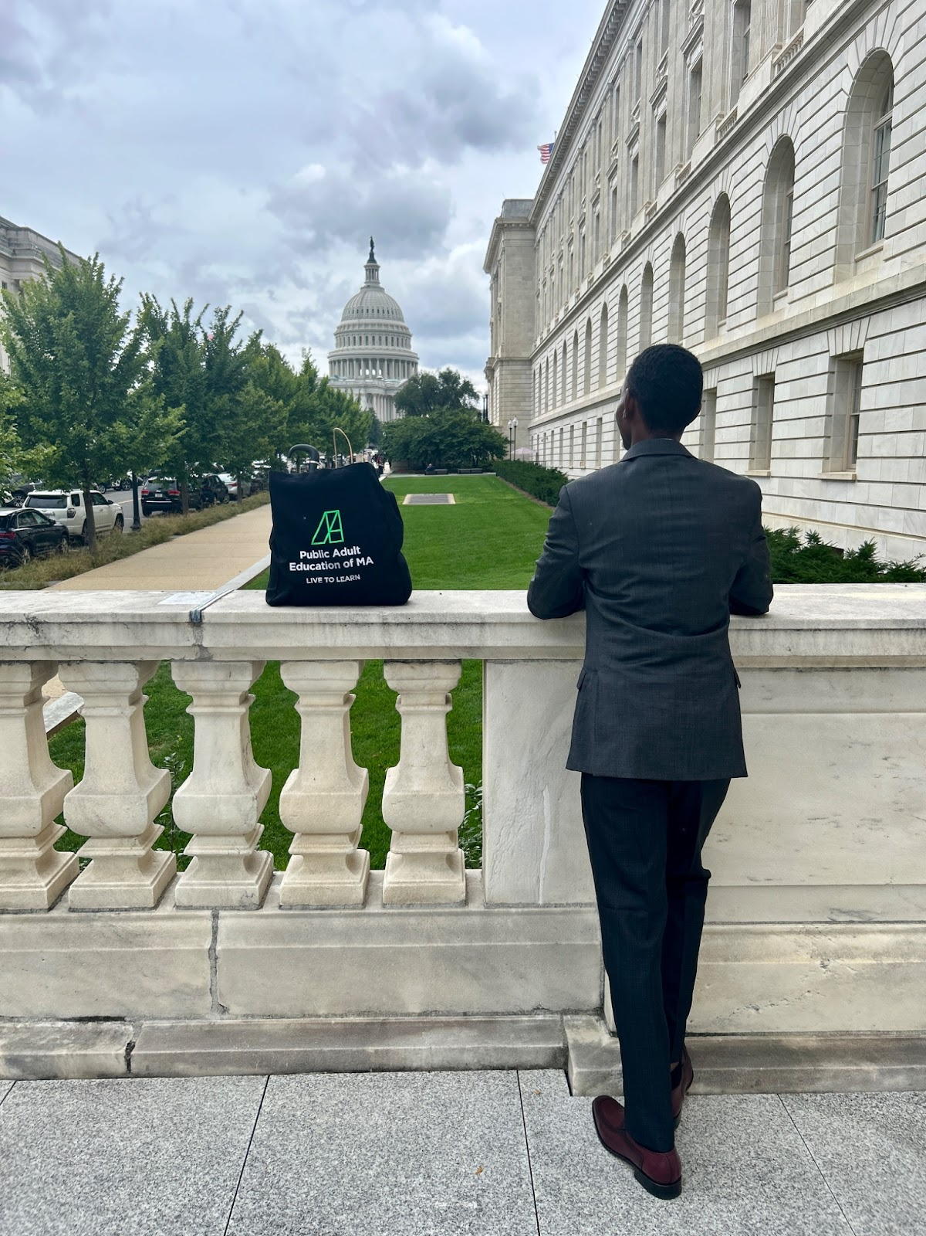


Adut and Community Learning Services
Adult and Community Learning Services
December 16, 2025

Slide 2
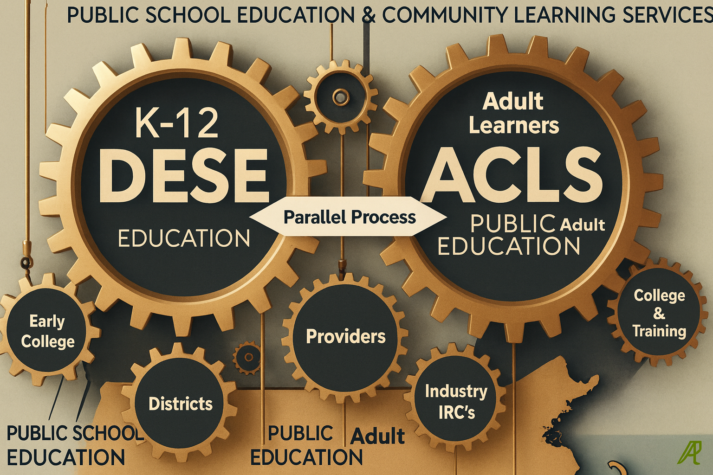
Public School Education & Community Learning Services

Slide 3


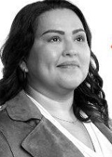


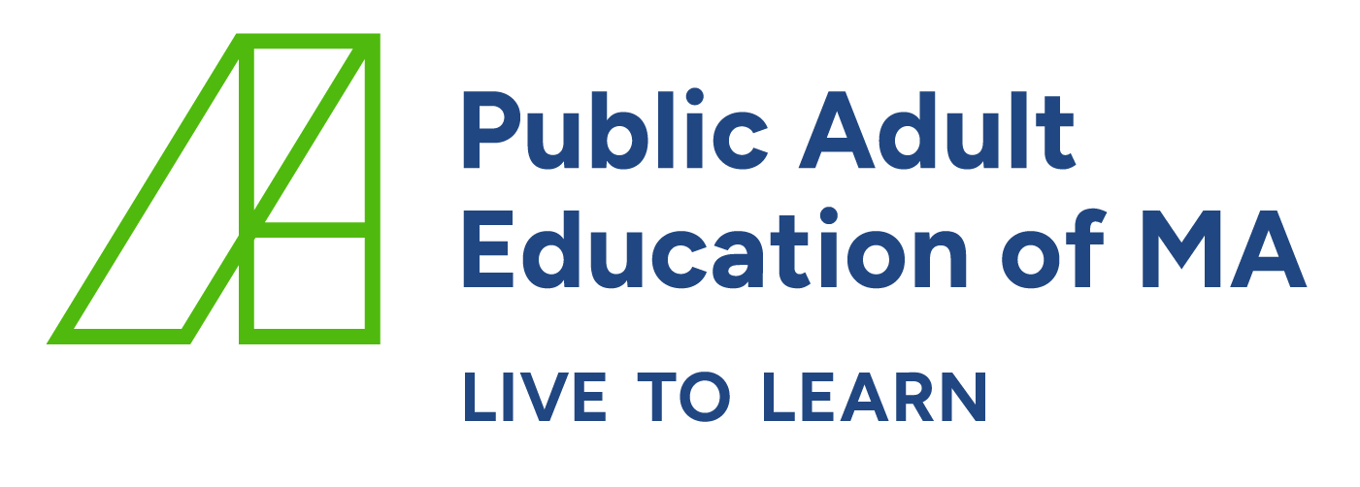
Who We Serve
Diverse Lives. Shared Determination.
Adults seeking a high school equivalency or English language acquisition
Immigrants and refugees
Multilingual, internationally trained adults
Parents balancing work, childcare, and school
Workers preparing for industry pathways
Justice Involved adults
3 | Public Adult Education of MA

Slide 4
Multiple Pathways, One System, Multiple Providers
Merrimack Valley
North Central
Greater Lowell
North Shore
74 Community Core Service
6 Correctional Providers
25 MassSTEP (32 programs)
11 College Transition Providers
5 Training-to-Employment Providers
1 Online Virtual Academy (MassLINKS)
13 One-to-One Tutor Communities
Franklin Hampshire
Metro
North
Berkshire
Boston
Metro South/West
Central Region
Hampden County
Greater
Brockton
Bristol County
South Shore
Greater
New Bedford
Cape
& Islands
2 | Public Adult Education of MA
Notes:
Adult Basic Education (ABE): Foundational literacy and numeracy programs.
English for Speakers of Other Languages (ESOL): Language acquisition for non-native speakers.
Transition-to-College: Preparing adults for postsecondary education success.
Integrated Education and Training (IET): Combines education with workforce integration.
Vocational ESOL and Workforce Preparation: Specialized training for workforce integration.
High School Equivalency (HSE): GED/HiSET preparation and testing.
Professional Development: Capacity building for educators and staff.
Equity Initiatives: Focused programming to include marginalized communities.

Slide 5
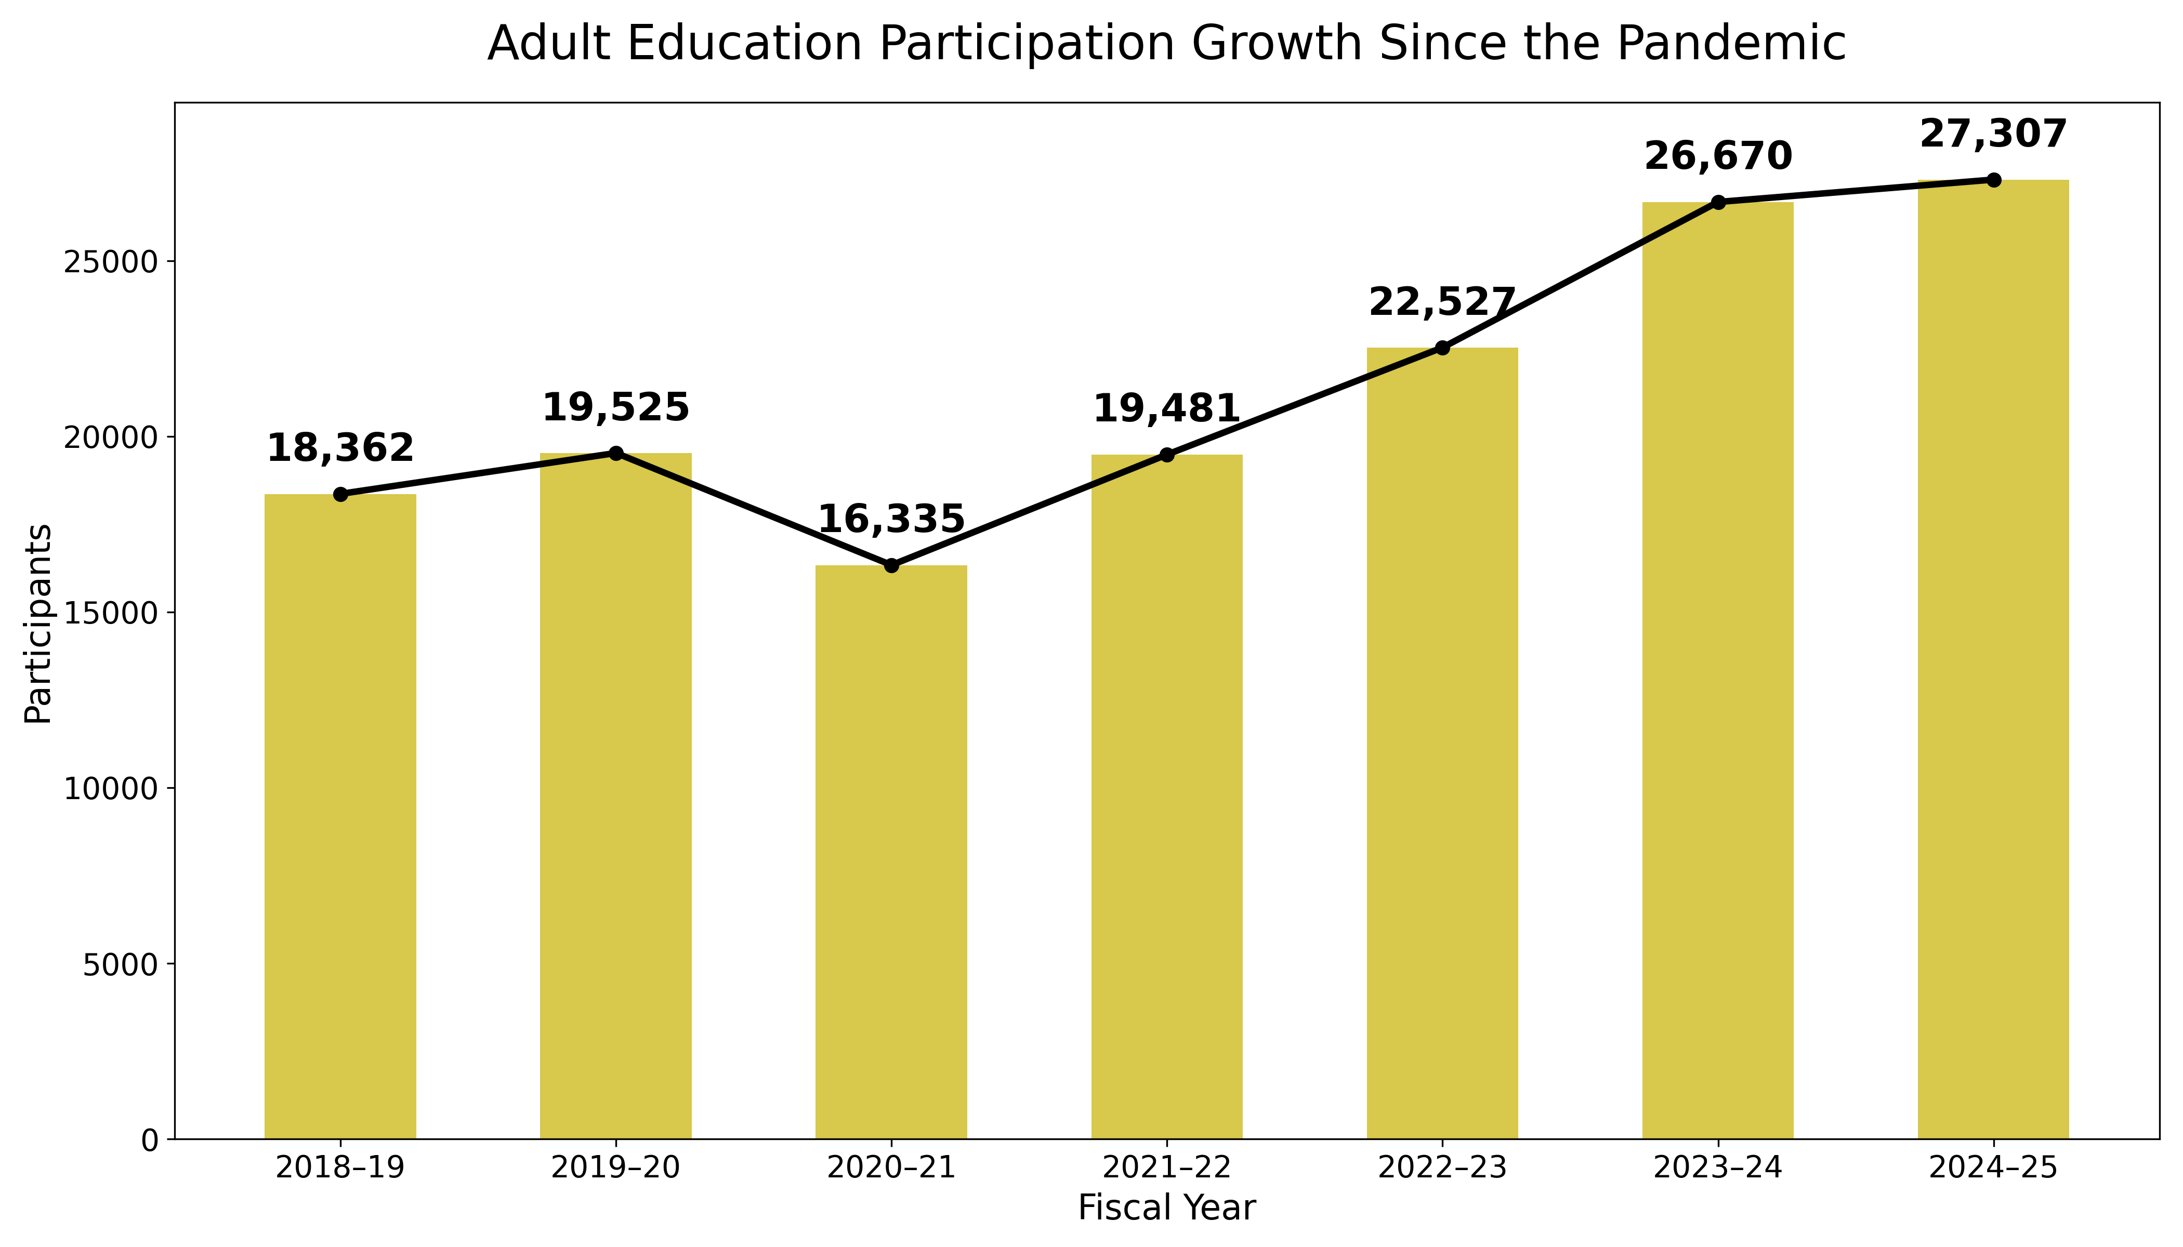
Adult Education By the Numbers
Enrollment – Core programming
5 | Public Adult Education of MA

Slide 6
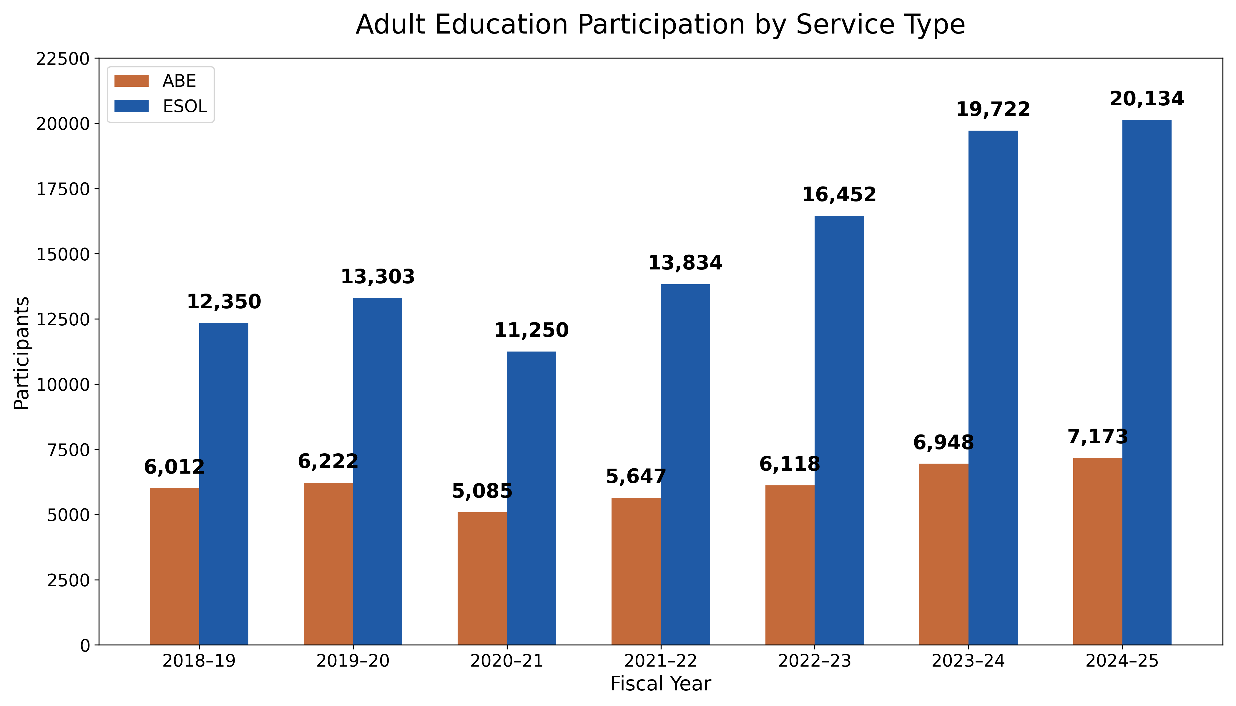
Adult Education By the Numbers
Enrollment – Core programming
6 | Public Adult Education of MA

Slide 7
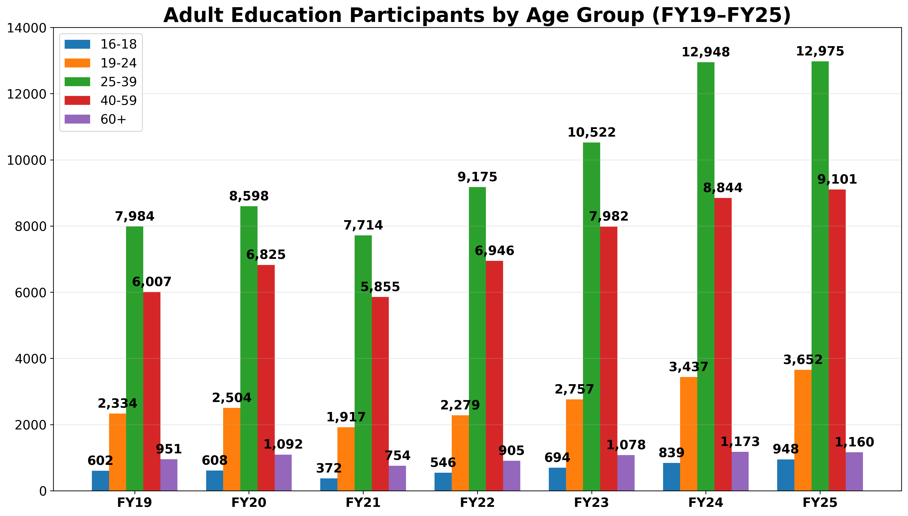
Adult learners by age
7 | Public Adult Education of MA

Slide 8
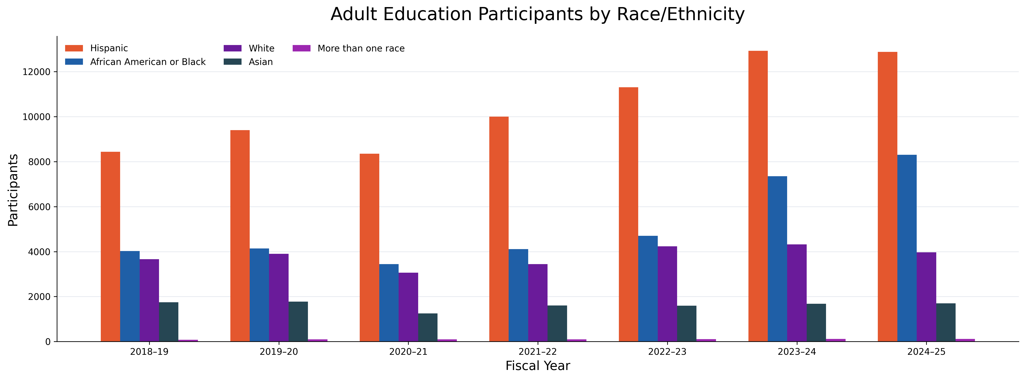
Adult learners by race/ethnicity
8 | Public Adult Education of MA

Slide 9
Alignment to DESE’s Educational Vision
Whole Learner • Deeper Learning • Diverse & Effective Workforce
Student Ambassadors → ‘Known & Valued’
Elevates student voice
Builds leadership and belonging
Guides policy from lived experience
Conversation Cafés
→ Real-World Learning
Builds language confidence
Strengthens community partnerships
Expands program collaboration
Student to Staff→ Individualized Access
Online learning statewide
Workforce-aligned pathways
Flexibility for adults balancing work/family
9 | Public Adult Education of MA
Notes:
Program Goals:
Elevate student voice & leadership in adult education.
Increase visibility of adult education as a vital part of the state’s
workforce pipeline.
Engage learners in shaping ACLS programs, policies & practices.
Who Are the Student Ambassadors?
GED students, college graduate, teacher, professor of economics, artist, parents, community leader, operations manager, business and finance operations, customer service, a lawyer, community college student, education advocate, Tech support, healthcare (CNA).
Languages Spoken: Chinese, Haitian Creole, French, Arabic, Russian, Italian, Portuguese, Spanish, Brazilian ASL, English, & Ukrainian.
Leading Conversation Cafes for 72 waitlist students in three different regions (Holyoke, Lawrence & Boston), days/evenings. 90-95% student attendance!
Paid internship opportunities include short-term (typically 6-12 weeks) & one-time, project-based.
If your program would like to host one or more Student Ambassadors, please complete the Request Form.
Conversation Café- Work Ready
[Insert your body content here]
NDEC-L – 30 students – 3rd week
HCC – 42 students – 2nd week
JVS – coming soon

Slide 10
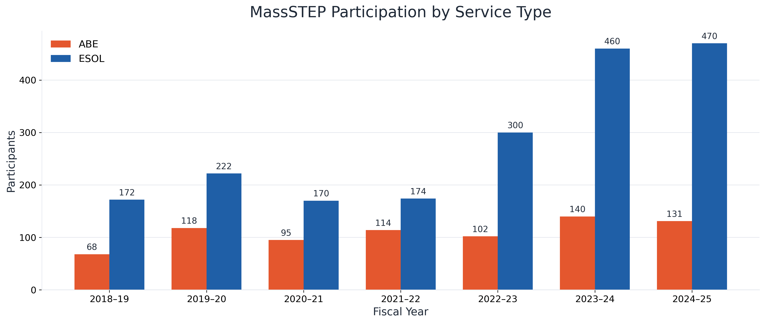

MassSTEP Enrollment
Adult Basic Education, English for Speakers of Other Languages
10 | Public Adult Education of MA

Slide 11
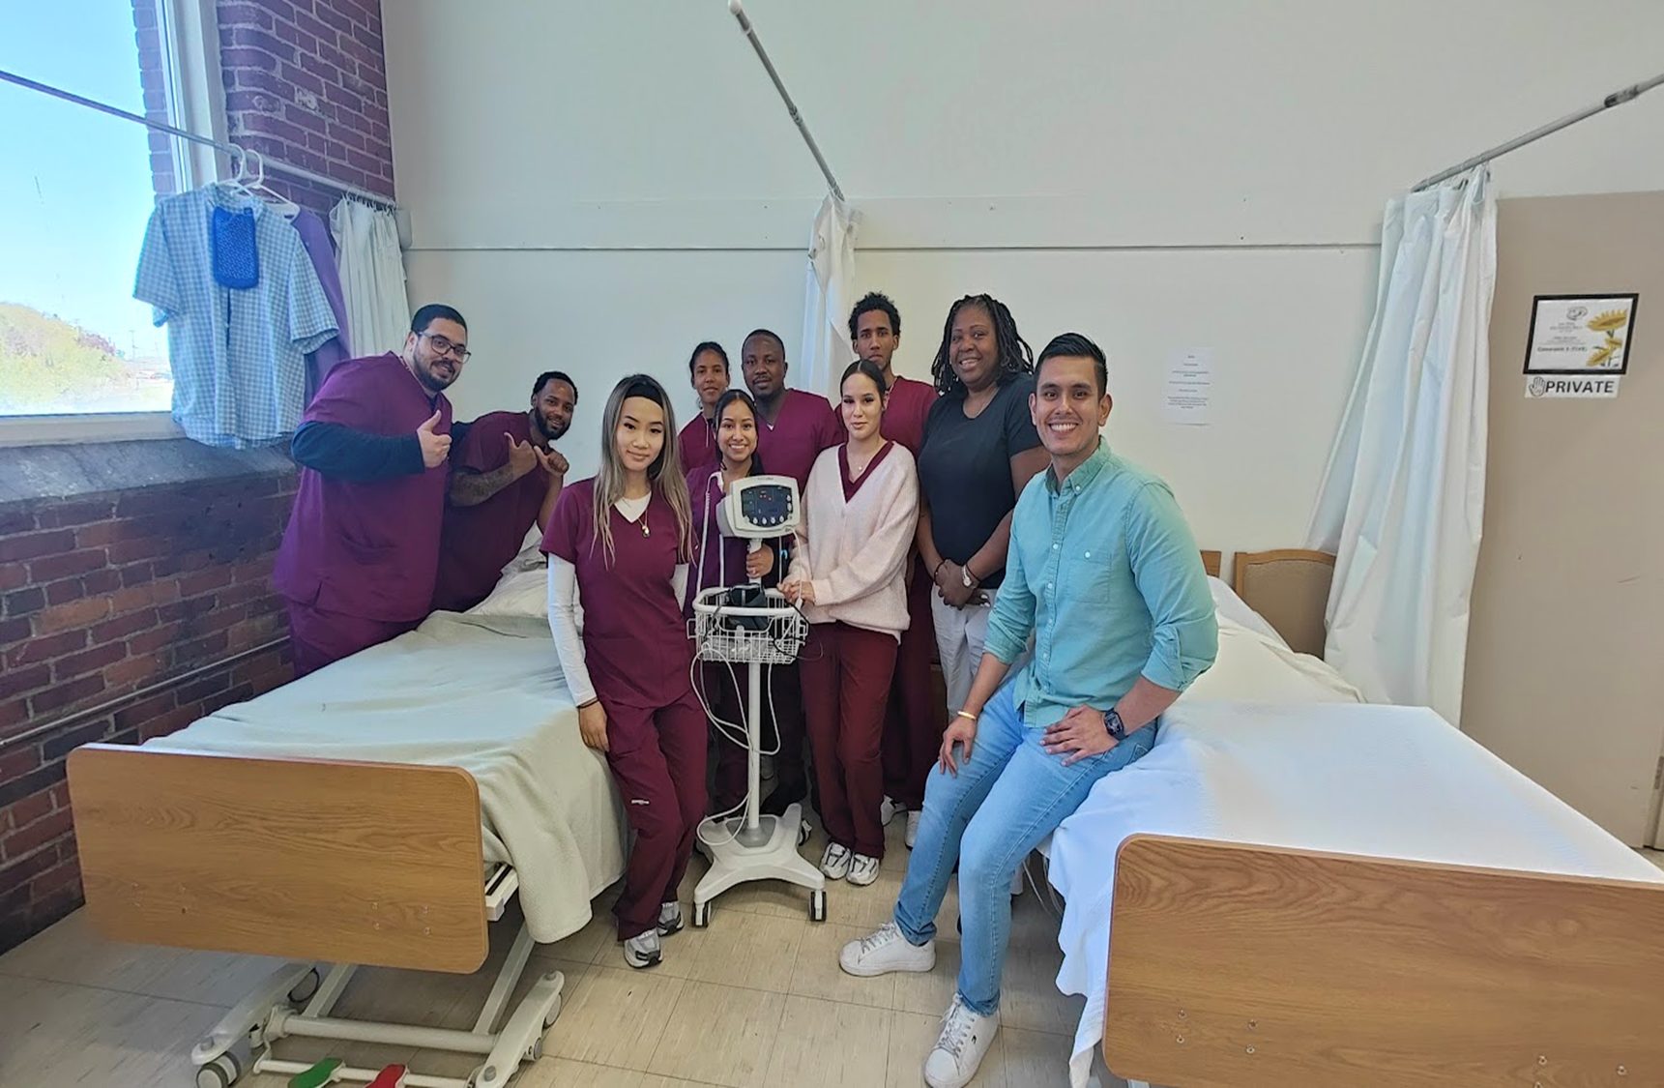
Group photo
11 | Public Adult Education of MA

Slide 12

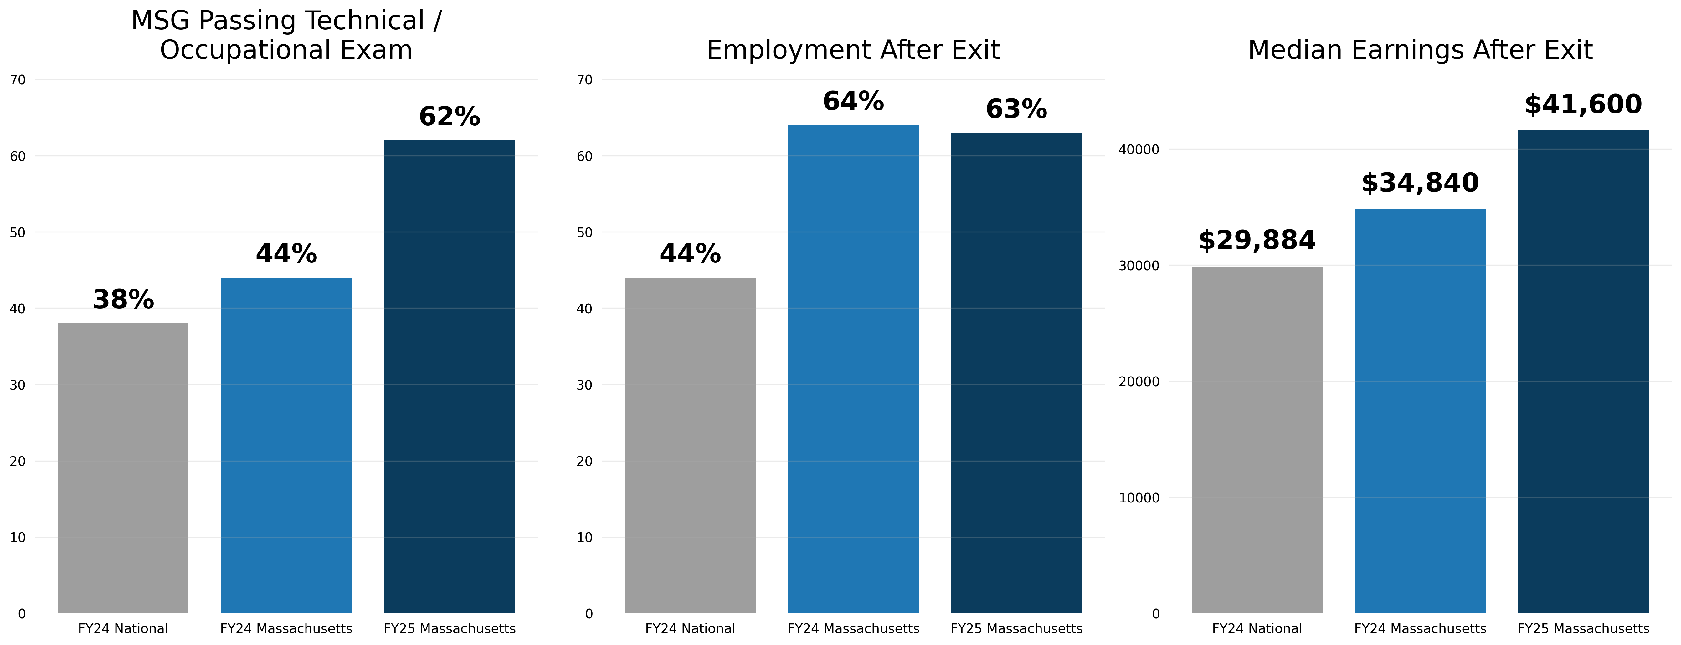
Achievements
Growth, Scale, and System Strengthening
12 | Public Adult Education of MA

Slide 13

Future Ready Institute @
Preparing Adult Learners for College, Career &
an AI-Driven Workforce
What Learners Gain
A statewide innovation that equips adults with the digital, academic, and professional skills needed to thrive in today’s economy
Digital & Technology Skills: Data literacy, cloud computing, cybersecurity, and AI fluency
Critical Thinking & Problem-Solving: Cognitive flexibility, analysis, and continuous learning
Professional Power Skills: Leadership, communication, teamwork, and emotional intelligence
Workplace & Industry Knowledge: Resilience, project management, design thinking, and cross-cultural competency
Industry-Aligned ESOL Redesign
Career-themed English courses aligned to statewide workforce clusters (e.g., IT Services, Healthcare, Biotechnology, Business & Consumer Services).
13 | Public Adult Education of MA

Slide 14
Thank you!

