Slide 1
Commissioner's Priorities
Presented to the Board of Elementary and Secondary Education
December 16, 2025

Slide 2
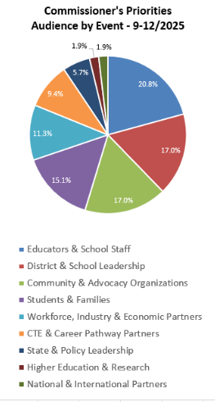
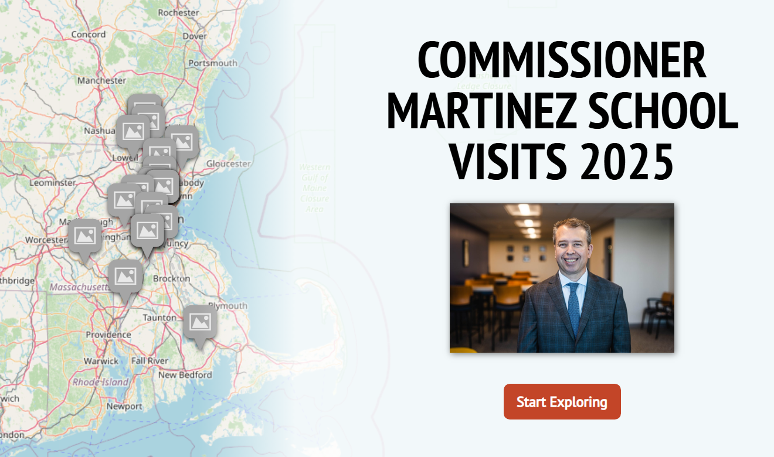
Stakeholder Engagement
Over 2,700 stakeholders engaged
Over 50 events

Slide 3
No MA Student Group at Pre-Pandemic Levels on MCAS
2025 MCAS Meets/Exceeds Compared to 2019
 | ELA 3-8 | ELA 10 | Math 3-8 | Math 10
All Students | -10​ | -10​ | -8​ | -14​
Black or African American ​ | -7​ | -3​ | -6​ | -9​
Asian​ | -8​ | -2​ | -5​ | -4​
Hispanic or Latino​ | -11​ | -6​ | -9​ | -10​
Multi-Race, Not Hispanic or Latino​ | -7​ | -9​ | -3​ | -13​
American Indian or Alaska Native​ | -12​ | -15​ | -10​ | -6​
Native Hawaiian or Pacific Islander​ | -13​ | -9​ | -8​ | -25​
White​ | -9​ | -10​ | -7​ | -14​
English Learners​ | -10​ | -1​ | -8​ | -4​
Low Income​ | Low Income Student Definition/Calculation has shifted since 2019, so cannot do a direct comparison.
Students with Disabilities​ | -4​ | -5​ | -2​ | -6​

Slide 4
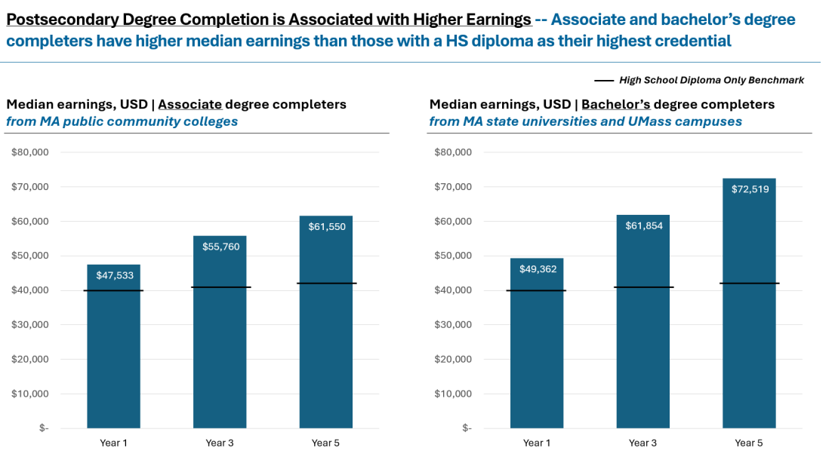
The More You Learn, The More You Earn

Slide 5

Vision of a Massachusetts Graduate
Thinkers:
Academically Prepared
Creative Problem-Solvers
Contributors:
Self-Aware Navigators
Intentional Collaborators
Leaders:
Responsible Decision-Makers
Effective Communicators

Slide 6
DESE Strategic Priorities
Cross-Agency Anchor Priorities:
Future Focused – Preparing all students to pursue their postsecondary goals through the implementation of new statewide graduation standards

Slide 7
DESE Strategic Priorities
Cross-Agency Anchor Priorities:
Future Focused – Preparing all students to pursue their postsecondary goals through the implementation of new statewide graduation standards
Accelerating Achievement – Providing comprehensive supports for low-performing schools and elevating best practices of school improvement

Slide 8
DESE Strategic Priorities
Cross-Agency Anchor Priorities:
Future Focused – Preparing all students to pursue their postsecondary goals through the implementation of new statewide graduation standards
Accelerating Achievement – Providing comprehensive supports for low-performing schools and elevating best practices of school improvement
Supporting Priorities:
Power of Presence – Increasing student attendance and engagement
Literacy Launch – Strengthening evidence-based early literacy practices
Inclusive Impact – Amplifying evidence-based practices for students with disabilities and English learners
Teach Tomorrow – Building a robust teacher pipeline
Strategic Objective 1: Whole Student
Strategic Objective 2:
Learning Experiences
Strategic Objective 3:
Diverse and Effective Workforce

Slide 9
Next Steps
Engage stakeholders in finalizing priority actions and goals
Promote internal coherence with reorganization of DESE around the priorities
New deputy commissioner structure (Lauren Woo and Rob Curtin)
New roles to support the new work
Senior associate commissioner for teaching and learning (Erin Hashimoto-Martell)
Senior associate commissioner for specialized support (Darcy Fernandes)
Senior associate commissioner for secondary schools and beyond (posted)
Senior associate commissioner for school assistance (posted)
Senior associate commissioner for data, assessment and accountability (posted)
Senior associate commissioner for special education programs (posted)
Senior associate commissioner for strategy, monitoring, and compliance (posted)
Work in consultation with the Board towards a new strategic plan

