Slide 1
Update on the K-12 Statewide Graduation Council
Presented to the Board of Elementary and Secondary Education
December 16, 2025
Notes:
Claire
Good morning Chair Craven, Secretary Tutwiler, and members of the board. Thank you for inviting us here today, and thank you for the introduction, Commissioner Martinez. We are here today to talk through proposed amendments to our preparation and licensure regulations related to a new pathway to licensure, as well as some more technical amendments to clarify subject matter knowledge requirements and definitions. Pending an affirmative vote form members of the board, these proposed amendments would then go out public comment for a period of 60 days.

Slide 2
Agenda
Graduation Council Charge
Graduation Council Process and Timeline
Stakeholder Engagement Activities
Vision of a Massachusetts Graduate
Recommendations, Considerations, and Additional Information
Next Steps

Slide 3
Graduation Council Charge
To study and make recommendations on a new statewide graduation requirement, including but not limited to the role of assessment, the potential for differentiated pathways to earning the competency determination, and the completion of additional experiences that demonstrate civic, college, and career readiness.
Guiding Questions
What should students know and be able to do before they graduate?
How should students demonstrate their achievements in ways that accurately reflect their skills and knowledge​?
What conditions should be in place to promote meaningful and equitable student experiences?

Slide 4
Graduation Council Process & Timeline
Stakeholder Engagement
Governor and Legislature Receive Final Recommendations
Interim Report Delivered to Governor and Legislature
Release Vision of a Massachusetts Graduate
Spring 2025
September 2025
December
2025
June 2026

Slide 5
Stakeholder Engagement Activities
Ongoing feedback from Council members and their respective constituent groups throughout the process
8 in-person and virtual listening sessions with approximately 400 attendees
2 student-specific listening sessions with approximately 125 attendees
A statewide online survey offered in multiple languages received 6,615 responses
A school district leader survey received 103 responses across the state
2 advisory groups convened to provide additional perspective from the Special Education and Multilingual Learner communities. Each advisory group has had two sessions to share direct input with the Council co-chairs

Slide 6

Vision of a Massachusetts Graduate
Thinkers:
Academically Prepared
Creative Problem-Solvers
Contributors:
Self-Aware Navigators
Intentional Collaborators
Leaders:
Responsible Decision-Makers
Effective Communicators

Slide 7
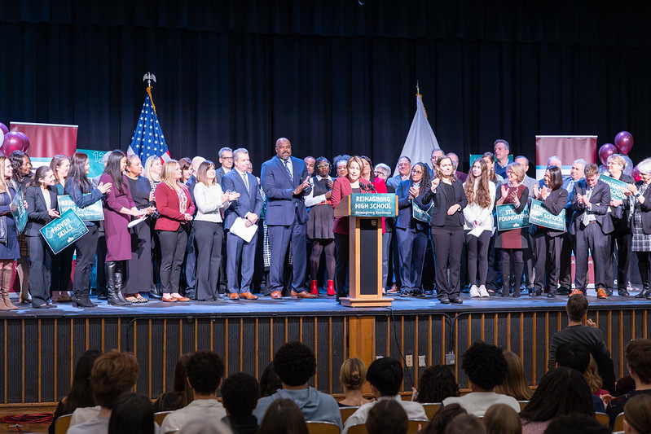
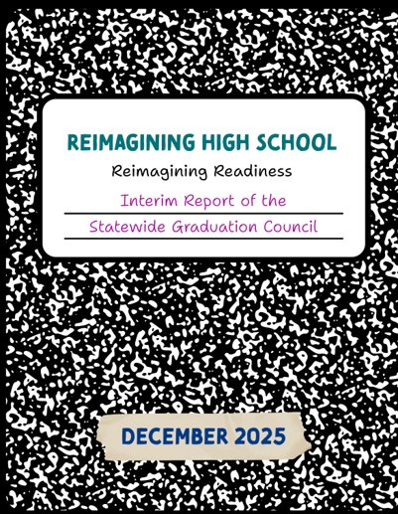
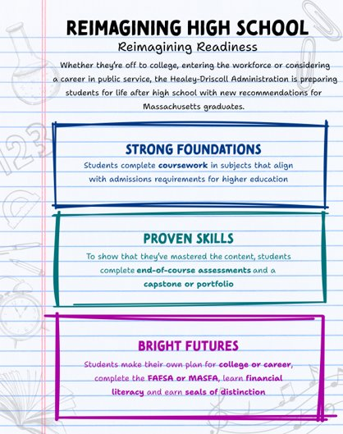
Interim Report
Statewide High School Graduation Framework | Mass.gov

Slide 8
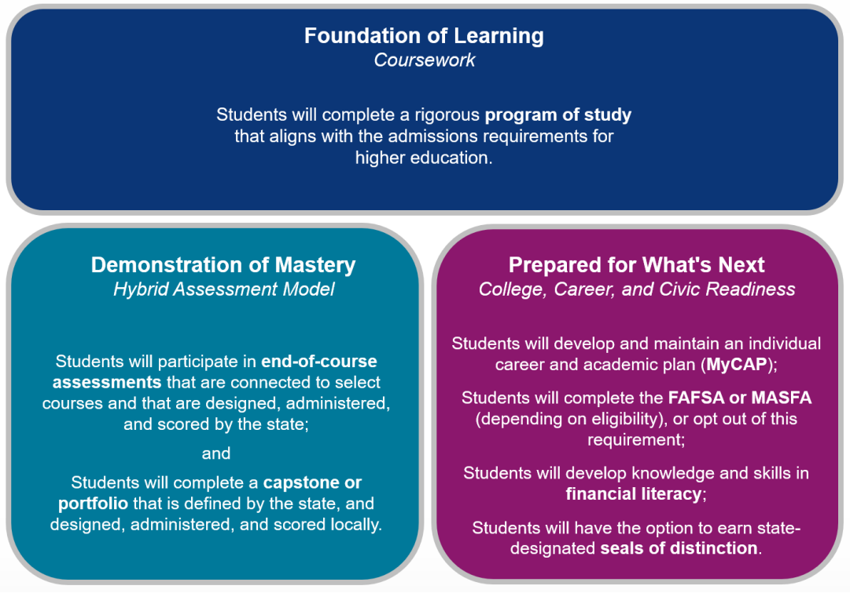
Recommendations

Slide 9
Considerations
Foundation of Learning
Demonstration of Mastery
Prepared for What's Next
Expanded flexibility in MassCore
Alternatives for certain student populations
Integration of MassCore and other existing pathways
Timelines and waivers
Determination of courses with EOC assessments
Role of EOC assessments in graduation
Equitable pathways for assessing mastery
Assessment landscape
Role of capstones and portfolios in graduation
Clarity and consistency of process and requirements for plan
Diversity of paths in MyCAP
FAFSA/MASFA opt-out process
Mechanism for developing financial literacy
Seal selection and logistics

Slide 10
Additional Information - General
While this work is ongoing, districts are still required to develop and submit their CD policies by December 31, 2025, per the updated regulations (603 CMR 30.00).
An implementation timeline will be determined through thoughtful and broad-based stakeholder engagement. Different components will likely be phased in over a set period of time.
The Graduation Council will continue to meet and assess costs and state resources that may be needed to implement these recommendations.
Some of these recommendations do require that state legislation be filed. The administration is assessing the best way to approach implementation.

Slide 11
Additional Information - EOCs
Failure to pass an end of course assessment alone will not prevent a student from getting a diploma.
Students will not be required to pass EOCs to earn a diploma. The weight and role of EOCs, as one component of a comprehensive system that validates a student’s readiness to graduate, will need to be further reviewed and discussed with stakeholders before anything is finalized.

Slide 12
Next Steps
Continue to work with stakeholders to address key considerations and implementation of recommendations
Present final report to Governor and Legislature in June 2026

Slide 13
Questions?

