Slide 1
Educator Preparation in Massachusetts
Presented to the Board of Elementary and Secondary Education
January 27, 2026

Slide 2
Presenters
Erin Hashimoto-Martell – Senior Associate Commissioner
Claire Abbott – Director, Office of Educator Effectiveness
Siobhan Allen – Early Literacy Coordinator

Slide 3
Agenda
Overview: Educator Preparation Review & Approval in Massachusetts
Spotlight: Early Literacy Program Reviews
Discussion

Slide 4
Overview: Educator Preparation Review & Approval in Massachusetts

Slide 5
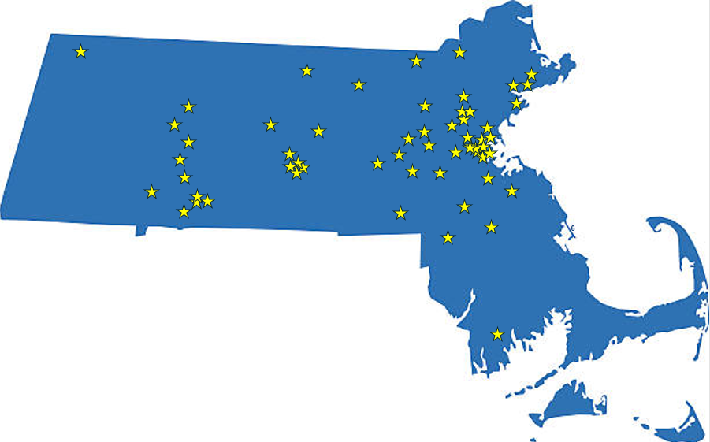
Educator Preparation in Massachusetts
62 sponsoring organizations
Over 1,200 preparation programs
4,300 completers (on average) each year

Slide 6
Review and Approval Authority
Commissioner has authority to make approval determinations
Guidelines for Educator Preparation Program Approval outline expectations and processes for review and approval
Approved organizations undergo periodic formal reviews to continue operating programs
7-year approval terms

Slide 7
Goal for Educator Preparation in MA
All aspiring educators are prepared to be effective*; using evidence-based practices, including culturally and linguistically sustaining practices, that well-serve all students in Massachusetts, particularly those from systemically marginalized groups and communities, such that all students have equitable opportunities to excel in all content areas across all grades.
*Effective educators in Massachusetts are those who nurture and cultivate academic achievement, cultural and linguistic competence, sociopolitical awareness, and emotional intelligence.

Slide 8
Key Features of an Aligned Model for Educator Preparation in Massachusetts
Preparation
MA PreK-12 Schools and Classrooms
Content
MTEL and Alternative Assessments
Assess functional content knowledge aligned with relevant…
Subject Matter Knowledge Guidelines
MA Curriculum Frameworks
Require all PreK-12 academic licensure candidates to build fluent content knowledge in relevant…
Pedagogy
Professional Standards for Teachers
Define expected pedagogical skills that mirror the…
MA Standards of Effective Practice
Candidate Assessment of Performance
Designed to reflect the process used by in-service educators on the Standards of Effective Practice in the…
MA Model Educator Evaluation Framework

Slide 9
Formal Reviews: Content
Instruction (INS)
Partnerships (PAR)
Provides effective instruction to all candidates and ensures that all completers have the requisite content knowledge and evidence-based pedagogical skills
Intentional and collaborative PK-12 partnerships that benefit candidates and schools/districts… [and cultivate] an increasingly diverse and effective workforce
Continuous Improvement (CI)
Field-Based Experiences (FBE)
Drive toward improved experiences and equitable outcomes for all candidates and the PK-12 students, schools, and districts they serve
All candidates engage in high-quality school-based experiences that prepare them to be effective educators for all students
The Candidate (CAN)
The Organization (ORG)
Effective guidance and comprehensive support to all candidates… ensures that [they] are prepared to be effective educators
Committed to achieving, and has systems, structures, and personnel in place to enable, equitable and effective program experiences and outcomes

Slide 10
Formal Reviews: Process
State-collected data on licensure and employment
Surveys, focus groups, and interviews with candidates, completers, sponsoring organization personnel, and PK12 partners
Review of completer artifacts for performance assessments, additional supports, etc.
Sponsoring organization evidence that demonstrates success relative to the criteria
LAUNCH
INITIAL INQUIRY
FOLLOW-UP INQUIRY
DETERMINATION

Slide 11
Formal Reviews: Outcomes
Approved with Distinction
Approved
Approved with Conditions
Requires submission of improvement plan and evidence of impact at least annually to show growth in most significant findings
Probationary Approval
Requires improvement plan and evidence of impact
1- or 3-year term of approval, DESE conducts formal review
Not Approved
Notes:
Include an overall statement about how important it is to improve SOs who are less than approved, describe how rigorous that process is, and Include an example of a change made as a result of formal review

Slide 12
Formal Reviews: Outcomes (2015-2022)
SY2015-SY2022 Reviews
Approved with Distinction
Approved
Approved with Conditions
Requires submission of improvement plan and evidence of impact at least annually to show growth in most significant findings
Probationary Approval
Requires improvement plan and evidence of impact
1- or 3-year term of approval, DESE conducts formal review
Not Approved
51
+9
16
0 (29 elected to expire)

Slide 13
Formal Reviews: Impact
According to study of formal review ratings and their relationship to measures of in-service teacher quality,
“When comparisons are made across all schools and districts in the state, review scores positively predict in-service teacher evaluations and value added for [program] graduates.”
Partnerships and field-based experience domain ratings were particularly important to this relationship
Meagan Comb, James Cowan, Dan Goldhaber, Zeyu Jin, Roddy Theobald (2023). State Ratings of Educator Preparation Programs: Connecting Program Review to Teacher Effectiveness. Journal of Education Human Resources. Volume 41, Number 2.

Slide 14

For more information
For more information, please visit the Educator Preparation website: https://www.doe.mass.edu/edprep/
For questions, email:
EducatorPreparation@mass.gov

Slide 15
Early Literacy Program Reviews
Spotlight:

Slide 16

Focus Areas of the Literacy Launch Initiative
Programs for Schools and Districts
- PRISM I Grant
- PRISM II Grant
- Literacy Launch Institutes
- Support Networks
Programs for Educator Preparation
- Accelerated Program Reviews
- Professional Learning Communities
- Resource Hub
- District/Prep Partnership Grants
Literacy Launch Evaluation

Slide 17
Special Committee on Pandemic Recovery & Literacy
Maintain formal review criteria requiring that teachers be prepared in evidence-based literacy instruction
Review preparation program quality in both field-based experiences and coursework
Accelerate formal reviews of preparation programs
Support higher education faculty to meet new criteria
Explore changes to licensure regulations to strengthen expectations for administrator preparation
Recommendations for Educator Preparation from 2024 Summary Report

Slide 18
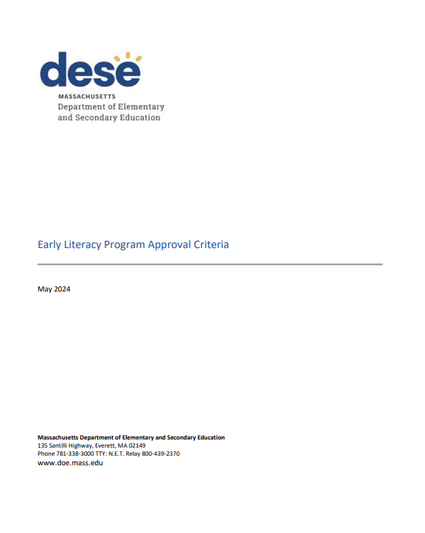
Early Literacy Program Reviews: Approval Criteria
Released in May 2024
Set the expectations for evidence-based preparation in relevant licensure programs (Early Childhood, Elementary, Moderate Disabilities)
Comprehensive of all literacy knowledge and skills
Equitable Literacy Instruction
Language Comprehension
Foundational Skills
Reading Comprehension
Writing

Slide 19
Accelerated Literacy Program Reviews
2025
2026
2027
2028
36 Programs
32 Programs
46 Programs
47 Programs
Shortens timeline from 8 years to 4 years
(all literacy-specific program reviews will be completed by SY2028-29)

Slide 20
Early Literacy Program Reviews: What We Look For
Alignment of program of study to new approval criteria
Course observations
Quality of field-based placements and supervision
Literacy-specific candidate observations

Slide 21
Early Literacy Program Reviews: Approval Designations
Individual programs will receive one of the following approval designations:
Approved with Distinction
Approved
Approved with Conditions → improvement plan
Probationary Approval → improvement plan + 1-3 year approval term
Not Approved

Slide 22
Professional Learning and Supports
Coaching
Early Literacy Consortium Grant
Asynchronous Courses for Faculty and Program Supervisors
Educator Preparation Learning Track at the Literacy Launch Institutes
Professional Learning Communities
Early Literacy in Educator Preparation Resource Hub
Opportunities for Educator Preparation Programs and Faculty to:
Gain critical content knowledge
Develop programs of study that support ALL candidates to become effective educators of evidence-based literacy

Slide 23
For more information on early literacy
For more information, please visit the Early Literacy in Educator Preparation webpage:
https://www.doe.mass.edu/edprep/resources/early-literacy.html
For questions, email:
EducatorPreparation@mass.gov

Slide 24
Thank You

