Slide 1


Early Literacy Updates
Presented to the Board of Elementary and Secondary Education
February 24, 2026
Erin Hashimoto-Martell, Senior Associate Commissioner, Teaching & Learning
Katherine Tarca, Director, Literacy & Humanities

Slide 2


Update Topics
Early Literacy as a Strategic Priority
Progress of Literacy Launch
  PRISM grants
  Literacy Launch Institutes and Coaching
High Dosage Tutoring
Image credit: Boston Public Library

Slide 3
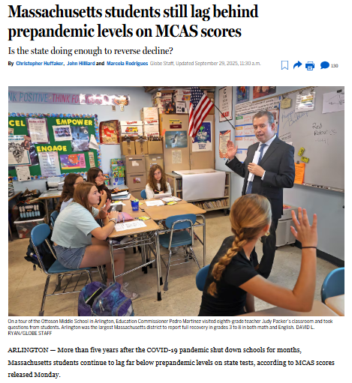
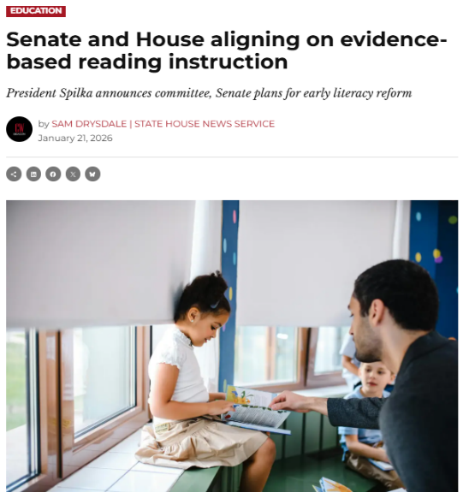
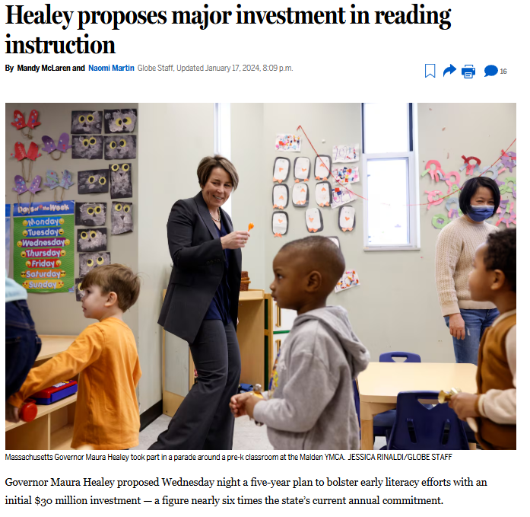
Early Literacy as a Strategic Priority

Slide 4

Progress of Literacy Launch Programs
Statewide
Opportunities
Targeted
Opportunities
Educator Preparation
Literacy Launch Institutes & Coaching
PRISM I grant
Accelerated Program Reviews
High Quality Instructional Materials Community of Practice
PRISM II grant
Professional Learning Communities & Resources

Slide 5

Partnership for Reading
Success- Massachusetts
PRISM I
PRISM II
Supports preK-3 literacy
One cohort of 15 districts
Up to 4 ½ years of funding
Districts already have strong early literacy infrastructure
Strengthen multi-tiered systems of support for early literacy
Supports preK-3 literacy
Two cohorts
Up to 60 districts total
Up to 2 years of funding
Select, purchase, and roll out high-quality instructional materials for early literacy

Slide 6

PRISM I
Strong Instruction, Student Learning
Aligned Materials & Classroom Practices
Professional Learning & Coaching
Strategically Deployed Resources
Partnerships & Collaboration

Slide 7
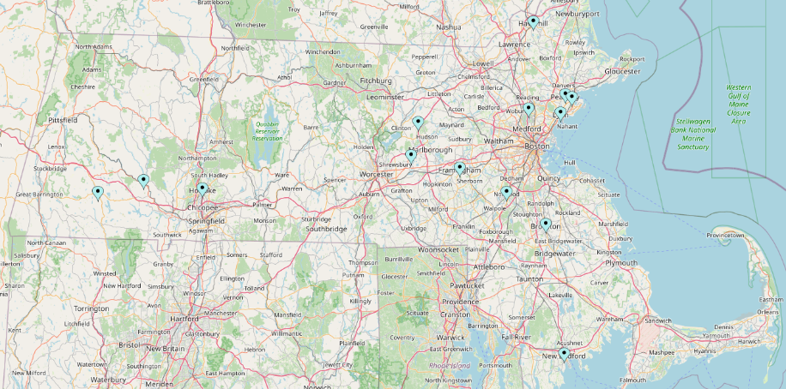
PRISM I Grant
5-year Metrics of Success
80% of students meet reading benchmarks by the end of each grade K-3
33% increase in the percentage of students meeting or exceeding MCAS expectations
Reduce disparities in the percentage of students meeting or exceeding screening benchmarks and MCAS expectations
PRISM I Districts

Slide 8


PRISM II Grant
31 districts selected for first cohort
Second cohort opportunity will open this spring
Two years of funding and coaching to select, purchase, and roll out high-quality instructional materials for early literacy
Amplify CKLA curricular materials

Slide 9
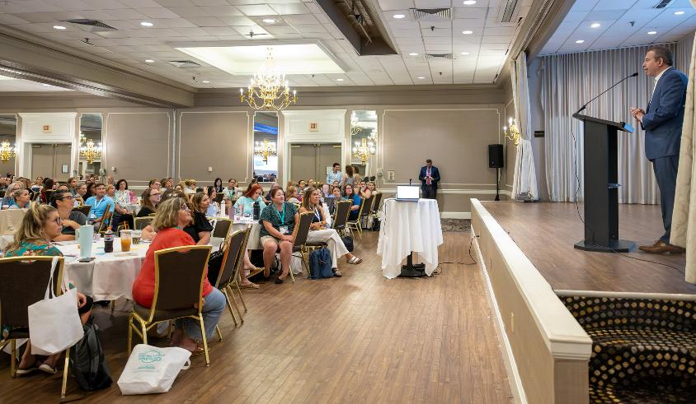
Literacy Launch Institutes and Coaching
Open to any public school educator, plus some preschool and higher education
500+ educators last summer
1,300 educators this winter/spring and summer
Free onsite coaching also available for school teams
Summer 2025 Literacy Launch Institute

Slide 10
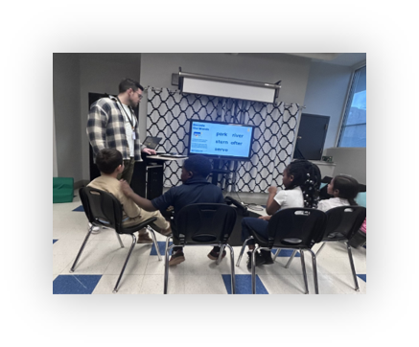
Early Literacy High Dosage Tutoring
$25M appropriated in FY26 to expand the program
Fall tutoring cycle: October through January
Spring tutoring cycle: February/March through May
Reaching about 10,000 students in 337 schools
Evaluation by Center for Research and Reform in Education (CRRE) at Johns Hopkins University
Federal Education Innovation and Research (EIR) grant – additional $10M over 5 years
Tutoring in Worcester, MA

