Slide 1

Isabella Chamberlain, SSAC Chair & Student Board Member
SSAC Mid-Year Report (2025-26)

Slide 2
What is the State Student Advisory Council (SSAC)?
Student Representatives from secondary schools serve on 5 Regional Student Advisory Councils (RSACs). Each region elects their leadership who make up and also serve on the State Student Advisory Council (SSAC).
The student Board member is elected by the members of SSAC.
The SSAC elevates student concerns and connects students across Massachusetts.

Slide 3
2025-2026 Council Progress to Date
Council Focus Topic Determination
Regional to State Connections
Communicating Progress
Engaging Stakeholders

Slide 4
2025-2026 SSAC Focus
The council came to a consensus on the focus of the year during a data party during which we analyzed MA educational and education-related data.
Data analyzed during the data party were selected based on issues and concerns student representatives felt were important to bring to the council.
This year we decided to focus on Utilizing Student Voice to Impact Wellness with a focus on:
Emotional Wellbeing
Bullying and Harassment
Nutrition and School Nutritional Environments

Slide 5
Regional to State Connections
Each of the regional councils dives deeper into the focus area topics to understand the regional impact of concerns.
The State Council focuses on learning the impacts in each region and synthesizing regional perspectives into state level considerations.

Slide 6
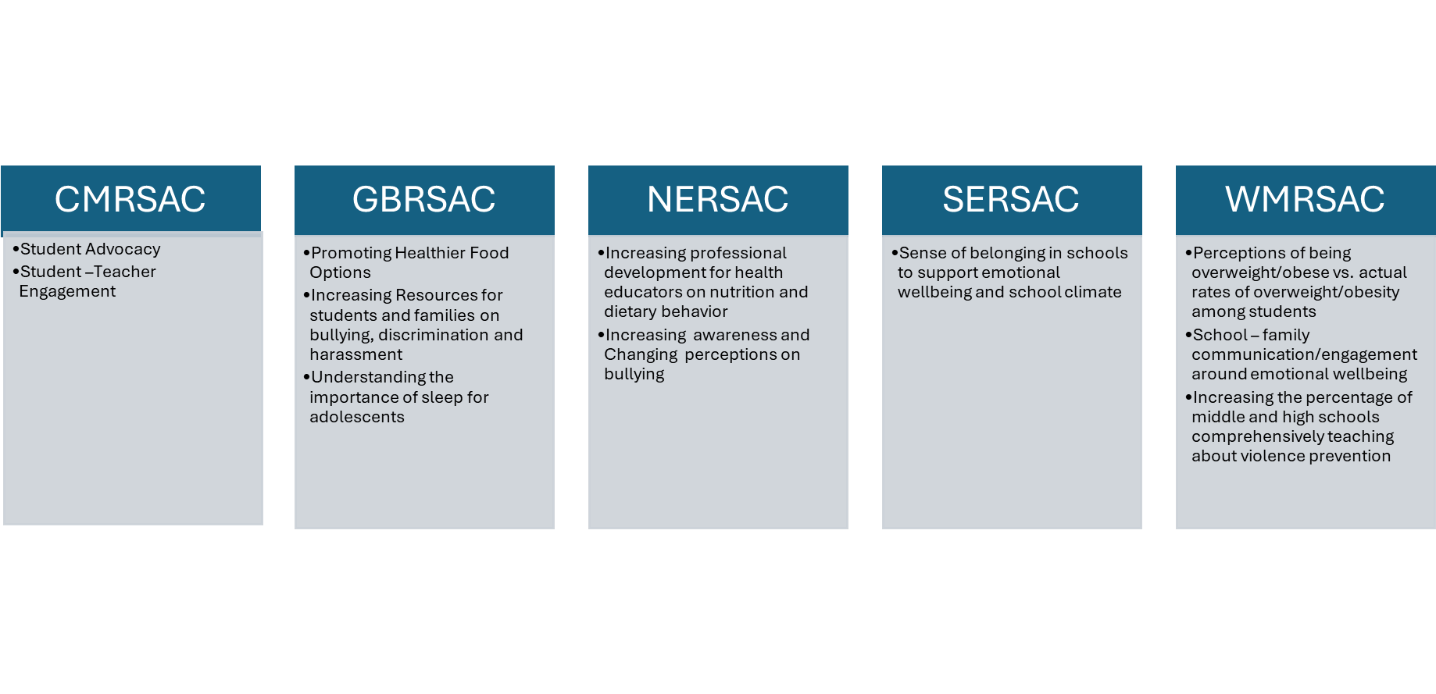
Council Subgroups

Slide 7
Data Sources for Council Data Parties
MA Statewide Data
•2023 MA YRBS (trend data: 2013-2023)
•2024 School Health Profiles
•2025 VOCAL (trend data: 2018-2025)

Slide 8
Snapshot of the Data at the Center of Concerns
Emotional Wellbeing
23.6% of high school students reported getting 8 or more hours of sleep on an average school night (2023 MA YRBS)
65.0% of all middle and high schools provided parents and families with information to increase family knowledge on mental and emotional health during the current school year (2024 School Health Profiles)
Bullying and Harassment
Among high school students, 56.8% of black students, 34.5% of hispanic students, 55.8% of asian students, and 39.8% of multiracial and other students feel as though they are treated badly or unfairly in school because of their race or ethnicity most of the time or always (2023 MA YRBS)

Slide 9
Snapshot of the Data at the Center of Concerns
Bullying and Harassment (cont.)
13% decrease between 2018 and 2025 of 5th grade students reporting that students at their school try to stop bullying when they see it (2025 VOCAL)
Nutrition and Nutritional Environments
26.1% of high schools have a lead health education teacher who has received professional development (e.g., workshops, conferences, continuing education, any other kind of in-service) on nutrition and dietary behaviors during the past two years (2024 School Health Profiles).

Slide 10
Snapshot of the Data at the Center of Concerns
Nutrition and Nutritional Environments (cont.)
Students who perceive themselves as overweight is higher than the the amount of students who are actually overweight (28.1% > 15%) with a high minority of students activity trying to lose weight at the same time (~42%) (2023 YRBS).

Slide 11
What the Council Identified as Strengths
92.3% of schools have placed fruits and vegetables near the cafeteria cashier, where they are easy to access (2024 School Health Profiles).
There was a 7% increase in the number of 10th graders who said they felt comfortable reaching out to teachers/counselors for emotional support if needed (61% in 2022 → 68% in 2025) (VOCAL)
70.8% of students feel like they have at least one teacher or adult at school that they can talk to if they have a problem (2023 YRBS).

Slide 12
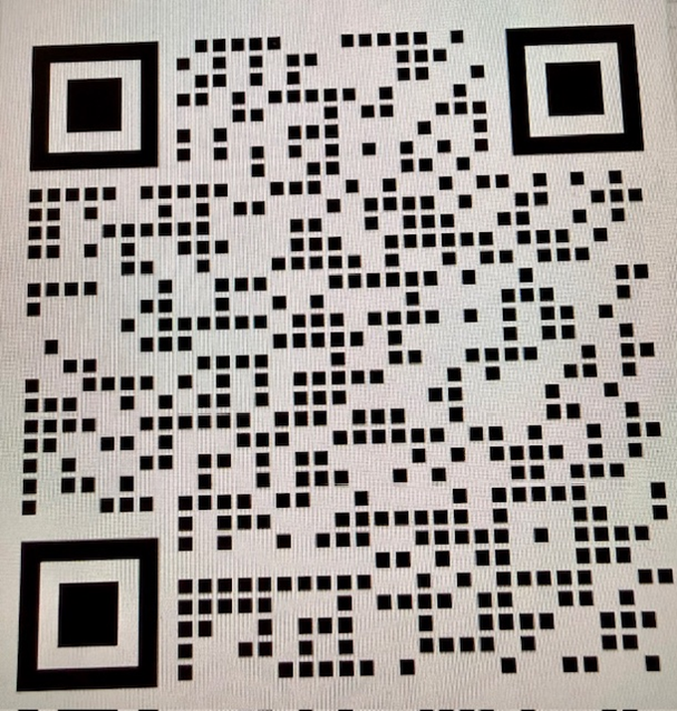
SSAC Newsletter
Released for the first time this year, the SSAC has a public newsletter highlighting the progress and work of the state and regional councils.
Includes current council information and resources on how other students can get involved.

Slide 13
State Council’s Next Steps: Stakeholder Engagement Event
On March 26th, the State Student Advisory Council will be holding their Stakeholder Engagement event.
Each regional council has already held their own Stakeholder Engagement Events to ask questions and receive feedback on their initiatives. The state event will help continue to bring in new perspectives, ideas, and information, and will assist the state council in supporting regional objectives and projects.
Notes:
If asked about the attending the event, let them know this is a targeted event, invite only. The information from this event will be detailed in the end of the year report.

Slide 14
Thank You!
Questions?

