Slide 1

Research and Evaluation at DESE
May 2026

Slide 2
Agenda
Why research matters
The Office of Planning and Research (OPR) and its functions
Ongoing research
Recent studies that improved DESE’s work
  State-level policy research
  Vulnerable student group research
  Discrete program evaluation
Limitations
What’s next

Slide 3
Why Research Matters
In a complex and rapidly evolving world, consequential decision-making benefits from adopting a researcher’s mindset:
  rigorously test our assumptions and intuitions
  promote intellectual curiosity, humility, and flexibility in our thinking
  a willingness to continuously refine and update our beliefs based on new evidence

Slide 4
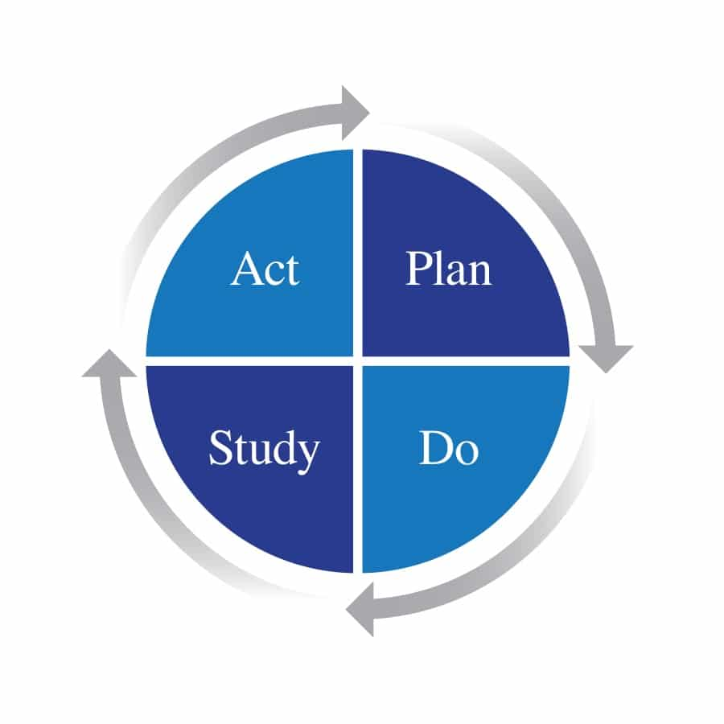
Why Research Matters
Research at DESE is not just about reporting on results after the fact; it is how we design better programs, learn together as we implement, and deliberately improve over time.
In short, OPR strives to make DESE an organization that learns from new evidence, so we make more informed decisions that benefit the students who count on us

Slide 5
OPR’s Research Functions
  Agency-wide research agenda
  Research project development, procurement, management, and dissemination
    Cross-agency research collaborations
    FERPA and FIPA compliant confidential data access for independent researchers (data-sharing MOUs, etc.)
  Development of data and statistical tools and training for educators on understanding and using these (VOCAL, DARTs, RADAR, etc.)
  Research grant applications and administration
  Researcher Community of Practice

Slide 6
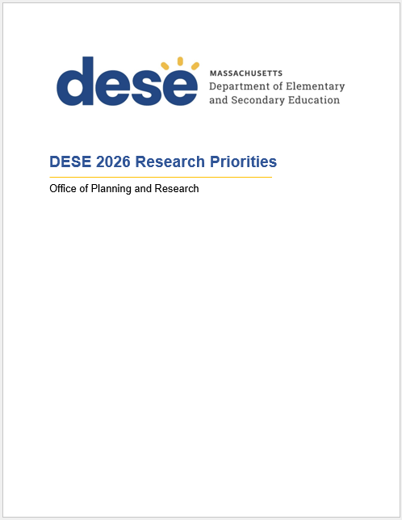
DESE’s Research Agenda
DESE publicly posts priority research topics both broad and specific:
Aligned to DESE’s Vision and Strategic Objectives
Organized by broad topics
Additionally, you’ll find lists of:
Ongoing research projects and partners
Completed research projects and publications

Slide 7

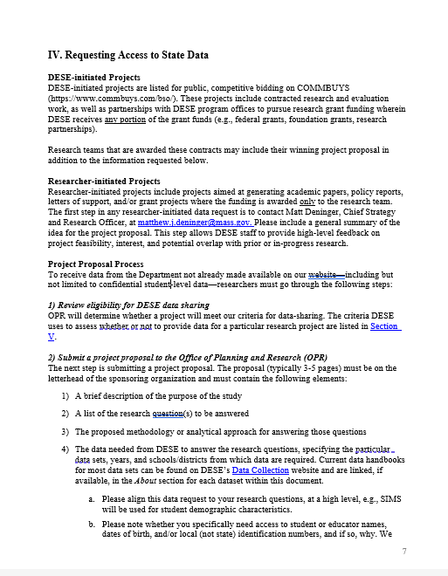
DESE’s Researcher’s Guide to Massachusetts State Education Data
Specifies available data and how to obtain and interpret it.
We have four kinds of data for researchers:
aggregate data at the school, district, and statewide levels,
non-confidential student-level data
confidential student-level data,
individual-level data on educators

Slide 8
Our General Process
OPR maintains an open, rolling research proposal process
3-5 proposals typically received monthly
External partnerships support research we couldn't otherwise conduct
1. Research Request Review
2. Data Sharing Agreement
3. Secure Data Delivery & Upkeep
4. Project Management, Publication, and Closeout

Slide 9
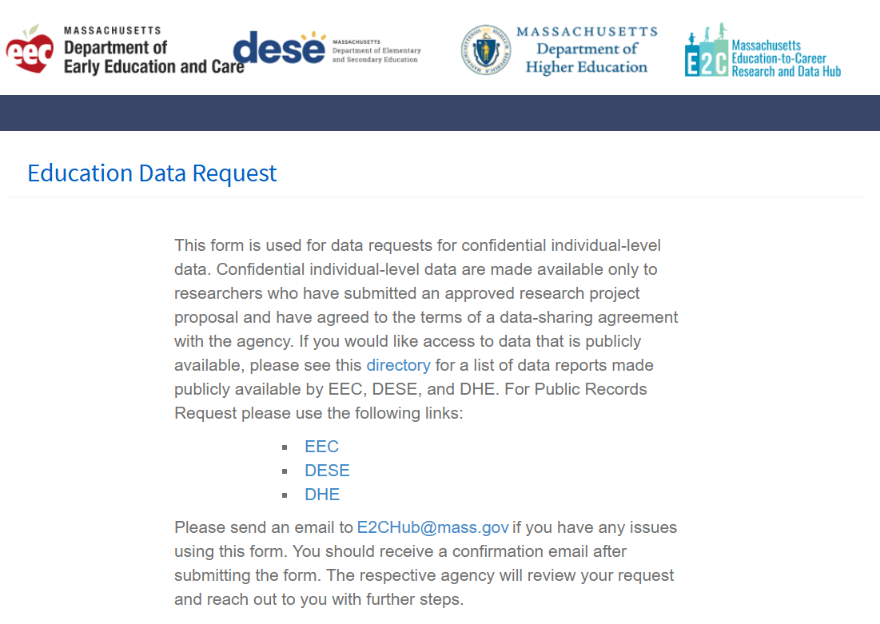
New Research Request Portal
One place for education agency and cross-agency data requests
Automated MOU creation if projects are approved
Simplified and centralized tracking of all requests

Slide 10
Sample of Ongoing Research

Slide 11
Teaching and Learning & Multilingual Learners
Research Team | Teaching and Learning Topic | Start Date
Johns Hopkins University | Early Literacy High Dosage Tutoring | 10/21/2025
Brown University | Literacy Launch | 9/22/2025
Columbia University | High Quality Instrucitonal Materials (HQIM) Implementation | 8/25/2025
Boston University/WEPC | The Calculus Project | 8/16/2025
Rethinking Learning | Computer Science in elementary and middle schools | 6/28/2024
MC2 Education | Genocide Education | 7/1/2023
WestEd | Early Literacy Screeners | 7/22/2022
Research Team | Multilingual Learners Topic | Start Date
Brown University | Experience of Multilingual Learners and Newcomers | 2/4/2026
UMass Lowell | Multilingual Learners who have Disabilities | 1/27/2026
WestEd | Bilingual Programs and Seal of Biliteracy (LOOK Act) | 3/19/2024
Westat | ESSA Entrance and Exit Policies for Multilingual Learners | 5/1/2023

Slide 12
College and Career Readiness
Research Team | Topic | Start Date
American Institutes for Research | Innovation Career Pathways (ICP) Evaluation | 4/9/2026
Boston College | Gender Peer Effects on Selection into Technical Education | 2/24/2026
Boston University/WEPC | Early College and Innovation Career Pathways: ELs and SWD | 2/2/2026
UMass Donahue Institute | Advanced Placement STEM and ELA | 5/1/2025
Harvard University | Topics in Early Education (EEC PIER Fellow) | 6/24/2024
MIT | Impact of Charter Schools on Student Postsecondary Outcomes | 10/25/2023
Boston College | CTE and Postsecondary Transition for Low-achieving Students | 4/6/2023

Slide 13
Diverse and Effective Workforce
Research Team | Topic | Start Date
Boston University/WEPC | Early Educator Workforce | 1/21/2026
Brown University | Persistently Effective Teachers | 9/25/2025
UMass Donahue Institute | Teacher Diversification Grants | 1/24/2025
CALDER at AIR | Impacts of Teacher Shortages on Teachers, Learning, & Equity | 1/10/2024
Boston University/WEPC | Leadership Pipeline | 1/3/2023
MIT | Impacts of Teacher Effectiveness on Charter School Quality | 8/5/2022
Harvard University | Teacher Pipeline Diversity | 6/22/2021

Slide 14
Whole Student
Research Team | Topic | Start Date
American Institutes for Research | Elevating Student Voice and Well-being | 1/8/2026
Harvard University | Multi-State Study on State Cell Phone Policies | 12/12/2025
University of Michigan | Long-term Pre-K Impacts | 5/20/2025
Harvard University | Early Learning Study at Harvard (ELS@H) | 3/21/2025
University of Chicago, NORC | Playful Learning Institute | 4/19/2024
St. Anslem College & BU/WEPC | Special Education Policy and Practice | 7/20/2023
MIT | Effect of Charter School Suspensions on Student Outcomes | 11/16/2022

Slide 15
Federal Research Grant Awards
Date/Partner | Competition | Title | Status
2026 DESE with Johns Hopkins University | Education Innovation and Research | Building Ongoing Outcomes in Student Tutoring (BOOST) | Ongoing
2023 WestEd | Institute of Educational Sciences | Examination of LOOK Act Implementation in Massachusetts | Ongoing
2020 DESE with UMass Donahue Institute | USDOE | Advanced Placement Expansion | Complete
2019 Brown University | Institute of Educational Sciences | Consequences of High School Exit Examinations for Student Life Outcomes | Complete

Slide 16
Recent Studies that Improved DESE’s Work
State-level Policy Research
Vulnerable Student Group Research
Discrete Program Evaluation

Slide 17
Recent Studies that Improved DESE’s Work
State-level Policy Research
Vulnerable Student Group Research
Discrete Program Evaluation

Slide 18
State Policy Research – Grad Requirement
September 2018 - present
Research Partnership
  John Papay, Brown University
  Dick Murnane, Harvard University
  Ann Mantil, Harvard University
Highlights
  Relationship between MCAS and later outcomes
  Grade inflation
  Effective high schools
  Community college transfer and attainment
  High School Newcomers
  Relationship between MassCore completion and later outcomes

Slide 19
Recent Studies that Improved DESE’s Work
State-level Policy Research
Vulnerable Student Group Research
Discrete Program Evaluation

Slide 20
Students Experiencing Homelessness
October 2023 - December 2024
Students Experiencing Homelessness in Massachusetts
DESE’s Educational Stability Office, Student and Family Support
  First comprehensive study of “highly mobile” Massachusetts students:
    Experiencing homelessness
    Foster care
    Migrant families
    Military families
  Mixed methods design:
    Outcomes for “highly mobile” students
    Efforts of districts, schools, and community organizations to support these students and their families
    Key facilitators, challenges, and recommendations for improvement

Slide 21
Numbers of Massachusetts K-12 students experiencing homelessness 2010 - 2025
K-12 student homelessness nearly tripled from 2010-2025

Slide 22
Key Findings
Rising numbers of K-12 students experiencing homelessness, in foster care, in migrant worker families and military families
Hispanic or Latino, African American or Black, English Learners, Low Income and Students with disabilities overrepresented
Students experiencing homelessness or in foster care have poorer nonacademic and academic outcomes compared to their less mobile peers:
  Lower attendance
  Higher suspension
  Higher dropout
  Lower rates of MCAS grade 3 and 6 meeting or exceeding expectations
  Lower rates of passing all 9th grade courses
  Lower graduation
  Lower college enrollment

Slide 23
Application of Findings
Informed project plans for DESE’s Educational Stability Team
Provided districts with a clearer understanding of the influence of attendance and mobility on the academic outcomes of students experiencing homelessness
Increased district training for and focus on family engagement efforts for students with disabilities who are also experiencing homelessness.
Improved districts and Regional Homelessness Liaisons professional development
  Offered technical assistance to all districts not just McKinney-Vento grantees
  Focused technical assistance on specific topics
  Included district case consultancies
  Offered technical assistance in collaboration with key partners
    Other MA agencies (e.g., Department of Children and Families)
    DESE units (e.g., Federal Grants, Special Education, Problem Resolution)

Slide 24
Recent Studies that Improved DESE’s Work
State-level Policy Research
Vulnerable Student Group Research
Discrete Program Evaluation

Slide 25
Evaluation of HQIM High-Quality Implementation
June 2023 - June 2024
Evaluation of the High-Quality Instructional Materials (HQIM) Implementation Grant Program
DESE’s Instructional Policy Office, Teaching and Learning
Evaluation of DESE support for and district implementation of HQIM.
Documented evidence of:
  Progress, successes, and challenges in supporting effective district systems to implement HQIM.
  Changes in educator mindsets, understanding of district HQIM goals, educator practices, and expectations of students

Slide 26
Key Findings
Over a six-month period of implementing HQIM, teachers reported positive shifts in their:
  expectations for students
  beliefs about student capabilities
  perceptions of equitable HQIM implementation
  overall satisfaction with HQIM
Teachers reported decreased satisfaction with HQIM supports for Multilingual Learners and students performing below grade level.
More positive teacher perceptions were associated with stronger leadership support for:
  culturally and linguistically sustaining practices
  effective two-way communication between administrators and educators
  access to necessary HQIM materials, and
  sufficient time for HQIM implementation.

Slide 27
Application of Findings
Updated district supports, tools, and resources to concretely center the role of building-level leadership and effective systems:
  Implement MA Guide: a clear roadmap for districts to navigate the evaluation, selection, launch, and implementation of HQIM.
Stimulated ongoing continuous improvement in district HQIM implementation, including:
  Identification of specific instructional practices requiring improvement
  Development of full-year professional development calendars
  Alignment of district and school leadership and teachers on areas for improvement, namely supports for Multilingual Learners
  District monitoring of progress and measures of success

Slide 28
Limitations
Funding
Researcher Availability/Market
Mismatch between questions asked and available data
We do as much as we can to extend the reach of research, but because there are so many programs and initiatives, we cannot rigorously evaluate all of them
Qualitative research:
  Higher cost and higher burden on educators
  Quantitative data might not fully answer the question

Slide 29
What’s Next:
Sharpened focus on how research can continuously inform and shape DESE’s major initiatives
Expanding dissemination and transparency of research and findings:
  Newsletters
  Researcher Round Tables
  External Research Report Library

