Slide 1
SSAC End of Year Presentation
Student Board Member - Isabella Chamberlain
June 23, 2026

Slide 2
What is the State Student Advisory Council (SSAC)?
Student Representatives from secondary schools serve on 5 Regional Student Advisory Councils (RSACs). Each region elects their leadership who make up and also serve on the State Student Advisory Council (SSAC).
The student Board member is elected by the members of SSAC.
The SSAC elevates student concerns and connects students across Massachusetts.

Slide 3

2025-2026 Council Year
Snapshot of the Year
SSAC – BESE Connections
Council Year Focus: Final Recommendations
Looking Forward

Slide 4
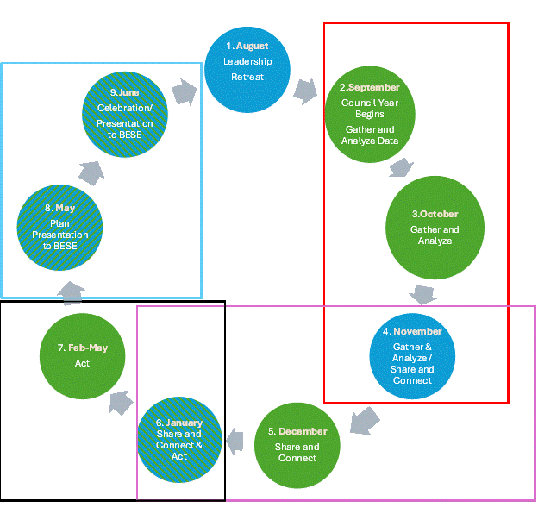
SSAC Framework
Gather & Analyze (red box)
  Data Analysis to identify topics aligned with state level goals and youth concerns
Share & Connect (purple box)
  Deeper stakeholder engagement in root causes and possible solutions
Act (black box)
  Creating and implementing action plans to make change both regionally & at the state level
Recommend, Showcase & Reflect (blue box)
  Preparing reports & presentations to inform BESE & other stakeholders on changes & impacts
  Reflecting & Celebrating on the work done & thinking about next steps
Notes:
Just a quick reminder of SSAC’s operating framework outlining the process used to develop and present the council’s recommendations and considerations. This operating framework is research and action oriented which aligns with the council’s purpose to actively engage students in educational processes, impacting DESE’s strategic priorities and making progress towards achieving the Commonwealth’s K-12 Educational Vision

Slide 5



SSAC Year in Review – Who We Are?
State Student Advisory Council Advisors
  Consists of the leadership from each of the 5 regional councils
Central Massachusetts RSAC (CMRSAC)
  24 students
  13 schools
Greater Boston RSAC (GBRSAC)
  28 Students
  16 Schools

Slide 6



SSAC Year in Review – Who We Are?
Northeast RSAC (NERSAC)
  17 students
  9 schools
Southeast RSAC (SERSAC)
  26 students
  15 schools
Western Massachusetts RSAC (WMRSAC)
  18 students
  13 schools

Slide 7
SSAC Year In Review – Highlights
Students used extensive amounts of State level data to support our three highlighted concerns.
Held successful regional and state level Stakeholder Engagement Events, hosting both regional level stakeholders (ex. principals, superintendents, counselors), and state level stakeholders (ex. DESE employees, state-level organizations) to gather information and feedback from them.
  Received lots of positive comments and feedback from both regional and state-level stakeholders regarding event structure, student’s preparation, and information shared.

Slide 8
.
Massachusetts Board of Elementary & Secondary Education
(SSAC Chair is full voting member)
Regional Leadership (30) make up the State Student Advisory Council to BESE and elect:
Chair
Vice Chair
Communications Chair
Regional Councils elect 6 to Leadership Roles:
2 Regional Co-Chairs
2 Regional Co-Communication Chairs
2 Stakeholder Engagement Coordinators
Secondary Schools elect 2 student representatives to serve on one of five Regional Student Advisory Council
Notes:
Flow of communication

Slide 9
Highlights of Council Support of SSAC Chair
During every SSAC meeting, representatives are given updates on BESE future/past agenda items by the Chair and given the opportunity to ask questions
  Information is then brought back to regional councils by representatives
When additional information is needed or needed to be given out (ex. by regional/state councils, council leadership), we often disseminate feedback forms to representatives or hold office hours hosted by the Chair for representatives to join.
Notes:
Ex. of additional information: MCAS office hour and Educator Diversity quetionare

Slide 10
Utilizing Student Voice to Impact Wellness
Final Recommendations and Considerations
Notes:
Remind Board that more detailed information and recommendations will be provided in the full final state report, as well as remind them that not every region had subgroups under each of our three categories, which is why we see differing numbers in recommendations for each category and not every region represented.

Slide 11
Bullying, Harassment and Discrimination
Regional Recommendations
GBRSAC
NERSAC
SERSAC
WMRSAC
  Streamline Reporting
    Universal bias response form
    Single district-wide bullying response coordinator
    Resources to support the promotion and creation of affinity groups within schools
  Increase bullying, harassment and discrimination awareness and education across all grade levels
    Guest speakers and experts to better connect with students
    Promotion and advertising of programs, prevention strategies and resources through infographics
  Expand training and visibility of counselors and school resource officers to increase trusting adults within the schools that students feel comfortable seeking help
  Standardize clear definitions of bullying across schools, with emphasis on verbal and social behaviors
  Implement school-wide bystander intervention training programs
  Increase adult supervision in high-risk areas within school buildings
  Strengthen student-adult trust systems to improve reporting rates
  Expand preventative education on peer interaction, inclusion, and respect
Notes:
Rationale: RSACS have identified a need for consistent protections, equitable responses, and stronger relationships with trusted adults to impact the bullying, harassment and discriminations experiences of students across the state. Universally and consistently implemented measures by districts help to create safe, respectful, and inclusive learning environments statewide.

Slide 12
Bullying, Harassment and Discrimination
State Recommendation
State- Level Recommendation:
To support needs and recommendations of each region, SSAC urges the promotion and adoption of more unified approaches across and within districts to preventing and addressing bullying, harassment and discrimination. Identified priorities center on: standardizing definitions and reporting processes, increasing access to trusted adults, and expanding education and awareness.

Slide 13
Emotional Development and Well Being
Regional Recommendations
CMRSAC
GBRSAC
NERSAC
SERSAC
WMRSAC
  Increase implementation of Flex blocks and mental health days.
  Implement district wide initiatives to raise student awareness of counseling services, peer support programs, and other resources for mental health
    Use methods such as surveys of students and teachers on understanding, awareness, needs and access to mental health resources to inform.
  Include mental health and wellbeing discussions into curriculums
    Starting conversations about mental health earlier in ways appropriate for younger students to build a foundation of understanding and willingness to seek help and advice from trusted adults
    Schools based their policies & programs on what their individual students need, want and would use in their respective communities
  Schools implement actions that increase students' sense of belonging
    Culture nights
    Affinity groups
    Freshman orientations
    Clubs
    Tutoring and faculty support for students
  Increased emphasis of sleep health in HS health and biology standards and curriculums.
Notes:
Rationale: Students desire a school culture where emotional wellbeing is prioritized alongside academic achievement, ensuring every students feels supported, connected, and prepared for success.

Slide 14
Emotional Development and Well Being
State Recommendation
State- Level Recommendation:
In consideration of the needs and recommendations detailed by each region, SSAC recommends that comprehensive approaches to emotional development and well-being be implemented by all districts. These approaches should be supported by research and reflective of the actualized needs of their respective students. SSAC recommends that districts strongly consider adding more flex block time and designated mental health days into schedules, building stronger sense of student belong through inclusive activities, and teaching mental health skills and the importance of sleep from kindergarten through graduation as integral aspects of their approaches.

Slide 15
Nutrition and Nutritional Environments
Regional Recommendations
GBRSAC
NERSAC
WMRSAC
  Strengthen partnerships with local farmers and food producers
    Require the use of the School Health Index (or similar assessment tools) to understand school/district nutritional environments
    Expand access to salad bars and fresh produce
  Partnering with local farms to improve the quality and healthiness of foods being served in schools
  Health classes that include nutrition education for every grade level
  More student surveys to find out what kinds of things students and adolescents feel influences their body image and are important to improve their nutrition.
Notes:
Rationale: Every school should provide healthy, inclusive, and culturally diverse food options that fuel learning and connects to the community they serve.

Slide 16
Nutrition and Nutritional Environments
State Recommendation
State- Level Recommendation:
To support the priorities for nutrition and nutritional environments with schools, SSAC recommends the promotion of policies, practices, and programs that expand nutrition education in classrooms, such as building partnerships with local farms and businesses and investing in training and resources for food service staff. Students and families should be more involved in helping to plan menus and taste-testing recipes to make sure meals reflect the cultural diversity of their communities.

Slide 17
Looking Forward: SSAC 2026-2027 Council Year
Currently completing elections for RSAC Leadership
State Leadership Council Orientation and Election of Chair/BESE student member
SSAC Leadership Summer Retreat in August
Notes:
SSAC activities over the coming weeks to prepare for the 2026-2027 school year.

Slide 18
Thank you!

