Slide 1
Civics Education Update
June 23, 2026
Erin Hashimoto-Martell, Senior Associate Commissioner, Teaching & Learning
Rebekah Judson, History and Social Science Content Support Specialist

Slide 2
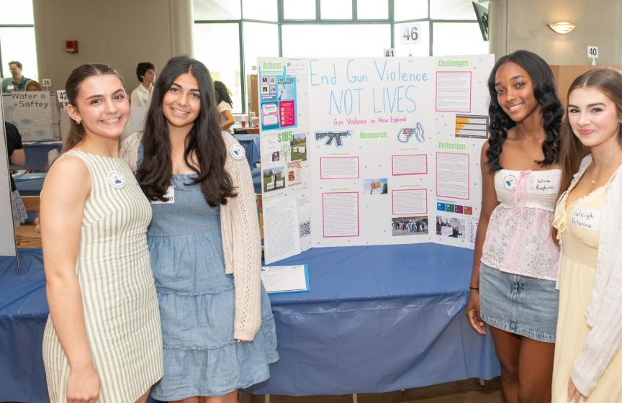

Civics Education in MA: Why it Matters Now

Slide 3
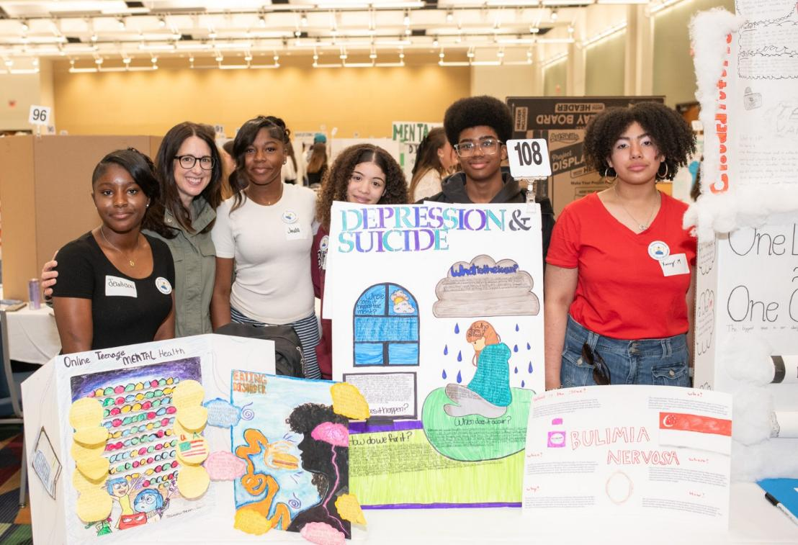
A Strong Foundation Since 2018
Revised HSS Framework
Civic engagement law
Student-led civics projects
Civics Project Trust Fund

Slide 4
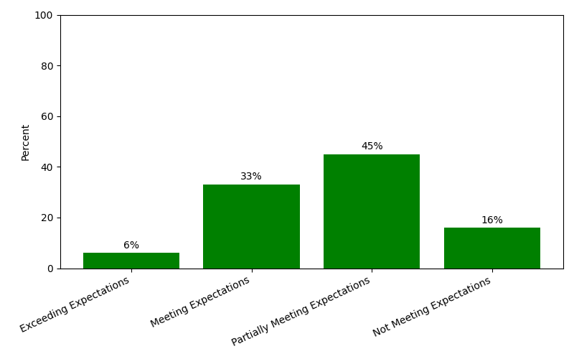
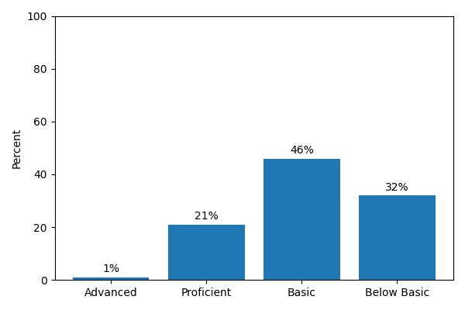
Civics Assessment Results
2025 MCAS, grade 8 Civics
2022 National NAEP, grade 8 Civics

Slide 5
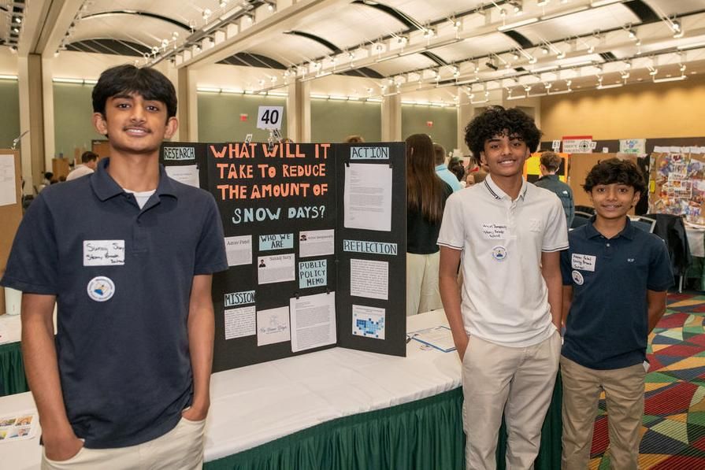
Investing in Civics Education
Civics Project Trust Fund
~$6M awarded since FY21
Professional learning, curriculum & experiential learning

Slide 6

Supporting Strong Civics Instruction
Civics project resources
Investigating History
Curricular Materials Guide
Teaching for Civic Empowerment initiative

Slide 7
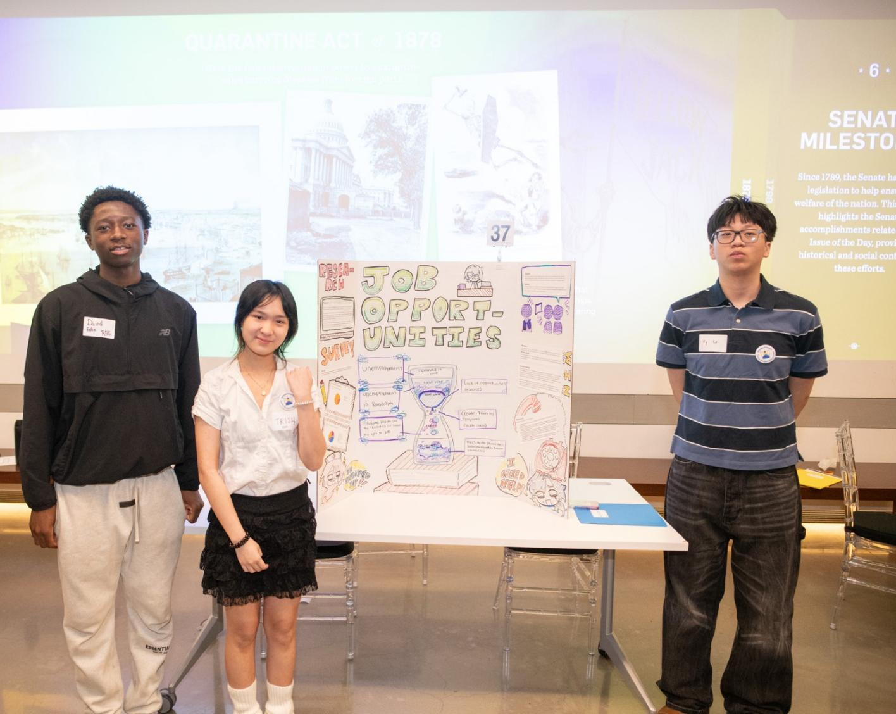
Showcasing Students' Civic Learning
2026 Civics Project Showcases:
  Boston
  Worcester
  Dartmouth
  Springfield

Slide 8
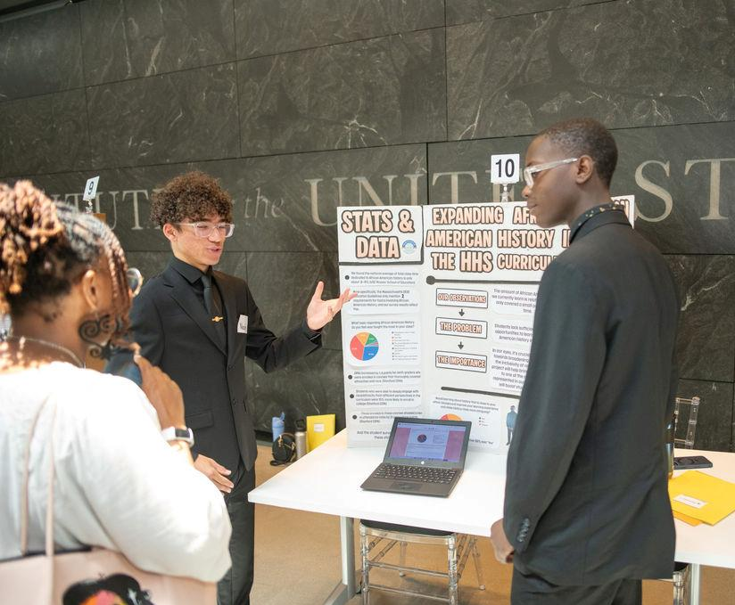
Showcasing Students' Civic Learning Cont’d
2026 Civics Project Showcases by the numbers:
1150 8th grade and high school student presenters
80 districts and 133 schools represented
317 local community advisors
33 student leaders

Slide 9
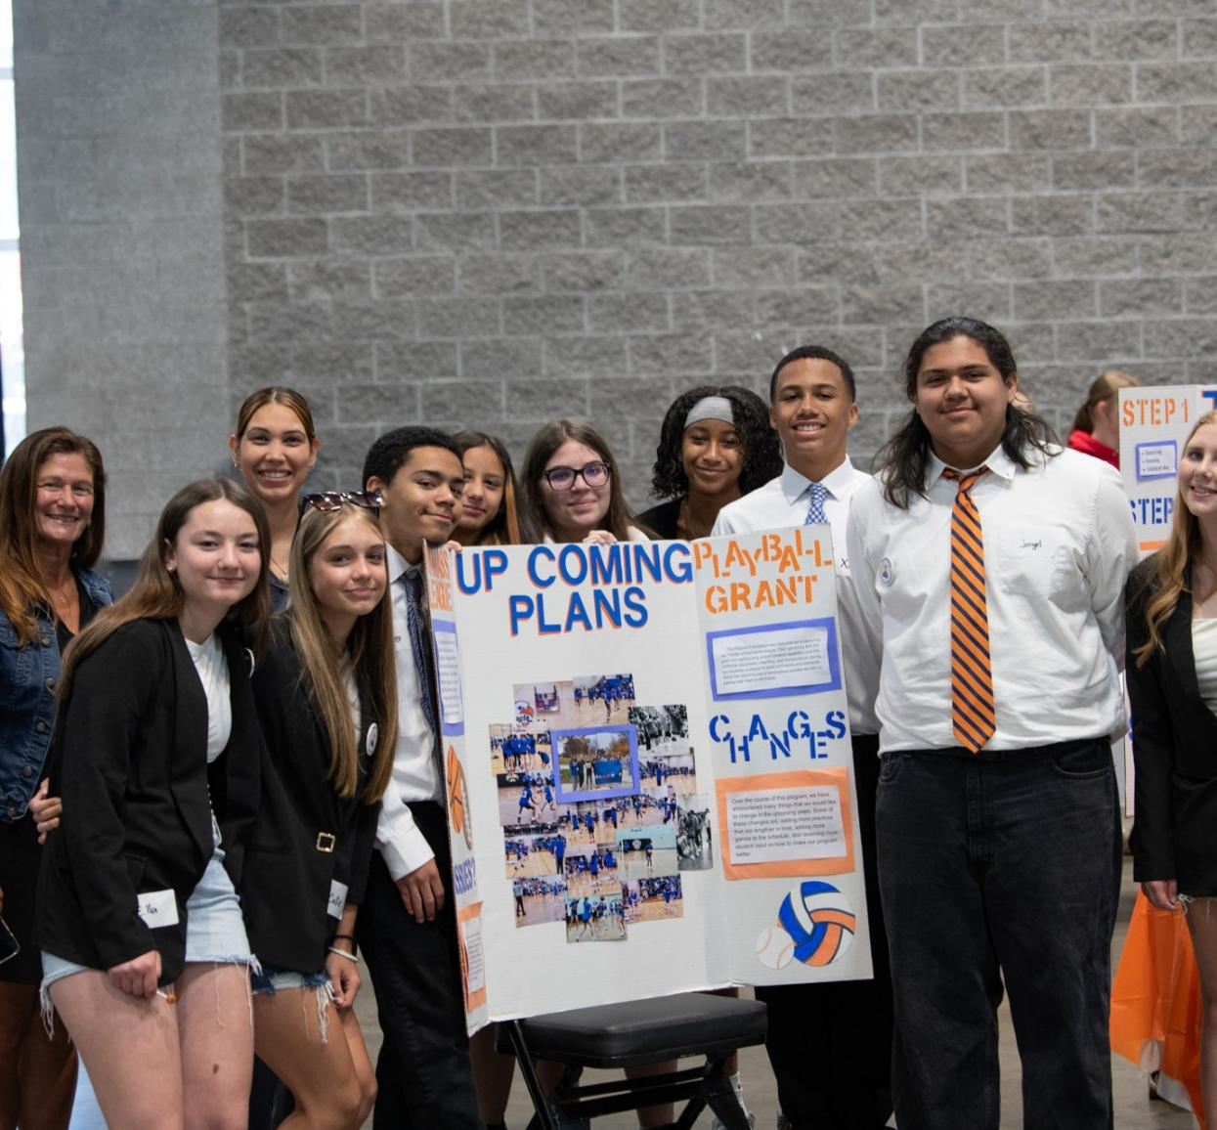

Looking Ahead

