Slide 1
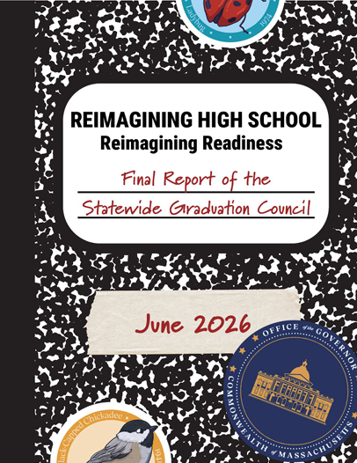
K-12 Statewide Graduation Council Final Report
Presented to the Board of Elementary and Secondary Education
June 22, 2026
Notes:
Claire
Good morning Chair Craven, Secretary Tutwiler, and members of the board. Thank you for inviting us here today, and thank you for the introduction, Commissioner Martinez. We are here today to talk through proposed amendments to our preparation and licensure regulations related to a new pathway to licensure, as well as some more technical amendments to clarify subject matter knowledge requirements and definitions. Pending an affirmative vote form members of the board, these proposed amendments would then go out public comment for a period of 60 days.

Slide 2
Agenda
Graduation Council Process and Timeline
Stakeholder Engagement Activitiess
Vision of a Massachusetts Graduate
Graduation Framework
  Primary Components
  Embedded Components
  Seals of Distinction
Implementation Timeline and Next Steps

Slide 3
Graduation Council Process and Timeline
Stakeholder Engagement
Final Report Delivered to Governor and Legislature
Interim Report Delivered to Governor and Legislature
Vision of a Massachusetts Graduate Released
Spring 2025
September 2025
December
2025
June 2026

Slide 4
Stakeholder Engagement Activities
8 Listening Sessions with 400+ attendees
3 student-specific sessions with 300+ attendees
Statewide Survey with 6,600+ responses
District Leader Survey with 100+ respondents
5 Advisory Groups with 79 individuals and 23 meetings
Public Input Form with 800+ responses
14 Statewide Graduation Council meetings

Slide 5
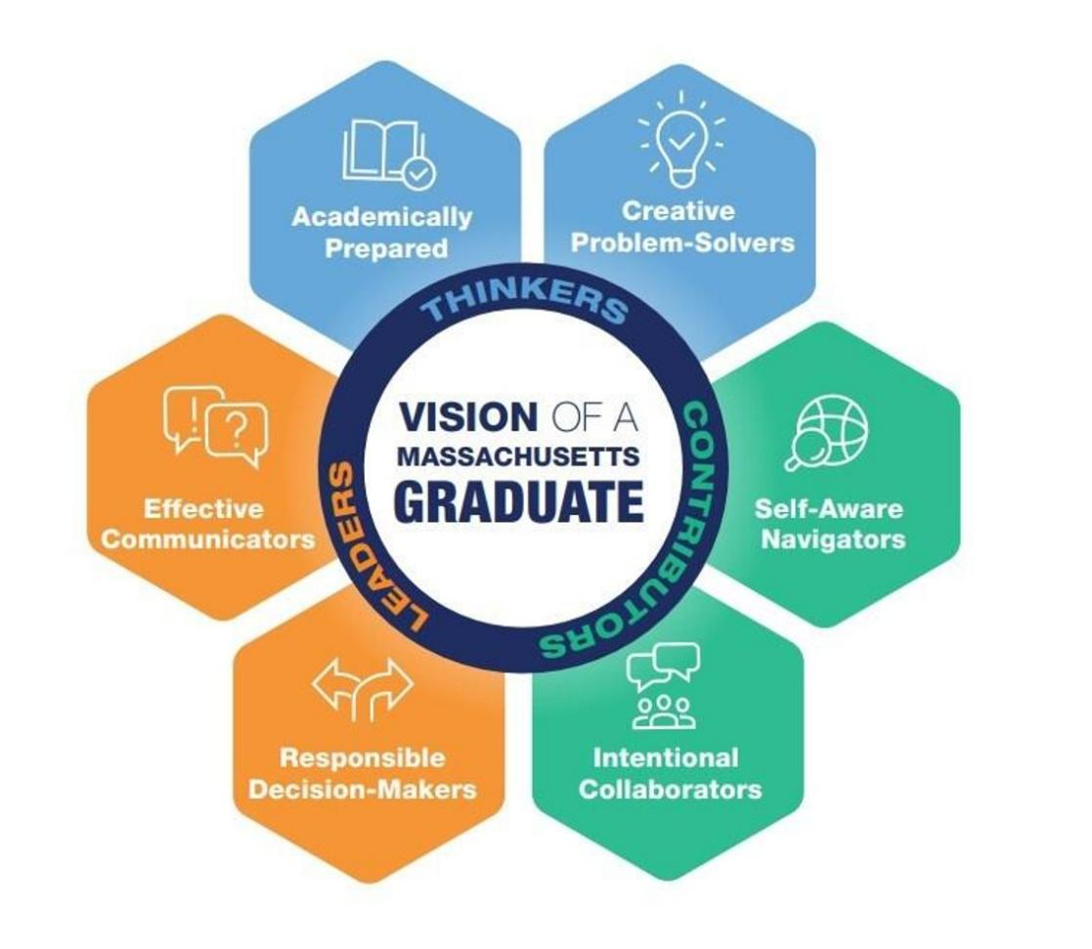
Vision of a Massachusetts Graduate
Thinkers:
Academically Prepared
Creative Problem-Solvers
Contributors:
Self-Aware Navigators
Intentional Collaborators
Leaders:
Responsible Decision Makers
Effective Communicators

Slide 6
Graduation Framework
Strong Foundations for Bright Futures

Slide 7
Strong Foundations for Bright Futures
Built on research spanning all 50 states and DC, the proposed framework is the most comprehensive approach to graduation requirements in the country — no other state has combined these components at this scale
Reflects a core belief that every student in Massachusetts deserves an education that prepares them for meaningful choice and opportunity after high school
Preserves local flexibility in how districts support students in meeting the requirements while maintaining a rigorous and uniform standard
Distinguishes between two categories: Primary Components, which set consistent statewide expectations for coursework, assessment, and postsecondary planning, and Embedded Components, which are integrated across core requirements to support college, career, and civic readiness

Slide 8
Primary Components
Foundational Coursework
End-of-Course Assessments
Postsecondary Planning
Culminating Experiences

Slide 9
Foundational Coursework
Recommendation: Students will complete MassCore, a rigorous program of study that aligns with the admissions requirements for higher education and keeps all postsecondary options available to students.
Why MassCore Matters:
  MassCore aligns with the admissions requirements of Massachusetts public four-year colleges and universities.
  National research literature indicates that high school coursework and academic performance is correlated with postsecondary success, including high school graduation, wages, and college enrollment, persistence, and academic performance.^{1,2,3,4}
  High school graduates who complete MassCore course recommendations are much more likely to enroll in and complete postsecondary education across the MCAS score distribution.⁵

Slide 10
End-of-Course Assessments
Recommendation: Students will complete end-of-course (EOC) assessments in specified MassCore subjects. EOC assessments are designed, administered, and scored by the state. Performance on the EOC assessments will meaningfully count toward students’ academic record and path to graduation.
Why End-of-Course Assessments Matter:
  EOC assessments work alongside MassCore to demonstrate a student’s proficiency in core content, their readiness to progress in a course sequence, and their preparedness for success in their postsecondary pursuits.
  Assessment research consistently finds that standards‑aligned, course‑aligned assessments provide a valid measure of student mastery of the curriculum standards.⁶

Slide 11
Postsecondary Planning
Recommendation: Students will develop a postsecondary plan that meets required year-by-year milestones defined in the state’s My Career and Academic Plan (MyCAP) framework, along with locally determined activities. Required milestones will include financial literacy, artificial intelligence and digital literacy, work-based learning, and FAFSA/MASFA completion or opt-out.
Why MyCAP Matters:
  MyCAP connects high school to what comes next, providing a structured, statewide approach for students to plan, reflect on, and align their coursework and learning experiences with individualized college and career goals, supporting student agency while keeping all postsecondary options open.
  Research literature indicates that when students continuously work with teachers, parents/caregivers, and counselors to develop and revise individual college and career plans, they are more likely to:
    Graduate from high school⁷
    Apply to college⁸
    Enroll in college⁹

Slide 12
Culminating Experiences
Recommendation: Students will complete a culminating experience, which can be either a capstone project or a portfolio of work. The state will define the parameters of the culminating experience and establish a standardized rubric specifying what students must demonstrate. Student work will be assessed locally using the state-developed rubric.
Why Culminating Experiences Matter:
  These performance-based assessments support personalization, student agency, and deeper learning, and allow students to further develop their skills as self-aware navigators, creative problem-solvers, and effective communicators.
  Research on the impact of capstones and portfolios is limited but encouraging, suggesting that engaging in these types of experiences may be associated with positive outcomes for students, including increased sense of responsibility over academic progress, increased opportunity for student reflection, and achievement in high school and beyond.^{10,11,12}

Slide 13
Embedded
Components
Financial Literacy
Work Based Learning
FAFSA/MASFA
Artificial Intelligence and Digital Literacy
Civic Readiness

Slide 14
Financial Literacy
Recommendation: Students will develop financial literacy knowledge and skills through a required MyCAP milestone. Students may further demonstrate advanced knowledge and skills through a culminating experience and/or a potential Seal of Distinction.
Rationale:
  Research literature indicates that when students are required to study financial literacy in high school, they are more likely to:
    Have higher credit scores¹³
    Pay credit card bills on time (fewer delinquencies)¹⁴
    Avoid credit default¹⁵
    Carry less debt¹⁶
    Have fewer personal bankruptcies¹⁷

Slide 15
Work-Based Learning
Recommendation: Students will engage in work-based learning experiences through a required MyCAP milestone. These experiences will support career exploration and preparation. Students may further demonstrate advanced knowledge and skills through a culminating experience and/or a potential Seal of Distinction.
Rationale:
  Work-based learning participation has been linked to the development of skills that are highly valued by employers and aligned with the Vision of a Massachusetts Graduate.^{18,19}
  Researchers have found that work-based learning participation may be associated with increased likelihood that students will matriculate into a postsecondary institution after high school graduation, even when those students have a lower high school GPA.^{20,21}

Slide 16
FAFSA/MASFA
Recommendation: Students will be educated on the Free Application for Federal Student Aid (FAFSA) and the Massachusetts Application for State Financial Aid (MASFA) through a required MyCAP milestone. Students will then complete the FAFSA or MASFA form or choose to opt out.
Rationale:
  Research demonstrates that students who complete the Free Application for Federal Student Aid by the end of senior year are 84 percent more likely to enroll in college.²²

Slide 17
Artificial Intelligence & Digital Literacy
Recommendation: Students will develop artificial intelligence (AI) and digital literacy knowledge and skills through a required MyCAP milestone. These competencies will be integrated across the graduation framework through MassCore coursework, relevant culminating experiences, and a potential Seal of Distinction.
Rationale:
  As of 2023, 92 percent of all jobs required digital skills, with this demand seen across industries.²³
  There is a 56 percent wage premium when comparing workers in the same job with AI skills and without AI skills.²⁴

Slide 18
Civic Readiness
Recommendation: Students will develop civic knowledge and skills through coursework and applied learning experiences. These competencies will be integrated across the graduation framework through MassCore coursework, required Civics Action Projects, relevant culminating experiences, and a potential Seal of Distinction.
Rationale:
  Research has shown that skills developed through civic education and civic participation (e.g., communication, information literacy, critical thinking) are associated with positive postsecondary outcomes such as degree attainment and gainful employment.²⁵

Slide 19
Seals of Distinction

Slide 20
Seals of Distinction
Recommendation: The state will develop and define a list of State Seals of Distinction. Districts will offer a minimum number of these state-designated seals that all students have access to attain. The criteria and parameters for issuing seals will be determined by the state.
Seals Recommended for Exploration and Consideration:
  Civic Engagement
  Financial Literacy
  Artificial Intelligence & Digital Literacy
  Global Competency
  Industry Recognized Credential Achievement
  Early College Credit Achievement
  Military Readiness
  Climate Literacy
  Artistic Accomplishment
  Massachusetts Inclusive Postsecondary Enrollment

Slide 21
Implementation Timeline and Next Steps

Slide 22
Implementation Timeline
The recommended timeline for the foundational coursework requirement (MassCore) to take effect is for the incoming 9th grade cohort in the fall of 2027 (current 7th graders)
  70 percent of high schools either currently require MassCore or are one subject away from requiring MassCore
The recommended timeline for the remaining requirements to take effect is for the incoming 9th grade cohort in the fall of 2028 (current 6th graders)
  Nearly 75 percent of Massachusetts districts report using one or more end-of-course assessments
  Approximately 40 percent of Massachusetts districts engage in MyCAP
  Approximatey 69 percent of districts report offering portfolios as a way for students to demonstrate mastery
  Approximatey 46 percent of districts report offering capstones as a way for students to demonstrate mastery

Slide 23
Next Steps
We anticipate bringing regulations to the Board for the foundational coursework component (MassCore).
We recommend that the Governor and Legislature work together to enact legislation that will codify the full set of requirements within the report, and that the Board subsequently promulgate regulations.
We are committed to providing guidance and assistance in the coming years to support districts in meeting the requirements.

Slide 24
Comments and Questions from the Board

Slide 25
References
Allensworth, Elaine M. & Clark, Kallie. “High school GPAs and ACT scores as predictors of college completion: Examining assumptions about consistency across high schools.” American Educational Research Association. Published January 2020. Retrieved August 6, 2025. https://journals.sagepub.com/doi/full/10.3102/0013189X20902110
Horn, Laura, & Carroll, C. Dennis. “High school academic curriculum and persistence path through college.” National Center for Educational Statistics. Published August 2001. Retrieved August 6, 2025. https://nces.ed.gov/pubs2001/2001163.pdf
Long, Mark C., Conger, Dylan, & Iatarola, Patrice. “Effects of high school course-taking on secondary and postsecondary success.” American Educational Research Association. Published April 2012. Retrieved August 6, 2025. https://journals.sagepub.com/doi/abs/10.3102/0002831211431952
Rose, Heather, & Betts, Julian R. “The effects of high school courses on earnings.” Public Policy Institute of California. Published May 2004. Retrieved August 6, 2025. the eddects of high school courses on earnings%20Earnings%20RESTAT%202005.pdf
Papay, John P., Mantil, Ann, Murnane, Richard J., Ferguson, Ian M., LoPresti, James, Mbekeani, Preeya P., McDonough, Aubrey, & Zorfass, Emma (2024). “The MCAS as a graduation requirement: Findings from a research-practice partnership.” Annenberg Institute at Brown University. Published in July 2024. Retrieved April 30, 2026. The MCAS as a Graduation Requirement Findings
The Center on Standards and Assessment Implementation. “Standards Alignment to Curriculum and Assessment.” PublishednMarch 2018. Retrieved May 11, 2026. https://files.eric.ed.gov/fulltext/ED588503.pdf
Engelmann, A., Solberg, V.S.H, & Tucker, A. “Colorado school counseling investments payoff for students: a CCD center case study.” Coalition for Career Development Center. Published 2022. Retrieved August 6, 2025. https://open.bu.edu/server/api/core/bitstreams/b7e49272-868d-4ffb-9ed0-7450a9c5fbda/content
Ibid.
Ibid.
Fine, Michelle, & Pryiomka, Karyna. “Assessing college readiness through authentic student work: How the City University of New York and the New York Performance Standards Consortium are collaborating toward equity.” Learning Policy Institute. Published July 2020. Retrieved April 30, 2026. https://files.eric.ed.gov/fulltext/ED606677.pdf
Wei, R.C., LaFors, Jeanette, Jackson, Orivlle, & Pecheone R. L. “Redesigning teaching and learning: A new approach to high school graduation by portfolio.” Academia. Published April 17, 2009. Retrieved August 8, 2025. https://www.academia.edu/24169016/Redesigning_Teaching_and_Learning_A_New_Approach_to_High_School_Graduation_by_Portfolio
Fine, Michelle, & Pryiomka, Karyna. “Assessing college readiness through authentic student work: How the City University of New York and the New York Performance Standards Consortium are collaborating toward equity.” Learning Policy Institute. Published July 2020. Retrieved April 30, 2026. https://files.eric.ed.gov/fulltext/ED606677.pdf
Urban, Carly, Schmeiser, Maximilian, Collins, J. Michael, & Brown, Alexandra. “The effects of high school personal financial education policies on financial behavior.” Economics of Education Review. Published October 2020. Retrieved September 16, 2025. https://www.sciencedirect.com/science/article/abs/pii/S0272775718301699
Ibid.
Ibid.
Brown, Meta, van der Klaauw, Wilbert, Wen, J., & Zafar, Basit. “Financial education and the debt behavior of the young.” Federal Reserve Bank of New York. Published September 2013. Retrieved September 16, 2025. https://www.econstor.eu/bitstream/10419/93586/1/771626673.pdf
Baulkaran, Vishaal. “Personal bankruptcy and consumer credit delinquency: The case of personal finance education.” International Review of Financial Analysis. Published May 2022. Retrieved October 21, 2025. https://www.sciencedirect.com/science/article/abs/pii/S1057521922000680#preview-section-snippets

Slide 26
References, Continued
Gamboa, Vitor, Paixão, Maria Puala, & Neves de Jesus, Saúl. “Internship quality predicts career exploration of high school students.” Journal of Vocational Behavior, 83, 78-87. Published August 2013. Retrieved April 30, 2026. https://www.sciencedirect.com/science/article/abs/pii/ S0001879113000651
Ross, Martha, Moore, Kristin Anderson, Murphy, Kelly, Bateman, Nicole, DeMand, Alex, & Sacks, Vanessa. “Pathways to highquality jobs for young adults.” Brookings Institution Published October 2018. Retrieved April 30, 2026. https://www.brookings.edu/articles/pathways-to-high-quality-jobs-for-young-adults/
Theodos, Brett, Pergamit, Michael., Hanson, Devlin, Edelstein, Sara, Daniels, Rebecca, & Srini, Tanaya. “Pathways after high school: evaluation of the urban alliance high school internship program. research report.” The Urban Institute. Published August 19, 2017. Retrieved April 30, 2026. https://www.urban.org/research/publication/pathways-after-high-school-evaluation-urban-alliancehigh-school-internship-program
Modestino, Alicia Sasser, Paul, Urbashee, & McLaughlin, Joseph. “What's in a job? Evaluating the effect of private sector employment experience on student academic outcomes.” American Economic Association. Published May 2022. Retrieved April 30, 2026. What's in a job?“Opportunities and challenges of universal FAFSA?”. UAspire. Published April 27, 2023. Retrieved August 13, 2025. https://www.uaspire.org/getattachment/40c4f21c-2240-4a58-998f-5832789338b5/Opportunities-Challenges-of-Universal-FAFSA.pdf
National Skills Coalition & Federal Reserve Bank of Atlanta. “Closing the Digital Skill Divide: The Payoff for Workers, Business, and the Economy.” Published February 2023. Retrieved May 1, 2026. https://nationalskillscoalition.org/wpcontent/uploads/2023/02/NSC-DigitalDivide_report_Feb2023.pdf
PwC. “2025 Global AI Jobs Barometer.” Published June 3, 2025. Retrieved May 7, 2026. https://www.pwc.com/gx/en/services/ai/ai-jobs-barometer.html
Levine, P., & Kawashima-Ginsberg, K. (2015). Civic education and deeper learning. Students at the Center: Deeper Learning Research Series. Jobs for the Future. https://files.eric.ed.gov/fulltext/ED559676.pdf

